Slide 1
DATAQUEST 3.0
ROUND 1
PROJECT DETAILS
TEAM & MEMBERS
PROJECT TITLE
GOGUIDE: STEAM career guidance for students and parents
A student and a parent evaluate careers together: the engine removes what the family cannot afford, ranks the rest with every score explained, and shows where they disagree.
TRACK
DQNM · Nano Mech Labs
TEAM
[ Pazhampori ]
PARTICIPANTS
Anup S— [ 25BCE5399 ]
Ayaan Saju — [ 25BCE5578 ]
Akshay Sunil — [ 25BCE5479 ]
Tanmay Nair — [ 25BCE5539 ]

Slide 2
DATAQUEST 3.0 · ROUND 1
02
Problem Definition
Who is impacted · Today's workarounds · Why current methods fail · Concrete proof
01 · AUDIENCE
02 · STATUS QUO
WHO & HOW OFTEN
CURRENT APPROACH
Students choosing a stream, course or career, and the parents who pay for it. The decision is made at a few fixed and is hard to reverse.
Family discussion, relatives opinions, generic interest quizzes and general-purpose chatbots. Parents are rarely part of the analysis, and costs are checked late, if at all.
03 · DEFICIENCY
04 · VALIDATION
WHY IT FALLS SHORT
EVIDENCE
No view of demand by city, no link between course cost, salary and loan repayment, and no way to see where student and parent disagree. The result is debt or conflict.
Over 90% of Indian students lack structured guidance, but gives no source, so it is not stated as fact.

Slide 3
DATAQUEST 3.0 · ROUND 1
03
Proposed Solution
System identity · End-to-end user workflow · Competitive advantages
SOLUTION CORE
PRISM ENGINE
Takes the student's interests and skills plus the parent's money limits and risk appetite, removes careers the family cannot afford, and ranks the rest with a full score breakdown, a compromise path and a roadmap.
USER FLOW
1. USER INPUT
Student: interests, skills, city. Parent: savings, loan cap, risk, expected careers.
2. PROCESSING
Vectors, affordability gate, fit, conflict, market, financial and risk scores.
3. OUTPUT
Ranked careers with breakdown, blocked reasons, compromise, gaps, roadmap.
➔
➔
ADVANTAGE
INNOVATION
WHY IT IS BETTER
WHAT IS DIFFERENT
Money is a pass/fail gate, not a soft score, and every number traces to a cited data field.
Centered cosine separates profiles that look identical when uncentered, and the parent is a second input, not an afterthought.

Slide 4
DATAQUEST 3.0 · ROUND 1
04
System Architecture
System diagram is the primary visual · Engineering decisions · Validation
SYSTEM DIAGRAM
Browser
Next.js · TypeScript · Tailwind
FastAPI (stateless)
/api/score → prism_engine
/api/demand → Adzuna proxy + cache
/api/explain (P2)
JSON reference data
careers · scholarships · snapshot
Firebase Auth + Firestore
(raw answers only)
Adzuna API
(live job counts)
TECH 01
TECH 02
TECH 03
KEY TECHNICAL DECISION
HARDEST PART
VALIDATION
Stateless FastAPI with a pure scoring package: same input, same output, easy to test. Firebase avoids writing auth code.
Zero or one feasible career crashed ROI normalization in the reference run; fixed with an empty-set return and a 0.5 default.
Reference run (illustrative data): centered conflict index 0.611 vs 0.12 uncentered. Planned: pytest gate edges, Python/TypeScript parity, offline run.

Slide 5
DATAQUEST 3.0 · ROUND 1
05
Feasibility & Scope
Concrete boundaries · Operational run rate · Risk mitigation · Post-hackathon plans
01 · BOUNDARIES
02 · ECONOMICS
1. SCOPE
2. RUNNING COST
In: student and parent forms, 20 to 30 sourced careers, affordability gate, ranking, conflict, gaps, roadmap, scholarships, sliders, offline demo.
Out: admission-probability model, study abroad, caste-based scholarships, production-scale security.
Free tiers: Vercel (frontend), Render or Cloud Run (backend), Firebase. No database server; reference data is JSON in the repo.
03 · CONTINGENCY
04 · HORIZON
3. RISKS & FALLBACK
4. AFTER THE HACKATHON
Live API down: dated snapshot data. Cold start on free hosting: localhost demo and a /health warm-up. No network: demo profile loads from fixtures. Dataset slips: ship 20 careers, never invent values.
Validate fit against real student outcomes, verifiable parental consent and a data-protection review (DPDP Act 2023), more careers and cities, objective skill tests.

Slide 6
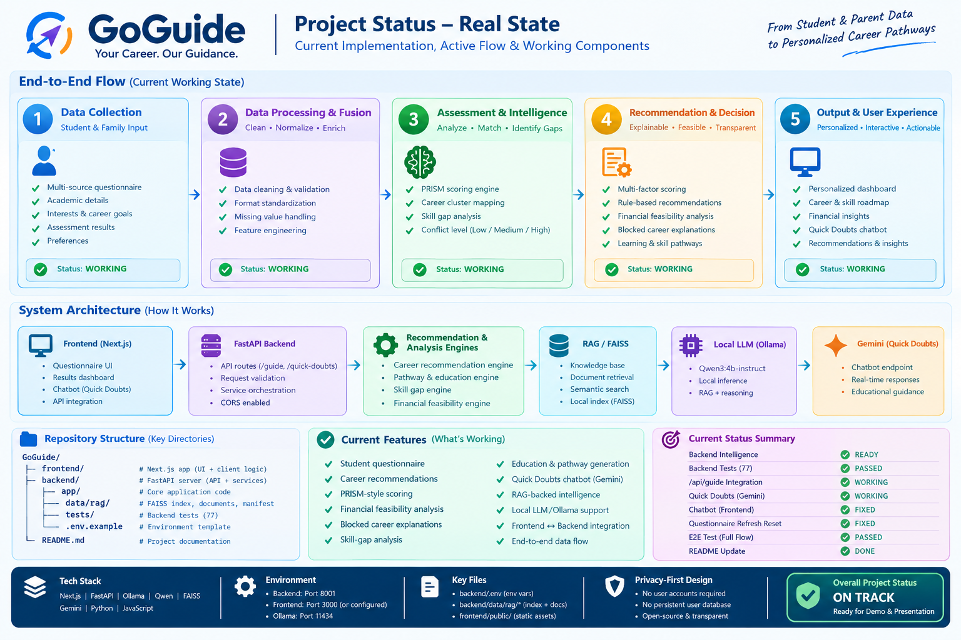

Slide 7
DATAQUEST 3.0 · ROUND 1
06
Impact & Metrics
Primary measurable impact · Transparent calculation · Stakeholder advantages
PRIMARY METRIC
100%
HOW IT WAS MEASURED
Automated check on every /score response: each ranked career must carry fit, market, financial, risk and conflict values. A dataset audit fails the build if any field has no source or 'estimate' label.
of recommendations show a full component breakdown (design target)
IMPACT 01
IMPACT 02
IMPACT 03
WHAT IMPROVES
WHO ELSE BENEFITS
RISKS / MISUSE
Instead of one opinion, the family sees a ranked list, the rupee gap for blocked careers, and the exact score components.
Counsellors and schools get an explainable tool; exam and scholarship deadlines surface early; local projects link skills to city problems.
Default weights favor parent-safe careers (exposed as sliders). Minors' finance data: consent, raw answers only, delete button, no caste data.

Slide 8
DATAQUEST 3.0 · ROUND 1
07
Why This Project?s
Direct contrast with today's alternatives · Unfair technical advantage
STATUS QUO
OUR SOLUTION
CURRENT APPROACH
OUR APPROACH
Generic quizzes and chatbots take one person's input, return an unexplained answer, ignore what the family can afford, and can produce numbers nobody can source.
Two inputs (student and parent), a rupee-based affordability gate that removes careers, deterministic scoring, and sourced data. A language model, if used, only rephrases computed results.
MOAT / DIFFERENTIATION
KEY DIFFERENCE
The engine measures student–parent conflict per career and checks affordability in rupees before ranking, so every recommendation is feasible, explained, and traceable to a cited field.

Slide 9
DATAQUEST 3.0 · ROUND 1
08
Formula Used
SCORING FORMULA
Score = Gate × (0.40·Fit + 0.30·Market + 0.15·Financial + 0.15·RiskCompat) − 0.20·Conflict
Gate = 1 only if funding need ≤ loan cap and EMI ≤ 40% of entry salary. Weights are design choices, exposed as sliders.

