Slide 1
A fall of comet dust and a field of boulders
Blog:http://blogs.esa.int/rosetta/2015/11/09/a-fall-of-comet-dust-and-a-field-of-boulders/

Slide 2
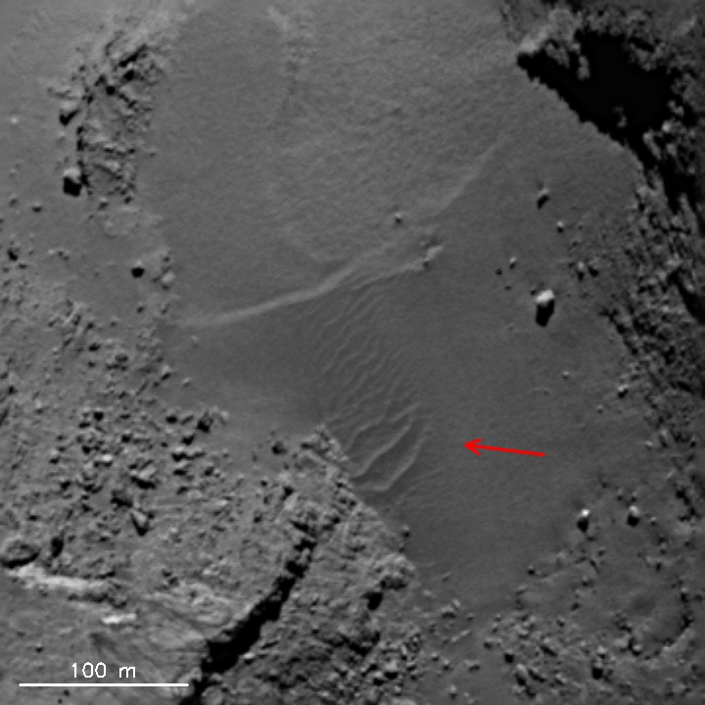
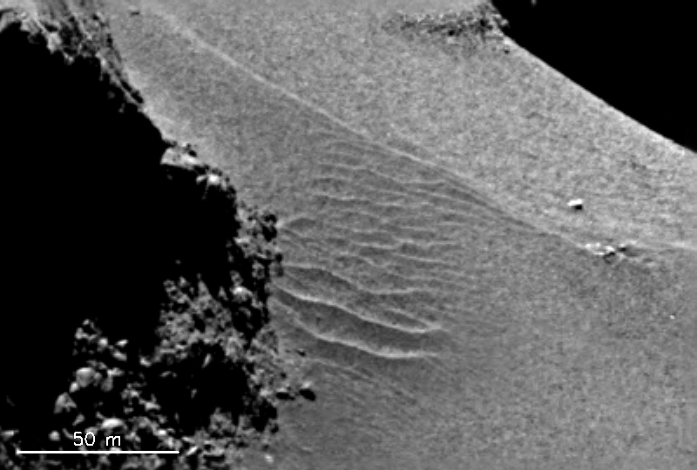
Airfall in Hapi region
Dunes formed by airfall
OSIRIS
Escaping gas
Weaker gas forces

Slide 3
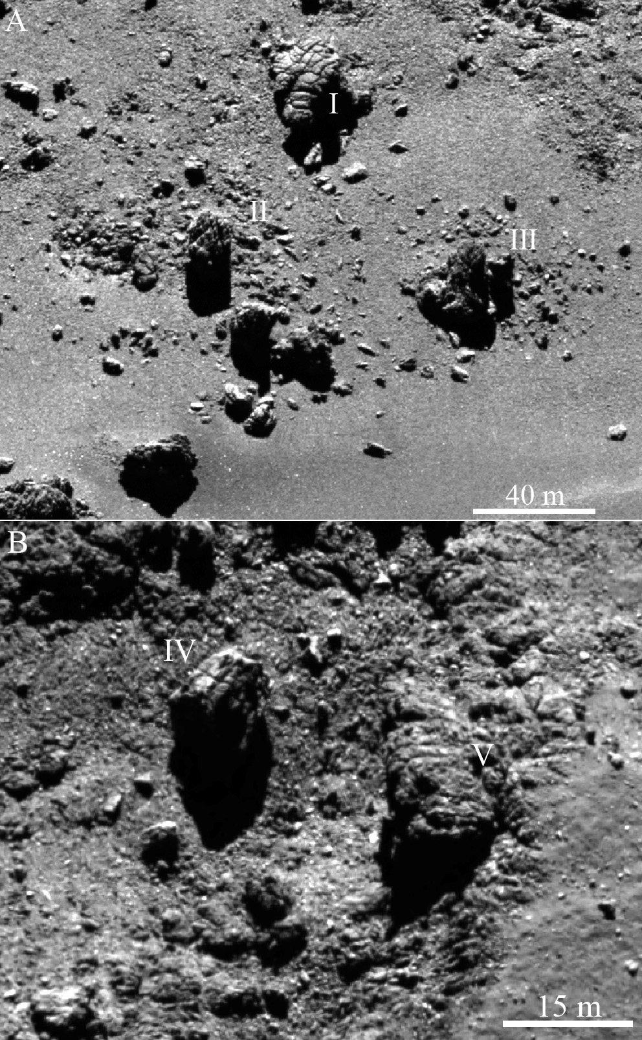
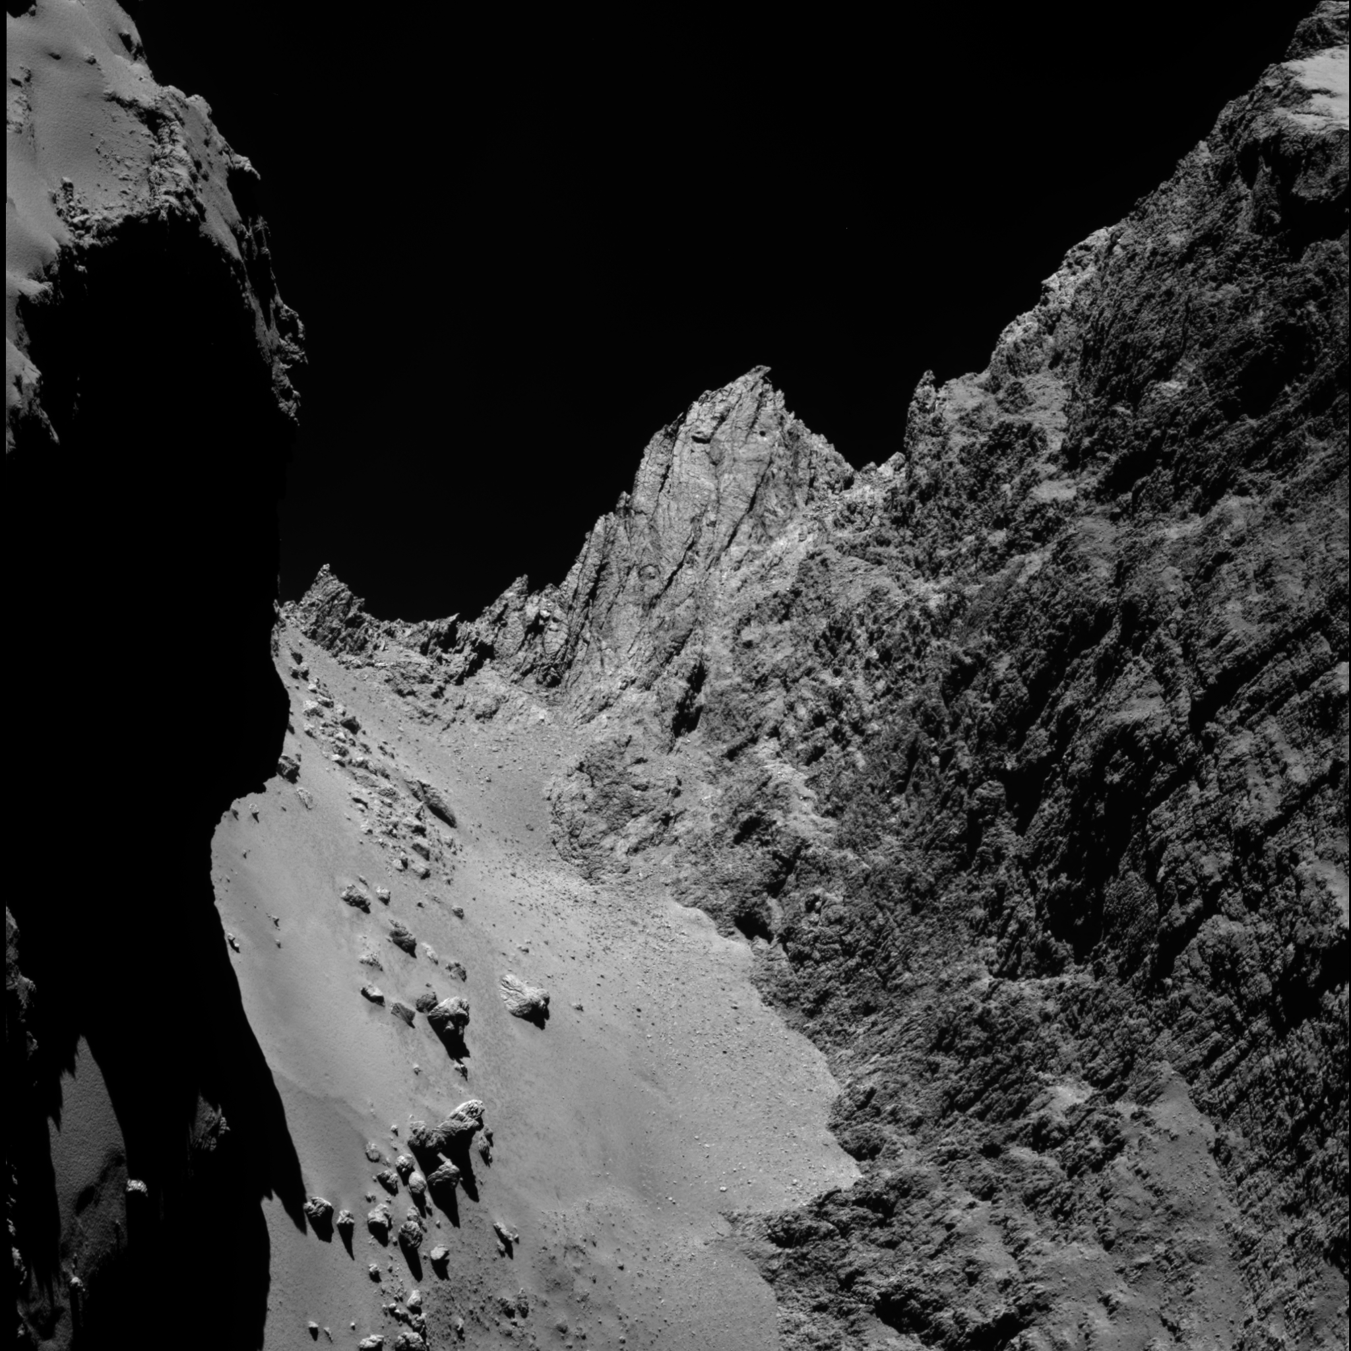
Boulders
3546 boulders larger than 7m in diameter
Smaller boulders on the head
Thermal stress
Cliffs of Hathor
Fewer smaller boulders in the neck region

