Slide 1

Axon for dummies
Knowledge Friday
magnus.mickelsson@gmail.com

Slide 2

Prerequisities
Domain-Driven Design
  Aggregates, entities
  Command objects
  Value objects
CQRS
Event Sourcing

Slide 3
Domain-Driven Design
Eric Evans has a great, but heavy book
Design complex applications based on a model of the related domain
  Healthcare: Patient, Condition, Medication, Dosage, Active Substance, Medical Staff, Doctor, Nurse, etc etc
  Sports betting: Punter, Bet, Odds, Event etc etc

Slide 4
Domain-Driven Design
Entity = An object defined by its identity (Patient)
Value object = An object defined by its value (Patient’s name)
Aggregate = A collection of objects bound together by a root entity, called an aggregate root (Hospital with patients and employees)*
Command object = A value object encapsulation of parameters/values needed for a command to be executed (Administer medicine to Patient)

Slide 5
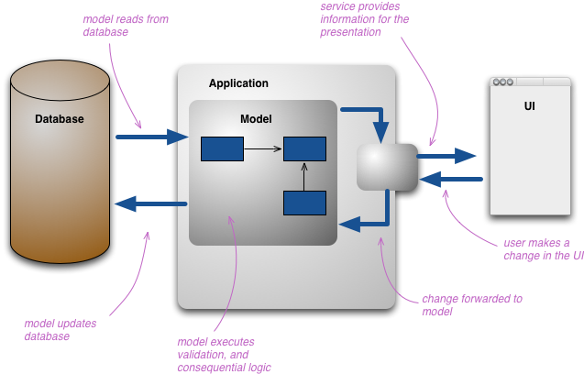
Classic non-CQRS

Slide 6
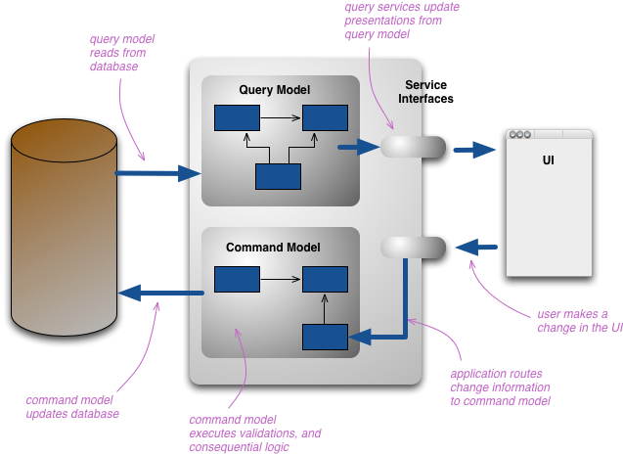
CQRS

Slide 7
CQRS via Axon - any good?
Different optimizations possible for read and write
Locking updates while others read is trivial
Eventual consistency “easy” even across a cluster
Full provable correct audit log “for free”
How to implement big changes of read model?
  Replaying messages a possibility
https://youtu.be/JHGkaShoyNs?t=341
https://youtu.be/JHGkaShoyNs?t=1017
https://youtu.be/JHGkaShoyNs?t=2672

Slide 8
Event Sourcing - Bank
Your bank account is the sum of all its transactions
  Balance is calculated via the transactions
Operation Amount Comment Source/Target
Deposit | 1000 SEK | Child benefit | 1.1.1.1
Withdraw | 200 SEK | Owed money to mom | 2.2.2.2
Withdraw | 40 SEK | Bought Red Bull | 3.3.3.3
Balance of account (read model) = 1000 – 200 – 40 = 760 SEK

Slide 9
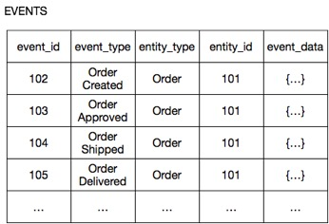
Event Sourcing
Aggregates/entities (state)
Read model
Order
- status
- id
...
OrderItem
- shipping status
- id
- item id
- payment status
Order
ID=101
status=
payment status=
...

Slide 10
Event Sourcing
Aggregates/entities (state)
Read model
Order
- status
- id
...
Event 102
OrderItem
- shipping status
- id
- item id
- payment status
Order
ID=101
Status= Created
payment status=
Not Payed
...

Slide 11
Event Sourcing
Aggregates/entities (state)
Read model
Order
- status
- id
...
Event 103
OrderItem
- shipping status
- id
- item id
- payment status
Order
ID=101
Status= Approved
payment status=
Payed
...

Slide 12

Axon - What, why, when?
Axon is a framework for CQRS and event sourcing
Write something for CQRS yourself?
  Some people (Greg Young) actually recommend not using a framework, and just use an event stream storage product
Useable when you have a complex domain that benefits from DDD, CQRS, event sourcing

Slide 13
When is it bad?
Not event based scenario
Simple problem – don’t add complexity
  Concepts
  Asynchronous
  Events serialized
Limited data size
  Event data serialized all in one table
  And data for read model

Slide 14
Live coding?
Let’s give it a go
  Bank account REST API wheeee!

Slide 15
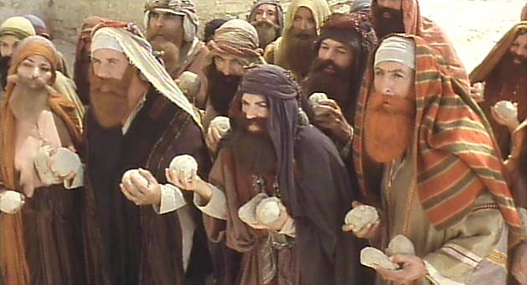
Questions/Feedback?
https://www.youtube.com/watch?v=0oo_LQ8qTro

