Slide 1
LS373
A₁₆-A₁₉ S₆-S₃
A₁₆-A₁₉
BHE’/S₇
BHE’
G
OE’
ALE
8086
LS373
AD₈-AD₁₅
A₈-A₁₅
G
OE’
LS373
AD₀-AD₇
A₀-A₇
G
OE’
System Bus of 8086 (Address)
MN/MX’
5V

Slide 2
RD
MEMR
WR
LOGIC
CIRCUIT
MEMW
IOR
IO/M
IOW
8086
LS245
AD₈-AD₁₅
D₈-D₁₅
DT/R’
DIR
OE’
DEN’
LS245
AD₀-AD₇
D₀-D₇
DIR
OE’
MN/MX’
5V
System Bus of 8086(Data + Control)

Slide 3
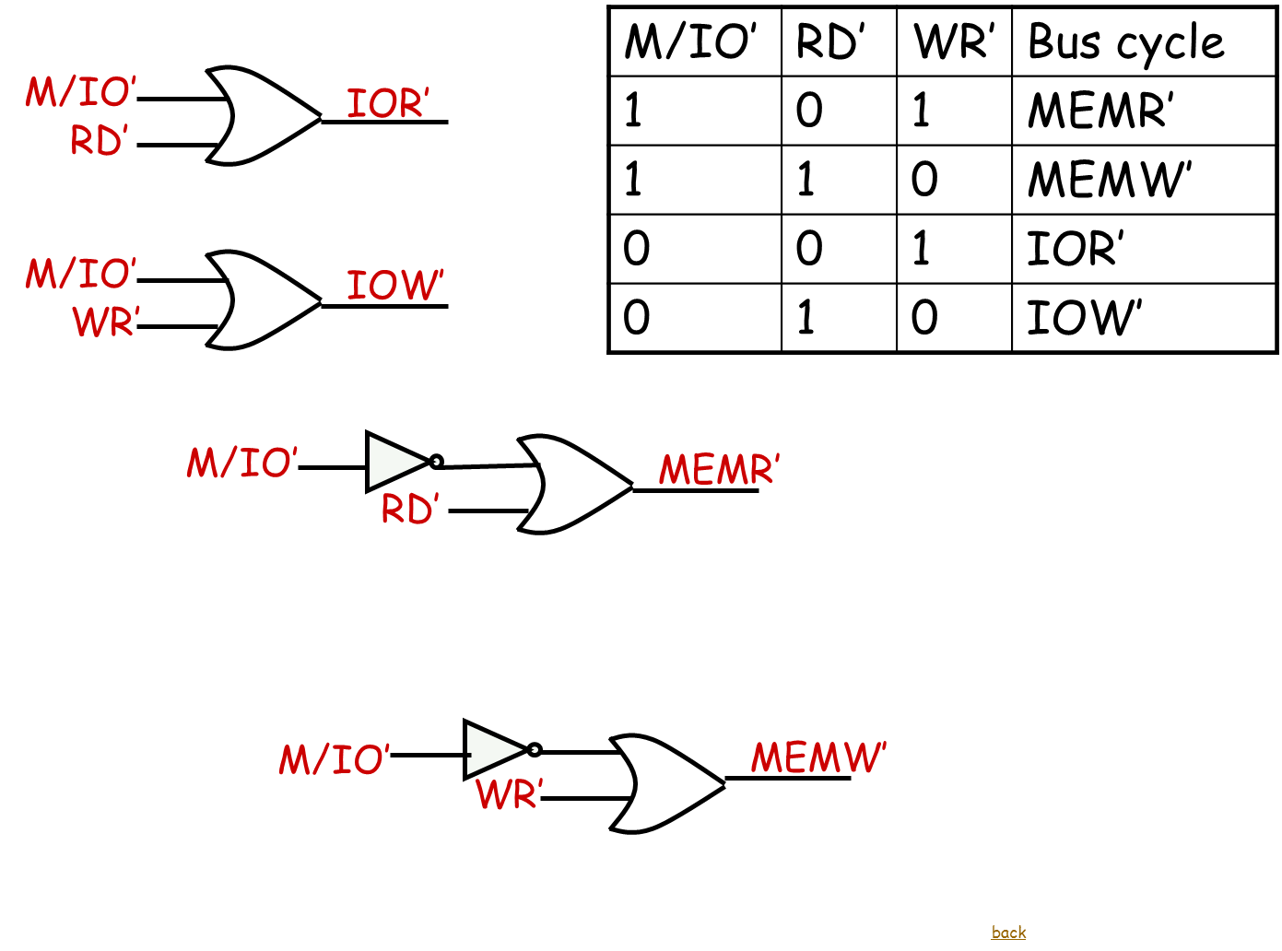

Slide 4
LS138
ROM
A₁₅A₁₄A₁₃
O₀
I₂ I₁ I₀
A₀
MEMR’
RDL’
O₁
RAM
A₀
MEMW’
WRL’
GND
G_{2B}
BHE’
MEMW’
WRH’
G_{2A} G₁
V_{CC}
BHE’
MEMR’
RDH’
GND
Memory Decoder

Slide 5
A₁
A₁₂
2732_{1E}
A₀
A₁₁
D₀
D₇
D₀
D₇
A₁
A₁₁
6116_{1E}
A₀
A₁₀
D₀
D₇
D₀
D₇
WRL’
RDL’
RAM’
WE’
OE’
CS’
RDL’
ROM’
OE’
CS’
A₁
A₁₂
2732_{1O}
A₀
A₁₁
D₀
D₇
D₈
D₁₅
A₁
A₁₁
6116_{1O}
A₀
A₁₀
D₀
D₇
D₈
D₁₅
WRH’
RDH’
ROM’₁
WE’
OE’
CS’
RDH’
ROM’
OE’
CS’
Memory Interfacing

Slide 6
LS138
8255 A CS’
A₅ A₄ A₃
O₀
I₂ I₁ I₀
O₁
8255 B CS’
O₂
8255 C CS’
O₃
8255 D CS’
O₄
O₅
O₆
8253 CS’
8255 E CS’
INTCTR
M/IO
G_{2B}
G_{2A} G₁
V_{CC}
A₆
I/O Decoder

Slide 7
8255 Interface to the processor
A₁
A₀
A₂
A₁
8255 CS’
CS
8255
IOR
RD
IOW
WR
D₀ – D₇
D₀ – D₇
RESET from 8086
RESET

Slide 8
5V
COM
COM
8255A
8255A
PB₀ PB₁ PB₂ PB₃
PA₀ PA₁ PA₂ PA₃
PB₄ PB₅ PB₆
PA₄ PA₅ PA₆
Common anode 7-segment display

Slide 9
OUT₂ 1 MHz
CLK
IN₀ IN₁ IN₂ IN₃ IN₄ IN₅ IN₆ IN₇
T₂₀ sensor 1
T₂₀ sensor 2
T₂₀ sensor 3
T₂₀ sensor 4
T₂₀ sensor 5
T₂₀ sensor 6
PA₀ –PA₇
DB₀ –DB₇
PB₀ PB₁ PB₂
NC
AD₀
AD₁
AD₂
V_{REF+}
5V
INTR_ADC
V_{REF-}
0V
EOC
5V
OE
Vcc
Supply
PC₀
GND
SOC
PC₁
ALE
ADC 0808

Slide 10
8253 Interface to the processor
A₁
A₀
A₂
A₁
8253 CS’
CS
8253
IOR
RD
IOW
WR
D₀ – D₇
D₀ – D₇

Slide 11
0.5sec
Count = 500_{d}
TIMER INT
CLK₀
OUT₀
PB0
GATE₀
mode₂
1KHz
OUT₁
CLK₁
1 MHz
Count = 1000_{d}
5V
GATE₁
mode₃
ADC CLK
1MHz
Count =5_{d}
CLK 5 MHz
CLK₂
OUT₂
5V
GATE₂
mode₃
8253

Slide 12
INTR
8259
INT
IR₀
Timer INT
8086
IR₁
IR₂
IR₃
IR₄
IR₅
IR₆
IR₇
INTA’
INTA
A₁
A₀
NC
IOR’
IOW’
8259 CS’
D₀
D₇
RD’
WR’
CS’
D₀
D₇
CAS₀ CAS₁ CAS₂
NC
SP/EN
5V
8259

Slide 13
5 V
VCC
24
VOUT
IN_ADC
GND
LM35

Slide 14
12V
PA0
A
C
PA2
+
+
PA1
B
D
PA3
UNIPOLAR STEPPER MOTOR

Slide 15


Keypad I/f
5V
0 | 1 |  | 2 |  | 3
4 |  | 5 |  | 6 |  | 7
8 |  | 9
PC₄
PC₅ PC₆ PC₇
PC₀
PC₁
PC₂ PC₃
T_{up}
T_{down}
ON
Bio Sleep
Off
Set TEMP

