Slide 1

Principal Component Analysis (PCA)
Matthew Goodsell

Slide 2
General Machine Learning Information

Slide 3
General Information
Model type:
Dimensionality-reduction model
Purpose is to find what dimensions have the most impact on the data. (link)
Pros and cons
When reducing the number of variables, you have a trade off of accuracy with simpilicity.
Used in neural networks or image classification.

Slide 4
Principal Components
Are new variables made up of a combination of other variables. They are a linear combination and are used to explain what variables have the most impact.
A relationship between an independent and dependent variable.
They don’t have real meaning since they are components of multivariable
Geometrically it represents the variables that are combined to represent direction in which the “maximal amount of variance” is explained.
“Think of them as new axes that provide the best angle to see and evaluate the data”
To start the principal components, match the total number of variables in the data

Slide 5
Steps to a PCA
There are five steps:
Standardize the range of continuous initial variables
Compute the covariance matrix to identify correlations
Compute the eigenvectors and eigenvalues of covariance from the matrix to identify the principal components.
Create a feature vector to decide which principal components to keep
Recast the data along the principal component axes.

Slide 6
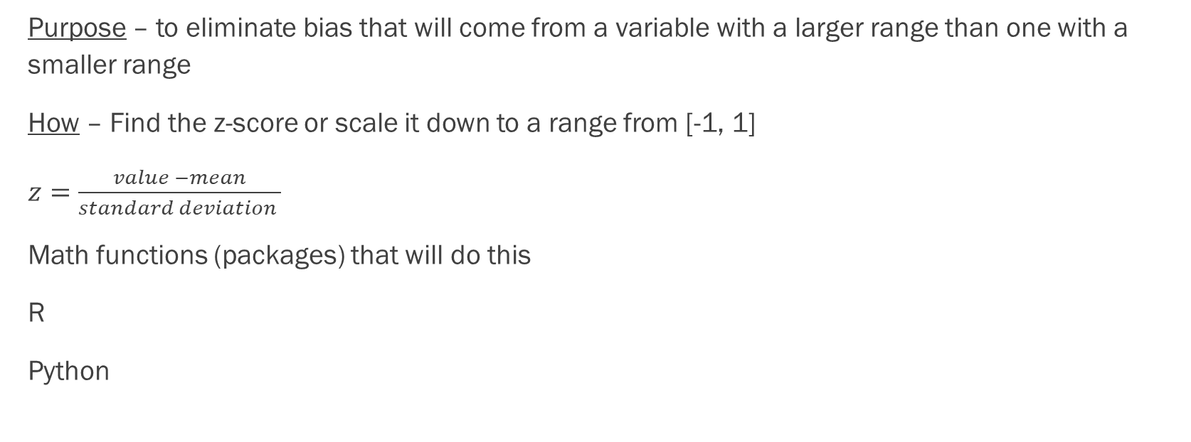
Step 1 – Standardization
Purpose – to eliminate bias that will come from a variable with a larger range than one with a smaller range
How – Find the z-score or scale it down to a range from [-1, 1]
$z=\frac{value −mean}{standard deviation }$
Math functions (packages) that will do this
R
Python

Slide 7
Step 2 – Covariance Matrix Computation
Purpose – understand how the variables interact with each other.
How
- matrix size is [p*p] where p is the number of variables in the dataset.
- positive covariance means positive correlation & negative covariance means negative correlation
Coding it
R - install.packages("corrplot") M<-cor(mtcars) head(round(M,2))
corrplot(M, method="circle")
Python

Slide 8
Step 3 – Eigenvectors & Eigenvalues
eigenvectors
Eigenvalues
Purpose – another step further in determining the principal components.
How – Come from the covariance matrix. Always come in pairs.
What – they are “the directions of the axes where there is the most variance (most information).” link
The number of eigenvectors match the total number of variables.
The coeffiences attached to the eigenvectors.
Tell us “amount of variance carried in each Principal Component”
Ranking the eigenvalues gives you the order of principal components from highest to lowest.

Slide 9
Eigenvectors
Eigenvalues
Vectors not affected by a linear transformation when applied to them. These vectors are know as eigenvectors of the transformation. This is why they are called eigenvectors because eigen in German means ‘specific’
Represents an orientation
They do not change direction only magnitude or length.
Specifies the size of the eigenvector. Represent the magnitude of the vector.

Slide 10
Math behind eigenvectors and values.
https://www.visiondummy.com/2014/03/eigenvalues-eigenvectors/

Slide 11
Step 3 – cont.
How to determine what eigenvector explains or captures most of the variance?
an eigenvalue / Sum of all eigenvalues.
Ordering by descending order gives the rank of significance.

Slide 12
Step 4 – Feature Vector
Purpose – Determine whether or not to discard some principal components.
How – by ordering the eigenvalues in descending order can now what ones to potentially disregard. Form a matrix with the remaining ones eigenvectors. This matrix is a Feature vector.
Notes – This is the first step towards dimensionality reduction.

Slide 13
Step 5 – Recast data along the principal component analysis.
Purpose – to show the data in terms of the principal components
How – FinalDataSet = Feature Vector * Standardized Original Dataset (data from step 1).

Slide 14
Purpose
By understanding the components or variables of the data that have the most impact on the outcome, it provides us with the ability to understand the data. We are able to make insights from it.
“So each principal component cutting through the scatterplot represents a decrease in the system’s entropy, in its unpredictability.” link

Slide 15
Math behind a PCA
Much of the math is explained here https://wiki.pathmind.com/eigenvector#:~:text=It%20builds%20on%20those%20ideas,special%20relationship%20between%20two%20things.
Uses mean, standard deviation, variance, covariance and eigenvalues and eigenvectors. Then uses ratios to help explain things.

Slide 16
From https://www.datacamp.com/tutorial/pca-analysis-r
Principal components help us understand what direction has the most variance from the dataset.

Slide 17
Links
https://builtin.com/data-science/step-step-explanation-principal-component-analysis
https://www.datacamp.com/tutorial/pca-analysis-r
https://wiki.pathmind.com/eigenvector#:~:text=It%20builds%20on%20those%20ideas,special%20relationship%20between%20two%20things.
https://www.visiondummy.com/2014/03/eigenvalues-eigenvectors/
https://www.youtube.com/watch?v=FgakZw6K1QQ

