Slide 1
Le miroir PyPI local du pauvre
Mathieu Agopian @magopian mathieu.agopian@gmail.com
Djangocong 2012

Slide 2
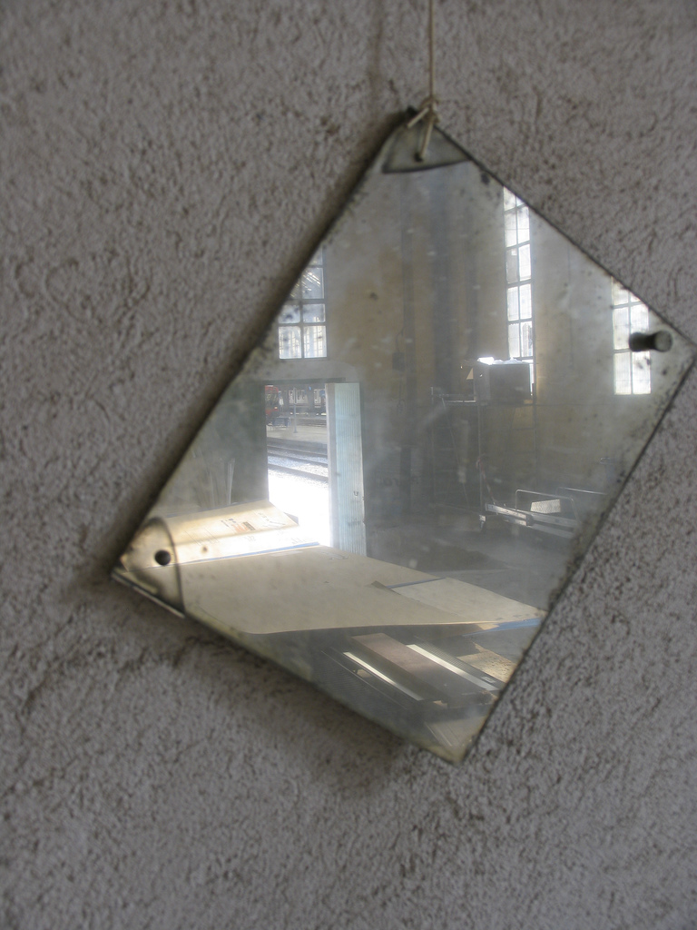
http://www.flickr.com/photos/paulk/136795301/

Slide 3
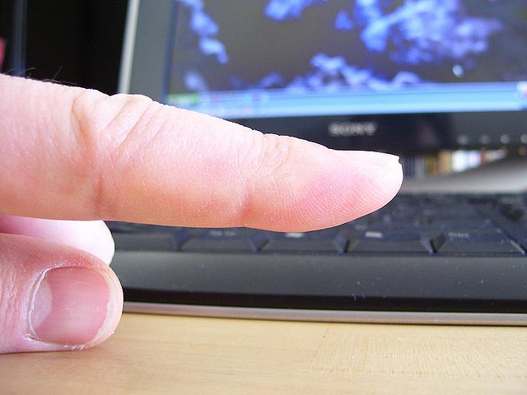
http://www.flickr.com/photos/sifalcia/2445454326/

Slide 4
POURQUOI ?

Slide 5

PyPI Down

Slide 6

Nouvelle version incompatible

Slide 7

Paquet supprimé
F7U12

Slide 8

Solutions
Basketweaver
Chishop
Localshop
Crate.io
Pep381client
z3c.pypimirror

Slide 9

Mais je suis fainéant

Slide 10

Le sauveur
pip --find-links --no-index
pip --find-links --index-url

Slide 11
requirements.pip
-e git+ssh://git@github.com/clintecker/django-google-analytics.git#egg=django-google-analytics
django-sentry
psycopg2==2.4.2

Slide 12

Faire télécharger les paquets à pip
pip freeze > freezed.pip
mkdir pypi
pip install -r freezed.pip --upgrade --download=pypi --build=pypi

Slide 13

Faire servir le répertoire
cd pypi
python -m SimpleHTTPServer
http://localhost:8000

Slide 14
Modifier requirements.pip
-e git+ssh://git@github.com/clintecker/django-google-analytics.git#egg=django-google-analytics
django-sentry
psycopg2==2.4.2

Slide 15

Modifier requirements.pip
(Like a Boss)
--find-links http://localhost:8000
--index-url http://localhost:8000
-e git+ssh://git@github.com/clintecker/django-google-analytics.git#egg=django-google-analytics
django-sentry
psycopg2==2.4.2

Slide 16

Profit
pip install -r requirements.pip

Slide 17

Des Questions ?

Slide 18
Mathieu Agopian
http://mathieu.agopian.info/blog/le-miroir-pypi-du-pauvre.html
http://carljm.github.com/tamingdeps/#1
@magopian
mathieu.agopian@gmail.com

