Slide 1

Muscle Movement Detection Unit
Ralph Mago
magor@unlv.nevada.edu
CPE 301 – Microcontroller Based Systems

Slide 2

University of Nevada Las Vegas. Howard R. Hughes College Of Engineering
Introduction
Aim:
Capture gyro/accelerometer data from muscle movements in the Z-axis, rotation around the X-axis, and rotation around the Y-axis.
Display these movement patterns using a serial terminal with values transmitted wirelessly via Bluetooth.
Because wireless implementation is possible, this device has an application in tracking muscle twitching patterns by storing data into a mobile device.
Fully developed version of this circuit will be similar to a surface electrode which transmits muscle movements to a serial terminal wirelessly.
Accomplishments:
Successfully paired microcontroller circuit to a serial terminal using Bluetooth
Tested hand movements by rolling left and right along X-axis and pitching up and down along Y-axis. Position of hand is changed along the Z-axis.
Observed changes in graphs. Three graphs for each axis is displayed.
Completed Schematic and PCB

Slide 3
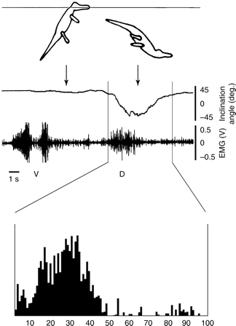
University of Nevada Las Vegas. Howard R. Hughes College Of Engineering
Applications
Applications:
Tracking animal muscle movement:
Diaphragm muscles measured in alligators before diving and during diving. Source: http://jeb.biologists.org/content/211/7/1141
In the figure to the right the alligator contracts muscles to jump, resulting in a graph spike
In mid-air, it relaxes, then contracts muscles again diving downwards

Slide 4
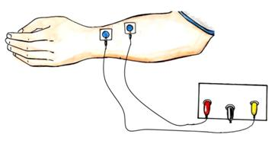
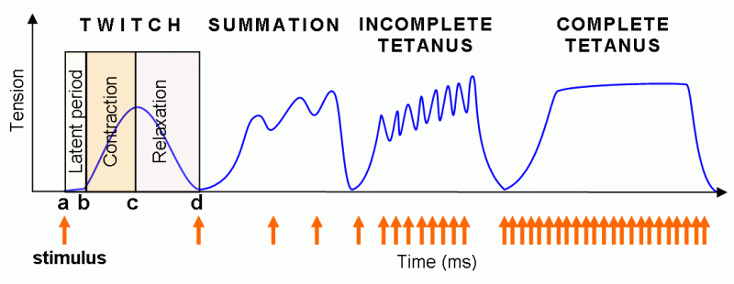
University of Nevada Las Vegas. Howard R. Hughes College Of Engineering
Applications
Applications:
Tracking muscle twitching patterns:
Muscle stimulation of patients with stages of tetanus. Source: http://www.pef.uni-lj.si/eprolab/comlab/sttop/sttop-bm/bm-elephy.htm
Tension patterns measured with electrodes that send nerve stimuli
Twitch: Normal muscle contraction
Summation: Three twitches applied
Incomplete Tetanus: Abrupt contraction and relaxation
Complete Tetanus: Long muscle contraction with no relaxation in between

Slide 5
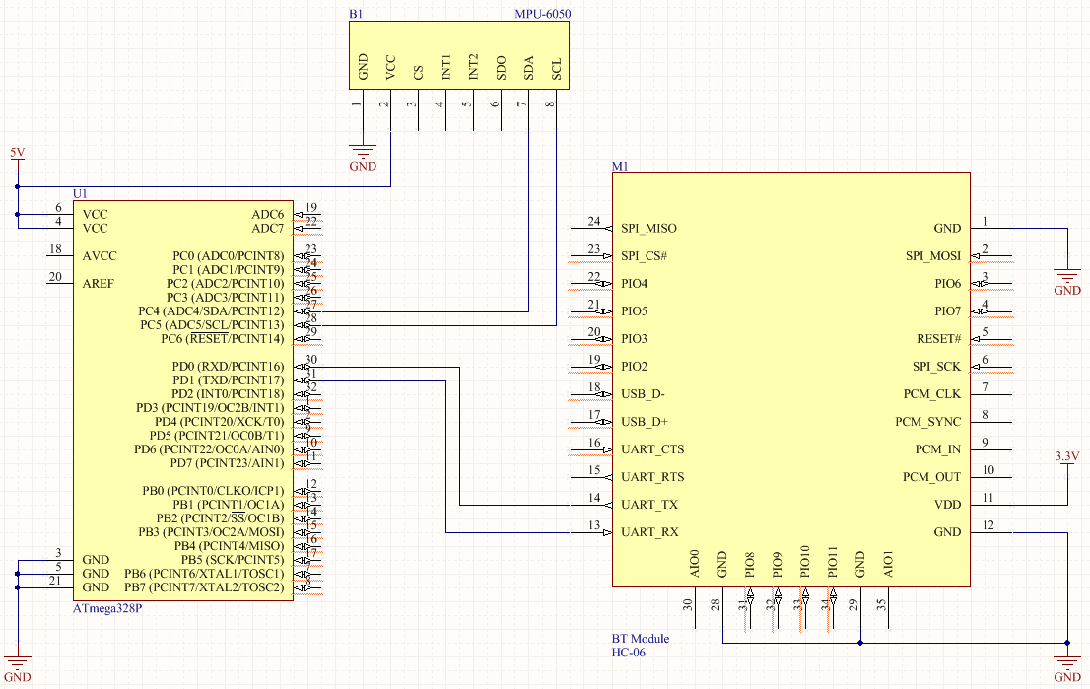
University of Nevada Las Vegas. Howard R. Hughes College Of Engineering
Schematic / PCB
ATMega328P has PC4 connected to SDA and PC5 connected to SCL on MPU-6050 (gyro/accelerator)
ATMega328P has RX and TX connected with TX and RX with HC-06 (BT Module)
ATMega328P and MPU-6050 connected to 5V power
BT Module connected to 3.3V power

Slide 6
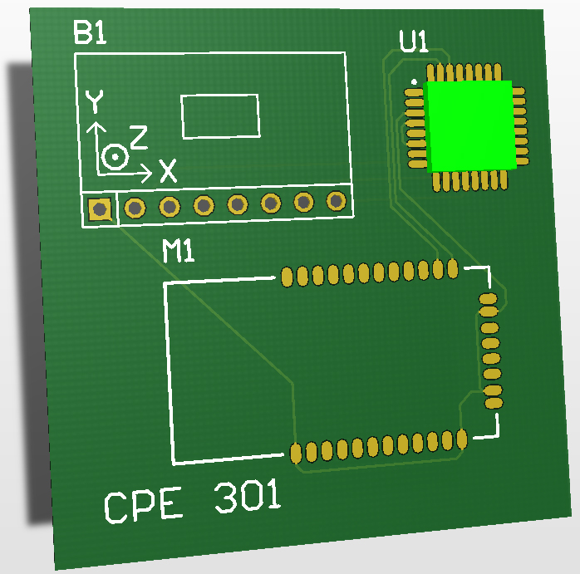
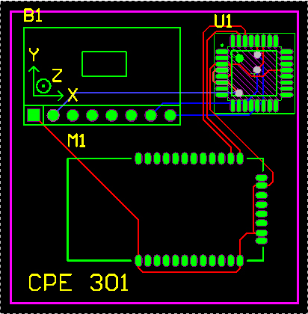
University of Nevada Las Vegas. Howard R. Hughes College Of Engineering
Schematic / PCB
UI represents ATMega328P
M1 represents HC-06 Bluetooth Module
B1 represents MPU-6050 Gyro/Accelerometer

Slide 7

University of Nevada Las Vegas. Howard R. Hughes College Of Engineering
Design Stages
Components
Atmel Xplained Mini (328P) | 1
MPU6050 Gyro/Accelerometer | 1
HC-06 Bluetooth Module | 1
Power Supply (5V) | 1
Interfaces
ATMega328P
UART – TX and RX between HC-06 and Serial Terminal
Serial Terminal used is Bluetooth Terminal/Graphics on Android
I2C – HC-06 is the slave device

Slide 8

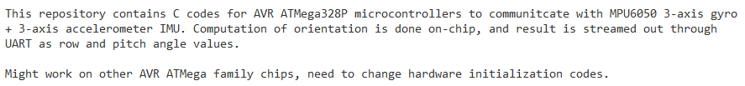
University of Nevada Las Vegas. Howard R. Hughes College Of Engineering
Code Development
This code is a variation of the code found at https://github.com/YifanJiangPolyU/MPU6050 which was created by Yifan Jiang in Hong Kong Polytechnic University for driving the MPU6050.
Includes headers for UART for printing output data into a string
Includes headers for I2C master library for address and transfer direction (same as i2cmaster.h and i2cmaster.c from Dr. Venki
Both libraries created by Peter Fleury on http://jump.to/fleury

Slide 9
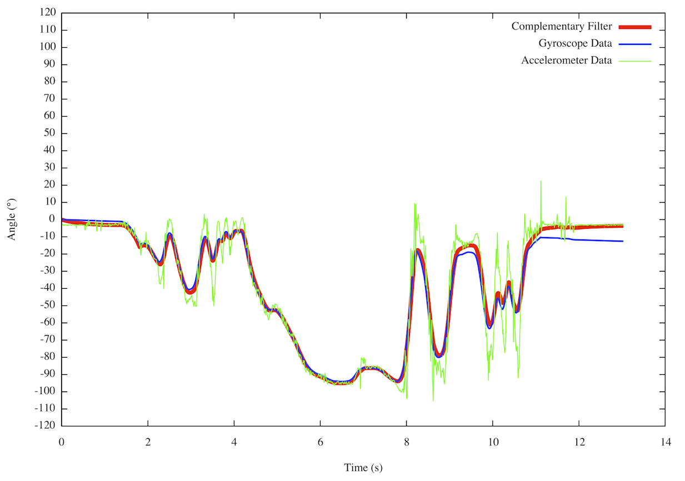
University of Nevada Las Vegas. Howard R. Hughes College Of Engineering
Code Development
The “complementary filter” is referenced from http://www.pieter-jan.com/node/11 allows us to read gyroscope data and accelerometer data without noise
Pitch and roll angle values are updated with new gyroscope values by means of integration over time

Slide 10
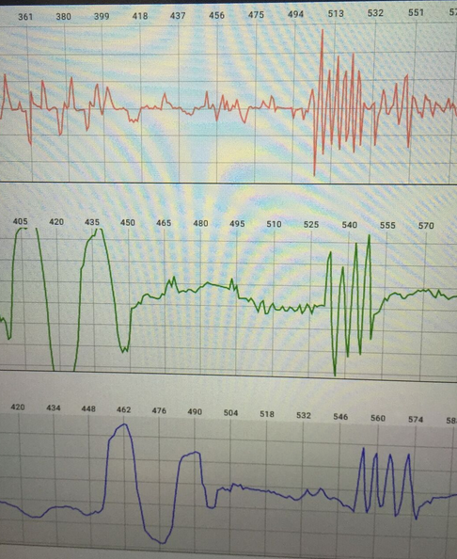
University of Nevada Las Vegas. Howard R. Hughes College Of Engineering
Output
Position along Z-axis (red)
Graph spikes up when moving left
Graph spikes down when moving right
Side-to-side rotation about X-axis aka Pitch (green)
Turning around X-axis results in a vector on the Y-axis
Graph spikes up rolling right
Graph spikes down rolling left
Up-and-down rotation about Y-axis aka Roll (blue)
Turning around Y-axis results in a vector on the X-axis
Graph spikes up pitching upwards
Graph spikes down pitching downwards

Slide 11
University of Nevada Las Vegas. Howard R. Hughes College Of Engineering
Video
Muscle Movement Detection Unit – YouTube
https://www.youtube.com/watch?v=6vSMingkX18

Slide 12
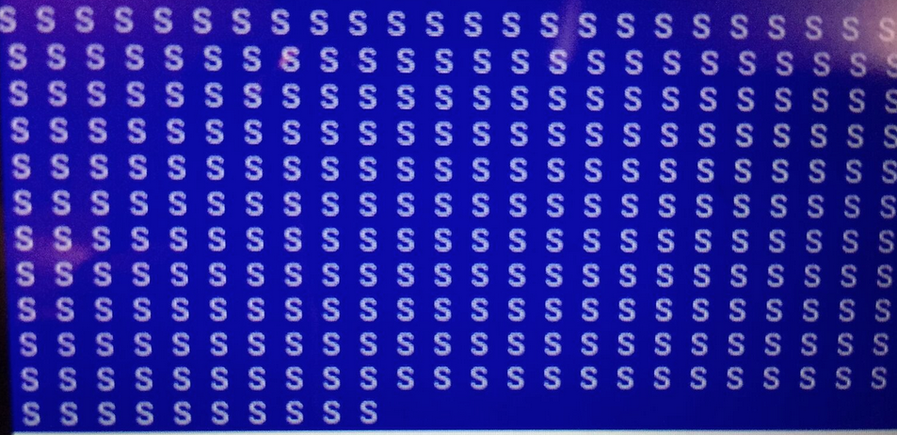

University of Nevada Las Vegas. Howard R. Hughes College Of Engineering
Encountered Problems
Serial Terminal displays random chars:
Solved by setting baud rate of Bluetooth Module to 9600
Serial Terminal does not display float values or double values correctly:
Solved by implementing command -Wl,-u,vfprintf -lprintf_flt –lm in the Toolchain Linker Options for Atmel Studio to implement floating point calculations (it doesn’t by default)

