Slide 1
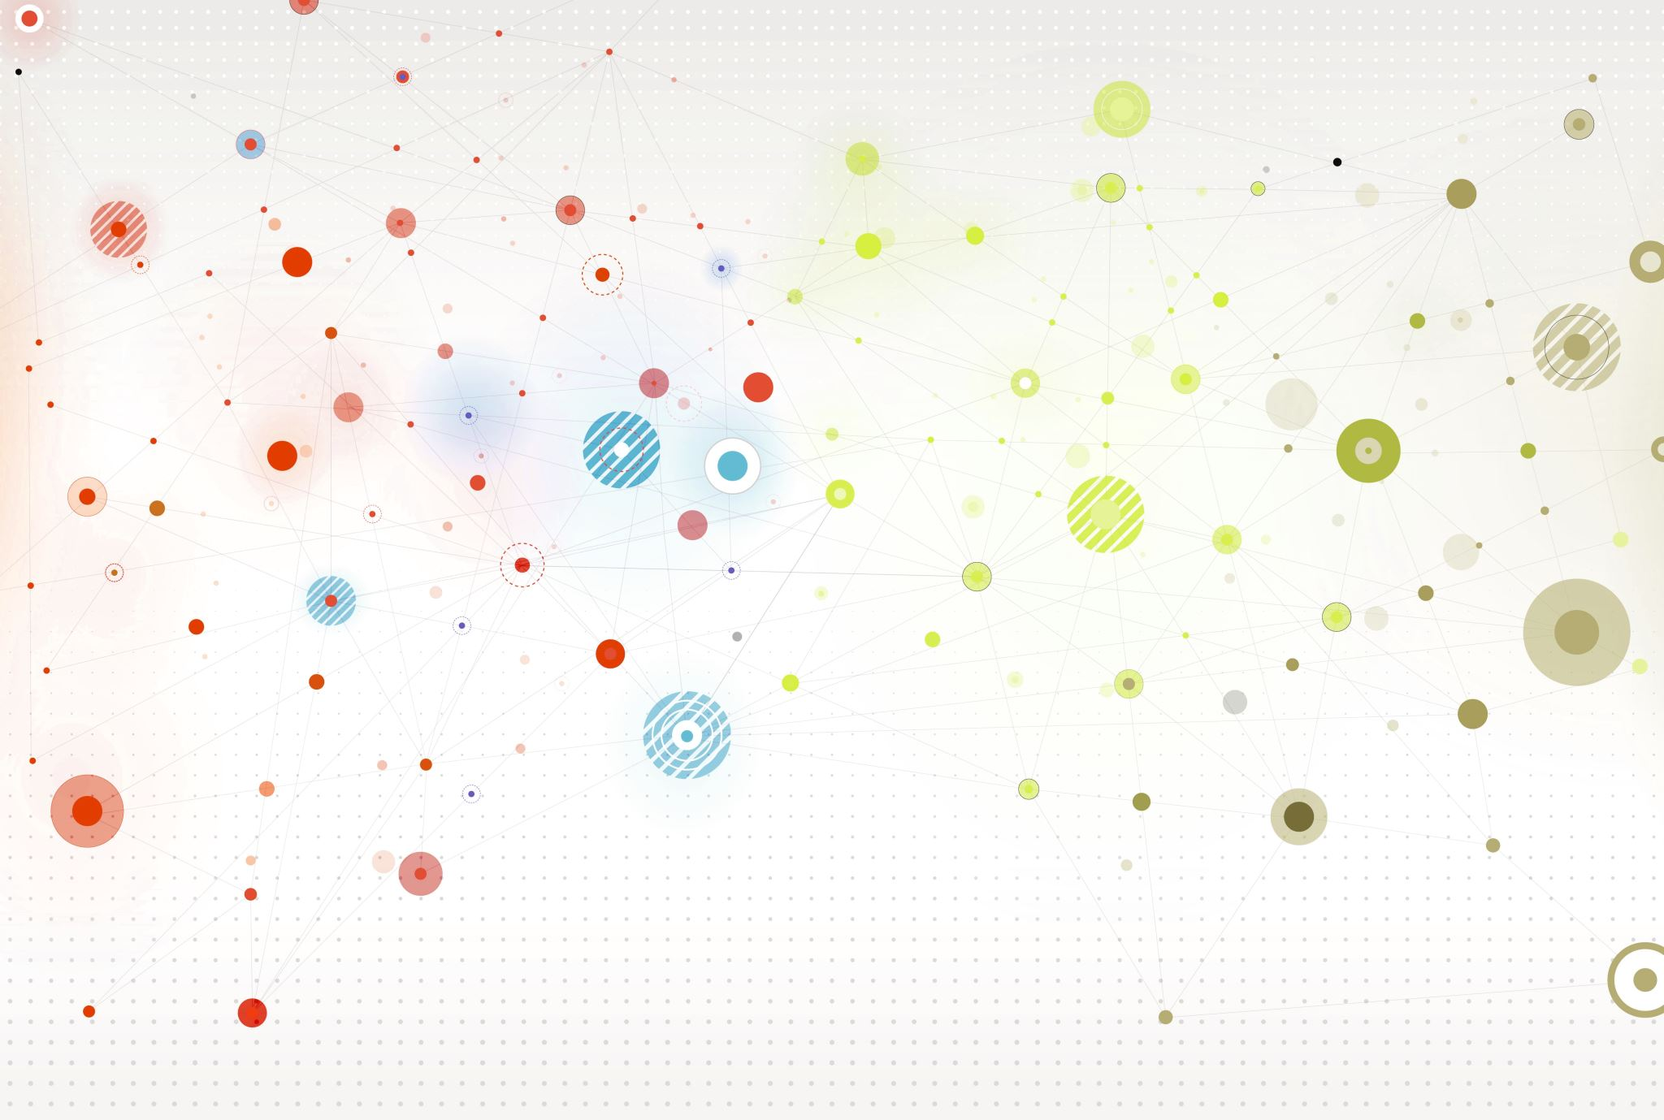
network analysis in Illinois high school students (1958) Koblenz Network Collection
Marwan Agourram
967349
DSE Student
26/09/2023

Slide 2
Introduction
Two identical surveys were taken during the Fall and Spring semesters in an Illinois high-school. Each boy was asked once in the fall of 1957 and the spring of 1958. The surveys posed a simple question to the students: ”indicate one of your closest friends in the whole school”
The male students in the high-school are 46
A node represents a boy and an arc between two boys shows that the left boy chose the right boy as a friend
Edge weights are the number of surveys in which the friendship was named. As a boy could choose the same boy twice, weights values are either 1 or 2

Slide 3
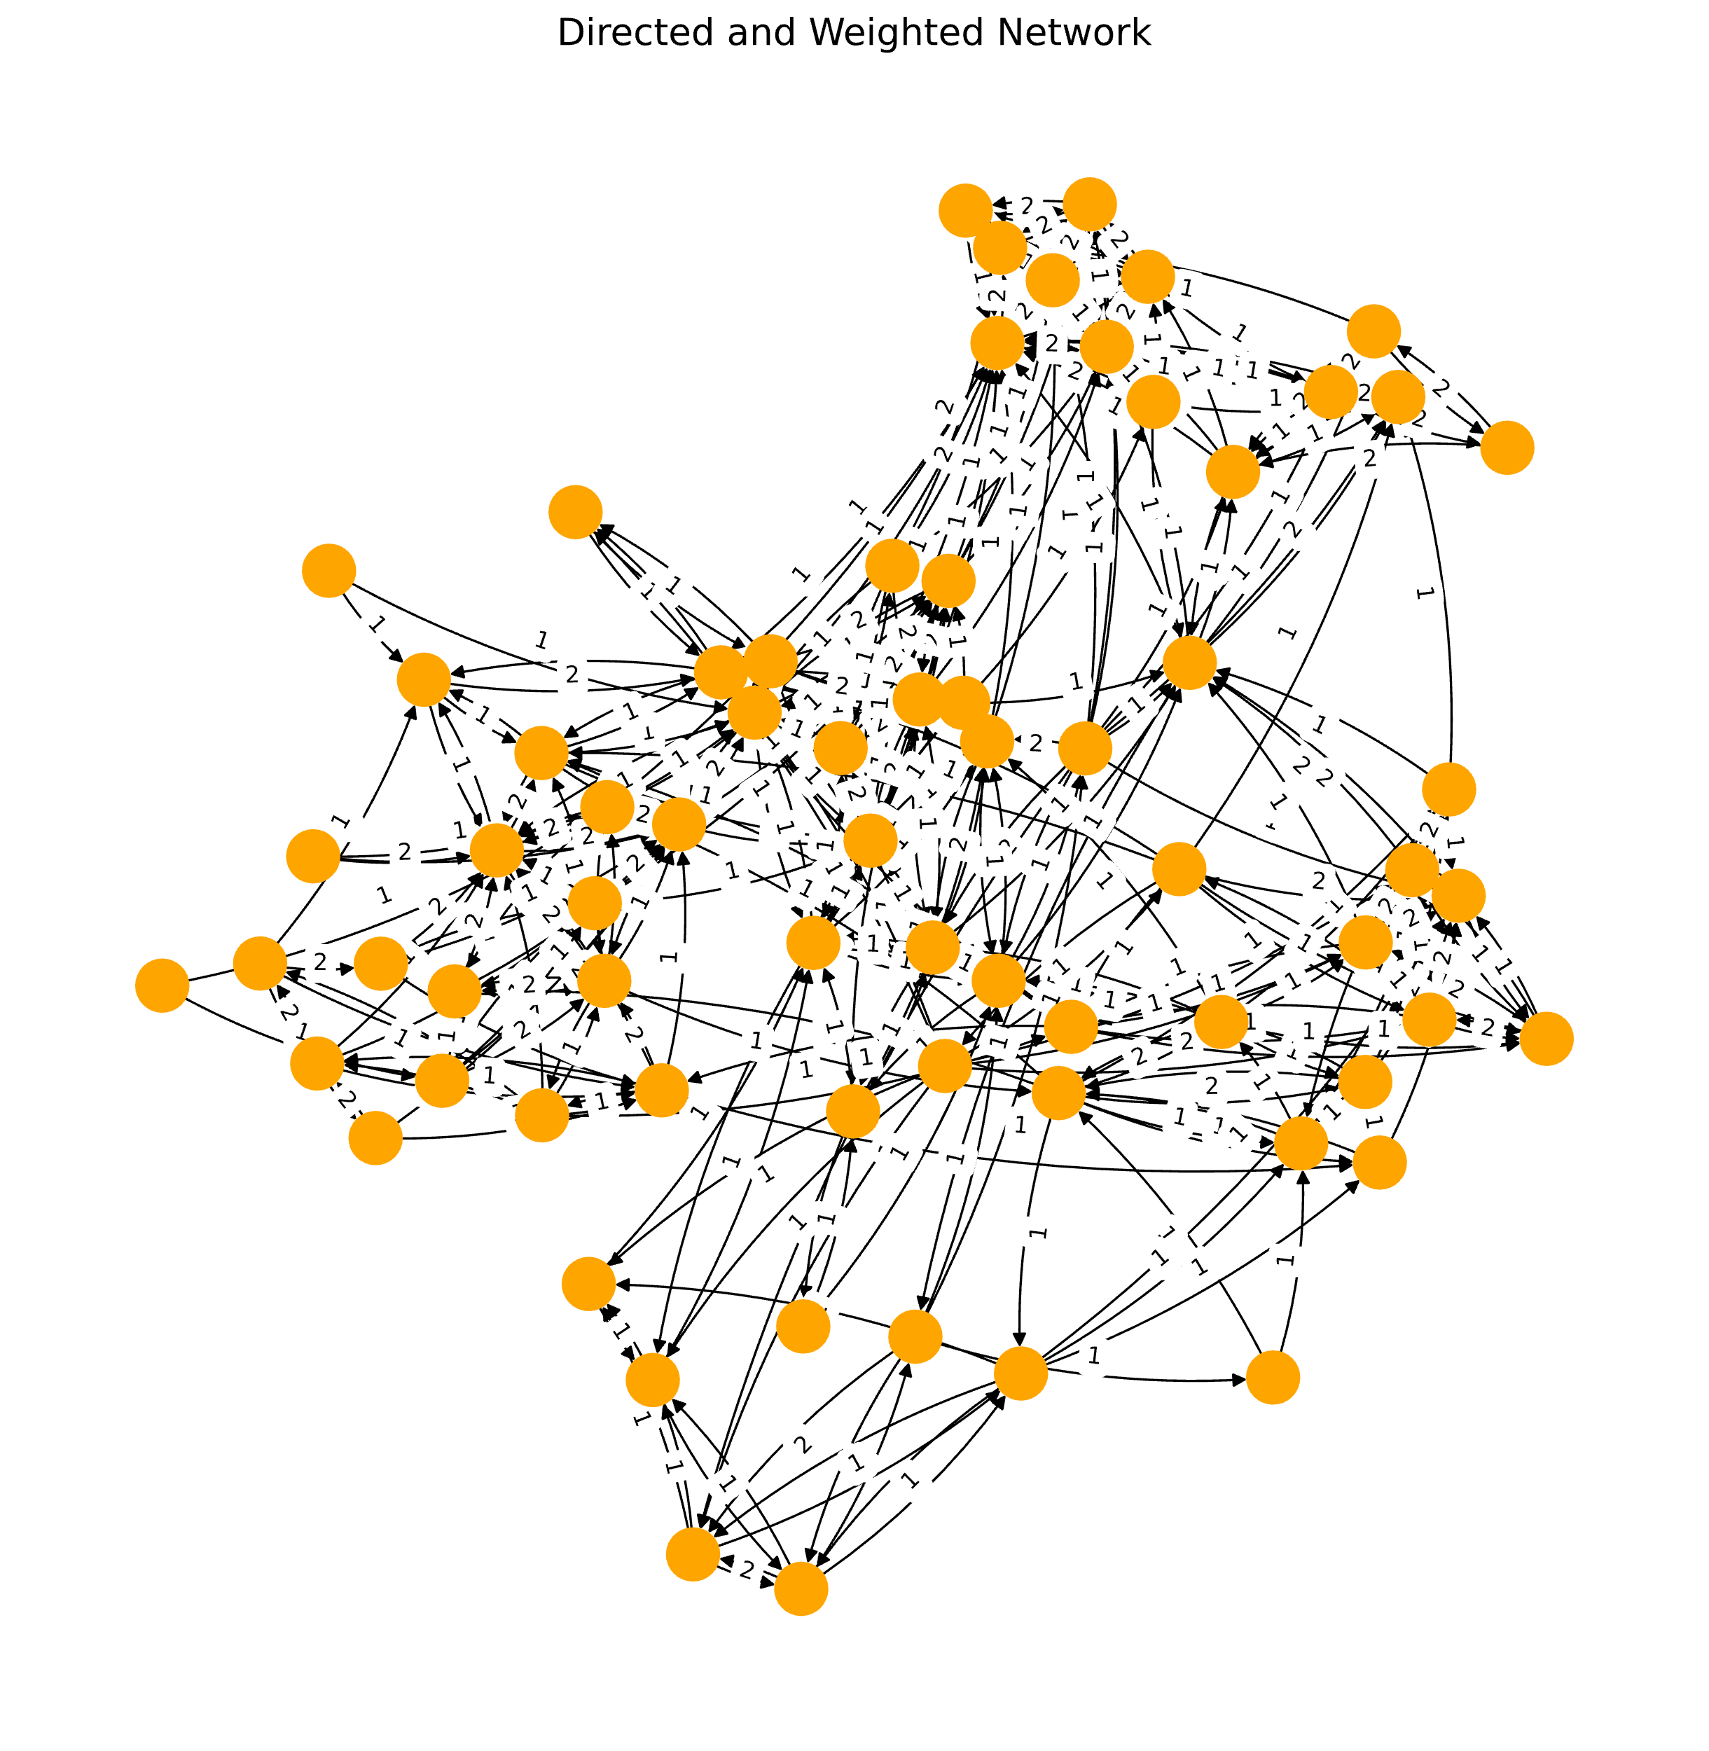
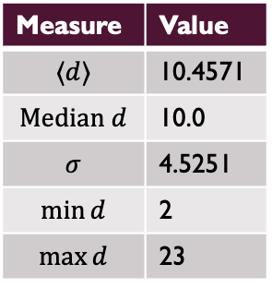
Network visualization
The network is Directed and Weighted
We have 70 nodes and 366 edges
Density: 0.0758
Isolated Nodes: [ ]
Hubs: [4, 5, 27, 7, 28, 46]
Measure | Value
$$⟨d⟩$$ | 10.4571
$$Median d$$ | 10.0
$$σ$$ | 4.5251
$$\min{d}$$ | 2
$$\max{d}$$ | 23

Slide 4
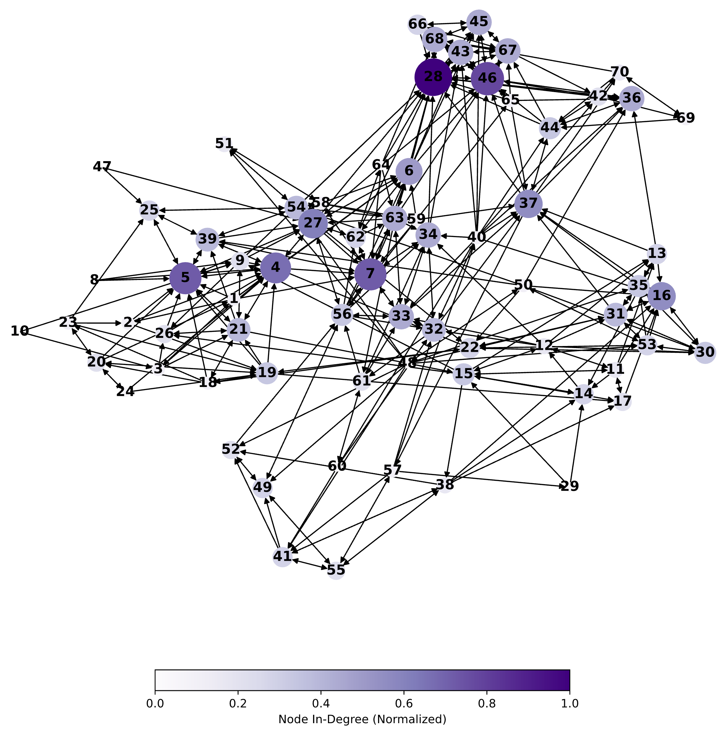
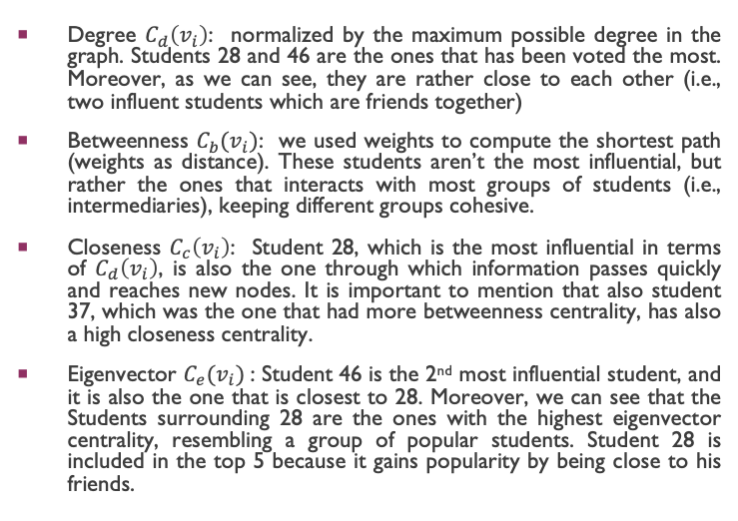
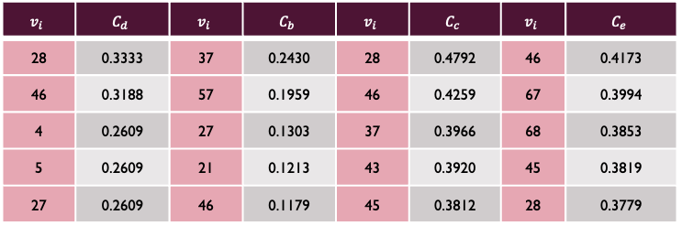
Central nodes
Degree $C_{d}\left(v_{i}\right)$: normalized by the maximum possible degree in the graph. Students 28 and 46 are the ones that has been voted the most. Moreover, as we can see, they are rather close to each other (i.e., two influent students which are friends together)
Betweenness $C_{b}(v_{i})$: we used weights to compute the shortest path (weights as distance). These students aren’t the most influential, but rather the ones that interacts with most groups of students (i.e., intermediaries), keeping different groups cohesive.
Closeness $C_{c}\left(v_{i}\right)$: Student 28, which is the most influential in terms of $C_{d}\left(v_{i}\right)$, is also the one through which information passes quickly and reaches new nodes. It is important to mention that also student 37, which was the one that had more betweenness centrality, has also a high closeness centrality.
Eigenvector $C_{e}(v_{i})$: Student 46 is the 2nd most influential student, and it is also the one that is closest to 28. Moreover, we can see that the Students surrounding 28 are the ones with the highest eigenvector centrality, resembling a group of popular students. Student 28 is included in the top 5 because it gains popularity by being close to his friends.
$$v_{i}$$ | $$C_{d}$$ | $$v_{i}$$ | $$C_{b}$$ | $$v_{i}$$ | $$C_{c}$$ | $$v_{i}$$ | $$C_{e}$$
28 | 0.3333 | 37 | 0.2430 | 28 | 0.4792 | 46 | 0.4173
46 | 0.3188 | 57 | 0.1959 | 46 | 0.4259 | 67 | 0.3994
4 | 0.2609 | 27 | 0.1303 | 37 | 0.3966 | 68 | 0.3853
5 | 0.2609 | 21 | 0.1213 | 43 | 0.3920 | 45 | 0.3819
27 | 0.2609 | 46 | 0.1179 | 45 | 0.3812 | 28 | 0.3779

Slide 5
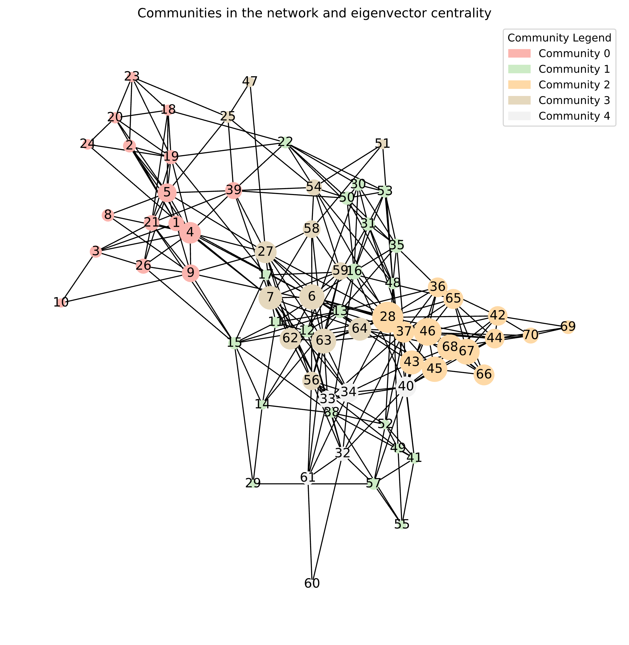
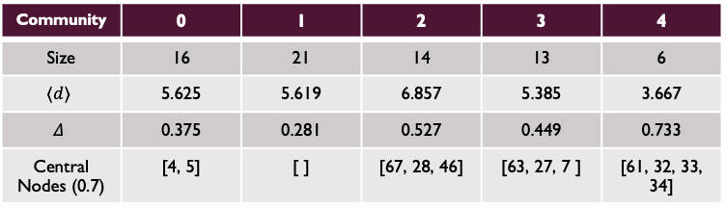
Community detection (LOUVAIN)
Community detection helps uncover the hidden structure within networks. It identifies groups of nodes that are more densely connected to each other
The current network (which has been turned into undirected for the purpose), shows 5 main communities
According to the Louvain algorithm's partition, there is no community overlapping in the network. Network primarily consists of larger connected components, and there are no small-network effect
Considering the centrality, we can see how Student 28 and 46 belong to the same Community. Moreover, Student 28 is the one that is more related to other students belonging to other communities. Also, Student 5 and 4 are the most central students in Community 0, while Student 27 is the only central Student that belongs to Community 3
The reason for the formation of these distinct, non-overlapping communities can be justified by since each Community may represent students from the same school class or, alternatively, students that have the same after school activities
Finally, using Degree Centrality (normalized), we set a threshold of 0.65 and we consider which are the most influential nodes within each community. For the selected threshold value, only Community 1 doesn’t have central nodes.
Community | 0 | 1 | 2 | 3 | 4
Size | 16 | 21 | 14 | 13 | 6
$$⟨d⟩$$ | 5.625 | 5.619 | 6.857 | 5.385 | 3.667
$$Δ$$ | 0.375 | 0.281 | 0.527 | 0.449 | 0.733
Central Nodes (0.7) | [4, 5] | [ ] | [67, 28, 46] | [63, 27, 7 ] | [61, 32, 33, 34]

Slide 6
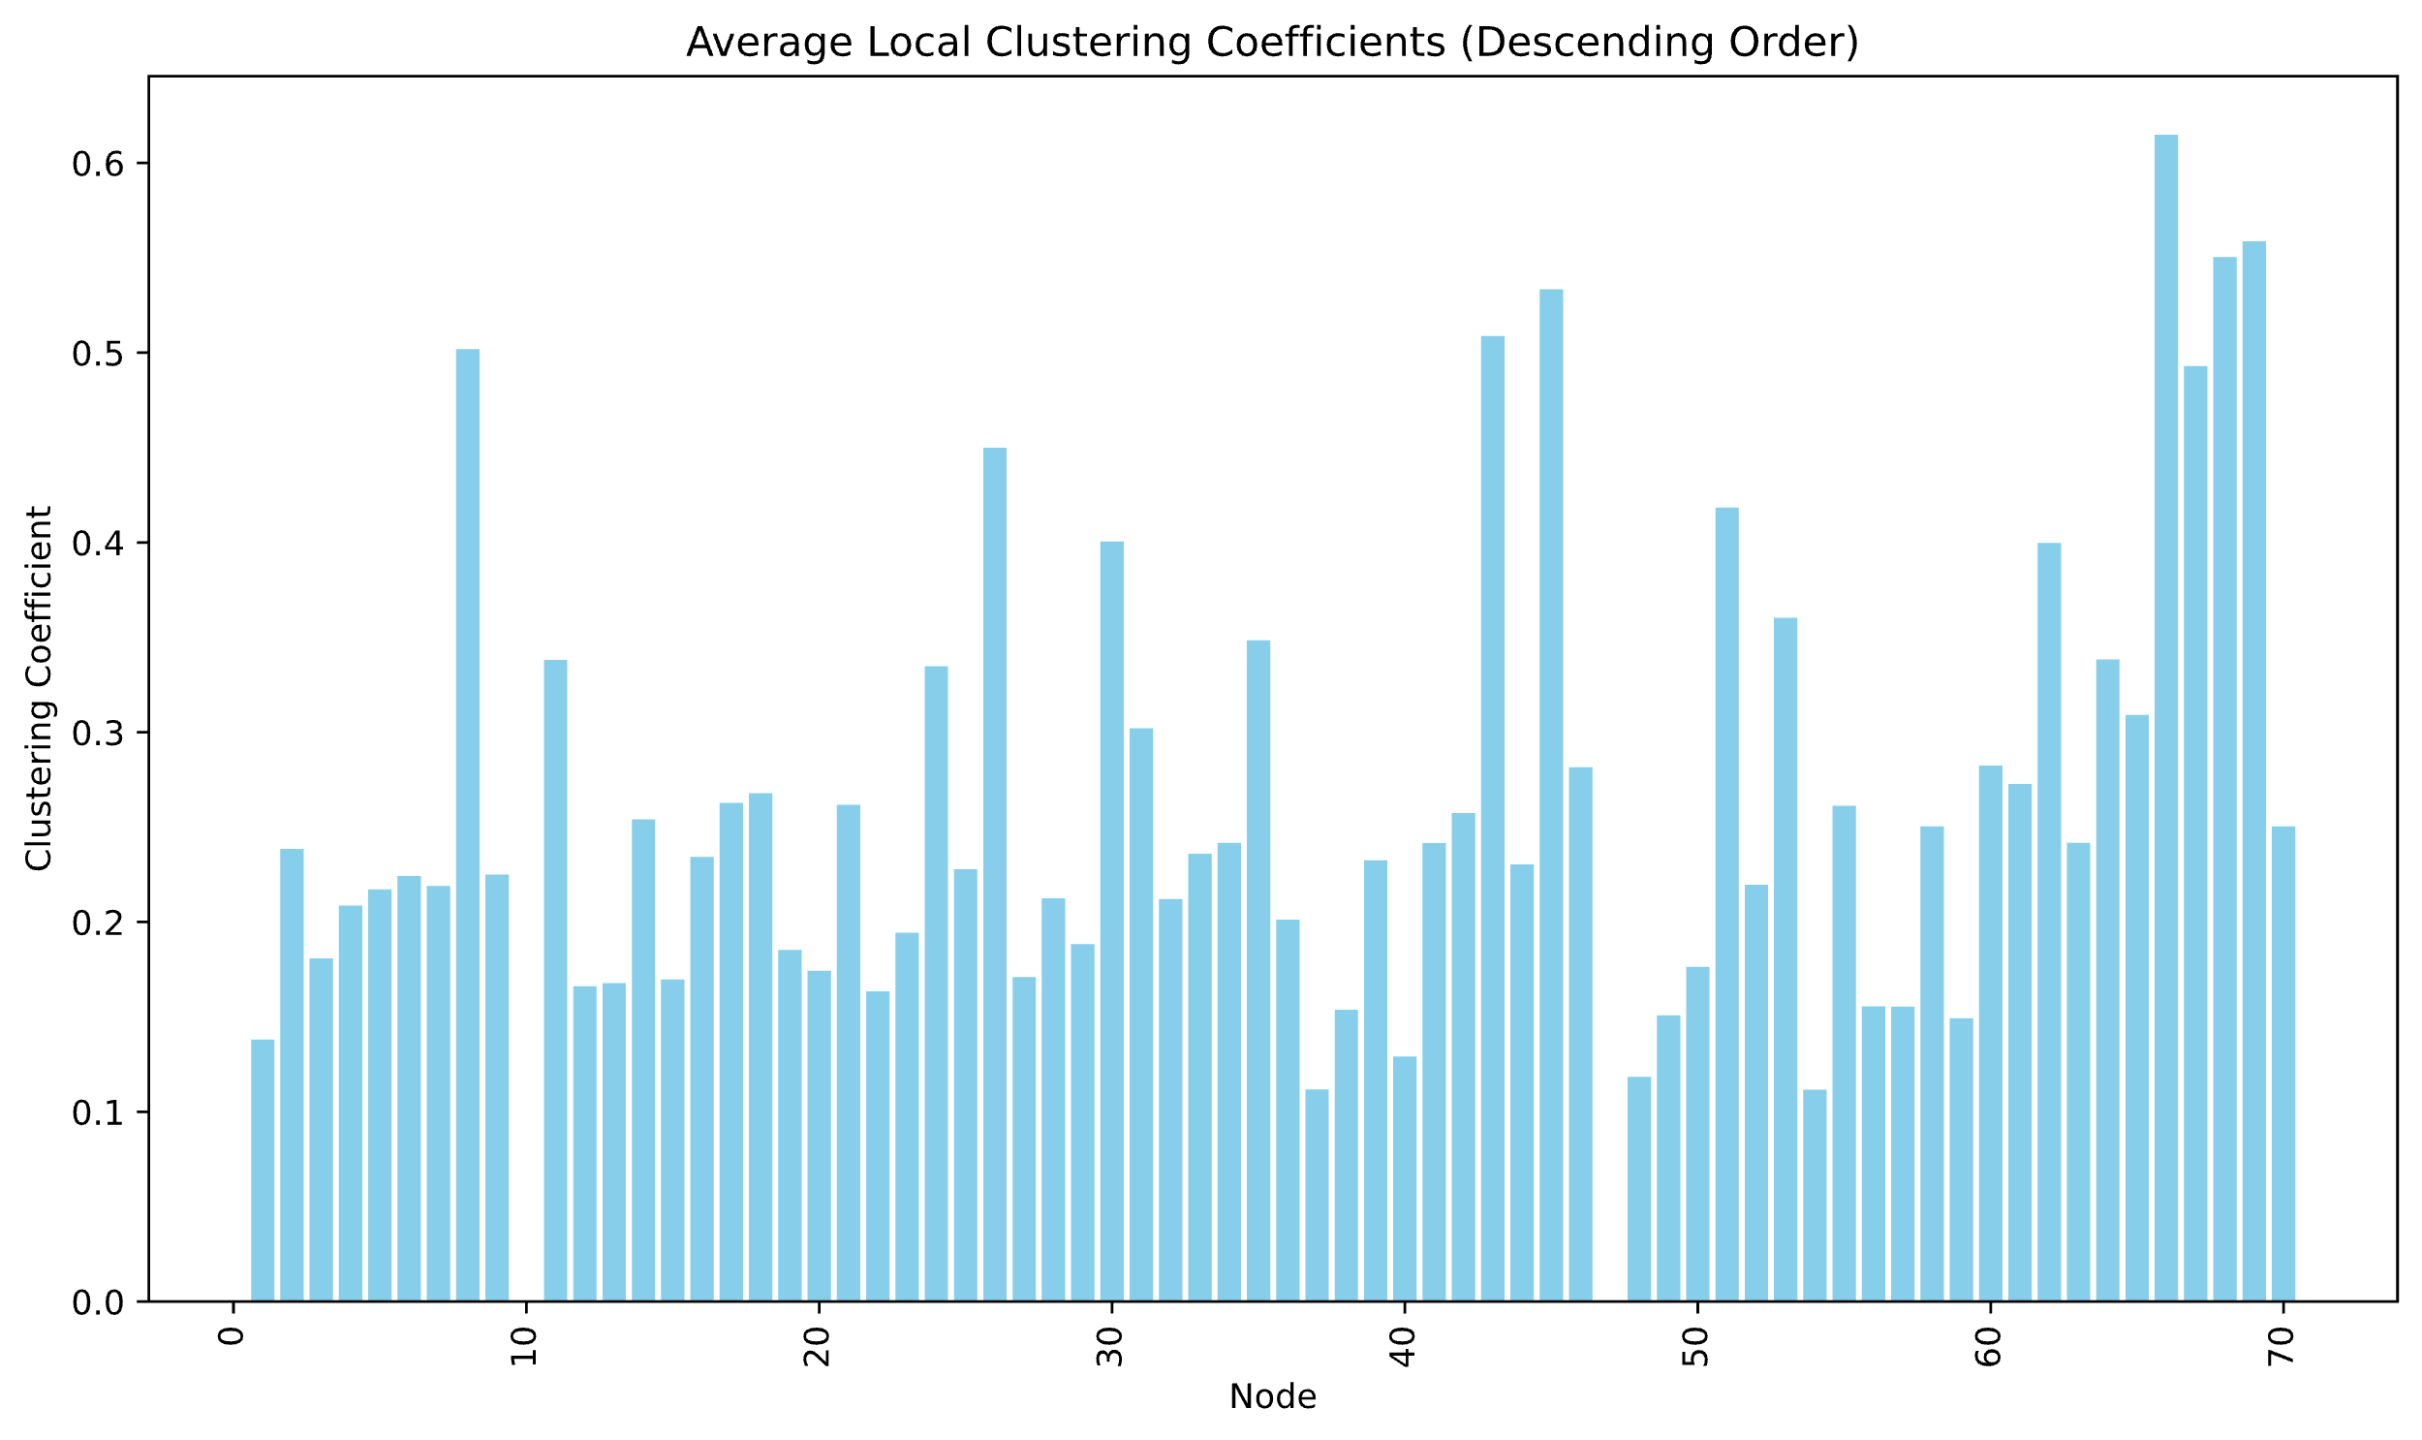
Reciprocity\ Clustering\ Transitivity
Reciprocity on the directed graph returns 0.5027. This suggest that half of the overall connections in the directed network are mutually corresponded, that is, they are bidirectional. Considered the studied network, this does not surprise since in social networks it is quite usual to see a reciprocal relation between two nodes
Transitivity on the studied network is 0.4052 (transitivity computed based on the number of triads\triples in the network). This value is to be considered as moderate, as it resembles the number of close triads with respect to the possible triads in the network. This shows how students in the network interacts in this small type of structures. This resonates with the previous analyses of community detection and with the reciprocity measures, that is, we can see how the formation of communities between nodes that tend to have a bidirectional connections reflects on the presence of closed triads
Average local clustering is 0.3624 if we do not consider the weights in the graph, while it decreases to 0.2577 if we do consider them. Local clustering coefficients resembles how nodes are interconnected with their respective neighbors. By not considering the weights of the links we are simply considering a directed graph: this way, we overestimate the importance of links between nodes that aren’t central in the network. If we consider the weights, we see how the coefficient decreases, showcasing the fact that several connections between neighbors are bypassed in favor of links with more influential nodes. Finally, by analyzing node 28 we can find that it forms an ego-network with the closest nodes in the graph.

Slide 7
Thank you

