Slide 1
RELATING NEWS ARTICLES SUMMARIES TO STOCK PRICES
MARCELO GROSSI FOR MCM - PRACTICUM
SCHOOL OF COMPUTING, DUBLIN CITY UNIVERSITY
EMAIL: MARCELO.GROSSI2@MAIL.DCU.IE

Slide 2
PRESENTATION SUMMARY
Relating News Articles Summaries to Stock Prices, Marcelo Grossi for MCM - Practicum
Part I
  Problem and definitions,
  State of the art,
  A new approach,
  Experiments,
  Results and Conclusion
Part II
  Implementation details,
  Technologies used

Slide 3
PART I

Slide 4
INTRODUCTION
Relating News Articles Summaries to Stock Prices, Marcelo Grossi for MCM - Practicum
Stock price analyses
  Can be highly lucrative!
  Fundamental and Technical analyses
    Econometrics
    Chart and indicator analyses
Increased computational power allows
  Relating stock price to big external data sources
  Such as News corpora

Slide 5
RELATING NEWS TO STOCK PRICES
Relating News Articles Summaries to Stock Prices, Marcelo Grossi for MCM - Practicum
How to relate textual data to numerical data?
  Stock prices → numerical time series
  News articles → unstructured textual data

Slide 6
STATE OF THE ART
Relating News Articles Summaries to Stock Prices, Marcelo Grossi for MCM - Practicum
Investor sentiment analysis
Intuition: ‘How will the investor react when confronted with news such as these?’
  ‘Economy exceeds expectations’
  ‘Market rallies after unexpected scenario’
  ‘Investment impacted after huge loss’

Slide 7
INVESTOR SENTIMENT
Relating News Articles Summaries to Stock Prices, Marcelo Grossi for MCM - Practicum
Good, neutral and bad news may influence investors into buying/selling stocks
Techniques to classify investor sentiment
  Lexicon-based approaches: dictionaries of financially good/bad terminology
  ML/NLP: Supervised learning classification on annotated corpus
Can investor sentiment be related to stock price movement?
  Gidfalvi, 2001 finds that news have predictive power in a 20 minutes window interval before and after publication
  Tetlock, 2007 shows that negative sentiment predicts downward pressure on prices
  Barber and Odean, 2008 correlate increase in trading volume with high news sentiment
  Bloomberg sells document sentiment analysis to investors (‘Bloomberg Market Impact’)

Slide 8
PROBLEM SOLVED?
Relating News Articles Summaries to Stock Prices, Marcelo Grossi for MCM - Practicum
Sentiment is not general (lacks stock context)
  What is good news to one is not necessarily good to all
Best results achieved through machine learning techniques
  Needs big annotated corpus
  If not applied to each individual stock also lacks context
Relationship of sentiment and stock price movement is cumbersome
  Assign probability of document moving prices
  Create index and using threshold as a significant event – for event analysis

Slide 9
OBJECTIVES
Relating News Articles Summaries to Stock Prices, Marcelo Grossi for MCM - Practicum
Explore a different approach to relating news and stock price movement
Does this new approach also impact stock prices?
Can it be used as a viable trading strategy?

Slide 10
DIFFERENT APPROACH TO RELATING NEWS CORPUS TO STOCK DATA
Relating News Articles Summaries to Stock Prices, Marcelo Grossi for MCM - Practicum
More pragmatic and intuitive
Use textual measure over time to directly transform textual corpus into time series!
Easier to use – just another time series..
Better for prediction
What measure?
  Relative Importance → daily TF-IDF
  Gives more weight to ‘important terms’

Slide 11
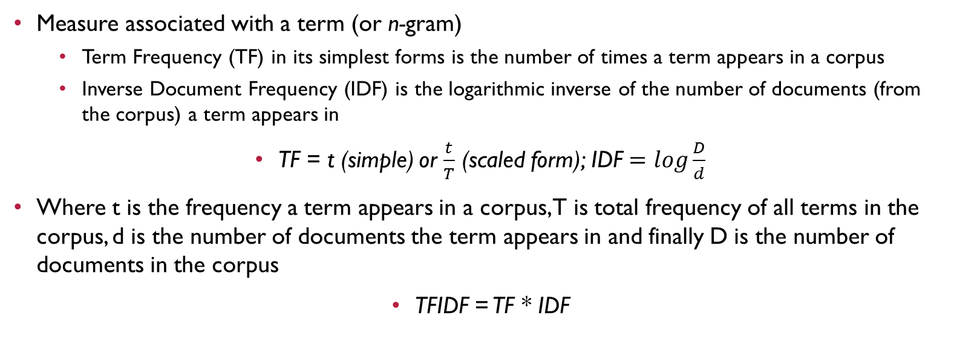
THE MEASURE: TERM FREQUENCY INVERSE DOCUMENT FREQUENCY (TFIDF)
Relating News Articles Summaries to Stock Prices, Marcelo Grossi for MCM - Practicum

Slide 12
TESTING FOR INFLUENCE
Relating News Articles Summaries to Stock Prices, Marcelo Grossi for MCM - Practicum
How to test if term time series has influence over stock prices?
  ‘The effect does not precede its cause in time’,
  ‘The cause has unique information about the series being caused that is not available otherwise’
    Eichler, 2012
Granger, 1969 and 1980 proposed a model for such a scenario
  Based on fitting a VAR model with and without the ‘causing’ series
  Granger-causality test or Granger-test

Slide 13
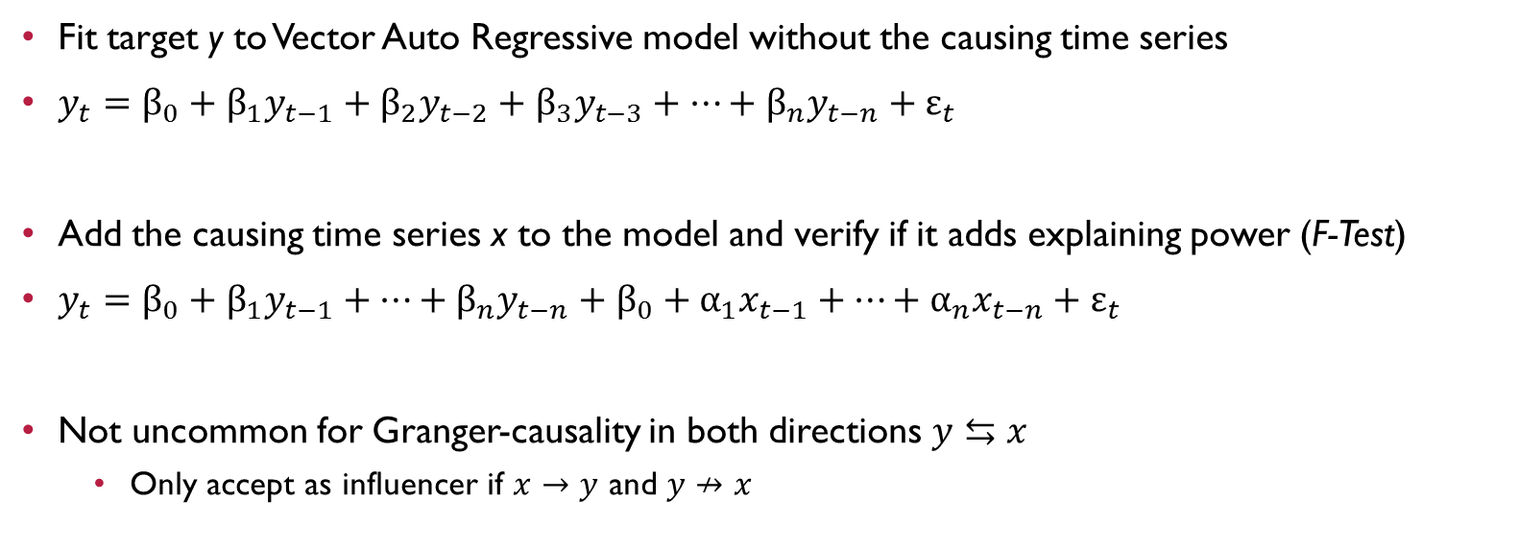
GRANGER CAUSALITY TEST
Relating News Articles Summaries to Stock Prices, Marcelo Grossi for MCM - Practicum

Slide 14
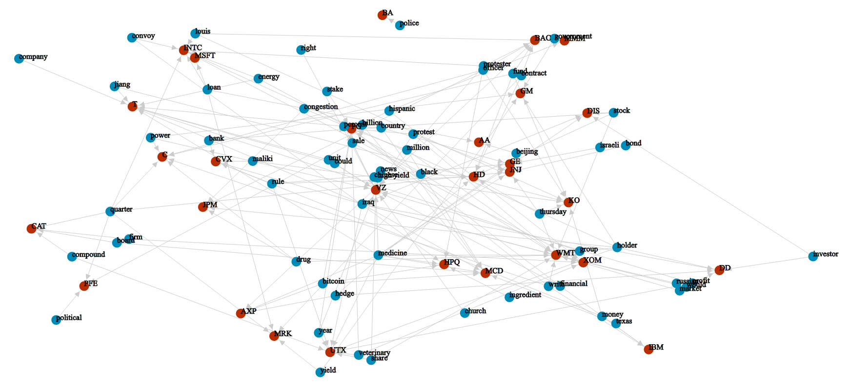
GRANGER-CAUSING TERMS TO GRANGER-CAUSED STOCKS (FORCE DIRECTED GRAPH)
Relating News Articles Summaries to Stock Prices, Marcelo Grossi for MCM - Practicum

Slide 15
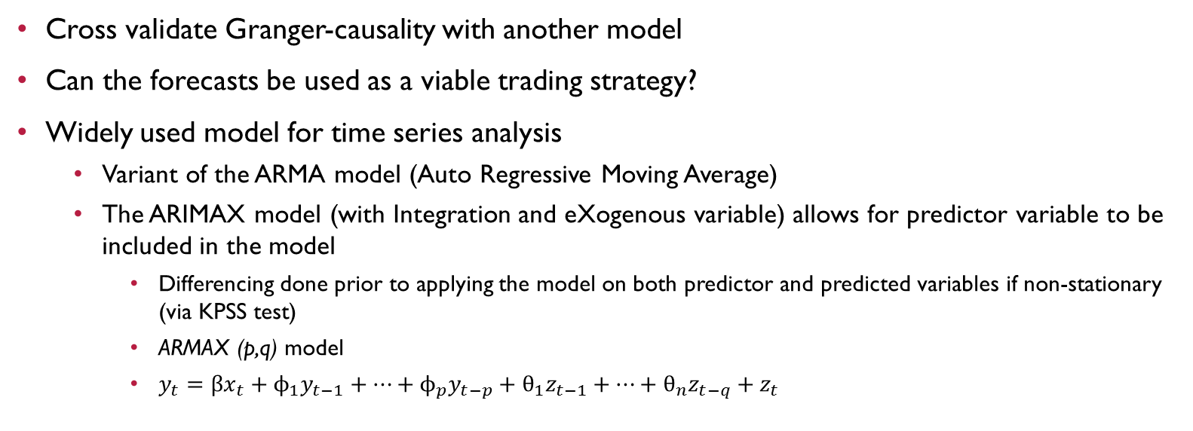
VALIDATING AND FORECASTING
Relating News Articles Summaries to Stock Prices, Marcelo Grossi for MCM - Practicum

Slide 16
RESULTS
Relating News Articles Summaries to Stock Prices, Marcelo Grossi for MCM - Practicum
Do the new term time series corroborate the Granger-tests results?
  Root Mean Squared Error
    Comparison between models with individual predictor (IND), all identified predictors (AGG) and no predictors (NOEX)
    Two tailed F-Test shows difference between IND, and NOEX, and also AGG and NOEX with 10% significance, confirming the Granger-causality tests
 | AGG | NOEX
IND | 0.564381 | 0.067272
AGG |  | 0.08543

Slide 17
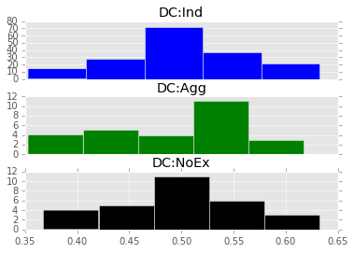
RESULTS (CONTD.)
Relating News Articles Summaries to Stock Prices, Marcelo Grossi for MCM - Practicum
Can it be used as a viable trading strategy?
  Directional Correctness Ratio
    Simple measure that avoids pitfalls of convoluted trading strategies to validate theories
    If not random (mean significantly different than 50%) means it is viable
    Results show random behaviour and thus can not be used directly as a viable trading strategy
 | MEAN | VARIANCE
IND | 0.5004 | 0.0042
AGG | 0.4961 | 0.0053
NOEX | 0.4969 | 0.0043

Slide 18
CONCLUSION
Relating News Articles Summaries to Stock Prices, Marcelo Grossi for MCM - Practicum
Granger-causing terms not always intuitive
  May be serving as a proxy for unknown variable
  Can be improved by filtering allowed terms (use only nouns, named entities, etc.)
ARMA models could fit the data better if more data was available
  Re-test with 10+ years news and stock data and compare results
  Could show improvement in directional correctness ratio (better fit!)

Slide 19
CONCLUSION (CONTD.)
Relating News Articles Summaries to Stock Prices, Marcelo Grossi for MCM - Practicum
Does this new approach also impact stock prices?
  Stock price forecasts made using the related term time series show better results than not using it
  Using all available term time series that are related to the same stock improve results further
Can it be used as a viable trading strategy?
  Directional correctness does not show deviance from random

Slide 20
FUTURE WORK
Relating News Articles Summaries to Stock Prices, Marcelo Grossi for MCM - Practicum
Repeat experiment using bigger data set
  Spanning more years,
  News corpora from different sources
  Can compare results between different news providers
Produce bag-of-words using filtered terms
  Nouns, named entities, etc.
Use the related term time series of different stocks and calculate distance
  Can use cosine similarity and produce graph of related stocks (from their related terms)
  May uncover non intuitive relationships that could prove useful as trading strategy

Slide 21
PART II

Slide 22
DATA SOURCES
Relating News Articles Summaries to Stock Prices, Marcelo Grossi for MCM - Practicum
Daily historical stock data from Yahoo! Finance
  Python Pandas Data Reader
New York Times news portal (http://www.nytimes.com/)
  Python Scrapy
  Scraping over 148,000 news articles from January 1st 2013 to October 19th 2014
  Filtered news articles by business related categories ending up with 49,227 articles
  Transformed from HTML to JSON files (with title, text and date)

Slide 23
TEXT PRE-PROCESSING
Relating News Articles Summaries to Stock Prices, Marcelo Grossi for MCM - Practicum
Pre-process news article raw textual content into bag-of-words (n-grams)
Python scripts
Sequence of transformations
  Expand contractions: ‘it’s’ → ‘it is’, ‘can’t’ → can not, ..
  Stopwords removal: ‘be’, ‘but’, ‘by’, ‘each’, ‘for’, ‘and’, ‘them’, ‘we’, ..
  Process sentences independently: So n-grams bigger than unity can only come from the same sentence.
  Work tokenization: ‘What a great day!’ → [‘what’, ‘great’, ‘day’]

Slide 24
TEXT PRE-PROCESSING (CONTD.)
Relating News Articles Summaries to Stock Prices, Marcelo Grossi for MCM - Practicum
Sequence of transformations (contd.)
  Lemmatization and Part-of-Speech Tagging:
    ‘saw’ + ‘verb’ → ‘see’
    ‘saw’ + ‘subject’ → ‘saw’
  Word n-gram generation (1 and 2-grams)
Bag-of-words saved to MongoDB for TF-IDF calculations
{
"source": "source of news article",
"date": "date in the format YYYY-MM-DD",
"tags": ["list", "of", "tags"],
"title": "title of news article",
"url": "url of article",
"bag_of_words": [["ngram1", freq1],..]
}

Slide 25
TF-IDF CALCULATIONS
Relating News Articles Summaries to Stock Prices, Marcelo Grossi for MCM - Practicum
Use MongoDB Map-Reduce-Finalize to calculate daily summaries
Easy to get n-gram time series (saved as dictionary, so efficient to query)
From this collection, it is easy to calculate TF-IDF for any period – as needed
{
“date": "date in the format YYYY-MM-DD",
“total_docs": number of unique news articles,
“total_terms": number of unique terms,
“term_counts": {
"ngram1“: [freq1, doc_freq1, tfidf1],
"ngram2“: [freq2, doc_freq2, tfidf2],
…
}
}

Slide 26
DATA ANALYSIS
Relating News Articles Summaries to Stock Prices, Marcelo Grossi for MCM - Practicum
Python Pandas
Python Stats Models (http://statsmodels.sourceforge.net/)
  Initiative to make Python a fully-featured statistical platform
IPython Notebook for results and interactive data exploration

Slide 27
THANK YOU!
Relating News Articles Summaries to Stock Prices, Marcelo Grossi for MCM - Practicum
Questions?

