Slide 1

Smart University Complaint System
A Web-Based Platform for Digital Complaint Management
Group Id: S26PROJECT4EE01 (BC220400155, BC220400156)
Supervisor Name: Muhammad Raheel | Virtual University of Pakistan

Slide 2

Smart University Complaint System (SUCS)
Final Project Presentation | CS619
Group Id: S26PROJECT4EE01
Group Members: BC220400155, BC220400156
Project Supervisor: Muhammad Raheel

Slide 3
Group Members Introduction
• Group Member 1: BC220400155
Role & Scope: Lead Software Architecture, Python Flask Backend Engine, SQLite 3 Relational Database Normalization, Automated Keyword Priority Triage, and Conflict-of-Interest Firewall Enforcement.
• Group Member 2: BC220400156
Role & Scope: UI/UX Engineering, Jinja2 Template Integration, Tailwind CSS Responsive Interface Design, Student Dashboard & Quota Counter, and Pytest Automated Quality Assurance Test Suite.
• Project Supervisor: Muhammad Raheel
Role & Scope: Academic supervision, requirements validation, methodology oversight, and evaluation guidance for the Virtual University Final Project (CS619).

Slide 4

INTRODUCTION OF PROJECT
▶ Problem Statement:
• Traditional campus grievance methods (paper suggestion boxes, unstructured emails) result in lost complaints, zero traceability, spamming, and severe conflict of interest when staff handle complaints filed against themselves.
▶ Proposed Solution:
• SUCS is an intelligent, role-governed web application featuring dedicated portals for Students, Administrators, and the Head of Department (HOD) with automated routing and status monitoring.
▶ Intelligent Triage & Automation:
• Includes automated hazard keyword priority escalation (High P1), 5-complaint monthly quotas, Conflict-of-Interest isolation (direct HOD escalation), and Category-Target problem clustering for 1-Click batch resolution.
▶ Project Scope & Boundaries:
• Focuses on internal web grievance management. Mobile apps, external SMS/Email gateways, and third-party ERP integration are scoped as future iterations.

Slide 5
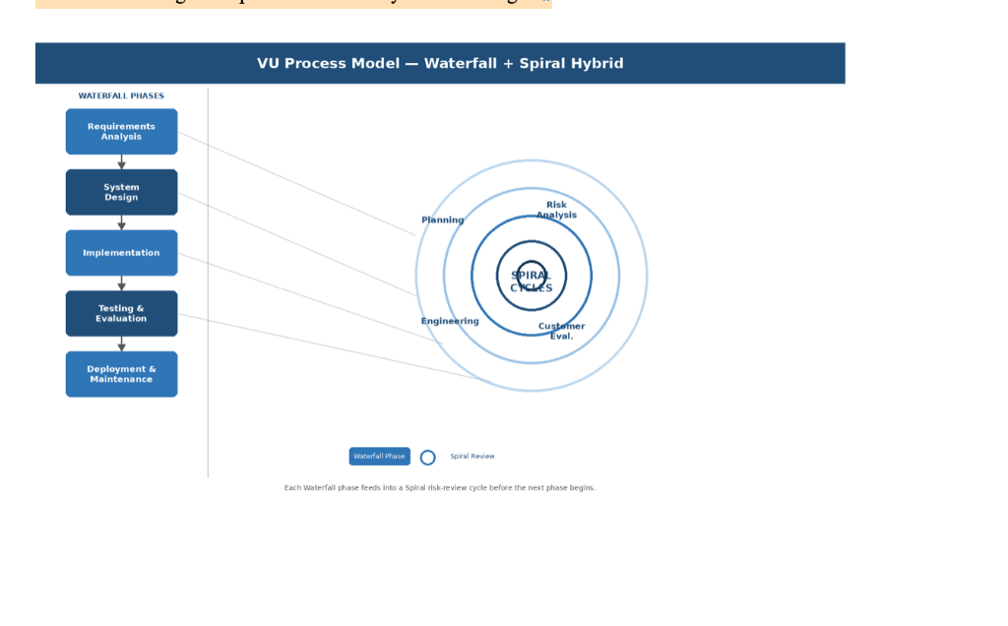
Process Model: VU Hybrid Waterfall-Spiral Lifecycle
Waterfall phase discipline integrated with Spiral risk mitigation reviews

Slide 6
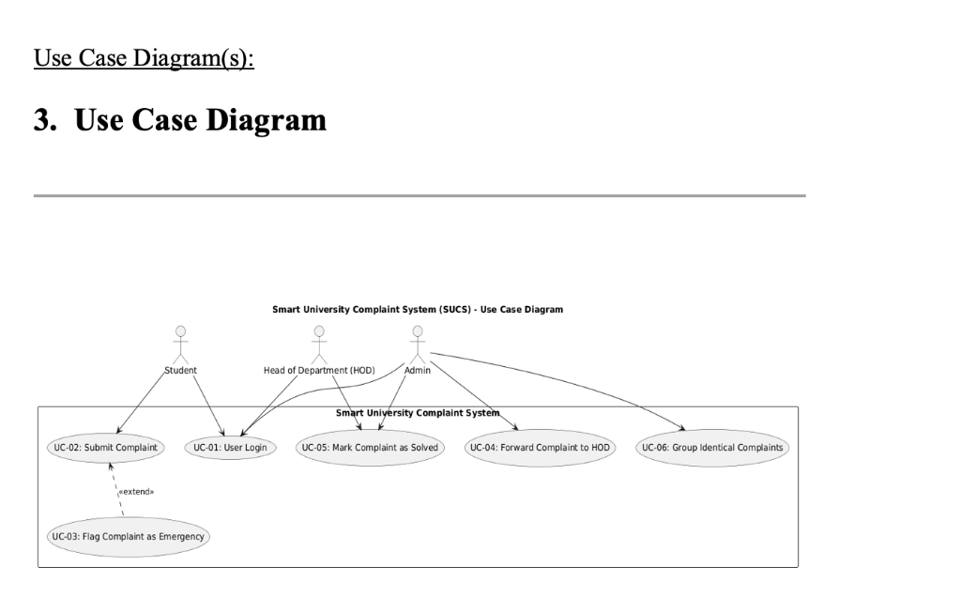
Use Case Diagram

Slide 7
Business Rules Catalog (BRC)
✔ BR-01: Monthly Quota Limit (FR3)
• Each student is limited to exactly 5 complaints per calendar month to prevent queue flooding and frivolous submissions.
✔ BR-02: Conflict of Interest (COI) Firewall (FR7)
• If a complaint is directed against Administration, it completely bypasses the Admin queue and routes directly to the HOD.
✔ BR-03: Emergency Keyword Priority Escalation (FR6)
• Complaints indicating physical danger (urgent, fire, shock, leak, hazard, broken wire) automatically escalate to High Priority (P1).
✔ BR-04: Intelligent Auto-Grouping (FR9)
• Complaints regarding the same Category and Target are automatically clustered under a common group_id token.
✔ BR-05: 1-Click Batch Resolution
• Admin and HOD can resolve all linked complaints in a cluster simultaneously with a single click and uniform audit note.
✔ BR-06: Mandatory Progress Remarks
• Changing ticket status to 'In-Progress' strictly mandates an investigative comment to keep students informed.

Slide 8
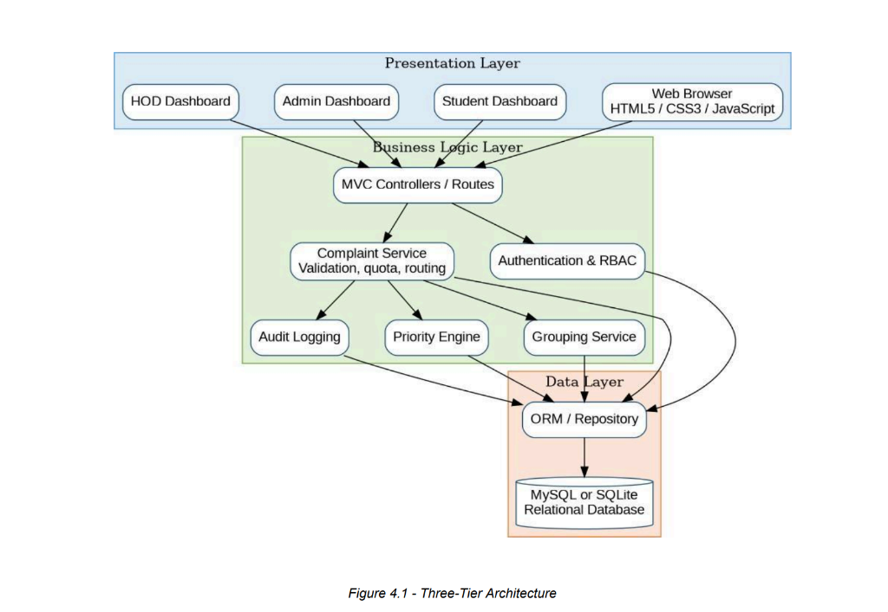
Architectural Design (3-Tier Layered MVC)

Slide 9
Team Structure & Work Breakdown
• Group Member 1: BC220400155 (Backend & Architecture Lead)
- Project architecture definition & 3-Tier Layered MVC specification.
- Python 3.9 Flask backend routing, session management, and Werkzeug PBKDF2 hashing.
- Normalized SQLite 3 database schema design (3NF), foreign keys, and indices.
- Emergency keyword priority triage engine and Conflict-of-Interest routing logic.
• Group Member 2: BC220400156 (Frontend & Quality Assurance Lead)
- Tailwind CSS aesthetic styling, responsive grid layouts, and color-coded status badges.
- Jinja2 template architecture (Student submission, Admin desk, HOD console, DB viewer).
- Software Requirements Specification (SRS) & Use Case Scenario documentation.
- Automated Pytest test suite implementation (9 automated test cases, 100% pass rate).

Slide 10
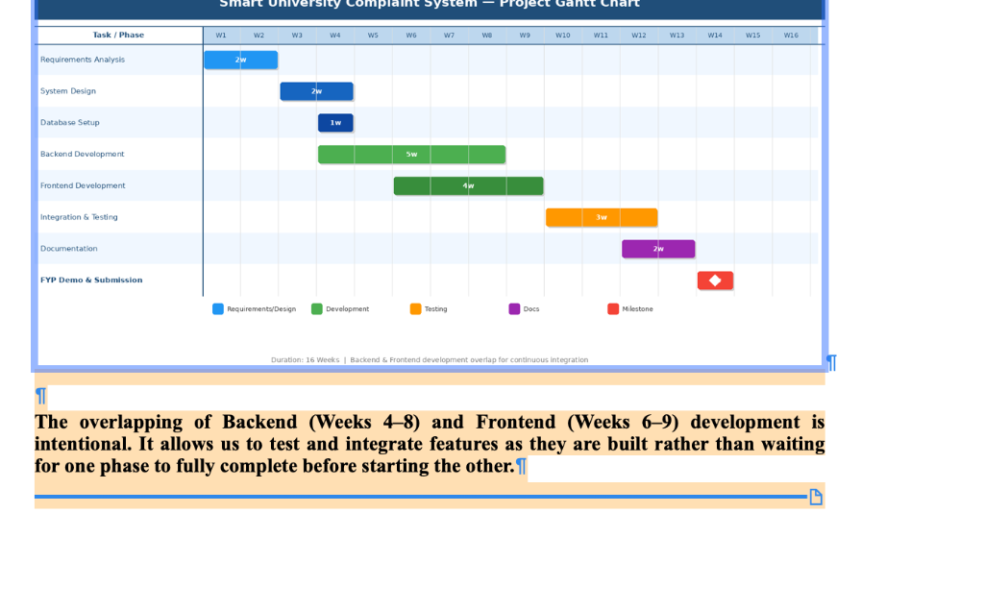
Project Schedule (Gantt Chart)

Slide 11
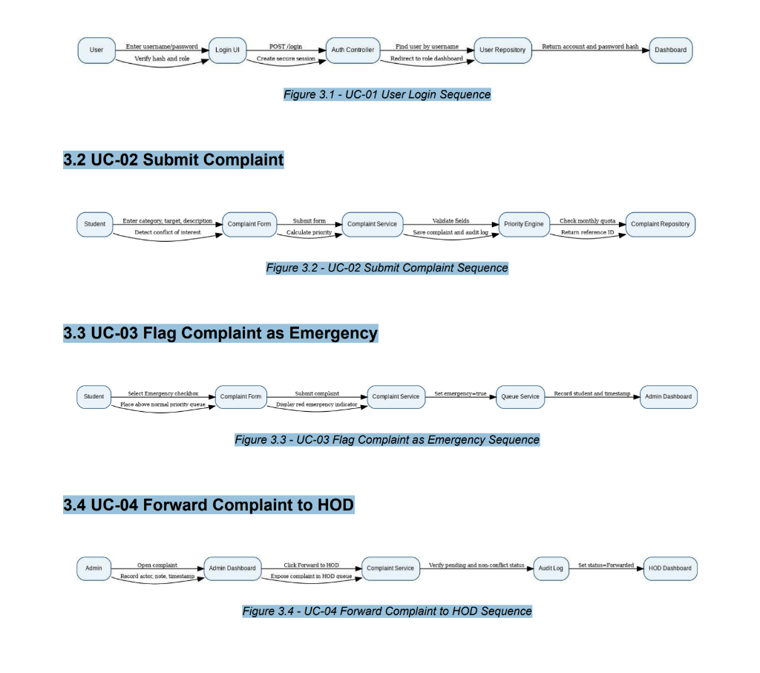
Sequence Diagram: User Login & Complaint Workflow

Slide 12
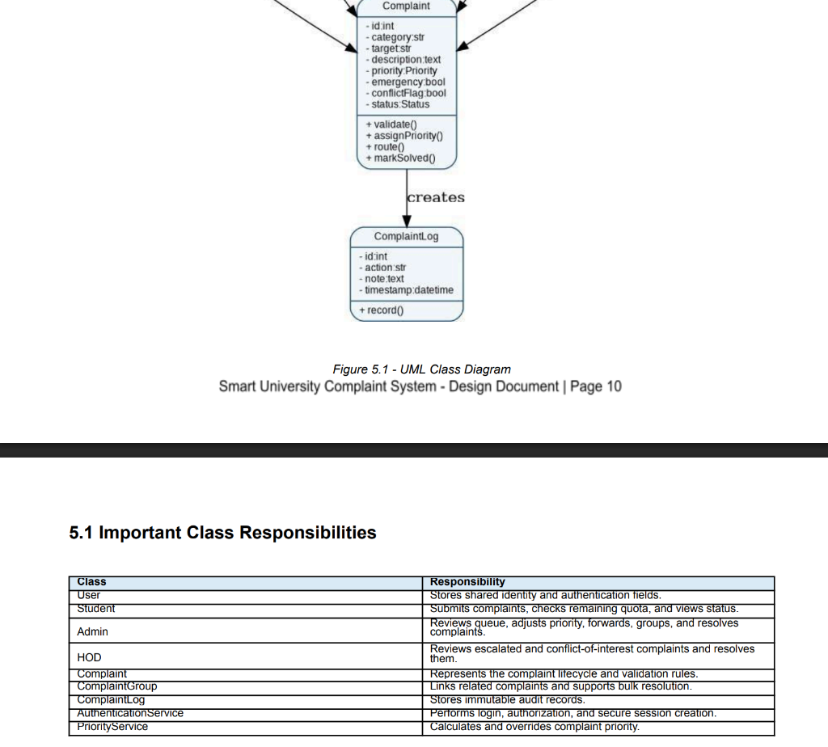
Logical Model / Class Diagram

Slide 13
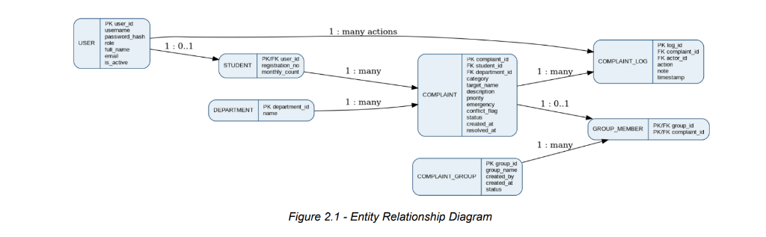
Entity-Relationship Diagram (ERD)
ERD Cardinality & Relational Design:
• USER (1 : 0..1) STUDENT: 1-to-1 specialization for student users tracking monthly complaint quota count.
• STUDENT (1 : N) COMPLAINT: Each student can submit multiple complaints (max 5 per calendar month).
• DEPARTMENT (1 : N) COMPLAINT: Complaints are categorized by target department for isolated triage.

Slide 14
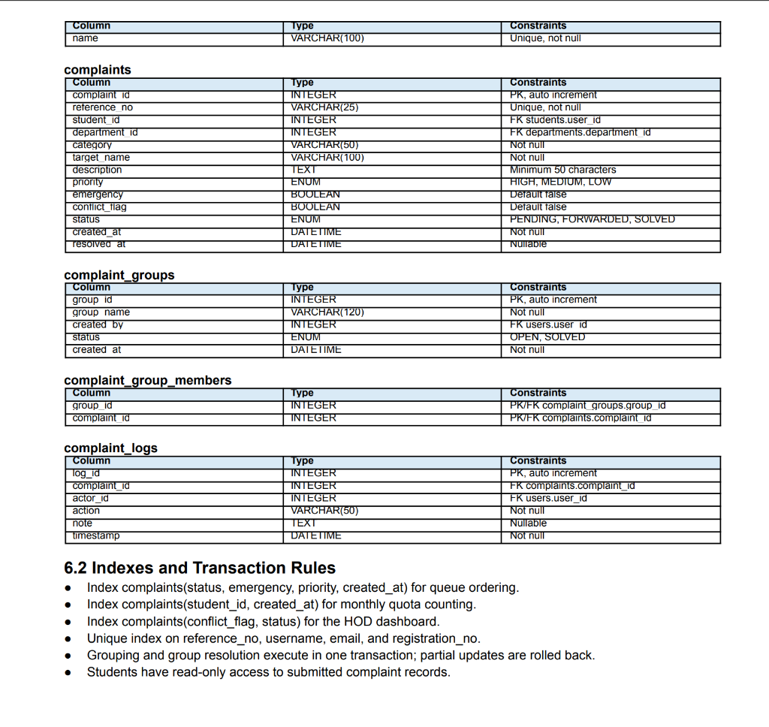
Database Diagram & Schema Specification

Slide 15
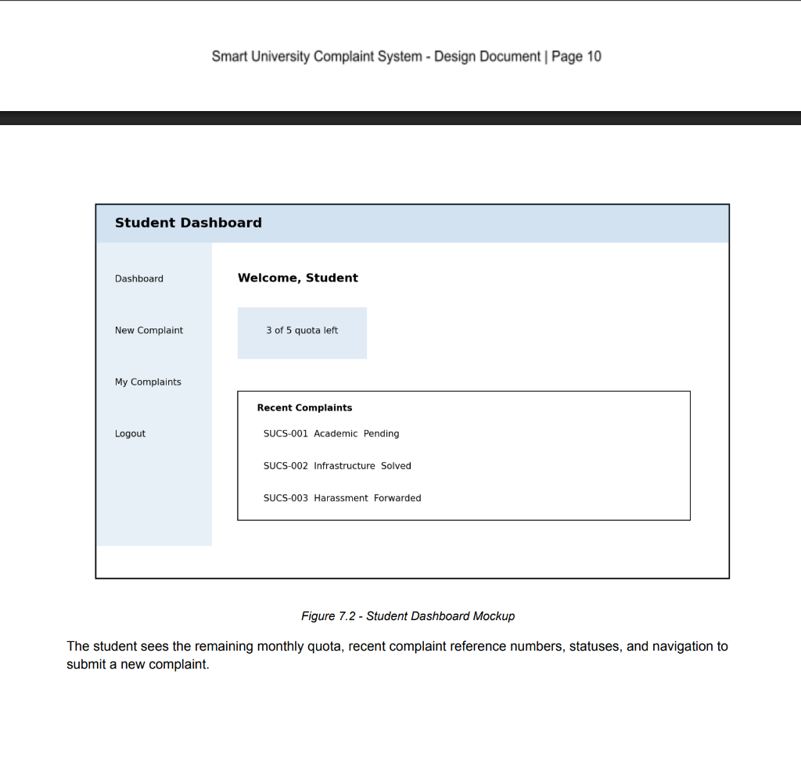
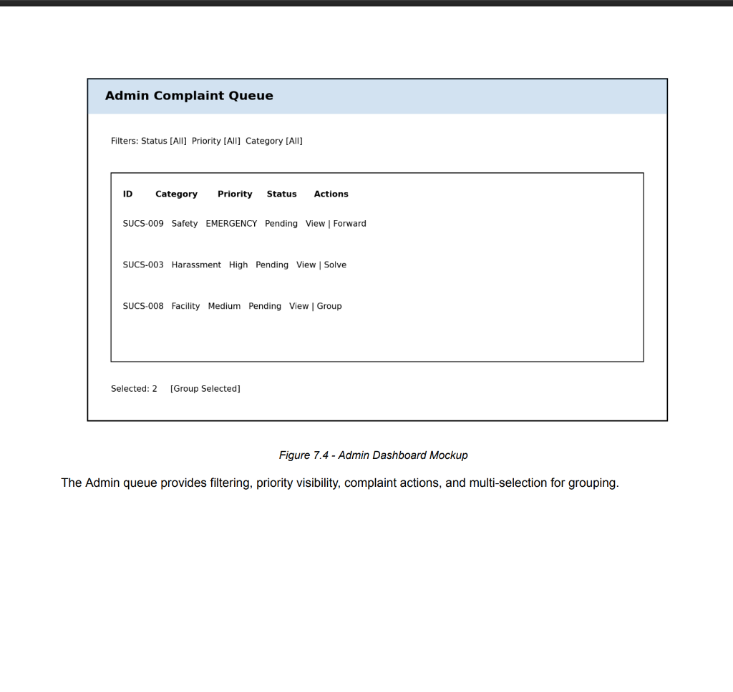
User Interfaces (Application Mockups)

Slide 16
Tools & Technologies Stack
✔ Python 3.9+ Programming Language
• Chosen for rapid prototyping, robust standard library, security primitives, and clean syntax.
✔ Flask 2.x Microframework
• Lightweight WSGI web framework providing granular control over HTTP routing, sessions, and request dispatching.
✔ SQLite 3 Relational Database Engine
• Zero-configuration, serverless, self-contained relational database guaranteeing ACID transaction compliance.
✔ Werkzeug Security Module
• Industry-grade password cryptography implementing salted PBKDF2-SHA256 password hashing.
✔ Tailwind CSS Frontend Styling
• Modern utility-first CSS framework delivering clean, accessible responsive cards, modals, and status badges.
✔ Jinja2 Template Engine
• Server-side template engine providing template inheritance, safe variable escaping, and role-based view isolation.
✔ Pytest 8.x Testing Framework
• Modern automated testing framework driving 9 automated integration test cases verifying 100% of business rules.

