Slide 1
Tutorial: Uso do PSP2
Personal Software ProcessSM
para Engenheiros: Parte 2

Slide 2


Slide 3
Objetivos do tutorial
Após este tutorial, você
  entenderá os novos elementos do processo PSP2,
  aprenderá como usar os scripts e formulários do PSP2,
  estará preparado para usar o PSP2 para o Programa 5.

Slide 4
Objetivos do PSP2
Os objetivos do PSP2 são consistem em introduzir:
  revisão de projeto,
  revisão de código,
  métodos para avaliar e melhorar a qualidade de suas revisões.

Slide 5
Novos elementos do processo
Existem dois novos elementos no processo:
  lista de verificação para revisão do projeto,
  lista de verificação para revisão do código.
As listas de verificação para revisão de projeto e código serão descritas separadamente..
Duas novas competências são adicionadas ao PSP:
  revisão de projeto e de código,
  planejamento de qualidade.
No PSP2, o formulário de resumo do planejamento do projeto é atualizado para comportar estas novas competências.

Slide 6
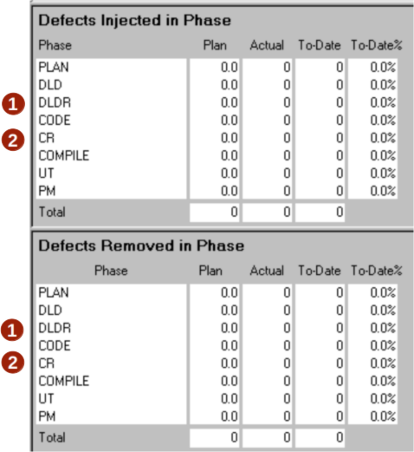
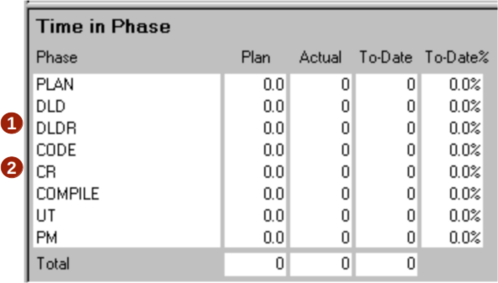
Revisões de projeto e de código
Duas novas fases são adicionadas ao processo:
  Revisão de projeto (DLDR)
  Revisão de código (CR)
Dados de tempo e defeitos destas fases também serão sumarizados no formulário de resumo de planejamento do projeto.

Slide 7
Planejamento de qualidade
PSP2 introduz a questão de planejamento de qualidade.
Planejamento de qualidade envolve:
  estimar a quantidade total de defeitos que serão inseridos,
  estimar a quantidade de defeitos que serão inseridos e removidos em cada fase do processo,
  estimar o tempo necessário para revisões de projeto e de código,
  ajustar esses parâmetros conforme necessário, garantindo um resultado de alta qualidade.

Slide 8
Estimativa do total de defeitos
Para estimar a quantidade total de defeitos inseridos e removidos, utilize o tamanho planejado do programa e a densidade de defeitos até o momento de defeitos.
Quantidade prevista de defeitos = | Quantidade de defeitos até o momento/KLOC (densidade de defeitos) x Quantidade planejada de adições e modificações

Slide 9
Estimating Defects by Phase
To estimate defects injected and removed by phase, distribute the planned total defects injected and removed based on historical data.
  Planned Total Defects
  To Date % defects injected in each phase
  To Date % defects removed in each phase

Slide 10
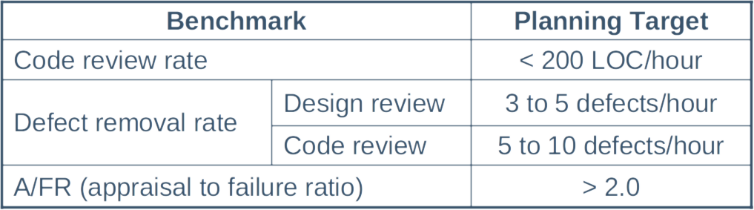
Estimating Review Time
These PSP benchmarks can be used to estimate design review and code review time in phase.
For manual calculations, starting with the code review rate
is recommended.

Slide 11

Estimating With Review Rates -1
Benchmark data on code review rates can be used to estimate review time.
From PSP data, we know that code review rates under 200 LOC/hour generally give high yield.
Using planned added and modified LOC, code review time can be calculated using this formula.
Assume a similar rate for design reviews.

Slide 12
Estimating With Review Rates -2
To add review time to your plan
  increase the total minutes, and/or
  reduce compile and test time
As a final check of your estimate, make sure that
  review rates are less than 200 LOC per hour
  defect removal rates are between
    3 to 5 per hour for design review
    5 to 10 per hour for code review
  A/FR is about 2.0

Slide 13
Estimating Considerations
Initially no historical data are available for planning defects injected and removed in review phases.
Until you have data for design and code review phases, you may want to consider
  defects injected are 0
  defects removed should be based on your yield goal
Your yield goal should be based on your interim report analysis. If you do not have a yield goal, you should try to achieve greater than 60% yield.

Slide 14
Estimating Defects Removed
Defects removed in a review phase are calculated using
  number of defects escaping from prior phases
  number of defects injected in a phase
  percentage of defects removed, i.e. Phase Yield
Defects present | = | escapes + injected
Defects removed | = | present × phase yield

Slide 15
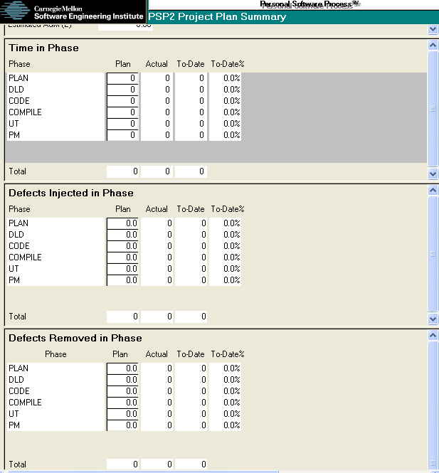
PSP2 Project Plan Summary
Complete your estimates of
  Time in phase
  Defects injected in phase
  Defects removed in phase
Enter these values on the PSP2 project plan summary.
1
2
3

Slide 16
Derived Quality Measures
PSP2 also provides the following derived quality measures.
  Defect removal efficiency
  Defect removal leverage
  Test defects per KLOC
  Total defects per KLOC
  Yield

Slide 17
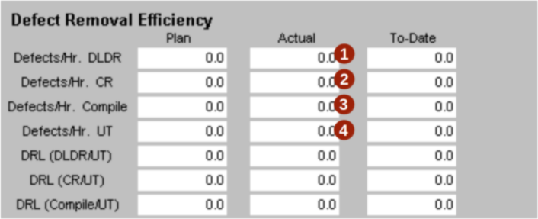

Defect Removal Efficiency
Defect removal efficiency is calculated automatically and shows the number of defects removed per hour for
  Design review
  Code review
  Compile
  Test

Slide 18
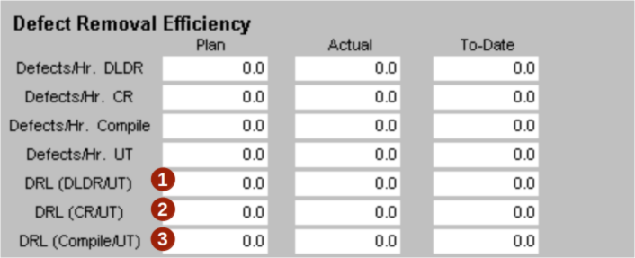

Defect Removal Leverage
Defect removal leverage is calculated automatically and compares removal efficiency for
  Design Review vs. Unit Test
  Code Review vs. Unit Test
  Compile vs. Unit Test

Slide 19
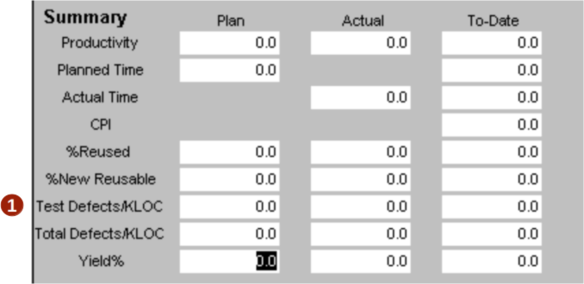

Test Defects Per KLOC
  Test defects per KLOC is calculated automatically and is an indicator of the quality of the program that you put into test.

Slide 20
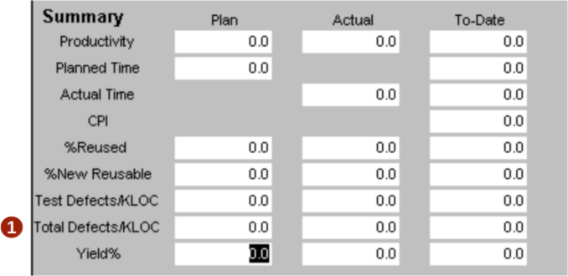

Total Defects Per KLOC
  Total defects per KLOC is calculated automatically and is a measure of the total defects injected during the process.

Slide 21
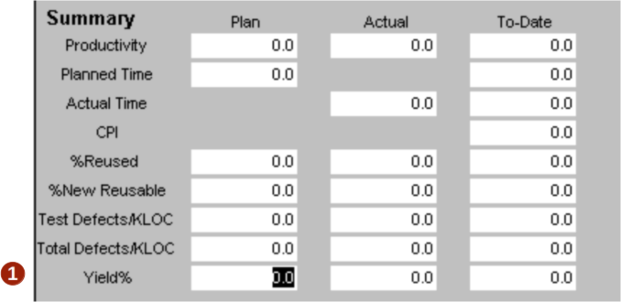

Yield
  Yield (actual and to-date) is calculated automatically for the entire process and is the percentage of defects injected and removed before the first compile.

Slide 22
Messages to Remember
You will see more improvement from design and code reviews than any other process change you make.
  Quality will improve.
  Productivity will increase.
PSP2 provides data that allows you to
  plan for specific quality levels
  control quality during development
  improve the quality of your PSP
  increase productivity without sacrificing quality

