Slide 1
Tutorial: Using PSP2.1
Personal Software ProcessSM for Engineers: Part I

Slide 2
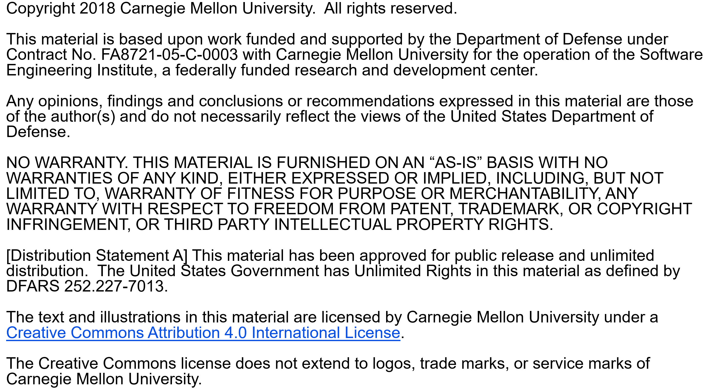

Slide 3
Copyright 2017 Carnegie Mellon University [Distribution Statement A] This material has been approved for public release and unlimited distribution. Please see Copyright notice for non-US Government use and distribution. This material is based upon work funded and supported by the Department of Defense under Contract No. FA8721-05-C-0003 with Carnegie Mellon University for the operation of the Software Engineering Institute, a federally funded research and development center. NO WARRANTY. THIS CARNEGIE MELLON UNIVERSITY AND SOFTWARE ENGINEERING INSTITUTE MATERIAL IS FURNISHED ON AN “AS-IS” BASIS. CARNEGIE MELLON UNIVERSITY MAKES NO WARRANTIES OF ANY KIND, EITHER EXPRESSED OR IMPLIED, AS TO ANY MATTER INCLUDING, BUT NOT LIMITED TO, WARRANTY OF FITNESS FOR PURPOSE OR MERCHANTABILITY, EXCLUSIVITY, OR RESULTS OBTAINED FROM USE OF THE MATERIAL. CARNEGIE MELLON UNIVERSITY DOES NOT MAKE ANY WARRANTY OF ANY KIND WITH RESPECT TO FREEDOM FROM PATENT, TRADEMARK, OR COPYRIGHT INFRINGEMENT. This material is distributed by the Software Engineering Institute (SEI) only to course attendees for their own individual study. Except for the U.S. government purposes described below, this material SHALL NOT be reproduced or used in any other manner without requesting formal permission from the Software Engineering Institute at permission@sei.cmu.edu. The U.S. Government's rights to use, modify, reproduce, release, perform, display, or disclose this material are restricted by the Rights in Technical Data-Noncommercial Items clauses (DFAR 252-227.7013 and DFAR 252-227.7013 Alternate I) contained in the above identified contract. Any reproduction of this material or portions thereof marked with this legend must also reproduce the disclaimers contained on this slide. Although the rights granted by contract do not require course attendance to use this material for U.S. Government purposes, the SEI recommends attendance to ensure proper understanding. PSPSM, Team Software ProcessSM and TSPSM are service marks of Carnegie Mellon University. DM-0004449

Slide 4
Tutorial Objectives
After this tutorial, you will
understand the new elements of PSP2.1
know how to use the PSP2.1 scripts and forms
be prepared to use PSP2.1 for programs 6, 7, and 8

Slide 5
PSP2.1 Objectives
The objectives of PSP2.1 are to introduce
additional measures for managing process quality
design templates that provide an orderly framework and format for recording designs

Slide 6
New Process Elements
PSP2.1 adds the following process elements:
PSP2.1 design review script
PSP2.1 design review checklist
operational specification template
functional specification template
state specification template
logic specification template
The design templates are discussed in the lectures on state machines and software design.

Slide 7
Project Plan Summary Example
We will walk through an example of a completed PSP2.1 project plan summary.
Only the new items on this form are discussed.

Slide 8
Program Size Prediction Intervals
Program size prediction intervals are automatically calculated using the method described in the text.
UPI – upper prediction interval
LPI – lower prediction interval
These values are calculated only if PROBE method A or B is used.

Slide 9
Development Time Prediction Intervals
Development time prediction intervals are automatically calculated using the method described in the text.
UPI – upper prediction interval
LPI – lower prediction interval
These values are calculated only if PROBE method A or B is used.

Slide 10
Summary: Percent Appraisal COQ
% Appraisal Cost of Quality is the percentage of development time spent in design review and code review.

Slide 11
Summary: Percent Failure COQ
% Failure Cost of Quality is the percentage of development time spent in compile and test.

Slide 12
COQ A/F Ratio
COQ A/F Ratio is the ratio of appraisal costs to failure costs.

Slide 13
Messages to Remember
PSP2.1 provides data that allows you to manage the cost of improving the quality of the programs you write.
The design templates will help you to record and document your design, making it easier to review.

