Slide 1
Tutorial: Using PSP2
Personal Software ProcessSM for Engineers: Part II

Slide 2
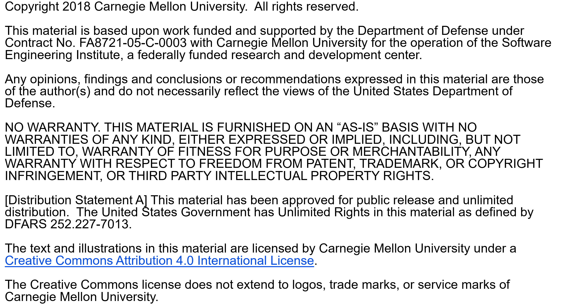

Slide 3
Copyright 2017 Carnegie Mellon University [Distribution Statement A] This material has been approved for public release and unlimited distribution. Please see Copyright notice for non-US Government use and distribution. This material is based upon work funded and supported by the Department of Defense under Contract No. FA8721-05-C-0003 with Carnegie Mellon University for the operation of the Software Engineering Institute, a federally funded research and development center. NO WARRANTY. THIS CARNEGIE MELLON UNIVERSITY AND SOFTWARE ENGINEERING INSTITUTE MATERIAL IS FURNISHED ON AN “AS-IS” BASIS. CARNEGIE MELLON UNIVERSITY MAKES NO WARRANTIES OF ANY KIND, EITHER EXPRESSED OR IMPLIED, AS TO ANY MATTER INCLUDING, BUT NOT LIMITED TO, WARRANTY OF FITNESS FOR PURPOSE OR MERCHANTABILITY, EXCLUSIVITY, OR RESULTS OBTAINED FROM USE OF THE MATERIAL. CARNEGIE MELLON UNIVERSITY DOES NOT MAKE ANY WARRANTY OF ANY KIND WITH RESPECT TO FREEDOM FROM PATENT, TRADEMARK, OR COPYRIGHT INFRINGEMENT. This material is distributed by the Software Engineering Institute (SEI) only to course attendees for their own individual study. Except for the U.S. government purposes described below, this material SHALL NOT be reproduced or used in any other manner without requesting formal permission from the Software Engineering Institute at permission@sei.cmu.edu. The U.S. Government's rights to use, modify, reproduce, release, perform, display, or disclose this material are restricted by the Rights in Technical Data-Noncommercial Items clauses (DFAR 252-227.7013 and DFAR 252-227.7013 Alternate I) contained in the above identified contract. Any reproduction of this material or portions thereof marked with this legend must also reproduce the disclaimers contained on this slide. Although the rights granted by contract do not require course attendance to use this material for U.S. Government purposes, the SEI recommends attendance to ensure proper understanding. PSPSM, Team Software ProcessSM and TSPSM are service marks of Carnegie Mellon University. DM-0004449

Slide 4
Tutorial Objectives
After this tutorial, you will
understand the new PSP2 process elements
know how to use the PSP2 scripts and forms
be prepared to use PSP2 for program 5

Slide 5
PSP2 Objectives
The objectives of PSP2 are to introduce
design and code reviews
methods for evaluating and improving the quality of your reviews

Slide 6
New Process Elements
There are two new process elements.
design review checklist
code review checklist
Design and code review checklists are described separately.
PSP2 adds two key capabilities to the PSP
design and code reviews
quality planning
The PSP2 project plan summary supports these two new capabilities.

Slide 7
Design and Code Reviews
Two phases have been added to the process
Design reviews (DLDR)
Code reviews (CR)
Time and defect data from these phases are summarized on the PSP2 Project Plan Summary.

Slide 8
Quality Planning
PSP2 introduces quality planning.
Quality planning involves
estimating the total number of defects that will be injected
estimating the number of defects that will be injected and removed in each process phase
estimating the amount of time needed for design and code reviews
adjusting these parameters as needed to ensure a high quality result

Slide 9
Estimating Total Defects
To estimate the total defects injected and removed, use the estimated program size and to-date defect density to calculate the estimated total defects.
Use this formula
Planned total defects = | To-date total defects/KLOC ×
 | Planned Added and Modified LOC / 1000

Slide 10
Estimating Defects by Phase
To estimate defects injected and removed by phase, distribute the planned total defects injected and removed based on historical data.
Planned Total Defects
To Date % defects injected in each phase
To Date % defects removed in each phase

Slide 11
Estimating Review Time
These PSP benchmarks can be used to estimate design review and code review time in phase.
For manual calculations, starting with the code review rate is recommended.

Slide 12
Estimating With Review Rates -1
Benchmark data on code review rates can be used to estimate review time.
From PSP data, we know that code review rates under 200 LOC/hour generally give high yield.
Using planned added and modified LOC, code review time can be calculated using this formula.
Assume a similar rate for design reviews.

Slide 13
Estimating With Review Rates -2
To add review time to your plan
increase the total minutes, and/or
reduce compile and test time
As a final check of your estimate, make sure that
review rates are less than 200 LOC per hour
defect removal rates are between
3 to 5 per hour for design review
5 to 10 per hour for code review
A/FR is about 2.0

Slide 14
Estimating Considerations
Initially no historical data are available for planning defects injected and removed in review phases.
Until you have data for design and code review phases, you may want to consider
defects injected are 0
defects removed should be based on your yield goal
Your yield goal should be based on your interim report analysis. If you do not have a yield goal, you should try to achieve greater than 60% yield.

Slide 15
Estimating Defects Removed
Defects removed in a review phase are calculated using
number of defects escaping from prior phases
number of defects injected in a phase
percentage of defects removed, i.e. Phase Yield
Defects present | = | escapes + injected
Defects removed | = | present × phase yield

Slide 16
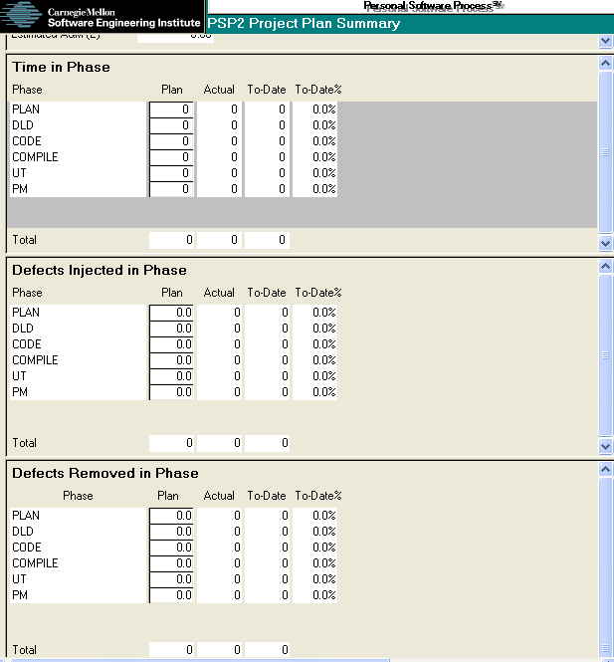
PSP2 Project Plan Summary
Complete your estimates of
Time in phase
Defects injected in phase
Defects removed in phase
Enter these values on the PSP2 project plan summary.
1
2
3

Slide 17
Derived Quality Measures
PSP2 also provides the following derived quality measures.
Defect removal efficiency
Defect removal leverage
Test defects per KLOC
Total defects per KLOC
Yield

Slide 18
Defect Removal Efficiency
Defect removal efficiency is calculated automatically and shows the number of defects removed per hour for
Design review
Code review
Compile
Test

Slide 19
Defect Removal Leverage
Defect removal leverage is calculated automatically and compares removal efficiency for
Design Review vs. Unit Test
Code Review vs. Unit Test
Compile vs. Unit Test

Slide 20
Test Defects Per KLOC
Test defects per KLOC is calculated automatically and is an indicator of the quality of the program that you put into test.

Slide 21
Total Defects Per KLOC
Total defects per KLOC is calculated automatically and is a measure of the total defects injected during the process.

Slide 22
Yield
Yield (actual and to-date) is calculated automatically for the entire process and is the percentage of defects injected and removed before the first compile.

Slide 23
Messages to Remember
You will see more improvement from design and code reviews than any other process change you make.
Quality will improve.
Productivity will increase.
PSP2 provides data that allows you to
plan for specific quality levels
control quality during development
improve the quality of your PSP
increase productivity without sacrificing quality

