Slide 1
Course Overview
Personal Software ProcessSM for Engineers: Part II

Slide 2
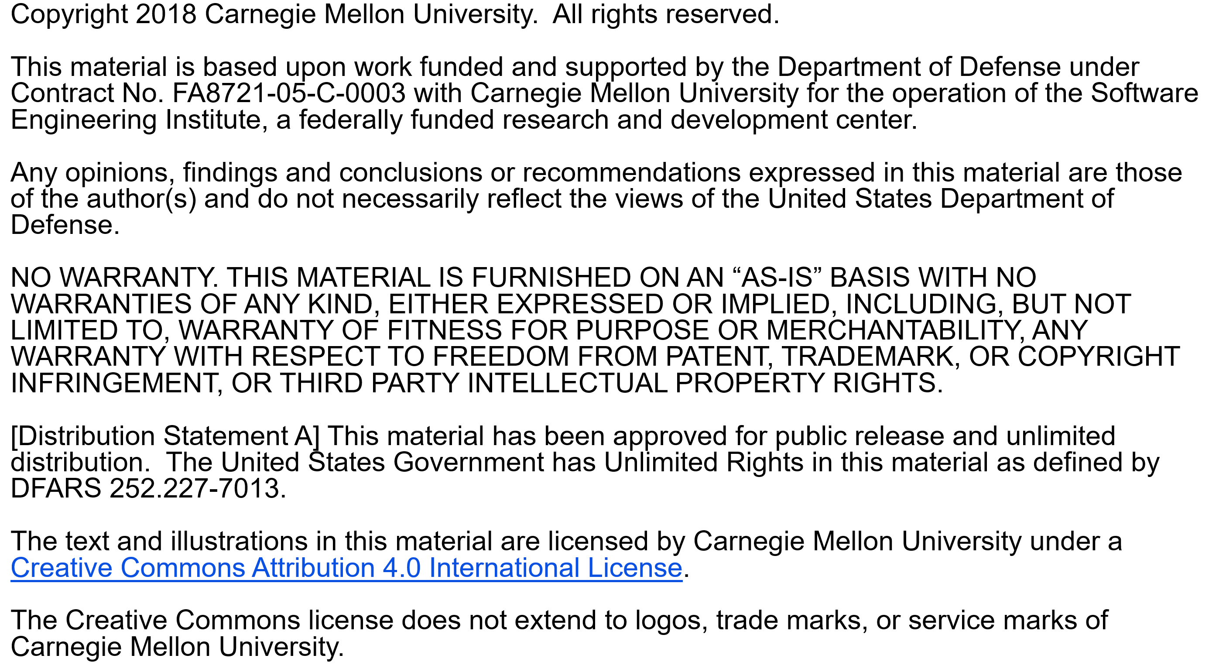

Slide 3
Copyright 2017 Carnegie Mellon University [Distribution Statement A] This material has been approved for public release and unlimited distribution. Please see Copyright notice for non-US Government use and distribution. This material is based upon work funded and supported by the Department of Defense under Contract No. FA8721-05-C-0003 with Carnegie Mellon University for the operation of the Software Engineering Institute, a federally funded research and development center. NO WARRANTY. THIS CARNEGIE MELLON UNIVERSITY AND SOFTWARE ENGINEERING INSTITUTE MATERIAL IS FURNISHED ON AN “AS-IS” BASIS. CARNEGIE MELLON UNIVERSITY MAKES NO WARRANTIES OF ANY KIND, EITHER EXPRESSED OR IMPLIED, AS TO ANY MATTER INCLUDING, BUT NOT LIMITED TO, WARRANTY OF FITNESS FOR PURPOSE OR MERCHANTABILITY, EXCLUSIVITY, OR RESULTS OBTAINED FROM USE OF THE MATERIAL. CARNEGIE MELLON UNIVERSITY DOES NOT MAKE ANY WARRANTY OF ANY KIND WITH RESPECT TO FREEDOM FROM PATENT, TRADEMARK, OR COPYRIGHT INFRINGEMENT. This material is distributed by the Software Engineering Institute (SEI) only to course attendees for their own individual study. Except for the U.S. government purposes described below, this material SHALL NOT be reproduced or used in any other manner without requesting formal permission from the Software Engineering Institute at permission@sei.cmu.edu. The U.S. Government's rights to use, modify, reproduce, release, perform, display, or disclose this material are restricted by the Rights in Technical Data-Noncommercial Items clauses (DFAR 252-227.7013 and DFAR 252-227.7013 Alternate I) contained in the above identified contract. Any reproduction of this material or portions thereof marked with this legend must also reproduce the disclaimers contained on this slide. Although the rights granted by contract do not require course attendance to use this material for U.S. Government purposes, the SEI recommends attendance to ensure proper understanding. PSPSM, Team Software ProcessSM and TSPSM are service marks of Carnegie Mellon University. DM-0004449

Slide 4
Introductions
Instructor introductions
Course logistics and building facilities
Student introductions
name and organization
course expectations
programming language you will use

Slide 5
PSP Course Objectives
This is a software process course. The objectives are to
introduce you to a process-based approach for developing software
show you how to measure and analyze your personal software process (PSP)
show you how to use process data to improve your personal performance
show you how to apply these methods to other structured tasks

Slide 6
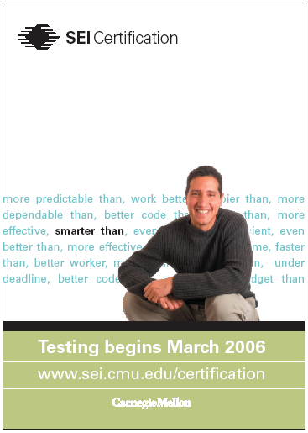
SEI-Certified PSP Developer
SEI-certified professionals will realize an increase in
knowledge and skills
prestige
marketability
professional recognition
compensation
“Rightly or wrongly, companies place a value on certification, and it will up your salary.”
- Information Week, April 2004
Notes:
From the perspective of the individual achieving a certification, there are four interrelated reasons why individuals want to attain a certification:
increase in knowledge or skill
increase in prestige
increase in marketability
increase in compensation.
Obviously, by virtue of going through the educational process and completing the knowledge and/or skill demonstration required by a certification, the individual will have gained in knowledge and/or skill. From an interpersonal standpoint, this designation should translate into higher levels of prestige within the individual’s profession. But, perhaps more importantly from the individual’s perspective, the attainment of a certification and the accompanying acknowledgement of knowledge and/or skills acquired should translate into increased ability to move within the profession either laterally within or between organizations or vertically to higher-level positions.
Finally, with the attainment of a certification and the acknowledgement of knowledge and skills acquired a justification for increases in compensation exists. And, in fact, most organization, recognize that the attainment of the better known and more applicable certifications do translate into increases in compensation.

Slide 7
General Course Information
Prerequisites
know a programming language
complete the pre-reading
Helpful background
familiarity with basic statistics
ability to read simple formal notations
Facilities
available development environment
Microsoft Word, Excel and Access capability

Slide 8
Course Topics
PSP Part I: Planning
Introduction to PSP and TSP
Size measurement
Estimating with PROBE I
Estimating with PROBE II
Using PSP data
PSP Part II: Quality
Software quality
State-machine design and verification
Design
Design verification
Using the TSP

Slide 9
Course Structure
Pre-course reading assignment
Typical course day
lecture: review key topics from textbook
lab
process tutorial
Program or report assignment
lab work
Post-course homework

Slide 10
Student Evaluation
The factors that affect your evaluation are
the quality of the data that you submit
the completeness and consistency of your results
adherence to the proper order and format of assignment submissions
your analysis of your PSP data

Slide 11
Instructor Availability
Instructors will be available
during class hours each day
after class by phone or e-mail

Slide 12
Expectations
Students learn the PSP by
completing the assigned reading
attending the class lectures, tutorials, and workshops
completing the assignments
You should plan to spend two weeks of classroom time and a few additional days outside of class to complete the course.
Each student is expected to make this commitment.

Slide 13
Ground Rules for Class
Be here on time; we will start on time each day.
Attend all sessions; discuss any exceptions with instructors.
Keep this room a “quiet zone” during lab periods; move conversations outside
You must use the PSP techniques and methods on the assignments. Your goal is to learn the process, not just to write programs.
Turn in assignments that are correct, complete, and in the proper order.

Slide 14
Course Agenda - Week 2 Day 6
8:00 | Continental breakfast
8:15 | Class data feedback
8:30 | Course overview L6. Software quality
10:00 | Break
10:30 | Lab session • Using PSP2 tutorial • Program 5 assignment
12:00 | Lunch
1:00 | Lab session (continued)

Slide 15
Course Agenda - Week 2 Day 7
8:00 | Continental breakfast
8:15 | Class data feedback
8:30 | L7. Software Design I Operational specification template exercise Functional specification template exercise State specification template exercise Logic specification template exercise
10:00 | Break
10:30 | Lab session • Using PSP2.1 tutorial • Program 6 assignment
12:00 | Lunch
1:00 | Lab session (continued)

Slide 16
Course Agenda - Week 2 Day 8
8:00 | Continental breakfast
8:15 | Class data feedback
8:30 | L8. Software design II State machine verification exercise
10:00 | Break
10:30 | Lab session • Program 7 assignment
12:00 | Lunch
1:00 | Lab session (continued)

Slide 17
Course Agenda - Week 2 Day 9
8:00 | Continental breakfast
8:15 | Class data feedback
8:30 | L9. Design verification Design verification exercise
10:00 | Break
10:30 | Lab session • Program 8 assignment
12:00 | Lunch
1:00 | Lab session (continued)

Slide 18
Course Agenda - Week 2 Day 10
8:00 | Continental breakfast
8:15 | Class data feedback
8:30 | L10. Using the PSP
10:45 | Break
11:15 | Lab session • Final report assignment
12:00 | Lunch
1:00 | Lab session (continued)
2:00 | Course feedback and evaluation
2:30 | Adjourn

Slide 19
Post-Course Homework
Assignments
Complete unfinished program assignments
Final report

Slide 20
Post-Course Schedule
Assignment | Estimated Effort | Due
Final report | 10-15 hours

