Slide 1
r(t)
+
e(t)
PID
u(t)
Plant
y(t)
-

Slide 2
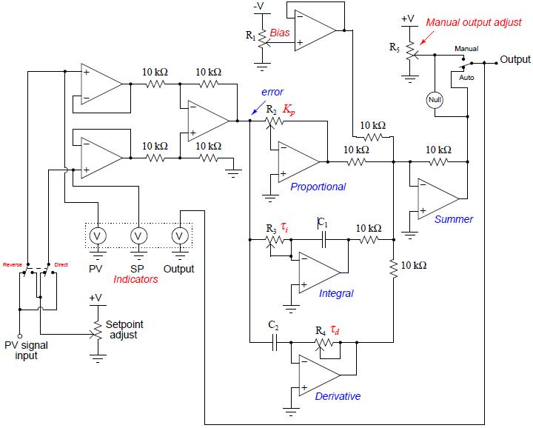
Error
Proportional
Adder
Integral
Derivative

