Slide 1
r
r*
H(s)
e
e*
G(s)
u
u*
T_{s}
T_{s}
T_{s}
R(s)
R*(s)
E(s)
E*(s)
U(s)
U*(s)

Slide 2
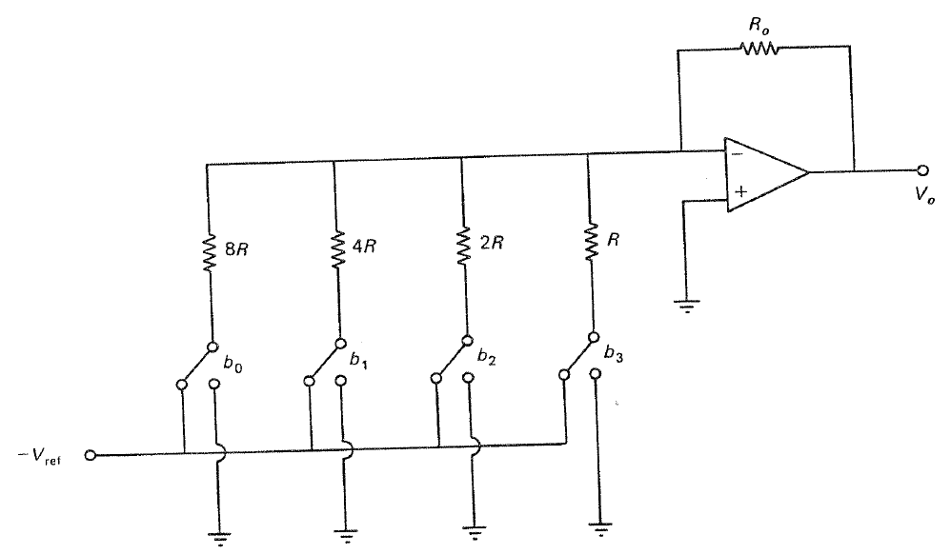

Slide 3
A/D
Digital
controller
Model of
D/A conv.
Plant
R(s)
+
E(s)
E*(s)
D*(s)
M*(s)
1 – e^{-sTs}
s
U(s)
G(s)
Y(s)
-
G_{p}(s)

Slide 4
R(z)
+
D(z)
G_{p}(z)
Y(z)
-

Slide 5
Digital
controller
Model of
D/A conv.
Plant
R(s)
R*(s)
+
E*(s)
D*(s)
M*(s)
1 – e^{-sTs}
s
U(s)
G(s)
Y(s)
-
G_{p}(s)
Y*(s)
Model of
A/D sampling

Slide 6
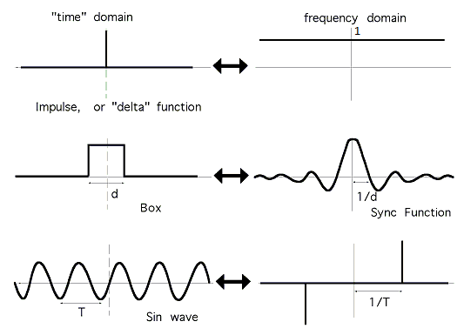
s
s

