Slide 1
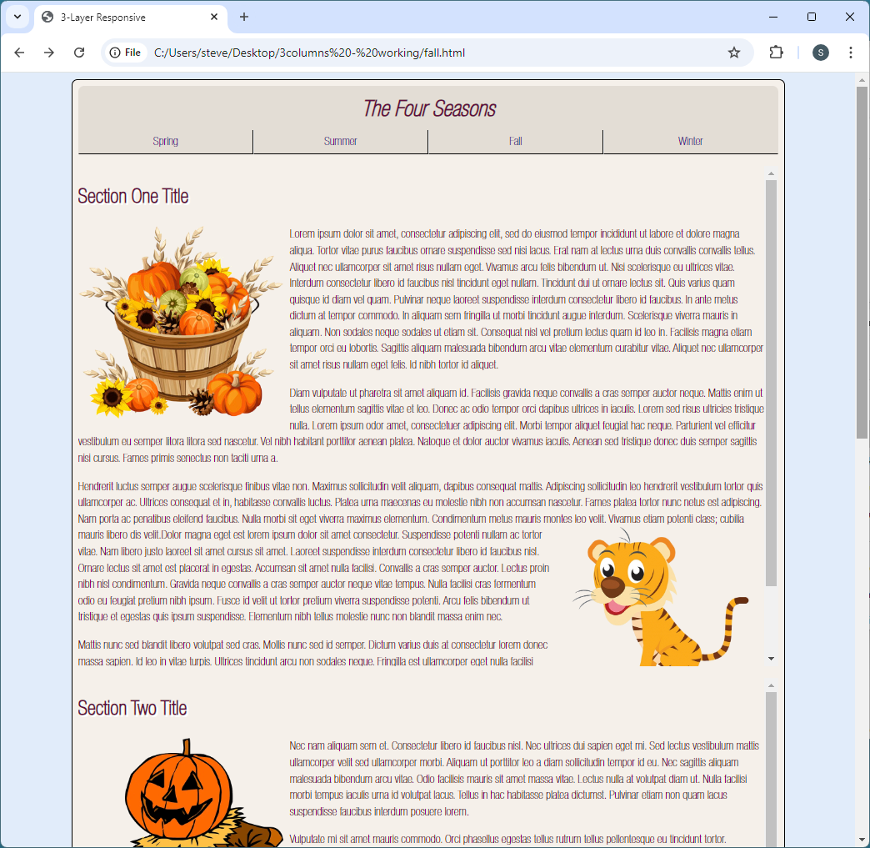

Slide 2
Three-Section RWD With Content:
HD screens are next:
@media screen and (min-width: 90em) {
}
@media screen and (min-width: 135em) {
}

Slide 3
Three-Section RWD With Content:
Changes to <body>, <main>, and <h1>:
@media screen and (min-width: 90em) {
main {
max-width: calc(120em - 1em);
width: calc(100% - 1em);
border: none;
}
header {
height: 3.5em;
}
h1 {
font-size: 2.2em;
}
section {
padding: .5em;
}

Slide 4
Three-Section RWD With Content:
Changes to <section> and <section> with id
#one, #two {
float: left;
width: calc(50% - 1.5em - 2px);
max-width: 60em;
border: 1px solid black;
border-radius: .4em;
}
#one {
margin-right: 1em;
}
#three {
clear: both;
max-width: 120em;
display: block;
width: calc(100% - 1em - 2px);
border: 1px solid black;
border-radius: .4em;
}

Slide 5
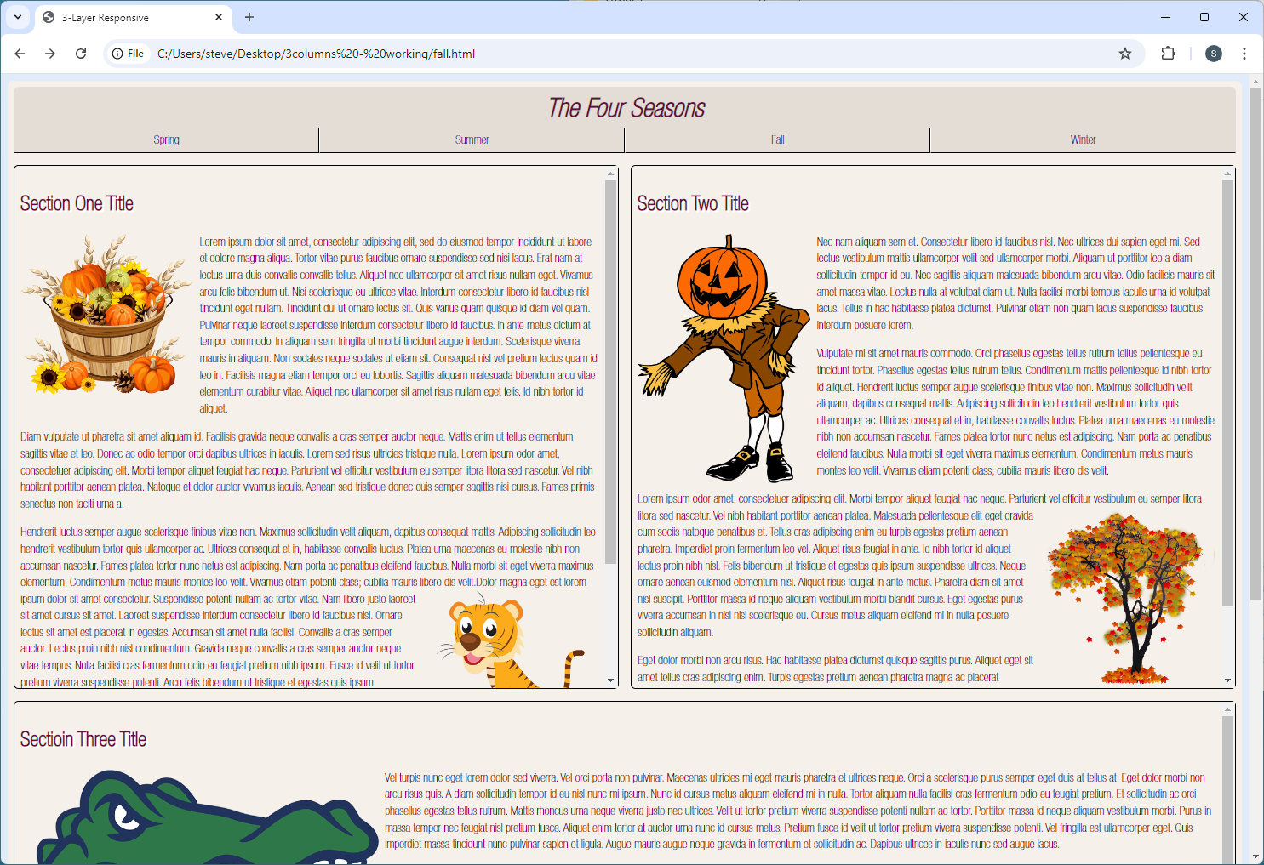
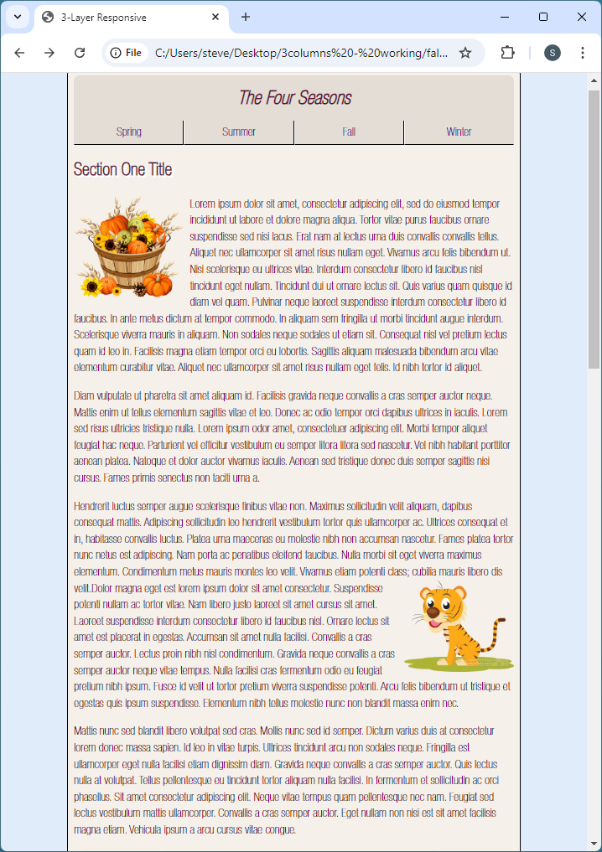

Slide 6
Three-Section RWD With Content:
<h2>:
h2 {
font-size: 1.75em;
font-weight: 700;
}
img {
width: 28%;
height: auto;
}
#three img {
width: 14%;
height: auto;
}
}

Slide 7
