Slide 1
Lab: Empty Box RWD
Mission:
three purple boxes on yellow background
size the window and move the boxes
minimal code to see the RWD
Download and unzip ‘emptyboxes.zip’; open ‘index’ and ‘styles’

Slide 2
<!doctype html>
<html lang="en">
<head>
<meta charset="utf-8">
<title>Untitled Document</title>
<meta name="viewport" content="width=device-width, initial-scale=1.0">
<link href="css/styles.css" rel="stylesheet">
</head>
<body>
<main>
<section id="one">
<p>1</p>
</section>
<section id="two">
<p>2</p>
</section>
<section id="three">
<p>3</p>
</section>
</main>
</body>
</html>
1
2
3

Slide 3
@charset "utf-8";
/* CSS Document */
main {
background: #ffffcc;
margin: 1em auto;
max-width: 96em;
border: 1px solid black;
overflow: auto;
}
p {
font-size: 3em;
color: white;
}
section {
width: 31em;
display: flex;
justify-content: center;
align-items: center;
height: 15em;
background: #8A54AA;
margin: .5em;
}
1
2
3

Slide 4
Lab: Empty Box RWD
What we’re doing:
64
96
32
32
32
.5em 31em . .5em
.5em 31em . .5em
.5em 31em . .5em
1
2
3
3
2
3

Slide 5
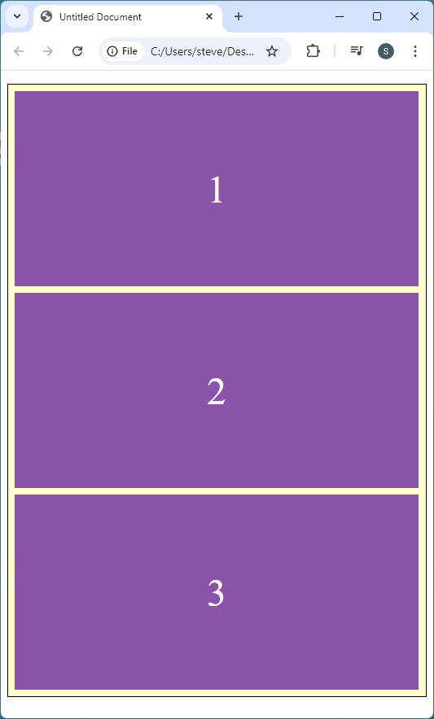
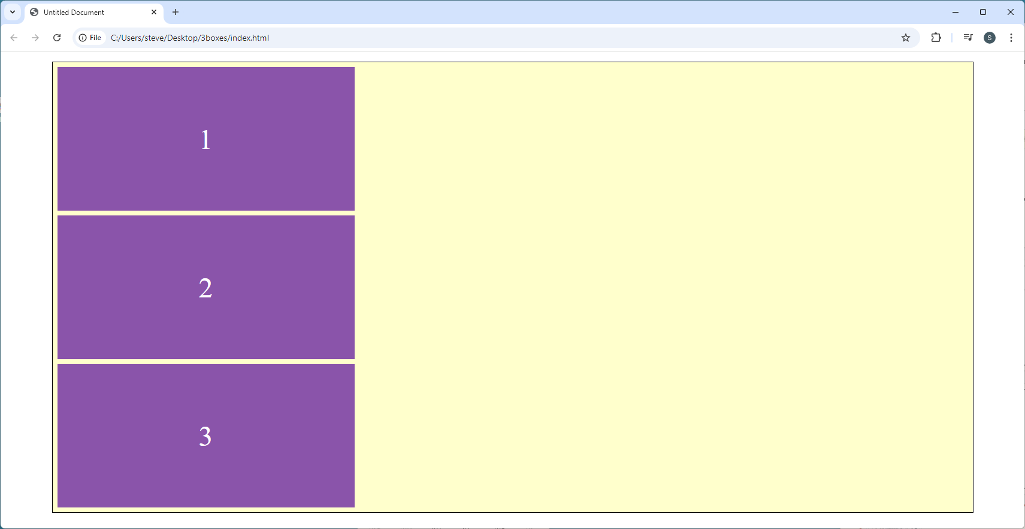
Lab: Empty Box RWD

Slide 6
Lab: Empty Box RWD
Add on to ‘styles.css’
section {
width: 31em;
display: flex;
justify-content: center;
align-items: center;
height: 15em;
background: #8A54AA;
margin: .5em;
}
section {
width: 31em;
display: flex;
justify-content: center;
align-items: center;
height: 15em;
background: #8A54AA;
margin: .5em;
}
@media screen and (min-width: 32em) {
#one {
float: left;
}
}

Slide 7
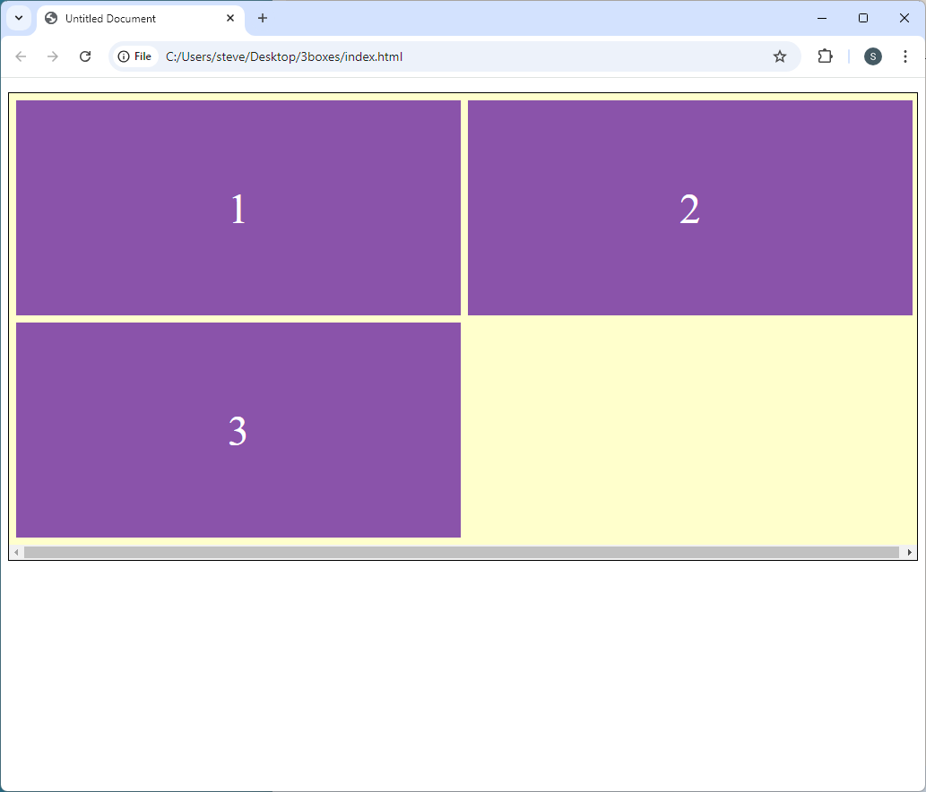
Lab: Empty Box RWD

Slide 8
Lab: Empty Box RWD
Add on to ‘styles.css’
@media screen and (min-width: 32em) {
#one {
float: left;
}
}
@media screen and (min-width: 32em) {
#one {
float: left;
}
}
@media screen and (min-width: 64em) {
#two {
float: left;
}
}

Slide 9
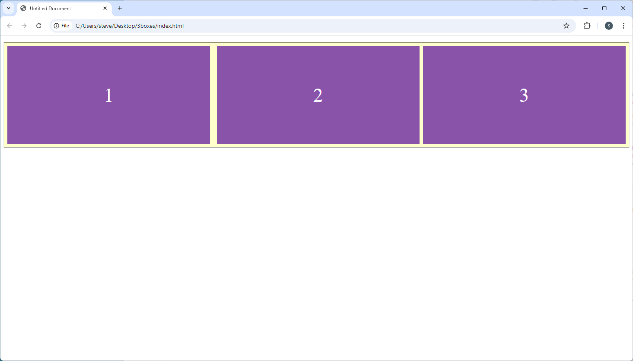
Lab: Empty Box RWD

