Slide 1
Three-Section RWD With Content:
Ultrawide monitor screens are last:
@media screen and (min-width: 135em) {
}

Slide 2
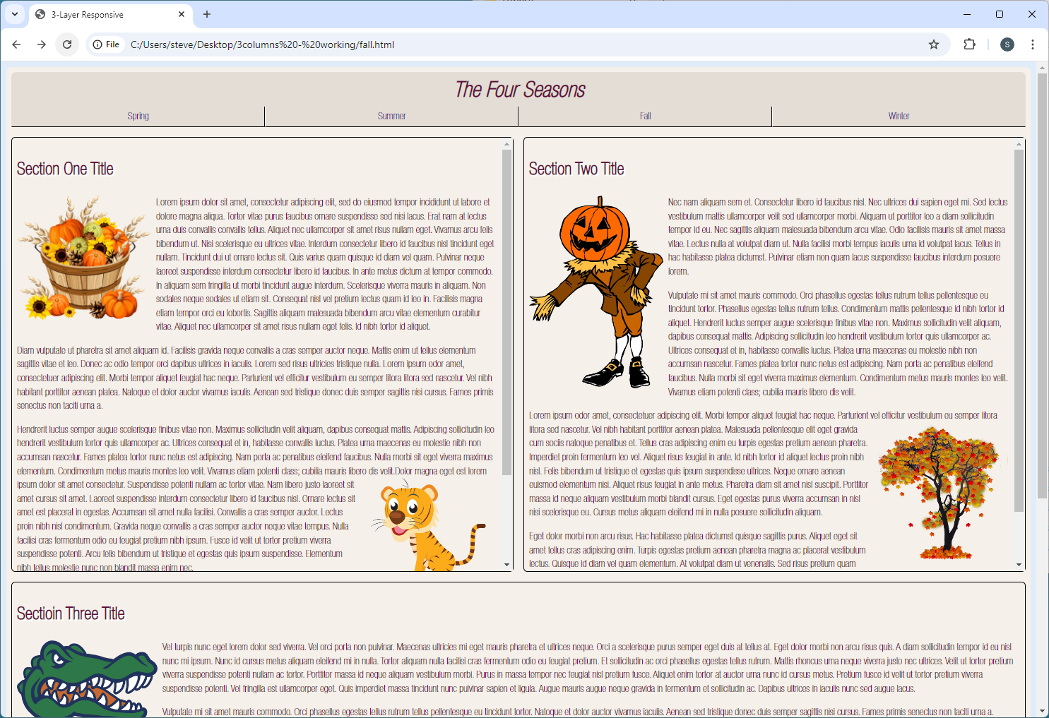

Slide 3
Three-Section RWD With Content:
Ultrawide monitor screens are last:
@media screen and (min-width: 135em) {
main {
max-width: 243em;
overflow: auto;
}
#one, #two, #three {
width: calc(33.33% - 1.7em - 2px);
max-width: 80em;
}
#two {
margin-right: 1em;
}

Slide 4
Three-Section RWD With Content:
Changes to <section> and <h2>:
#three {
clear: none;
}
#three img, img {
width: 25%;
height: auto;
}
section {
height: auto;
}
}

Slide 5
