Slide 1
Three-Section RWD With Content:
Laptops are next
@charset "utf-8";
/* CSS Document */
/* done */
@media screen and (min-width: 37.52em) {
}
@media screen and (min-width: 90em) {
}
@media screen and (min-width: 135em) {
}

Slide 2
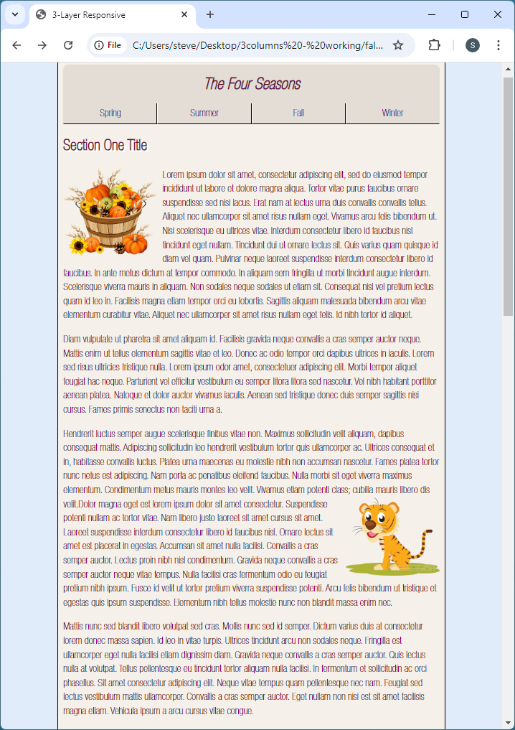

Slide 3
Three-Section RWD With Content:
Changes to <body> and <main>?
@media screen and (min-width: 37.5em) {
main {
max-width: 60em;
}
header {
height: 3.75em;
}
h1 {
font-size: 1.9em;
}

Slide 4
Three-Section RWD With Content:
Changes to <section>, <h2>, and <img>?
section {
display: block;
margin: 0 auto 1em;
max-width: 60em;
height: 600px;
overflow-y: auto;
}
h2 {
font-size: 1.7em;
font-weight: 700;
}
img {
width: 30%;
height: auto;
}
}

Slide 5
