Slide 1
Lab: Multiple Classes
Download, ‘multi.html’ and open in text editor, browser
Add these style rules to the page
<style>
.arial {
font-family: Arial;
background: #dddddd;
}
.oblique {
font-style: oblique;
}
.comic {
font-family: "comic sans ms";
color: #ffffcc;
}
</style>

Slide 2
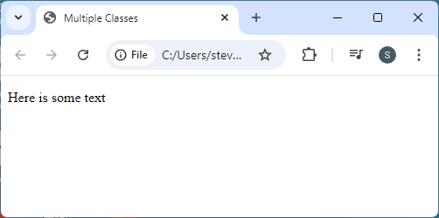
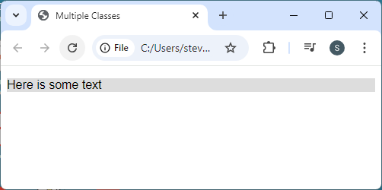

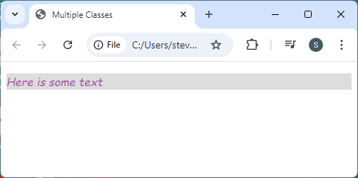
Lab: Multiple Classes
Multiple class calls create a cascade of classes
Specificity is same for all multiple class styles
<style>
.arial {
font-family: Arial;
background: #dddddd;
}
.oblique {
font-style: oblique;
}
.comic {
font-family: "comic sans ms";
color: #aa55aa;
}
</style>
<p class="arial">
<p class="arial oblique">
<p class="arial oblique comic">

