Slide 1

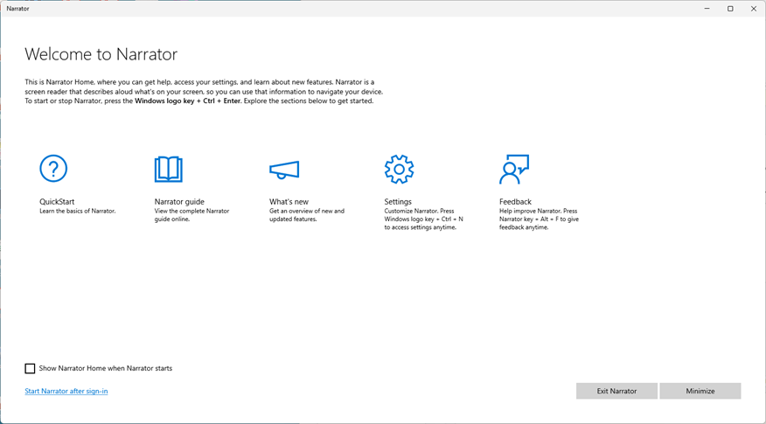
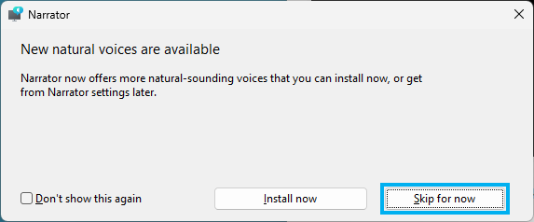
Windows Screen Reader (Narrator):
Narrator built into Windows 10/11 ( + ctrl + enter)
1

