Slide 1
Lab: Size
Download ‘size.zip’
Open ‘index.html’ in text editor
Add the code below to ‘index’ and save page
<head lang="en">
<meta charset="utf-8">
<title>Size</title>
</head
<head lang="en">
<meta charset="utf-8">
<title>Size</title>
<style>
</style>
</head>

Slide 2
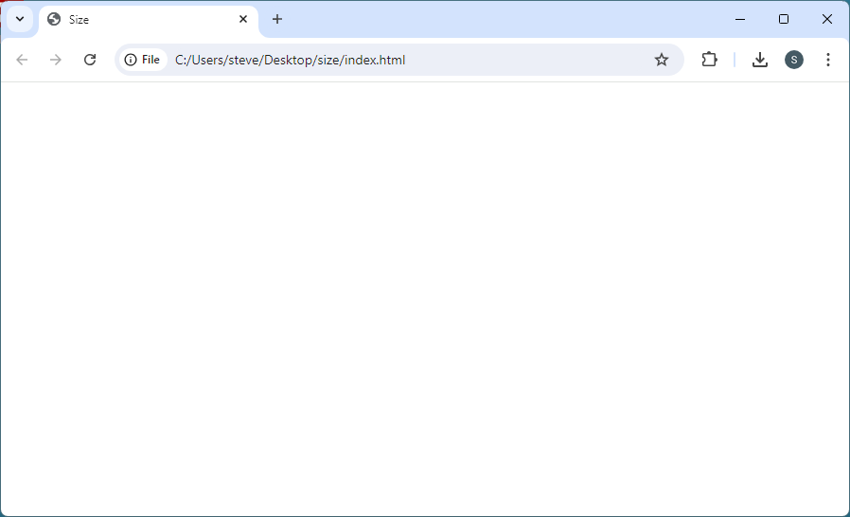
Lab: Size
Open ‘index’ in your browser; looks like a web page

Slide 3
Lab: Size
Add these embedded styles to ‘index’; Save your page
<style>
body {
background: red;
}
main {
background: yellow;
}
#one {
background: cyan;
}
#two {
background: magenta;
}
</style>
@charset "utf-8";
/* CSS Document */
<style>
</style>

Slide 4
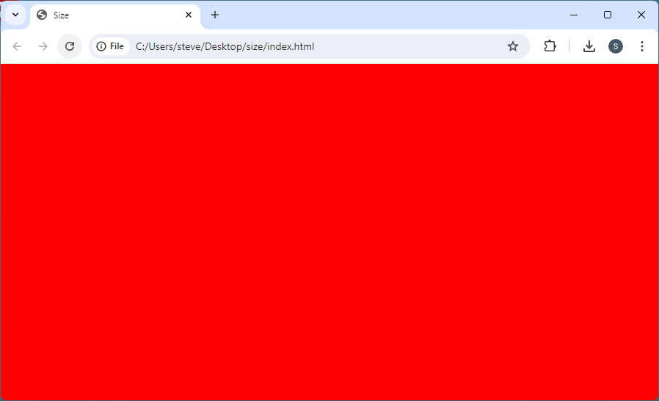
Lab: Size
Open ‘index’ in your browser; no color here.
Why?
<style>
body {
background: red;
}
main {
background: yellow;
}
#one {
background: cyan;
}
#two {
background: magenta;
}
</style>

Slide 5
Lab: Size
Default: body background fills browser window edge-to-edge
Add a border to each layer:
<style>
body {
background: red;
border: 1px solid black;
}
main {
background: yellow;
border: 1px solid black;
}
#one {
background: cyan;
border: 1px solid black;
}
#two {
background: magenta;
border: 1px solid black;
}
</style>
<style>
body {
background: red;
border: 1px solid black;
}
main {
background: yellow;
border: 1px solid black;
}
#one {
background: cyan;
border: 1px solid black;
}
#two {
background: magenta;
border: 1px solid black;
}
</style>

Slide 6
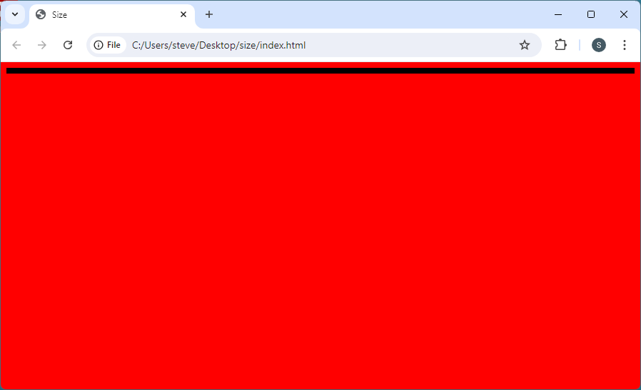
Lab: Size
8px worth of borders, but no ‘page’

Slide 7
Lab: Size
Add <p> to #one
@charset "utf-8";
/* CSS Document */
<section id="one">
</section>
<section id="one">
<p>Section one</p>
</section>

Slide 8
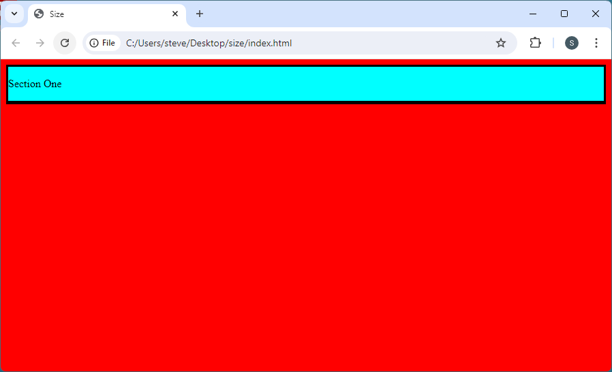
Lab: Size
8px worth of borders, but no ‘page’ Height: 3em;

Slide 9
Lab: Size
8px worth of borders, but no ‘page’
8px for margin on <body>
1px for body border
1px for main border
1px for #one border
1em margin ↑ for <p>
1em for text
1em for margin ↓ for <p>
2px for #two border (top, bottom)
1px for main border
1px for body border

Slide 10
Lab: Size
Where is <main> (color is yellow)? Where is #two (magenta)?
Covered by #one
empty

