Slide 1
Lab: Minmax
Download ‘minmax.zip’
Open ‘index.html’ and ‘styles.css’ in text editor
Add the code below to ‘index’
<head>
<meta charset="utf-8">
<title>Minmax</title>
</head
<head>
<meta charset="utf-8">
<title>Minmax</title>
<link href="css/styles.css" rel="stylesheet">
</head>

Slide 2
Lab: Minmax
Add these containers in the HTML and save page:
<body>
<main>
<section id="one">
</section>
<section id="two">
</section>
</main>
</body>
@charset "utf-8";
/* CSS Document */
<body>
</body>

Slide 3
Lab: Minmax
Create width for <main> at 100% between 50em and 75em:
/*Stylesheet for minmax*/
/*Stylesheet for minmax*/
main {
min-width: 50em;
max-width: 75em;
width: calc(100% - 1em);
background: #9eb99f;
padding: .5em;
overflow: auto; //forces parent to size in section
margin: 0 auto; //centers main in body
}

Slide 4
Lab: Minmax
Create style rule for the <section>:
/*Stylesheet for minmax*/
main {
min-width: 50em;
max-width: 75em;
width: 100%;
background: #9eb99f;
padding: .5em;
overflow: auto; //forces parent to size in section
margin: 0 auto;
}
main {
min-width: 50em;
max-width: 75em;
width: 100%;
background: #9eb99f;
padding: .5em;
overflow: auto;
margin: 0 auto;
}
section {
width: calc(50% - .5em);
height: 20em;
background: #d6d0ba;
float: left;
}
#two {
margin-left: 1em;
}

Slide 5
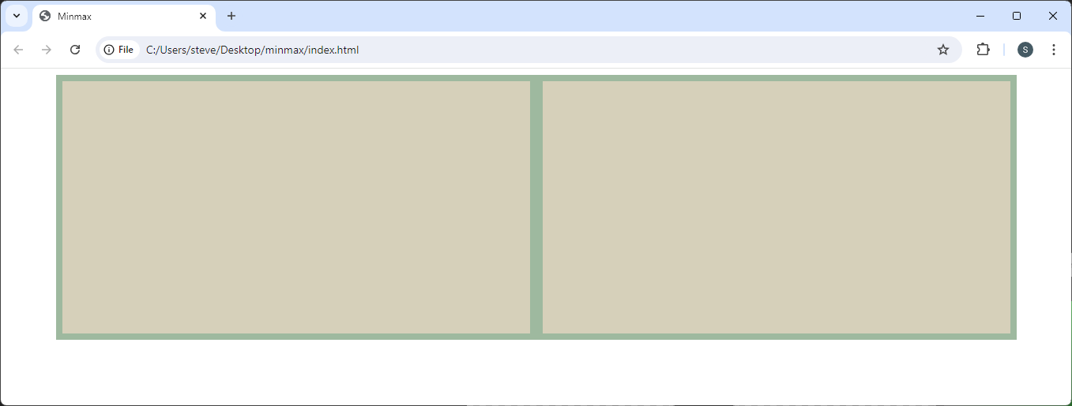
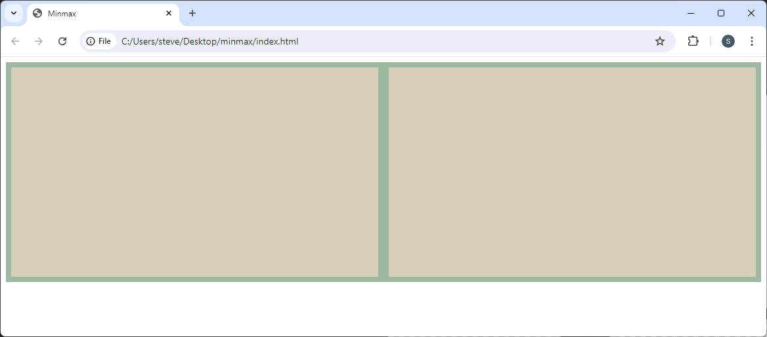
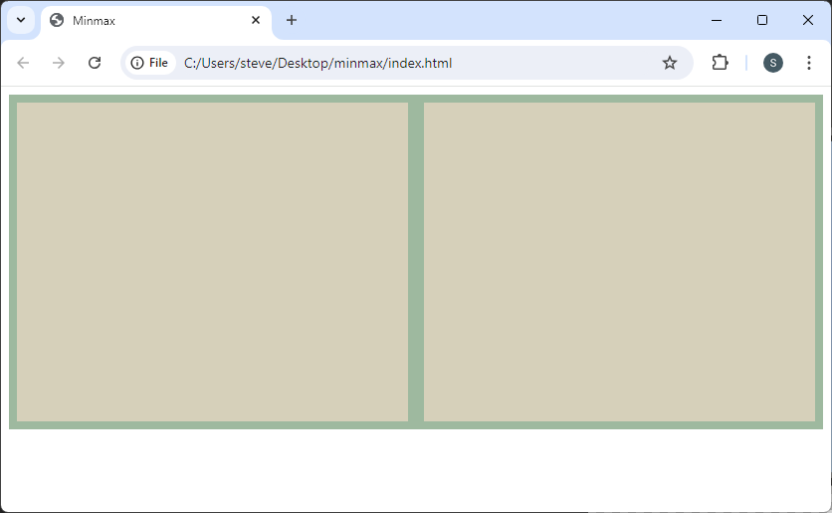
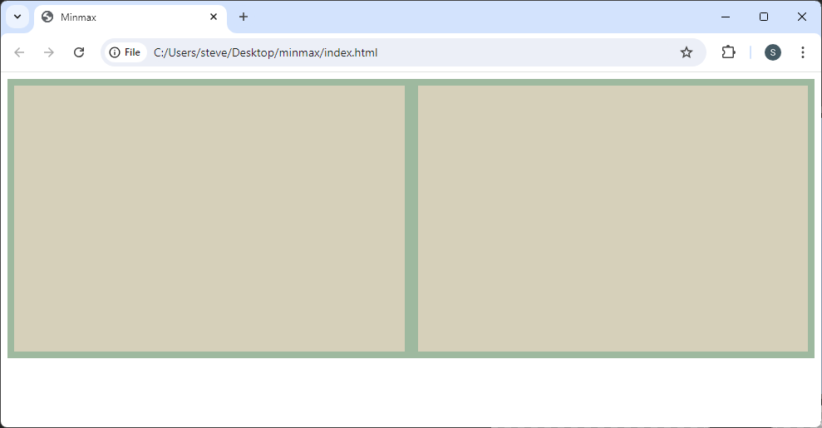
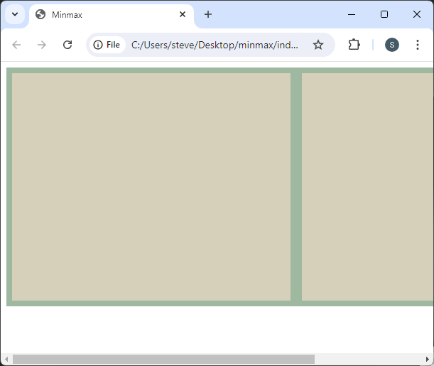
Lab: Minmax
Page as it expands:

Slide 6
Lab: Minmax
Calculations:
main {
padding: .5em;
margin: 0 auto;
}
section {
width: calc(50% - .5em);
}
#two {
margin-left: 1em;
}
.5em
1em
.5em

Slide 7
Lab: Minmax
Add borders on the <section>?
section {
width: calc(50% - .5em);
height: 20em;
background: #d6d0ba;
float: left;
}
section {
width: calc(50% - .5em – 2px);
height: 20em;
background: #d6d0ba;
float: left;
border: 1px solid black;
}

Slide 8
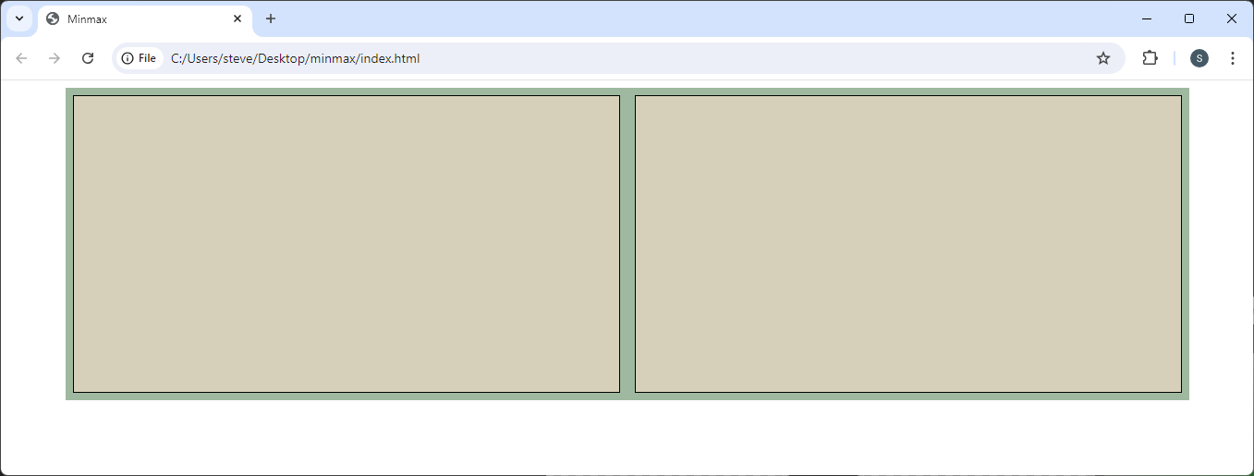
Lab: Minmax
Borders must be accounted for; outside the container

