Slide 1
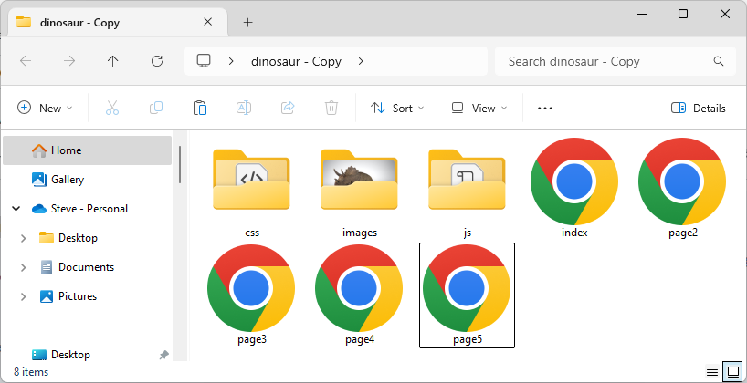
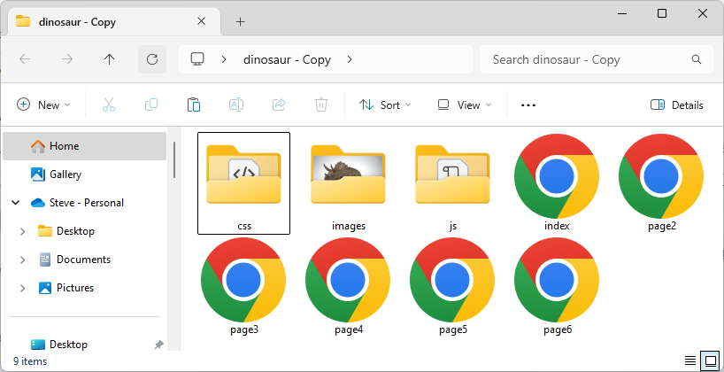
Dinosaur: Use <div>, not <ul>
Continue with the ‘dinosaur’ folder
Copy ‘index’ and rename it ‘page6.html’ (a repeated ‘index’)
Styling will be embedded
1

Slide 2
Dinosaur: Use <div>, not <ul>
Remove the <ul>
<nav>
<ul>
<li>Home</li>
<li><a href="page2.html">Triceratops</a></li>
<li><a href="page3.html">Stegosaurus</a></li>
<li><a href="page4.html">Archaeopteryx</a></li>
<li><a href="page5.html">Brontosaurus</a></li>
</ul>
</nav>
<nav>
</nav>
@charset "utf-8";
/* CSS Document */
2

Slide 3
Dinosaur: Use <div>, not <ul>
Add the links and <div> for the 5 pages
<nav>
</nav>
<nav>
<a href="index.html"><div id="first">Home</div></a>
<a href="page1.html"><div>Triceratops</div></a>
<a href="page2.html"><div>Stegosaurus</div></a>
<a href="page3.html"><div>Archaeopteryx</div></a>
<a href="page4.html"><div id="last">Brontosaurus</div></a>
</nav>
3

Slide 4

Dinosaur: Use <div>, not <ul>
Add the styling for the <div>
<style>
div {
font-family: "Ga Maamli", sans-serif;
width: calc(20% - 2px);
background: #d7d1bc;
height: 1.4em;
float: left;
text-align: center;
padding-top: .4em;
cursor: pointer;
border-left: 1px solid white;
border-right: 1px solid black;
border-bottom: 10px solid #d7d1bc;
}
4

Slide 5
Dinosaur: Use <div>, not <ul>
Set ‘edge’ borders to brown:
<style>
}
#first {
border-left: 1px solid #d7d1bc;
}
#last {
border-right: 1px solid #d7d1bc;
}
5

Slide 6
Dinosaur: Use <div>, not <ul>
Change the border-bottom on hover:
<style>
}
div:hover {
border-bottom: 10px solid #c2bdaa;
}
</style>
6

Slide 7
Dinosaur: Use <div>, not <ul>
To work, all <div> must have the same border
not hover: same width with standard background color
hover: change background color
7

Slide 8
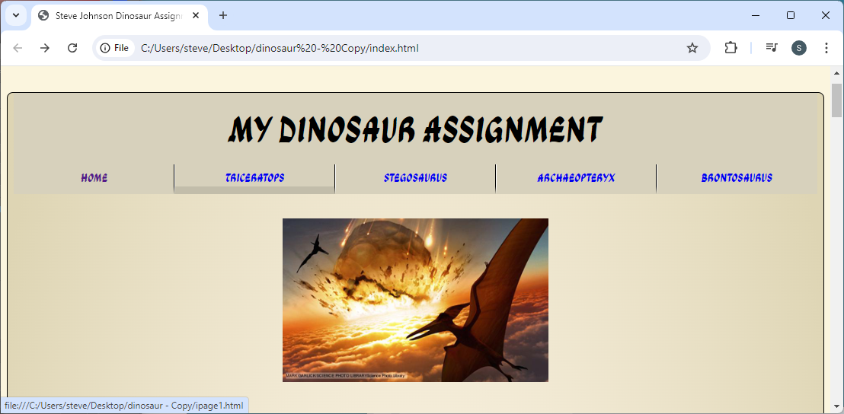
Dinosaur: Use <div>, not <ul>
Finished appearance:
8

