Slide 1
Lab: List-Based Navigation
Download, unzip ‘listnav.zip’
Open ‘index.html’ in text editor; and in browser
Link the stylesheet
<!DOCTYPE html>
<html lang="en">
<head>
<meta charset="utf-8">
<title>List Navigation</title>
<meta name="viewport" content="width=device-width, initial-scale=1">
</head>
<!DOCTYPE html>
<html lang="en">
<head>
<meta charset="utf-8">
<title>List Navigation</title>
<meta name="viewport" content="width=device-width, initial-scale=1">
<link href="css/styles.css" rel="stylesheet">
</head>

Slide 2
Lab: List-Based Navigation
Create the <header>, <nav> and <list>
<body>
</body>
<body>
<header>
<h1>List Navigation</h1>
</header>
<nav>
<ul>
<li>Home</li>
<li>North</li>
<li>South</li>
<li>East</li>
<li>West</li>
</ul>
</nav>
</body>

Slide 3
Lab: List-Based Navigation
Add the links to the list items
Save this page; done here
<body>
<header>
<h1>List Navigation</h1>
<header>
<nav>
<ul>
<li>Home</li>
<li>North</li>
<li>South</li>
<li>East</li>
<li>West</li>
</ul>
</nav>
</body>
<body>
<header>
<h1>List Navigation</h1>
</header>
<nav>
<ul>
<li><a href="index.html">Home</a></li>
<li><a href="north.html">North</a></li>
<li><a href="south.html">South</a></li>
<li><a href="east.html">East</a></li>
<li><a href="west.html">West</a></li>
</ul>
</nav>
</body>

Slide 4
Lab: List-Based Navigation
Add in these style rules to CSS:
@charset 'utf-8'
/* CSS Document */
@charset 'utf-8'
/* CSS Document */
header {
display: flex;
justify-content: center;
background: #f8f4ed;
border-top: 1px solid black;
border-right: 1px solid black;
border-left: 1px solid black;
}

Slide 5
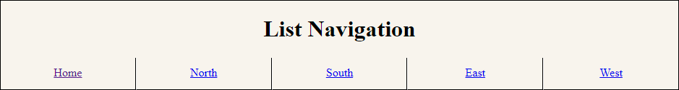
Lab: List-Based Navigation
ul {
padding: 0px;
margin: 0;
}
li {
list-style-type: none;
padding: 12px 0 0 0;
margin: 0;
float: left;
width: calc(20% - 2px);
height: 2em;
text-align: center;
border-left: 1px solid white;
border-right: 1px solid black;
border-bottom: 1px solid black;
background: #f8f4ed;
cursor: pointer;
}

Slide 6
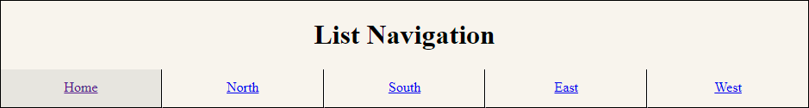
Lab: List-Based Navigation
Clean up the list items; page is complete:
li a {
display: block;
width: 100%;
height: 100%;
}
li:hover {
background: #e8e5df;
}
li:first-child {
border-left: 1px solid black;
}

Slide 7
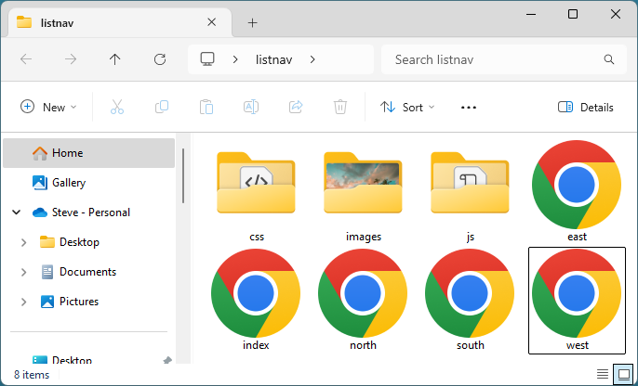
Lab: List-Based Navigation
Save both pages and view in browser
Make 4 copies of ‘index’ (5 total pages)
Name the pages:
north
south
east
west

Slide 8
Lab: List-Based Navigation
On ‘index’ (currently open) fix the link:
2 choices:
<ul>
<li><a href="index.html">Home</a></li>
<li>Home</li>
<li><a href="#">Home</a></li>
<li><a href="north.html">North</a></li>
<li><a href="south.html">South</a></li>
<li><a href="east.html">East</a></li>
<li><a href="west.html">West</a></li>
</ul>

Slide 9
Lab: List-Based Navigation
Open ‘north’ and fix the link:
<ul>
<li><a href="index.html">Home</a></li>
<li><a href="#">North</a></li>
<li><a href="south.html">South</a></li>
<li><a href="east.html">East</a></li>
<li><a href="west.html">West</a></li>
</ul>
<ul>
<li><a href="index.html">Home</a></li>
<li><a href="north.html">North</a></li>
<li><a href="south.html">South</a></li>
<li><a href="east.html">East</a></li>
<li><a href="west.html">West</a></li>
</ul>

Slide 10
Lab: List-Based Navigation
Open ‘south’ and fix the link:
<ul>
<li><a href="index.html">Home</a></li>
<li><a href="north.html">North</a></li>
<li><a href="south.html">South</a></li>
<li><a href="east.html">East</a></li>
<li><a href="west.html">West</a></li>
</ul>
<ul>
<li><a href="index.html">Home</a></li>
<li><a href="north.html">North</a></li>
<li>South</li>
<li><a href="east.html">East</a></li>
<li><a href="west.html">West</a></li>
</ul>

Slide 11
Lab: List-Based Navigation
Open ‘east’ and fix the link:
<ul>
<li><a href="index.html">Home</a></li>
<li><a href="north.html">North</a></li>
<li><a href="south.html">South</a></li>
<li>East</li>
<li><a href="west.html">West</a></li>
</ul>
<ul>
<li><a href="index.html">Home</a></li>
<li><a href="north.html">North</a></li>
<li><a href="south.html">South</a></li>
<li><a href="east.html">East</a></li>
<li><a href="west.html">West</a></li>
</ul>

Slide 12
Lab: List-Based Navigation
Open ‘west’ and fix the link:
<ul>
<li><a href="index.html">Home</a></li>
<li><a href="north.html">North</a></li>
<li><a href="south.html">South</a></li>
<li><a href="east.html">East</a></li>
<li>West</li>
</ul>
<ul>
<li><a href="index.html">Home</a></li>
<li><a href="north.html">North</a></li>
<li><a href="south.html">South</a></li>
<li><a href="east.html">East</a></li>
<li><a href="west.html">West</a></li>
</ul>

Slide 13
Lab: List-Based Navigation
Test the site:
open ‘east’ and look at link for ‘east’ (no link)
open ‘north’ and look at like for ‘north’ (looks like a link)
Which is better?

Slide 14
Lab: List-Based Navigation
Fix the li:hover to work only on links; save the page
li a {
display: block;
width: 100%;
height: 100%;
}
li:hover {
background: #e8e5df;
}
li:first-child {
border-left: 1px solid black;
}
li a:hover {
display: block;
width: 100%;
height: 100%;
}
li a:hover {
background: #e8e5df;
padding-top: 12px;
margin-top: -12px;
}
li:first-child {
border-left: 1px solid black;
}

Slide 15
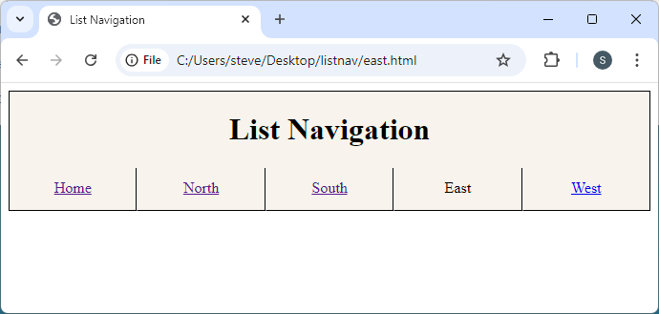
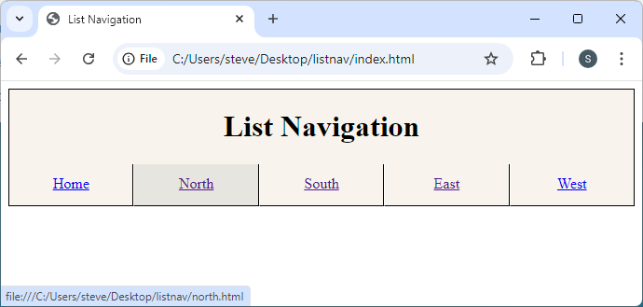
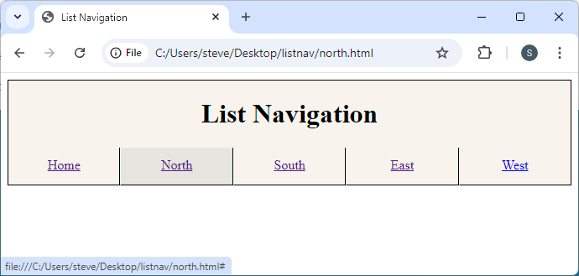
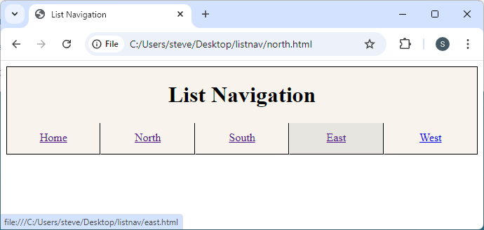
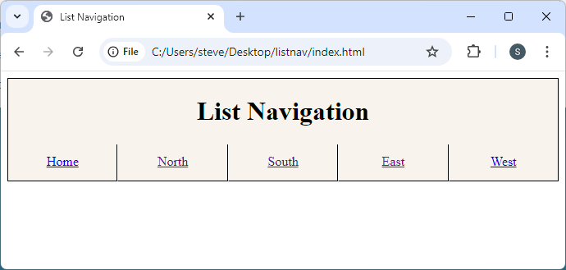
Lab: List-Based Navigation
Fix the li:hover to work only on links

