Slide 1
Lab: Advanced Selectors
Download ‘advselectors.html’; open in text editor
<!doctype html>
<html>
<head>
<title>My Title</title>
<style>
section {
width: 150px;
height: 70px;
background: red;
margin: 1em auto;
}
</style>
</head>
<body>
<p>Paragraph 1</p>
<p>Paragraph 2</p>
<p>Paragraph 3</p>
<p>Paragraph 4</p>
<div class="dark">
<p class="text">Paragraph 5</p>
<p class="text">Paragraph 6</p>
<p class="text">Paragraph 7</p>
<p class="text">Paragraph 8</p>
<p class="text">Paragraph 9</p>
</div>
<p>After div</p>
<section id="boxone"></section>
<section id="boxtwo"></section>
<a href="#"><p>This is a link that goes to the top of this page</p></a>
<a href="#"><p>This is a link that goes to the top of this page</p></a>
<a href="#"><p>This is a link that goes to the top of this page</p></a>
</body>
</html>
1

Slide 2
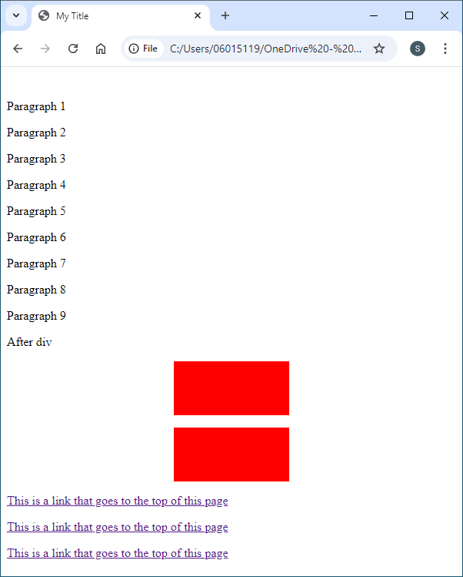
Lab: Advanced Selectors
2

Slide 3
Lab: Advanced Selectors
Write embedded advanced selectors in <style>
Change <div> with class ‘dark’; dark background and white text
<style>
section {
width: 150px;
height: 70px;
background: red;
margin: 1em auto;
}
</style>
<style>
section {
width: 150px;
height: 70px;
background: red;
margin: 1em auto;
}
div.dark {
background: #999;
color: #fff;
}
</style>
3

Slide 4
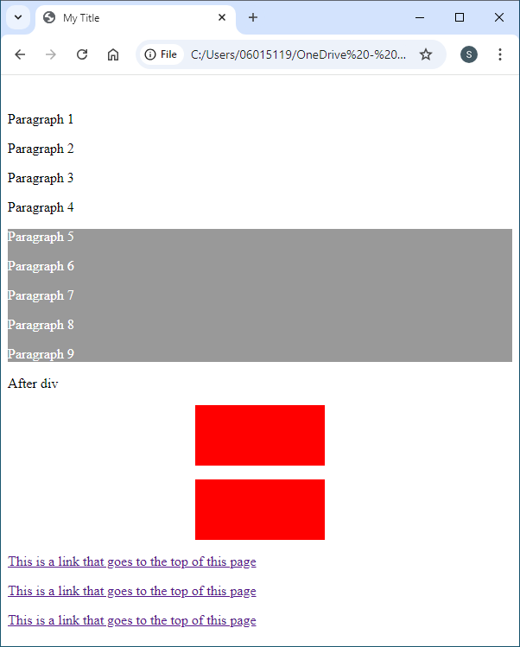
Lab: Advanced Selectors
div.dark {
background: #999;
color: #fff;
}
<p>Paragraph 1</p>
<p>Paragraph 2</p>
<p class="text">Paragraph 3</p>
<p class="text">Paragraph 4</p>
<div class="dark">
<p class="text">Paragraph 5</p>
<p class="text">Paragraph 6</p>
<p class="text">Paragraph 7</p>
<p>Paragraph 8</p>
<p>Paragraph 9</p>
</div>
<p>After div</p>
4

Slide 5
Lab: Advanced Selectors
Change <p> in <div> w/ class ‘text’: yellow background blue text
<style>
section {
width: 150px;
height: 70px;
background: red;
margin: 1em auto;
}
div.dark {
background: #999;
color: #fff;
}
</style>
<style>
div.dark {
background: #999;
color: #fff;
}
div .text {
background: #ff0;
color: #00f;
}
</style>
5

Slide 6
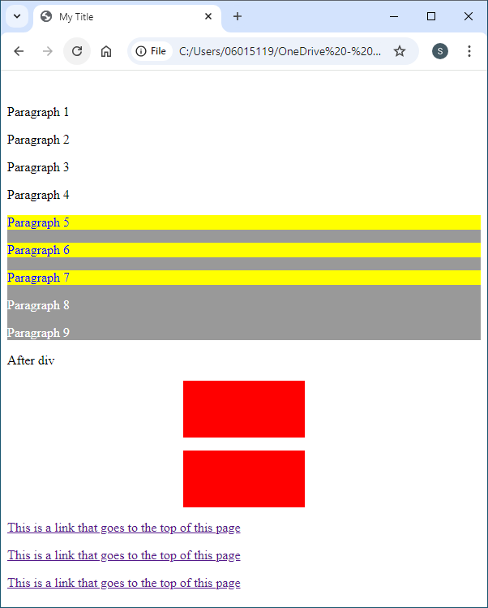
Lab: Advanced Selectors
div .text {
background: #ff0;
color: #00f;
}
<p>Paragraph 1</p>
<p>Paragraph 2</p>
<p class="text">Paragraph 3</p>
<p class="text">Paragraph 4</p>
<div class="dark">
<p class="text">Paragraph 5</p>
<p class="text">Paragraph 6</p>
<p class="text">Paragraph 7</p>
<p>Paragraph 8</p>
<p>Paragraph 9</p>
</div>
<p>After div</p>
6

Slide 7
Lab: Advanced Selectors
Remove first two style rules; more specific
Change all para in div to have red background and light blue text
<style>
section {
width: 150px;
height: 70px;
background: red;
margin: 1em auto;
}
div>p {
background: red;
color: #bbbbff;
}
</style>
<style>
div.dark {
background: #999;
color: #fff;
}
div .text {
background: #ff0;
color: #00f;
}
</style>
<style>
section {
width: 150px;
height: 70px;
background: red;
margin: 1em auto;
}
</style>
7

Slide 8
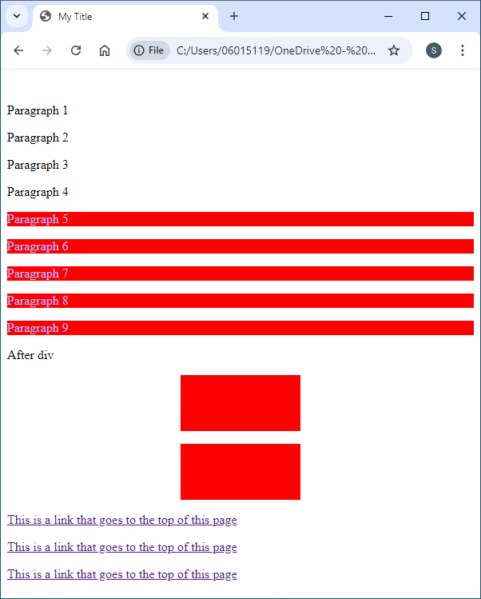
Lab: Advanced Selectors
div>p {
background: red;
color: #bbf;
}
<p>Paragraph 1</p>
<p>Paragraph 2</p>
<p class="text">Paragraph 3</p>
<p class="text">Paragraph 4</p>
<div class="dark">
<p class="text">Paragraph 5</p>
<p class="text">Paragraph 6</p>
<p class="text">Paragraph 7</p>
<p>Paragraph 8</p>
<p>Paragraph 9</p>
</div>
<p>After div</p>
8

Slide 9
Lab: Advanced Selectors
Change para after </div> to green background with yellow text
<style>
section {
width: 150px;
height: 70px;
background: red;
margin: 1em auto;
}
div>p {
background: red;
color: #bbbbff;
}
</style>
<style>
div>p {
background: red;
color: #bbbbff;
}
div+p {
background: green;
color: yellow;
}
</style>
9

Slide 10
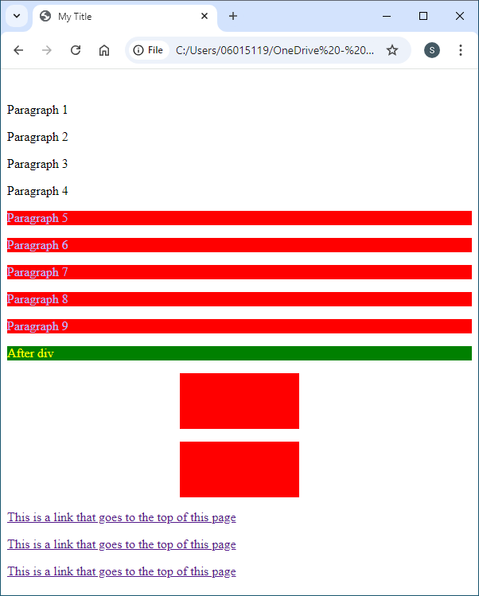
Lab: Advanced Selectors
Div+p {
background: green;
color: yellow;
}
<p>Paragraph 1</p>
<p>Paragraph 2</p>
<p class="text">Paragraph 3</p>
<p class="text">Paragraph 4</p>
<div class="dark">
<p class="text">Paragraph 5</p>
<p class="text">Paragraph 6</p>
<p class="text">Paragraph 7</p>
<p>Paragraph 8</p>
<p>Paragraph 9</p>
</div>
<p>After div</p>
10

Slide 11
Lab: Advanced Selectors
Change the normal link to bold and magenta
<style>
div+p {
background: green;
color: yellow;
}
</style>
<style>
div+p {
background: green;
color: yellow;
}
a:link {
color: magenta;
font-weight: 700;
}
</style>
11

Slide 12
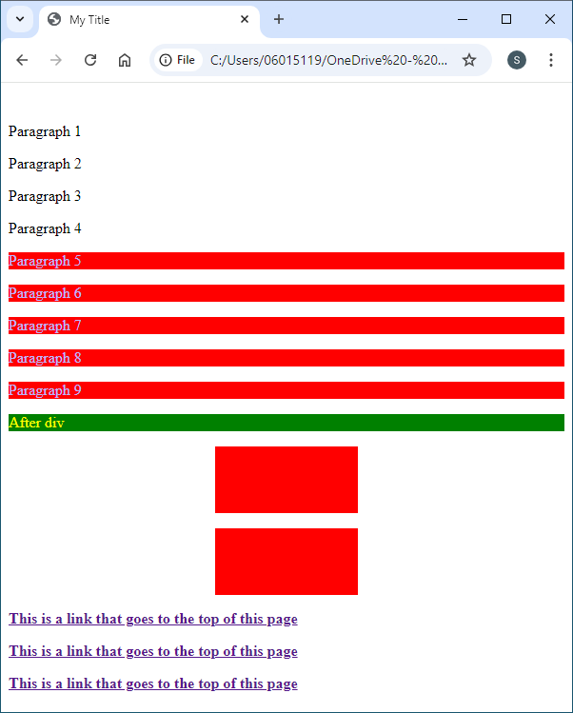
Lab: Advanced Selectors
12

Slide 13
Lab: Advanced Selectors
Change the visited link to bold and cyan
<style>
a:link {
color: magenta;
font-weight: 700;
}
a:visited {
color: cyan;
font-weight: 700;
}
</style>
<style>
a:link {
color: magenta;
font-weight: 700;
}
</style>
13

Slide 14
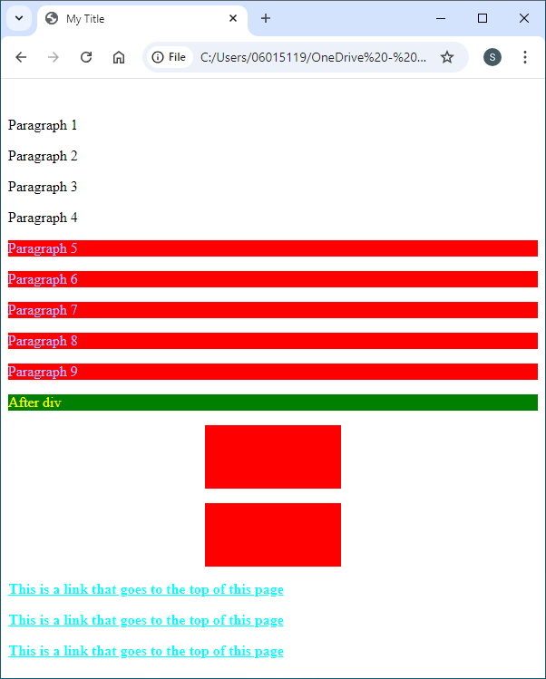
Lab: Advanced Selectors
14

Slide 15
Lab: Advanced Selectors
Change the hover link to bold and orange
<style>
a:link {
color: magenta;
font-weight: 700;
}
a:visited {
color: cyan;
font-weight: 700;
}
a:hover {
color: orange;
font-weight: 700;
}
</style>
<style>
a:link {
color: magenta;
font-weight: 700;
}
a:visited {
color: cyan;
font-weight: 700;
}
</style>
15

Slide 16
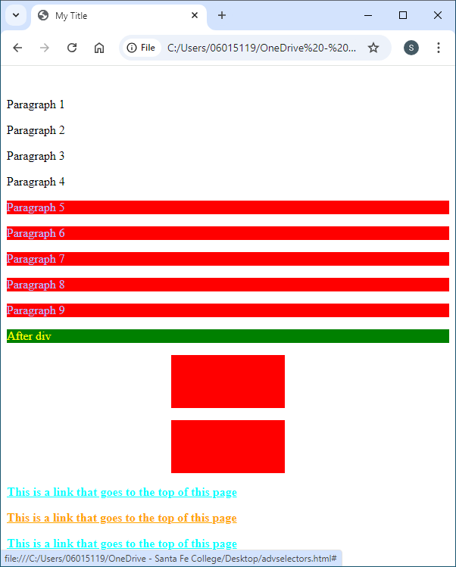
Lab: Advanced Selectors
16

Slide 17
Lab: Advanced Selectors
Change <section> color to pink on hover
<style>
a:hover {
color: orange;
font-weight: 700;
}
section:hover {
background: pink;
}
</style>
<style>
a:hover {
color: orange;
font-weight: 700;
}
</style>
17

Slide 18
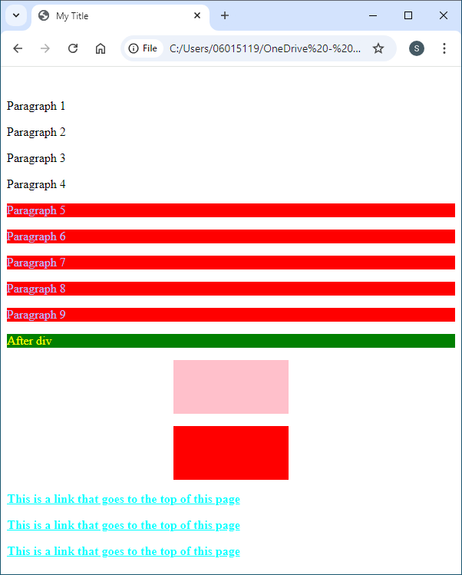
Lab: Advanced Selectors
18

