Slide 1

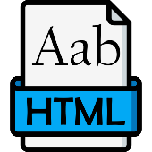

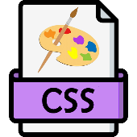

Lab: Text & Image Styles
Download ‘styles.zip’ and unzip it
Internal arrangement of ‘styles’
styles
Index.html
css
styles.css
images
left.jpg
center.png
right.webp
js

Slide 2
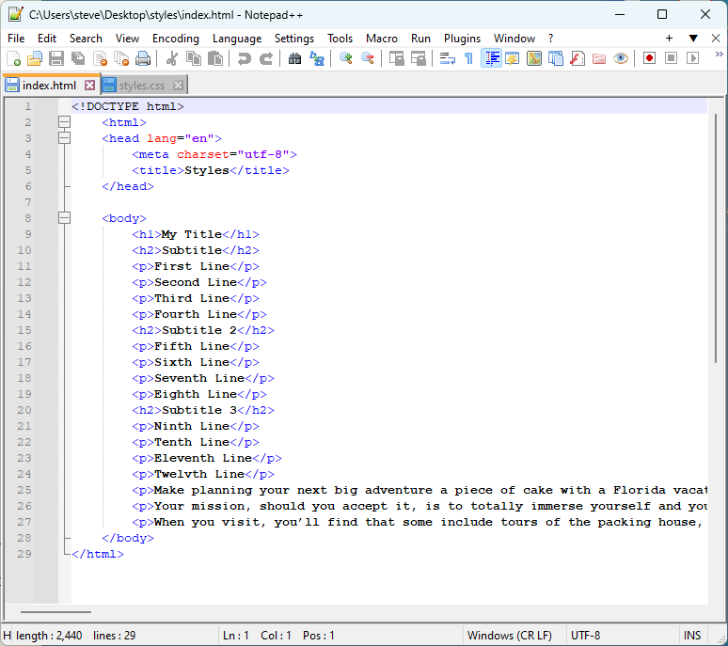
Lab: Text & Image Styles
Open ‘css/styles.css’ and ‘index’ in text editor

Slide 3
Lab: Text & Image Styles
How to tell what you’re looking at:
HTML has < > no semi-colons
CSS has { } colons and semi-colons
body {
background: #eeeeff;
font-family: Helvetica, serif;
width: 30em;
}
p {
font-size: .84em;
line-height: 1.3em;
color: #999999;
}
<!doctype html> <html lang="en"> <head> <meta charset="utf-8"> <title>Florida Vacations</title> </head>
<body>
<h1>Your Florida Vacation</h1>
<h2>Plan One Today</h2>
<p>Make planning your next big adventure a piece of cake with a Florida vacation package. Whether it's history, nature or something else entirely that draws you to this destination, our package deals help you experience it all. </p>
</body> </html>
HTML
CSS

Slide 4
Lab: Text & Image Styles
Write the body style rule in on ‘styles.css’
Save ‘styles’ and reload page in browser
@charset "utf-8";
/* CSS Document */
body {
background: #ffffee;
font-family: sans-serif;
}
<head>
<meta charset="utf-8">
<title>Styles</title>
</head>
<head>
<meta charset="utf-8">
<title>Styles</title>
<link href="css/styles.css" rel="stylesheet">
<style>
</style>
</head>
body {
background: #ffffee;
font-family: sans-serif;
}
4

Slide 5
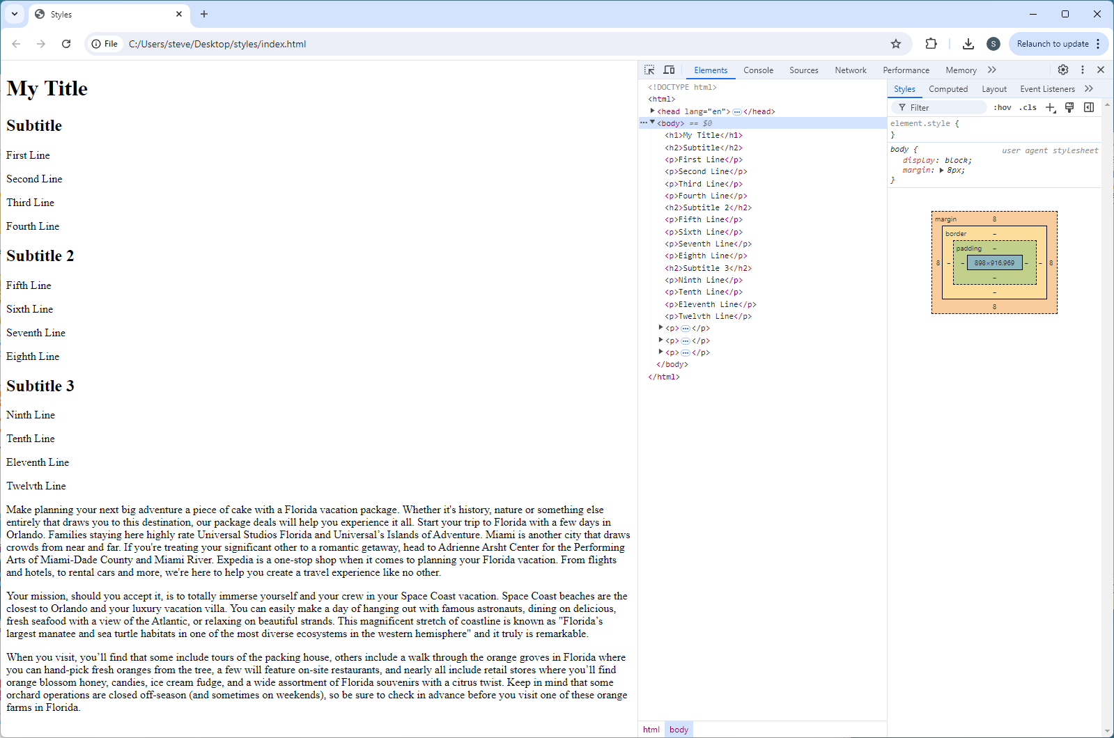
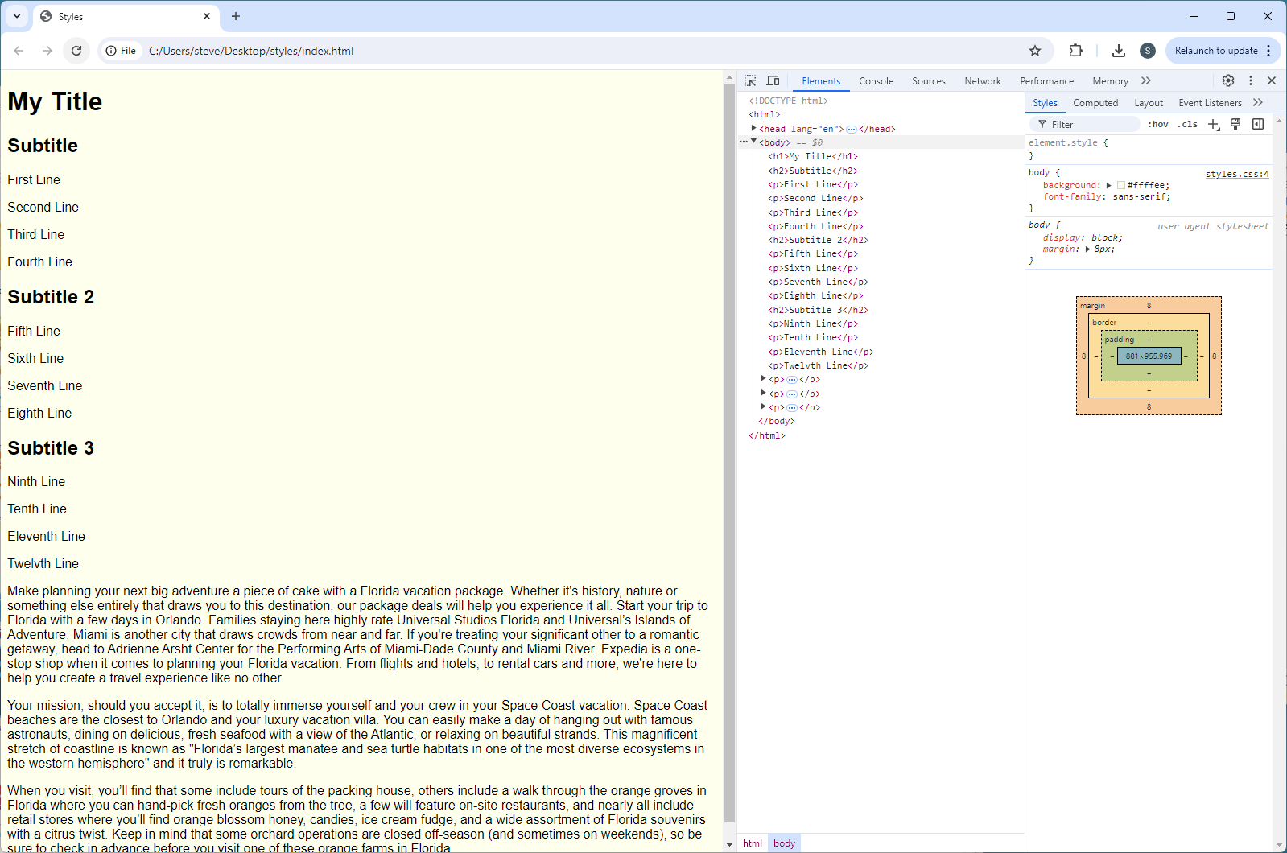
Lab: Text & Image Styles
Reload ‘index’ in browser:

Slide 6
Lab: Text & Image Styles
Write style rules to modify text (embed in ‘index’)
DO NOT TYPE the code in comments
<style>
h2 {
color: #aaaa99;
font-style: oblique; /* italic, oblique, normal */
text-align: center; /* left, center, right */
text-decoration: line-through; /* underline, overline, line-through */ }
</style>
<style>
</style>
6

Slide 7
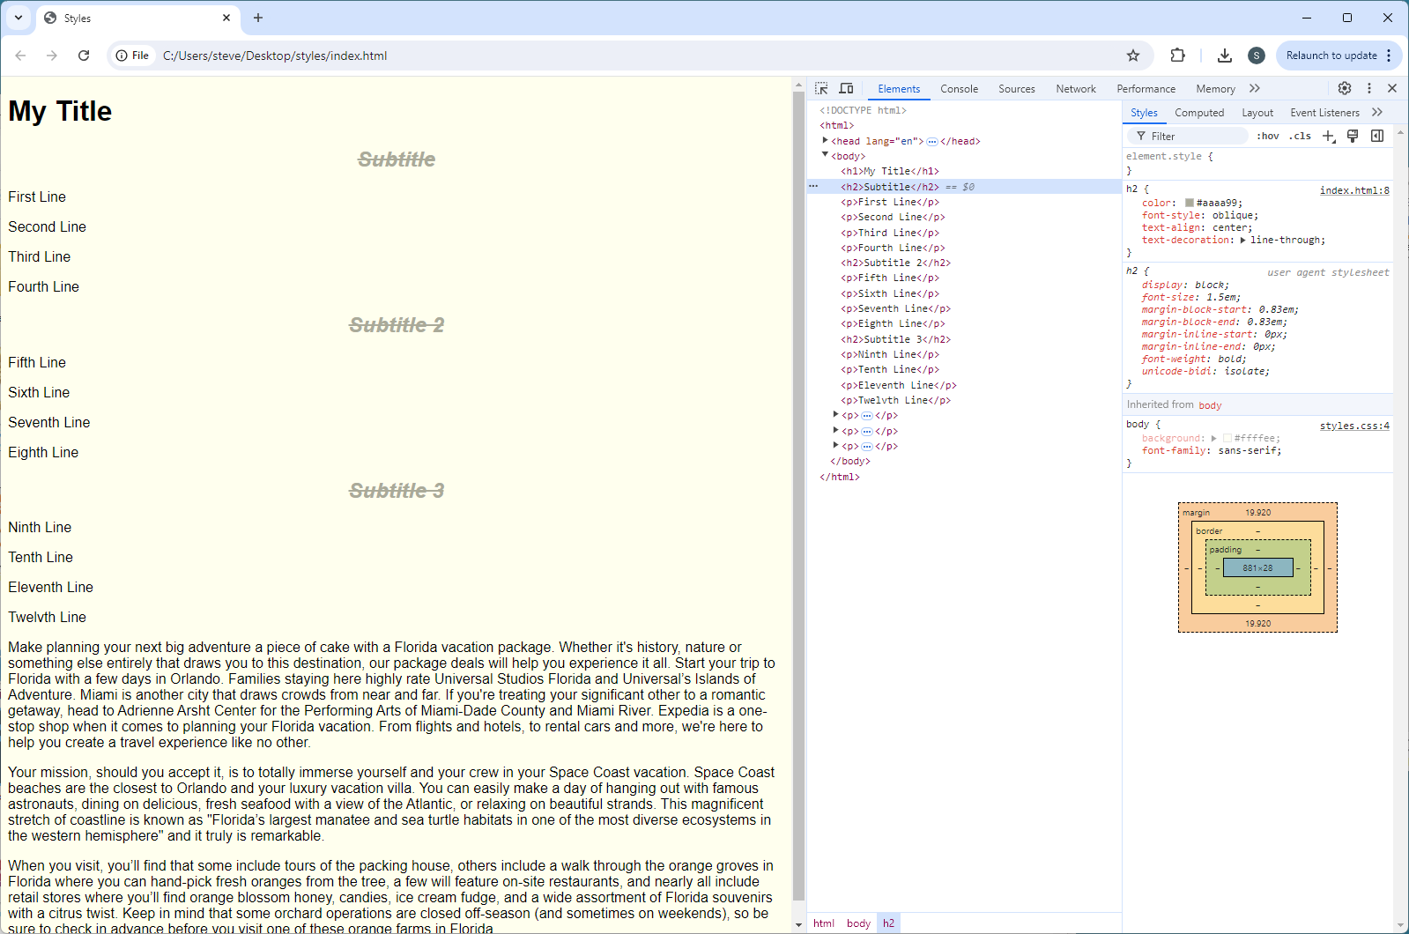
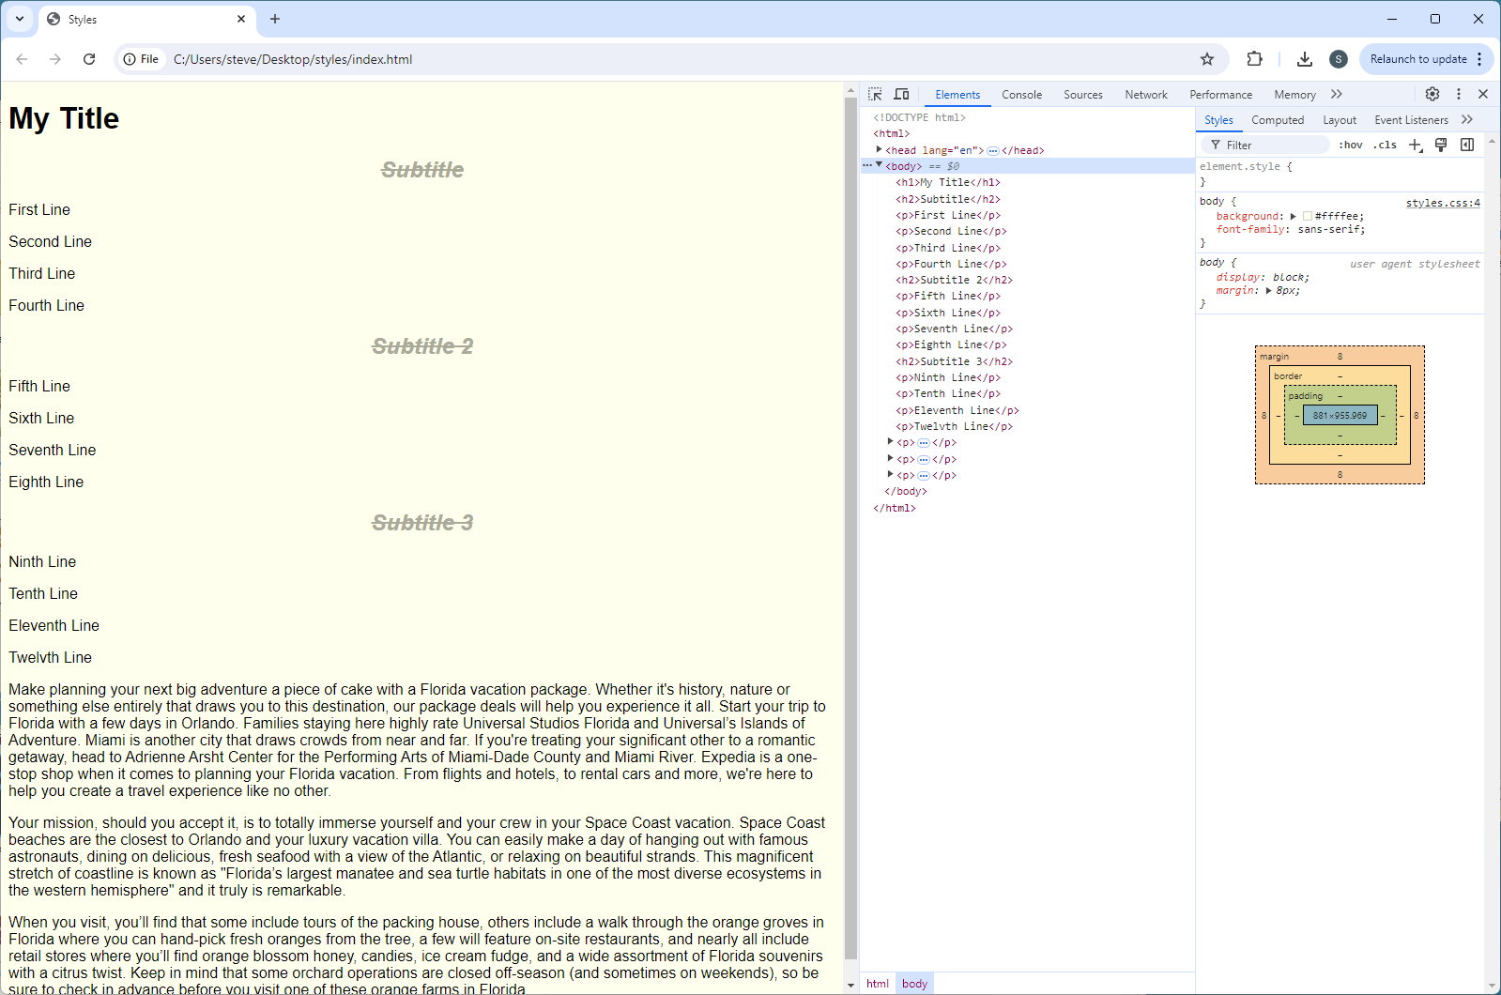
Lab: Text & Image Styles
Reload ‘index’ in browser:

Slide 8
Lab: Text & Image Styles
Add a unique style to 1st <h2> element on page
Order of CSS generally not important
<style>
h2 {
color: #aaaa99;
font-style: oblique; /* italic, oblique, normal */
text-align: center; /* left, center, right */
text-decoration: line-through; /* underline, overline, strikethrough */ }
</style>
<style>
h2 {
color: #aaaa99;
font-style: oblique; /* italic, oblique, normal */
text-align: center; /* left, center, right */
text-decoration: line-through; /* underline, overline, strikethrough */ }
#one {
font-variant: small-caps; /* normal, small-caps, initial, inherit */
}
</style>
<h2>Subtitle</h2>
<h2 id="one">Subtitle</h2>
8

Slide 9
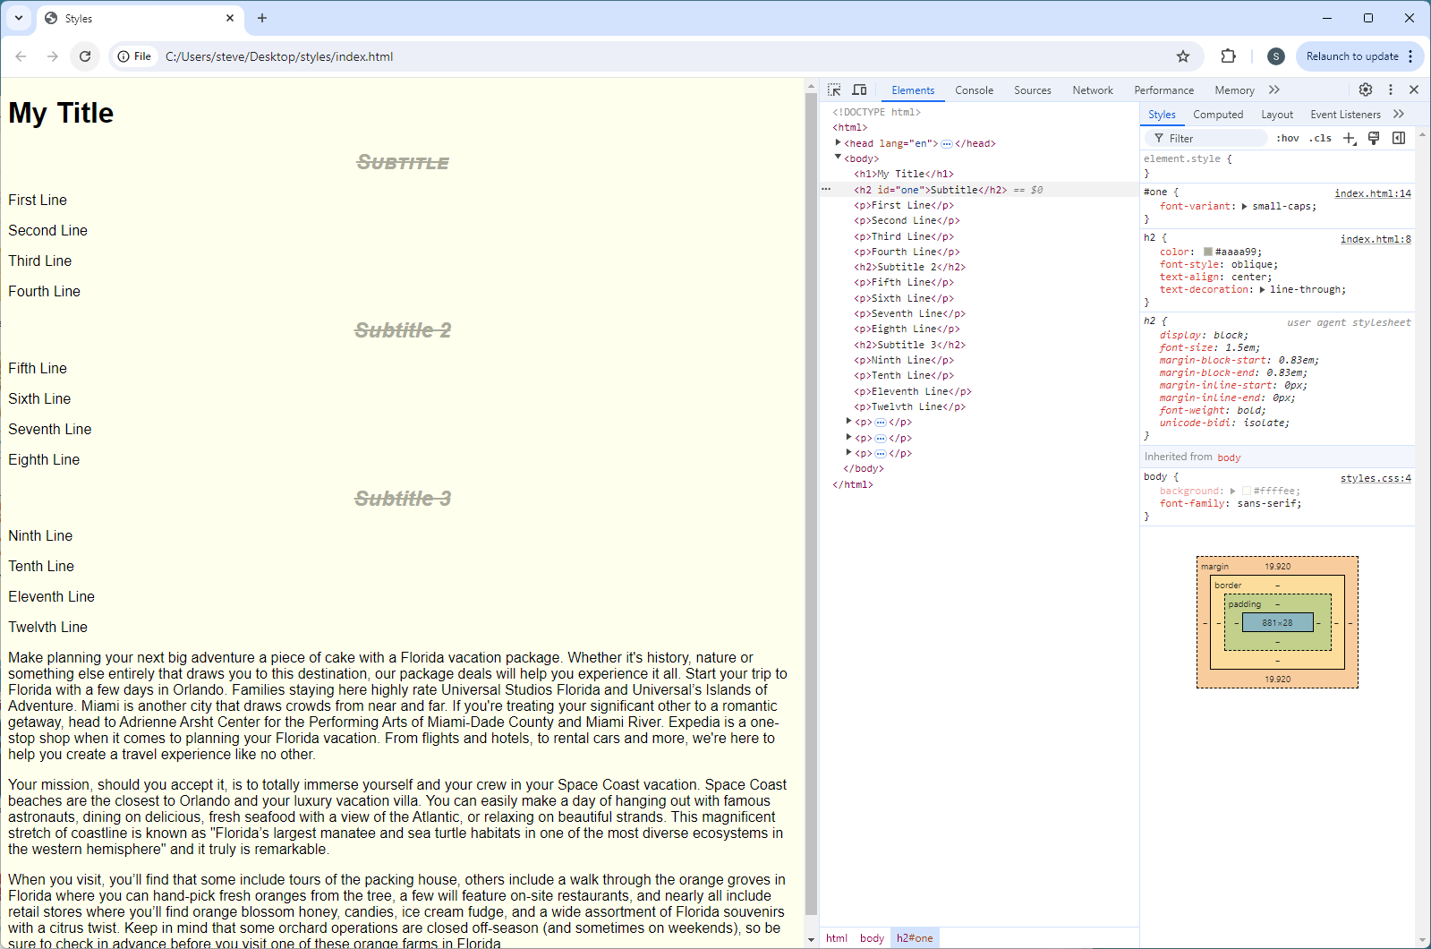
Lab: Text & Image Styles
Save & reload ‘index’ in browser:

Slide 10
Lab: Text & Image Styles
Style first four <p> elements with font-weight: 800
<style>
#one {
font-variant: small-caps; /* normal, small-caps, initial, inherit */
}
.weight {
font-weight: 700; /* bold, 100 – 900 */ }
</style>
<style>
#one {
font-variant: small-caps; /* normal, small-caps, initial, inherit */
}
</style>
<p>First Line</p>
<p>Second Line</p>
<p>Third Line</p>
<p>Fourth Line</p>
<p class="weight">First Line</p>
<p class="weight">Second Line</p>
<p class="weight">Third Line</p>
<p class="weight">Fourth Line</p>>
10

Slide 11
Lab: Text & Image Styles
Font-weight meanings:
100 − Thin
200 − Extra Light (Ultra Light)
300 − Light
400 − Normal
500 − Medium
600 − Semi-Bold (Demi Bold)
700 − Bold
800 − Extra Bold (Ultra Bold)
900 − Black (Heavy)
11

Slide 12
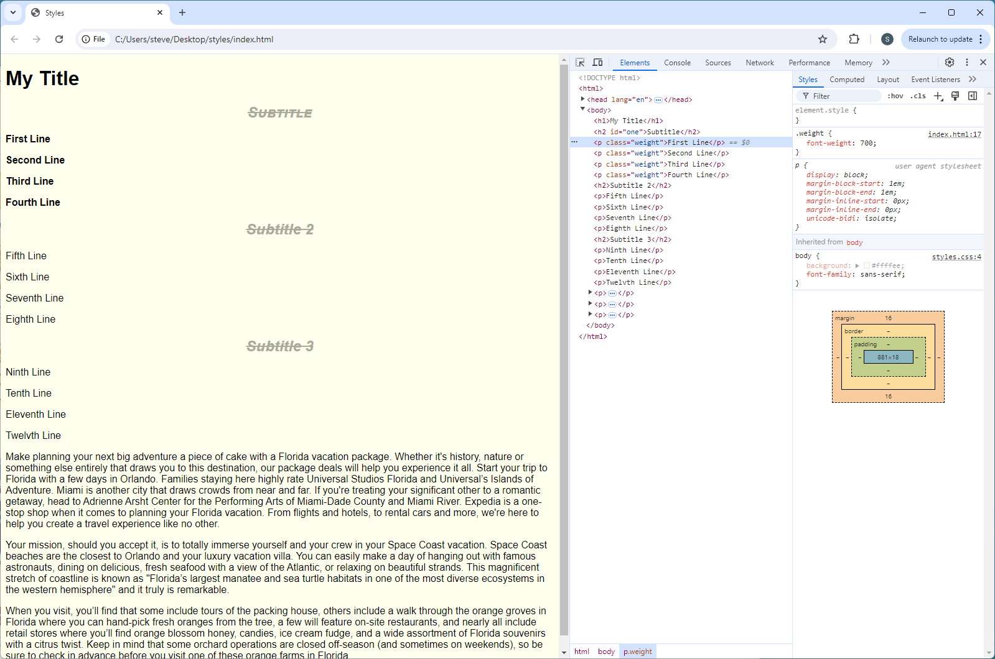
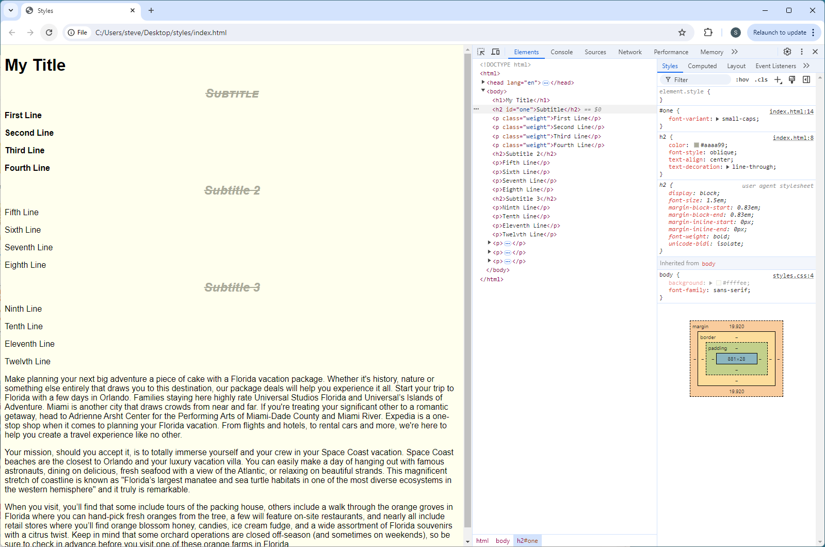
Lab: Text & Image Styles
Save & reload ‘index’ in browser:

Slide 13
Lab: Text & Image Styles
Style paragraph about Florida vacations (1st big paragraph)
<style>
.weight {
font-weight: 700; /* bold, 100 – 900 */ }
</style>
<style>
.weight {
font-weight: 700; /* bold, 100 – 900 */ }
#vacation {
line-height: 1.4; /* assumed em; % */
color: #bb00bb;
}
</style>
<p id="vacation">Make planning your next big adventure a piece of cake … </p>
<p>Make planning your next big adventure a piece of cake … </p>
13

Slide 14
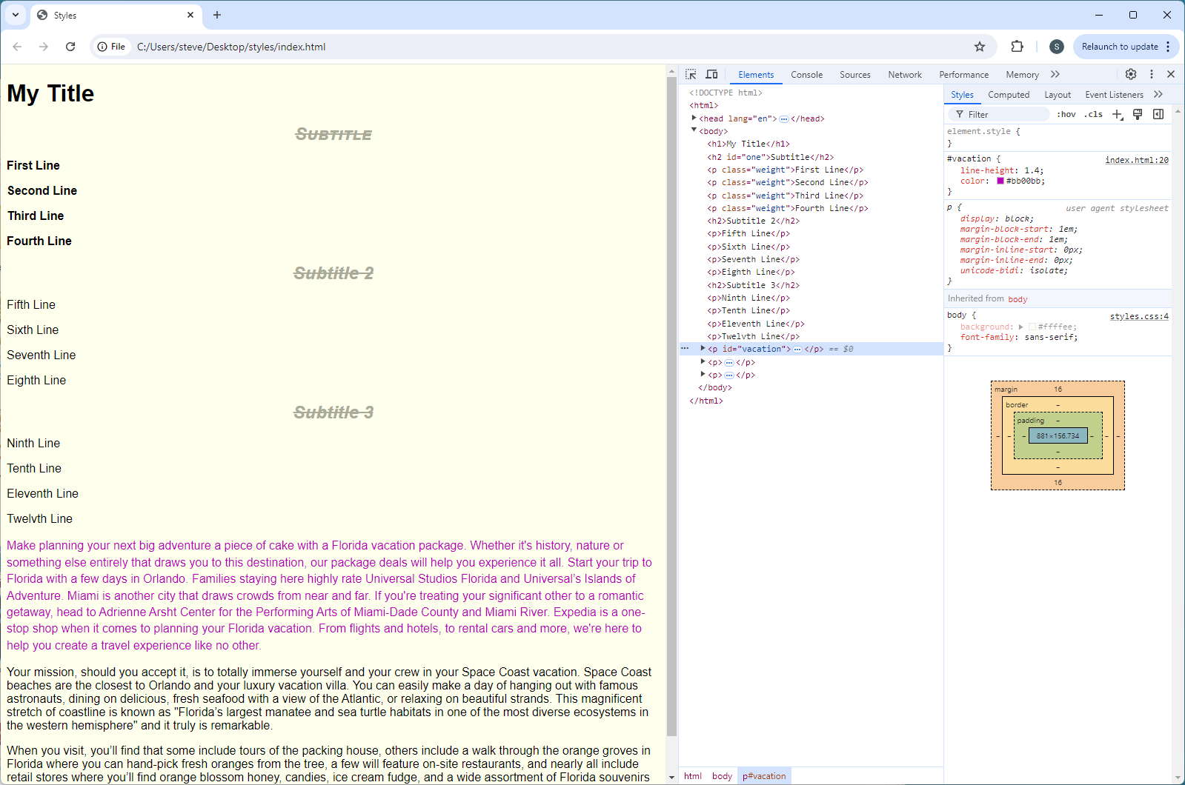
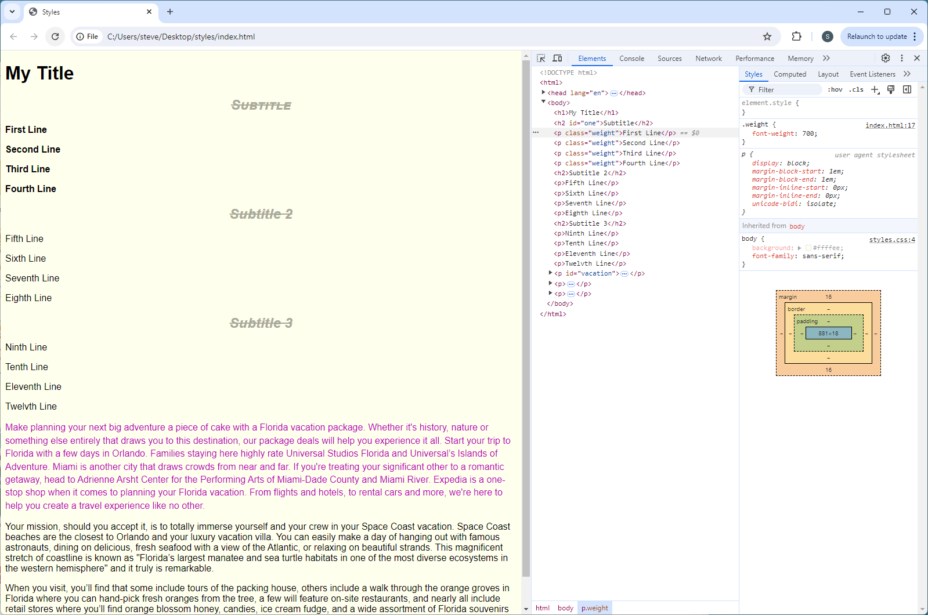
Lab: Text & Image Styles
Save & reload ‘index’ in browser:

Slide 15
Lab: Text & Image Styles
Add <img> to ‘vacation’ paragraph
<p id="vacation"><img src="images/left.jpg" width="660" height="400" alt="Fireworks" title="Florida Vacations are Exciting!" class="left">Make planning your next … </p>
p id="vacation">Make planning your next … </p>
15

Slide 16
Lab: Text & Image Styles
Add class ‘left’ to the <style>
<style>
#vacation {
line-height: 1.4; /* assumed em; % */
color: #bb00bb;
}
.left {
float: left;
margin-right: .5em;
margin-bottom: .5em;
width: 20%;
height: auto;
}
</style>
<style>
#vacation {
line-height: 1.4; /* assumed em; % */
color: #bb00bb;
}
</style>
16

Slide 17
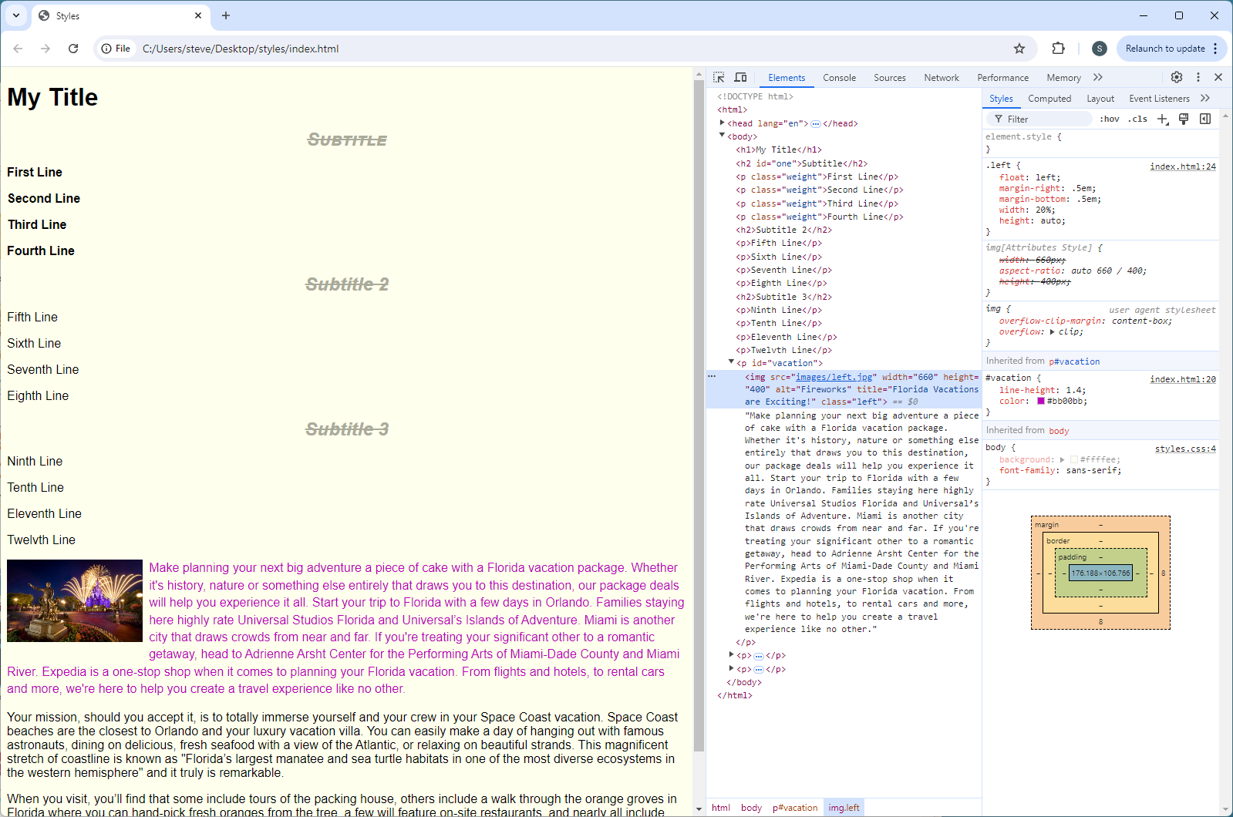
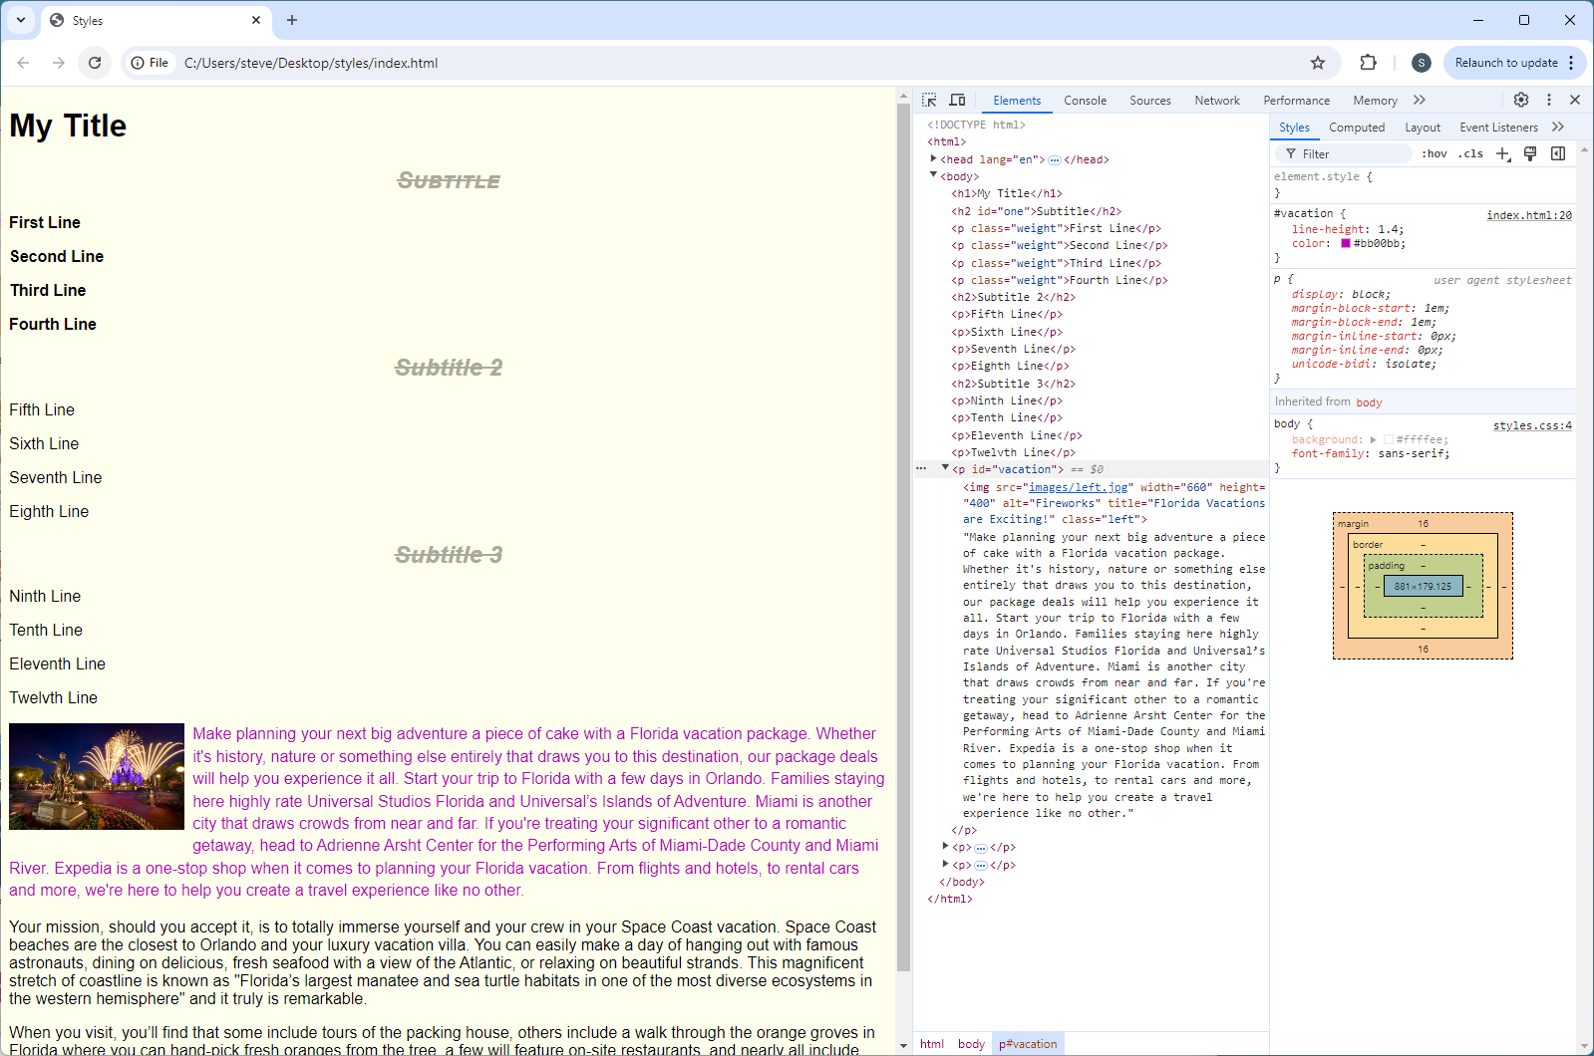
Lab: Text & Image Styles
Save & reload ‘index’ in browser:

Slide 18
Lab: Text & Image Styles
Place an image between p1 and p2 centered on the page
… travel experience like no other.</p>
<p style="text-align: center"><img src="images/center.png" width="710" height="500" alt="Rocket Garden" title="Space is Calling Your Name" class="center"></p>
<p>Your mission, should you accept it, is to totally immerse yourself and your crew …
… travel experience like no other.</p>
<p>Your mission, should you accept it, is to totally immerse yourself and your crew …
<style>
.left {
float: left;
margin-right: .5em;
margin-bottom: .5em;
width: 20%;
height: auto;
}
.center {
width: 30%;
height: auto;
}
</style>
<style>
.left {
float: left;
margin-right: .5em;
margin-bottom: .5em;
width: 20%;
height: auto;
}
</style>

Slide 19
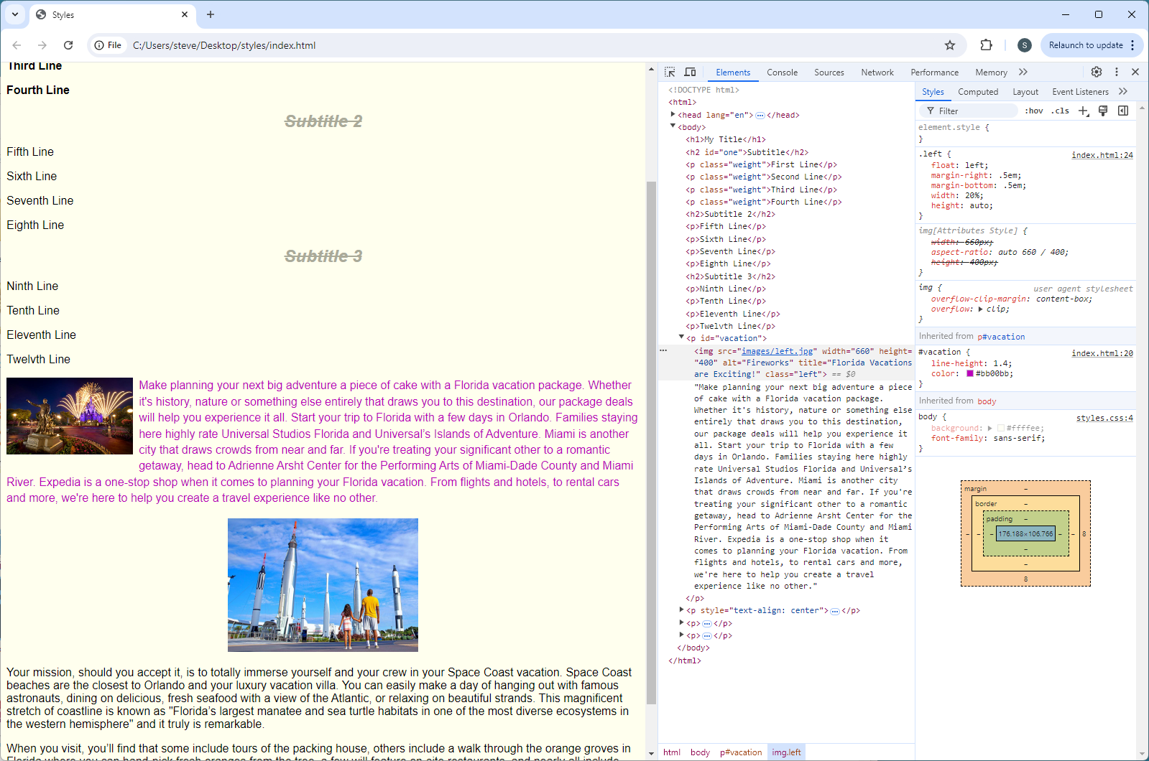
Lab: Text & Image Styles
Save & reload ‘index’ in browser:

Slide 20
Lab: Text & Image Styles
Add right-floated <img> to ‘citrus’ paragraph
<p><img src="images/right.webp" width="500" height="500" alt="Citrus Stand" title="Florida Citrus is the BEST!" class="right">When you visit, you’ll find that some include tours of the packing house, </p>
<p>When you visit, you’ll find that some include tours of the packing house …
20

Slide 21
Lab: Text & Image Styles
Add class ‘left’ to the <style>
<style>
.center {
width: 30%;
height: auto;
}
.right {
float: right;
margin-left: .5em;
margin-bottom: .5em;
width: 20%;
height: auto;
}
</style>
<style>
.center {
width: 30%;
height: auto;
}
</style>
21

Slide 22
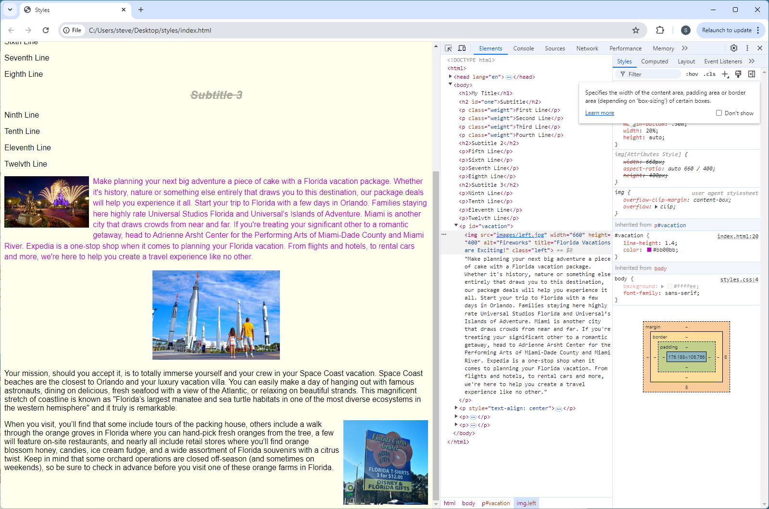
Lab: Text & Image Styles
Save & reload ‘index’ in browser:

Slide 23
<style>
h2 {
color: #aaaa99;
font-style: oblique;
text-align: center;
text-decoration: line-through;
}
#one {
font-variant: small-caps;
}
.weight {
font-weight: 700;
}
#vacation {
line-height: 1.4;
color: #bb00bb;
}
.left {
float: left;
margin-right: .5em;
margin-bottom: .5em;
width: 20%;
height: auto;
}
.center {
width: 30%;
height: auto;
}
.right {
float: right;
margin-left: .5em;
margin-bottom: .5em;
width: 20%;
height: auto;
}
</style>

