Slide 1
Lab: Specificity
Download ‘specificity.zip’
Open ‘specificity.html’ and ‘styles.css’
Add the code below to ‘specificity’
<head lang="en">
<meta charset="utf-8">
<title>Specificity</title>
</head
<head lang="en">
<meta charset="utf-8">
<title>Specificity</title>
<link href="css/styles.css" rel="stylesheet">
<style>
</style>
</head>

Slide 2
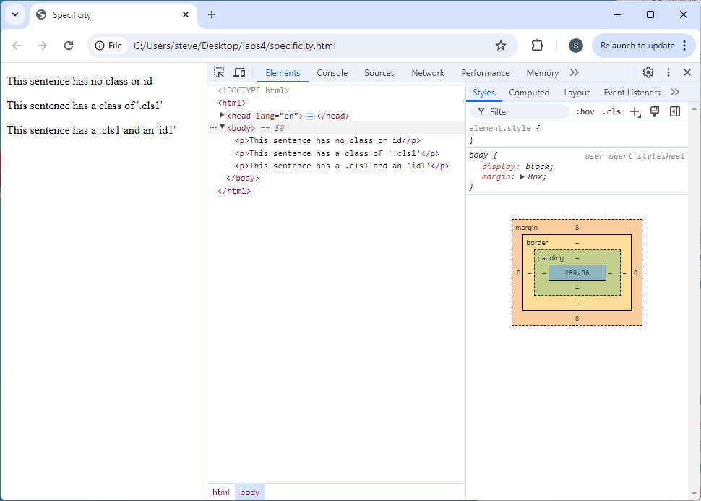
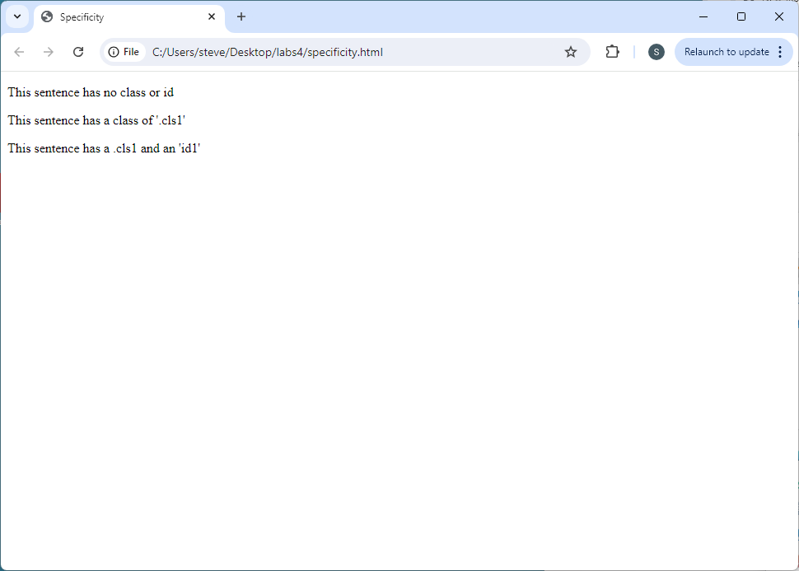
Lab: Specificity
Change the background color of <p> elements
Open ‘specificity’ in browser; then open ‘Developer Tools’ (F12)

Slide 3
Lab: Specificity
Style p element in the external stylesheet ‘styles.css’
@charset "utf-8";
/* CSS Document */
@charset "utf-8";
/* CSS Document */
p {
background: cyan;
}

Slide 4
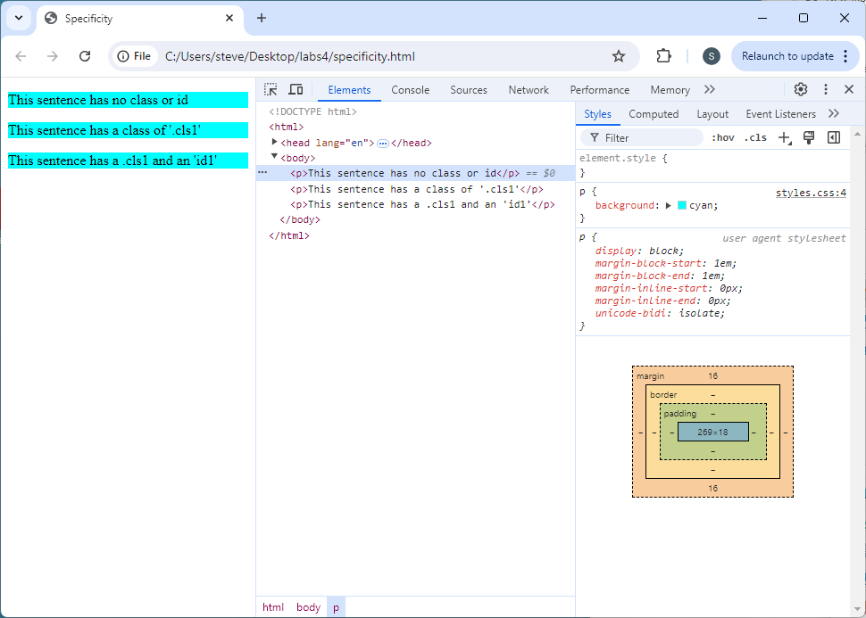
Lab: Specificity
Save pages; view in browser; look at Developer Tools

Slide 5
Lab: Specificity
Style p element in <style> of ‘specificity.html’
<link href="css/styles.css" rel="stylesheet">
<style>
</style>
<style>
p {
background: magenta;
}
</style>

Slide 6
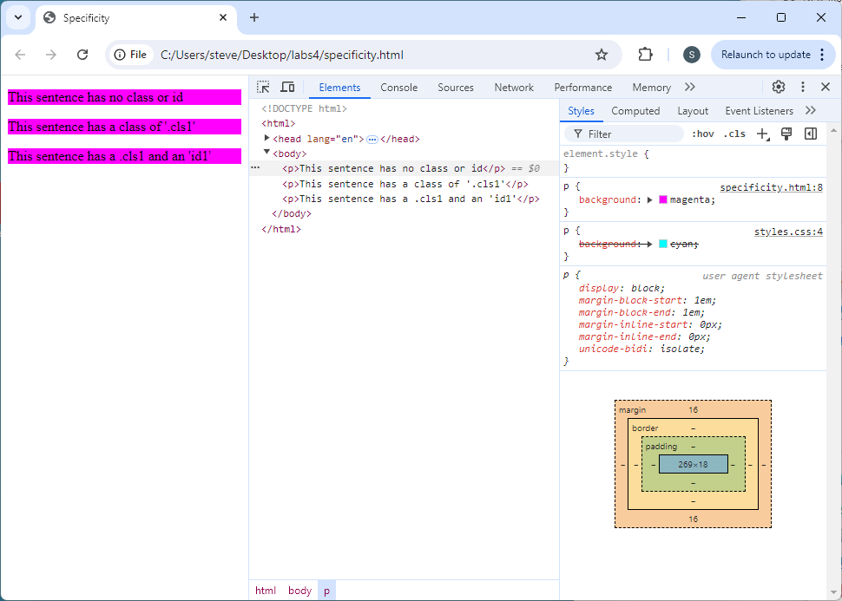
Lab: Specificity
Save pages; view in browser; look at Developer Tools

Slide 7
Lab: Specificity
Add a class to 2nd p element
Add a style rule to the external stylesheet ‘styles.css’
<body>
<p>This sentence has no class or id</p>
<p>This sentence has a class of '.cls1'</p>
<p>This sentence has a .cls1 and an 'id1'</p>
</body>
<body>
<p>This sentence has no class or id</p>
<p class="cls1">This sentence has a class of 'cls1'</p>
<p>This sentence has a .cls1 and an 'id1'</p>
</body>
p {
background: cyan;
}
p {
background: cyan;
}
.cls1 {
background: red;
}

Slide 8
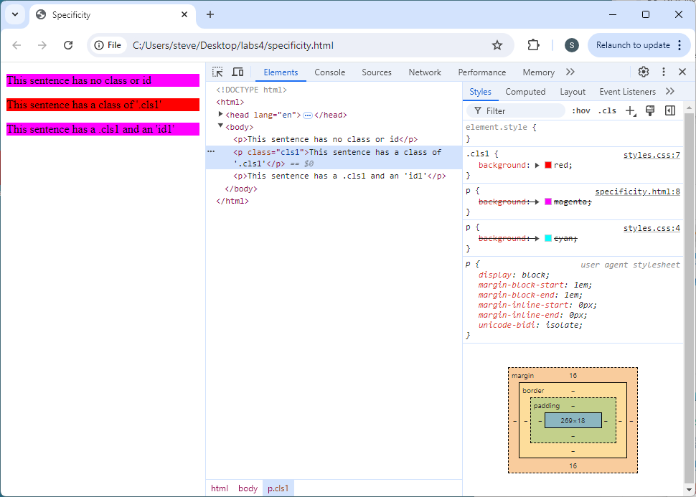
Lab: Specificity
Save pages; view in browser; look at Developer Tools

Slide 9
Lab: Specificity
Add a style rule to ‘specificity’ for ‘cls1’
<style>
p {
background: magenta;
}
.cls1 {
background: #ddffdd;
}
</style>
<style>
p {
background: magenta;
}
</style>

Slide 10
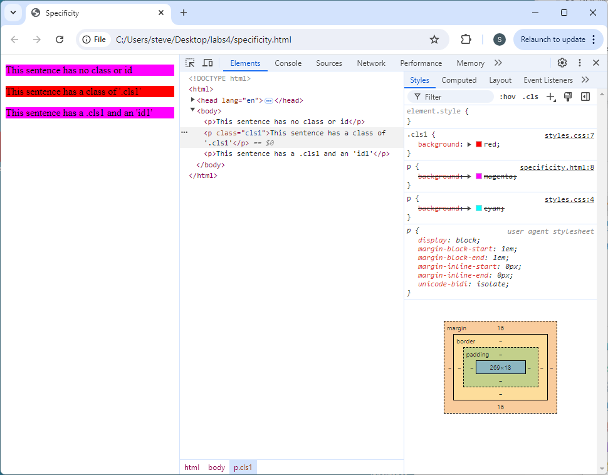
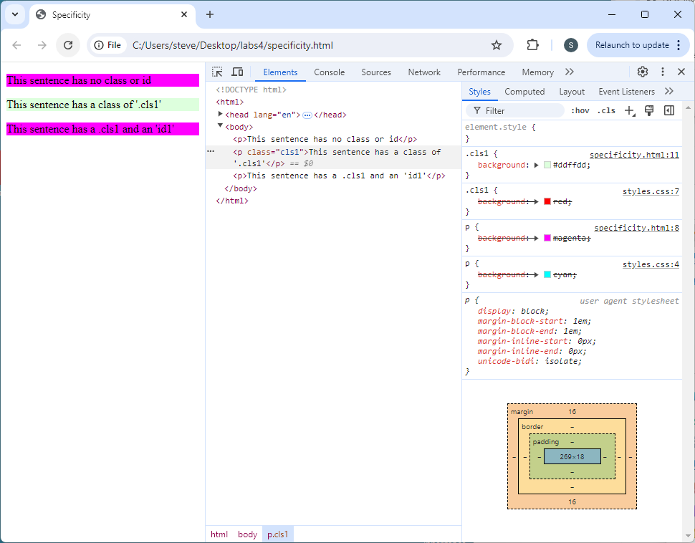
Lab: Specificity
Save pages; view in browser; look at Developer Tools

Slide 11
Lab: Specificity
Add an id to 2nd p element
Add a style rule to the external stylesheet ‘styles.css’
<body>
<p>This sentence has no class or id</p>
<p class="cls1">This sentence has a class of 'cls1'</p>
<p>This sentence has a .cls1 and an 'id1'</p>
</body>
<body>
<p>This sentence has no class or id</p>
<p class="cls1" id="id1">This sentence has a class of 'cls1'</p>
<p>This sentence has a .cls1 and an 'id1'</p>
</body>
p {
background: cyan;
}
.cls1 {
background: red;
}
p {
background: cyan;
}
.cls1 {
background: red;
}
#id1 {
background: #ffcc00;
}

Slide 12
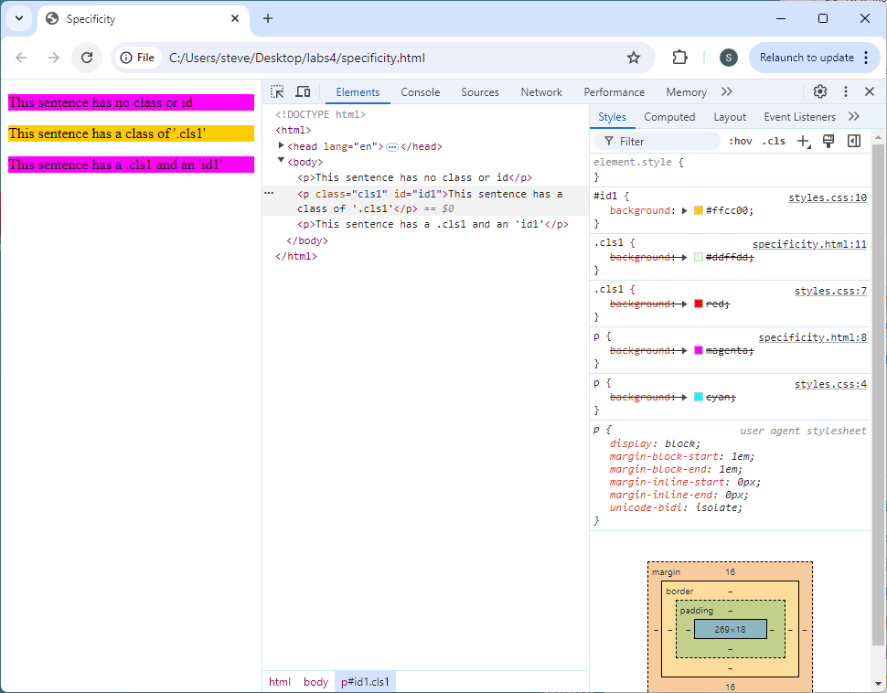
Lab: Specificity
Save pages; view in browser; look at Developer Tools

Slide 13
Lab: Specificity
Add a style rule to ‘specificity’ for ‘cls1’
<style>
p {
background: magenta;
}
.cls1 {
background: #ddffdd;
}
</style>
<style>
p {
background: magenta;
}
.cls1 {
background: #ddffdd;
}
#id1 {
background: #ddddff;
}
</style>

Slide 14
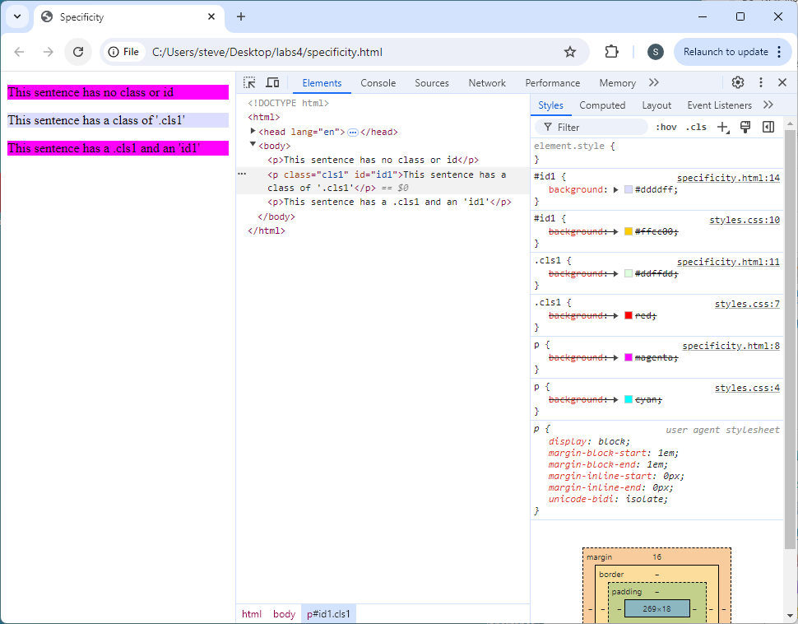
Lab: Specificity
Save pages; view in browser; look at Developer Tools

Slide 15



Lab: Specificity
Strongest
Least
Inline id
Embedded class
External type
Weakest
Most

