Slide 1


COURSERA COURSES METADATA FOR ANALYTICS 2025
View in Power BI
Last data refresh:
11/24/2025 8:53:36 PM UTC
Prepared by Sandrine Aboudi (November 2025)
Downloaded at:
11/24/2025 9:08:21 PM UTC

Slide 2
INTRODUCTION
This presentation is based on a Coursera dataset sourced from the Kaggle platform.
After obtaining the data, an initial phase of exploration, cleaning, and preparation was carried out in Python to ensure data quality and consistency.
Once the dataset was prepared, it was imported into Power BI to build interactive dashboards that analyze:
The distribution of courses
Instructor engagement across categories
Skill density per course and per instructor
Overall trends observed at the category level
The objective is to provide a clear, structured, and insightful overview of the educational patterns found in the Coursera dataset.

Slide 3
Summary
Slide 1 — Title and Presenter
Slide 2 — Introduction
Slide 3 — Summary
Slide 4 — Courses Dashboard
Slide 5 — Courses Insights
Slide 6 — Instructors Dashboard
Slide 7 — Instructors Insights
Slide 8 — Skills Dashboard
Slide 9 — Skills Insights
Slide 10 — Categories Dashboard
Slide 11 — Categories Insights
Slide 12 — Conclusion

Slide 4
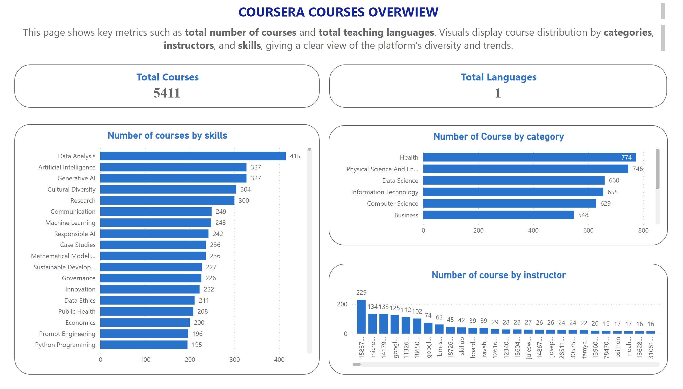
Courses
Notes:
Number of Course by category
This bar chart shows the number of courses per category, with Health leading at 774 courses.
Number of course by instructor
This column chart shows the number of courses per instructor, with the instructor ID 158375127 leading at 229 courses, followed by Microsoft with 134 courses.
Number of courses by skills
This column chart shows the number of courses per skill, with Data Analysis leading at 415 courses.
Number of courses by skills
This chart shows the number of courses per skill as a Treemap
.
textbox
COURSERA COURSES OVERWIEW
textbox
This page shows key metrics such as total number of courses and total teaching languages. Visuals display course distribution by categories, instructors, and skills, giving a clear view of the platform’s diversity and trends.
Total Courses
This KPI shows the total number of courses in the Coursera platform.
Total Languages
This KPI shows the total number of learning language.
listSlicer
No alt text provided
textSlicer
No alt text provided
textSlicer
No alt text provided
textSlicer
No alt text provided
textSlicer
No alt text provided
textSlicer
No alt text provided
textSlicer
No alt text provided

Slide 5
Courses Dashboard – Key Insights
Main KPIs
Total courses: 5,411
Teaching languages: 1 (English only)
Top Competencies
Data Analysis → 415 courses
Artificial Intelligence → 327 courses
Generative AI → 327 courses
Top Instructors
ID 158375127 → 229 courses
Microsoft → 134 courses
Top Categories
Health → 774 courses
Physical Science & Engineering → 746 courses
Data Science → 660 courses

Slide 6
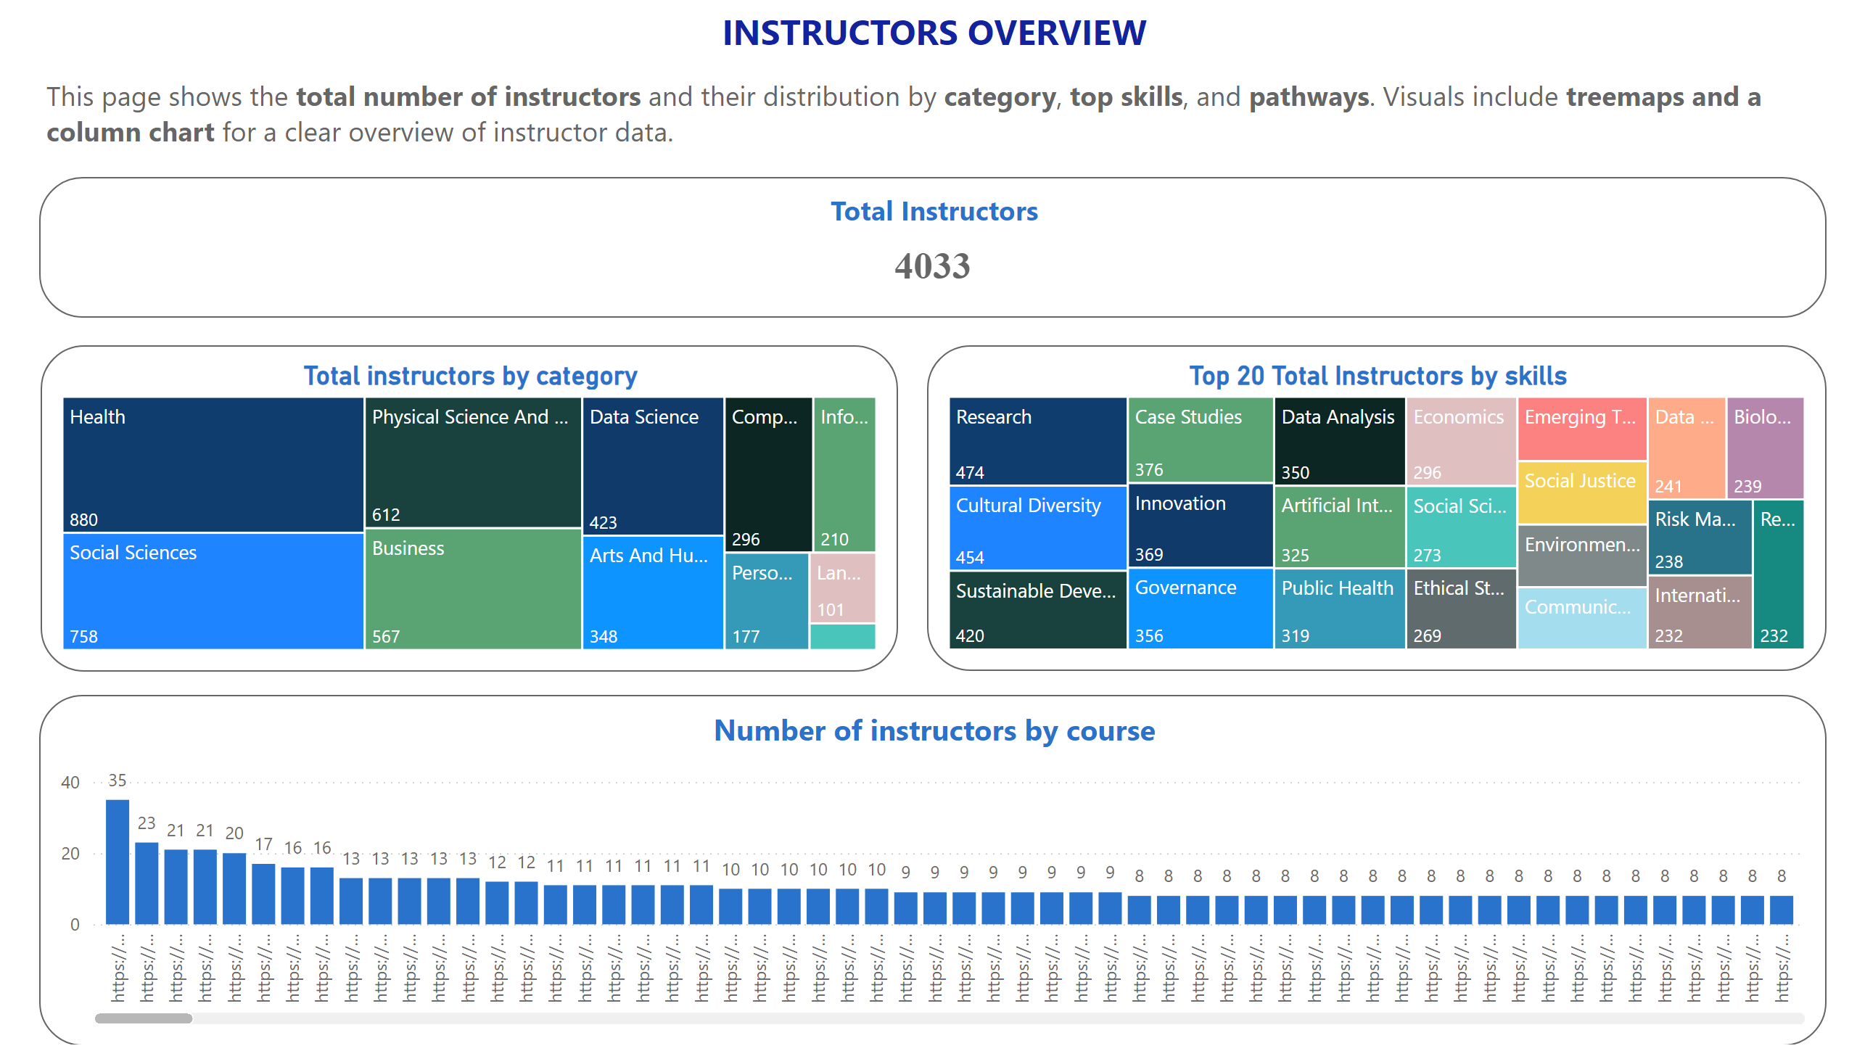
Instructors
Notes:
Number of instructors by course
This column chart shows the distribution of instructors by course
Total instructors by category
This treemap shows the distribution of instructors by category.
Top 20 Total Instructors by skills
This treemap shows the distribution of instructors by skill.
Total Instructors
This KPI shows the total number of instructors in the Coursera platform 4,033.
textbox
INSTRUCTORS OVERVIEW
textbox
This page shows the total number of instructors and their distribution by category, top skills, and pathways. Visuals include treemaps and a column chart for a clear overview of instructor data.
listSlicer
No alt text provided
textSlicer
No alt text provided
textSlicer
No alt text provided
textSlicer
No alt text provided
textSlicer
No alt text provided
textSlicer
No alt text provided
textSlicer
No alt text provided

Slide 7
Instructors Dashboard – Key Insights
Main KPI
Total Instructors: 4033
Top Categories by Number of Instructors
Health → 880 instructors
Social Sciences → 758 instructors
Physical Science & Engineering → 612 instructors
Top Competencies by Number of Instructors
Research → 474 instructors
Cultural Diversity → 454 instructors
Sustainable Development → 420 instructors
Top Courses by Number of Instructors
Course A → 35 instructors
Course B → 23 instructors
Course C → 21 instructors

Slide 8
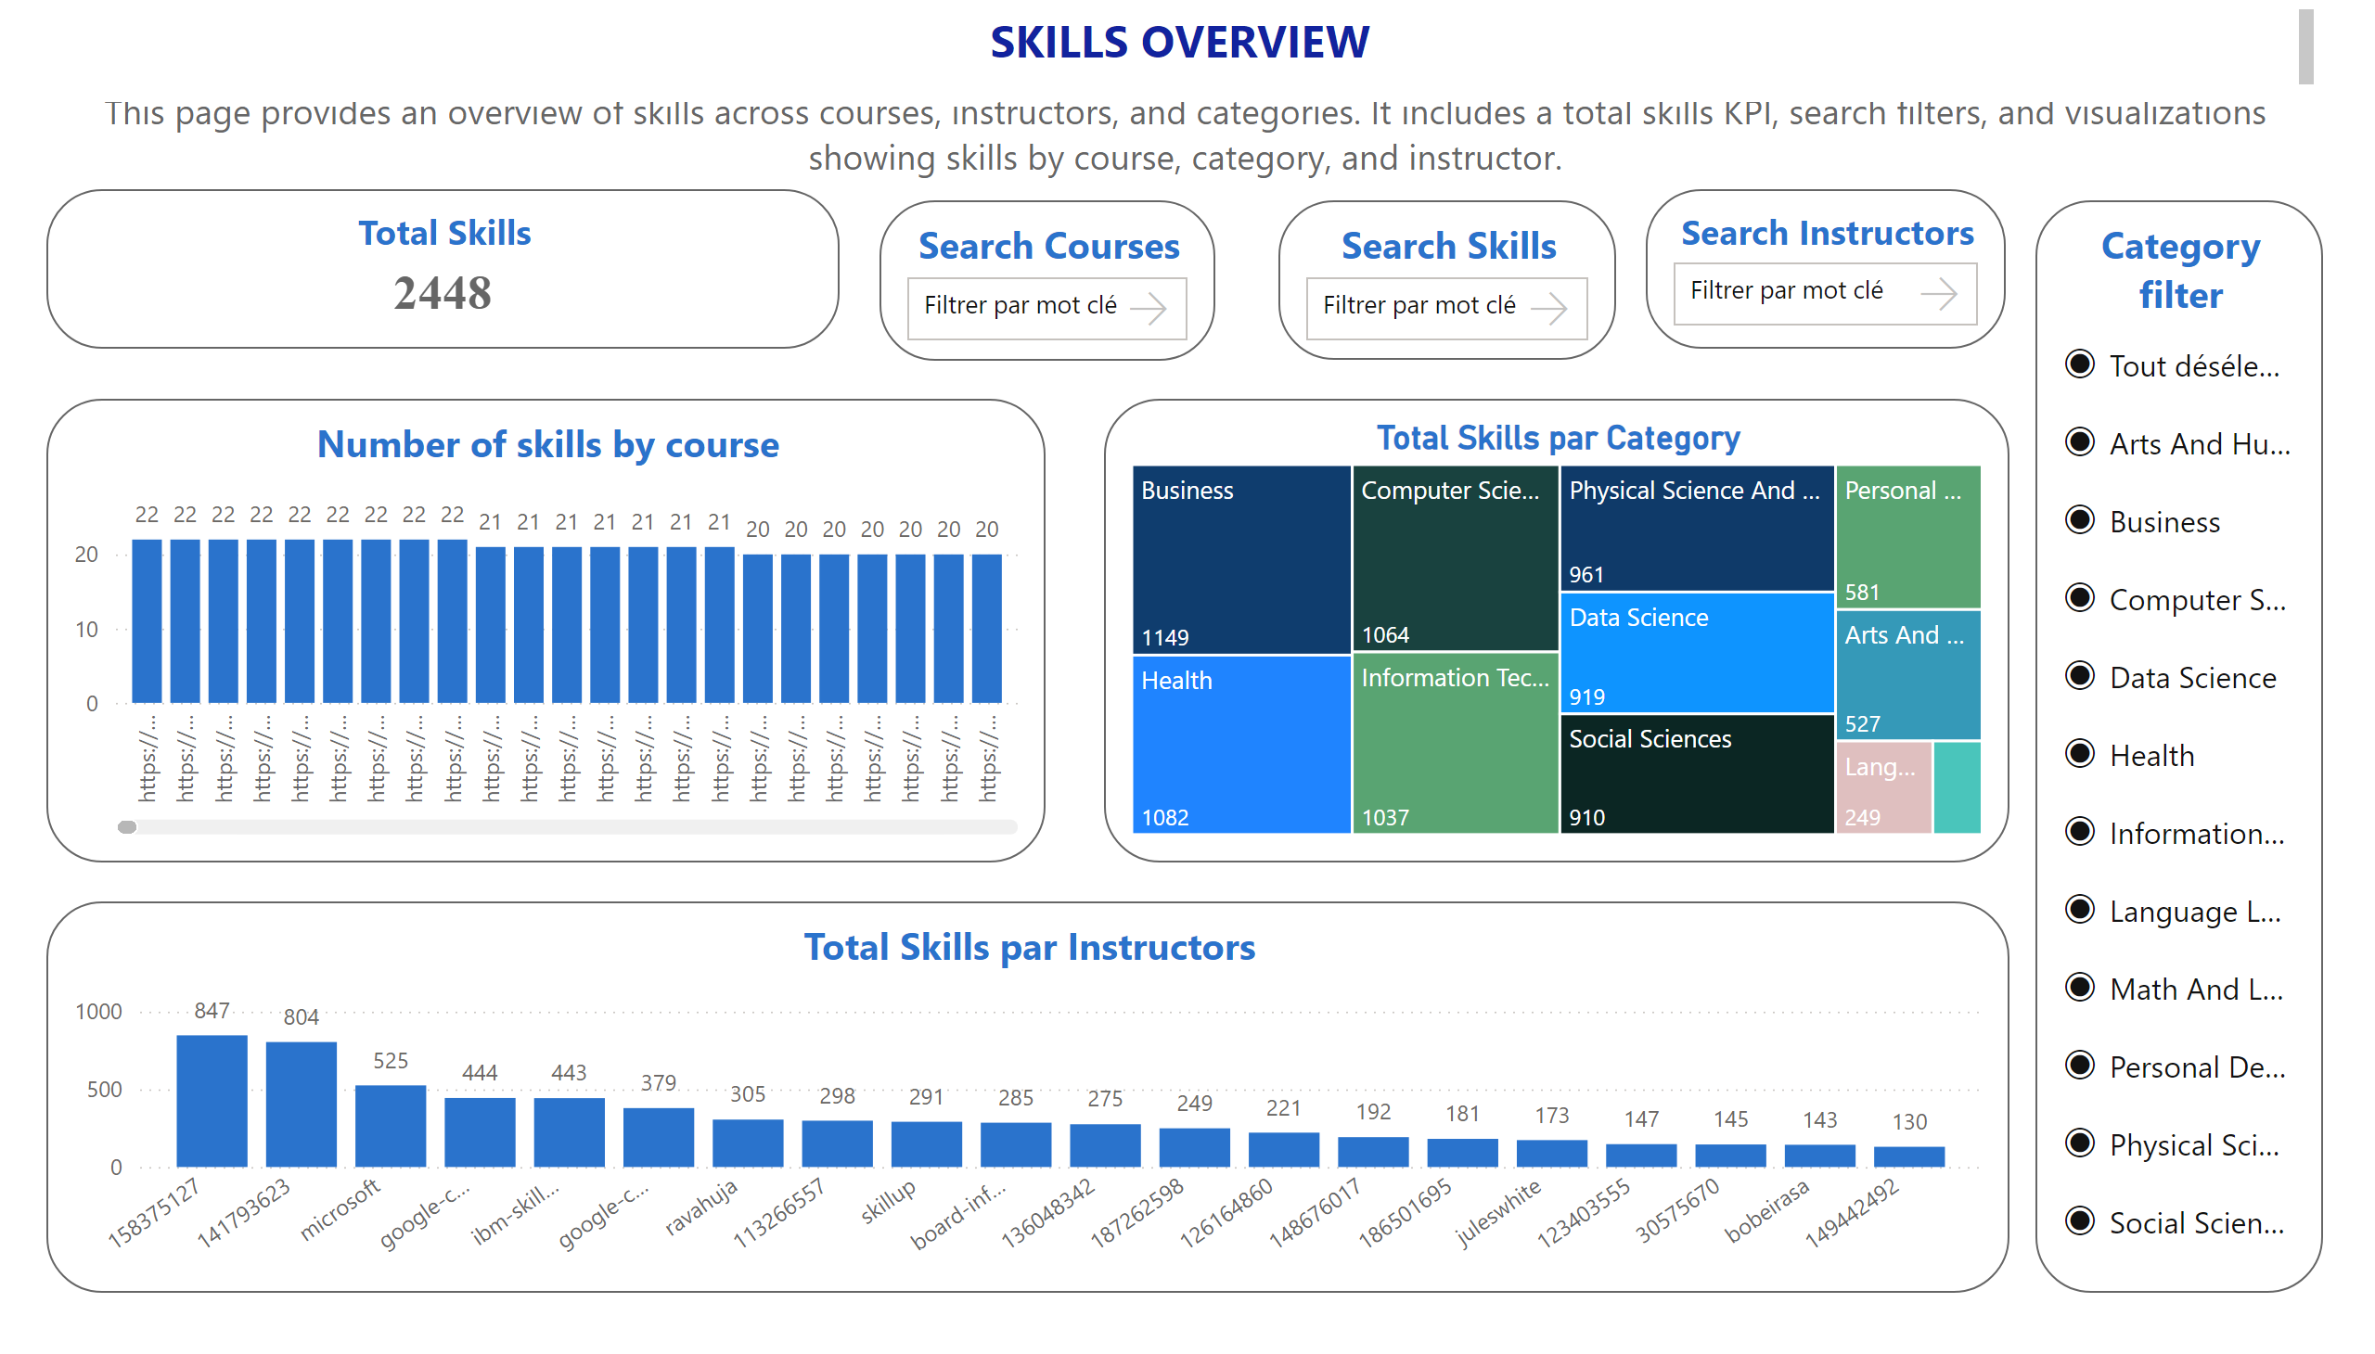
Skills
Notes:
Number of skills by course
This column chart shows the number of skills per course
treemap
This treemap shows the distribution of skills by category.
clusteredColumnChart
This column chart shows the distribution of skills by i,nstructor
Search courses
This filter allows users to search course names by keyword
Category filter
This filter allows users to select the course category.
Total Skills
This KPI shows the total number of skills available on the Coursera platform in our dataset.his KPI shows the total number of instructors in the Coursera platform 4,033.
textbox
SKILLS OVERVIEW
textbox
This page provides an overview of skills across courses, instructors, and categories. It includes a total skills KPI, search filters, and visualizations showing skills by course, category, and instructor.
Search Instructors
This filter allows users to search skills name by keyword
Search Skills
This filter allows users to search course names by keyword

Slide 9
Skills Dashboard – Key Insights
Main KPI
Total skills: 2,448
Available Filters
Search Courses
Search Skills
Search Instructors
Category Filter
Courses with the Highest Number of Skills
Top 9 courses → 22 skills each
Next 7 courses → 21 skills each
Top Categories by number of skills
Business → 1,149 skills
Health → 1,082 skills
Computer Science → 1,064 skills
Top Instructors by Number of Skills
Instructor ID 158375127 → 847 skills
Instructor ID 141793623 → 804 skills
Microsoft → 525 skills

Slide 10
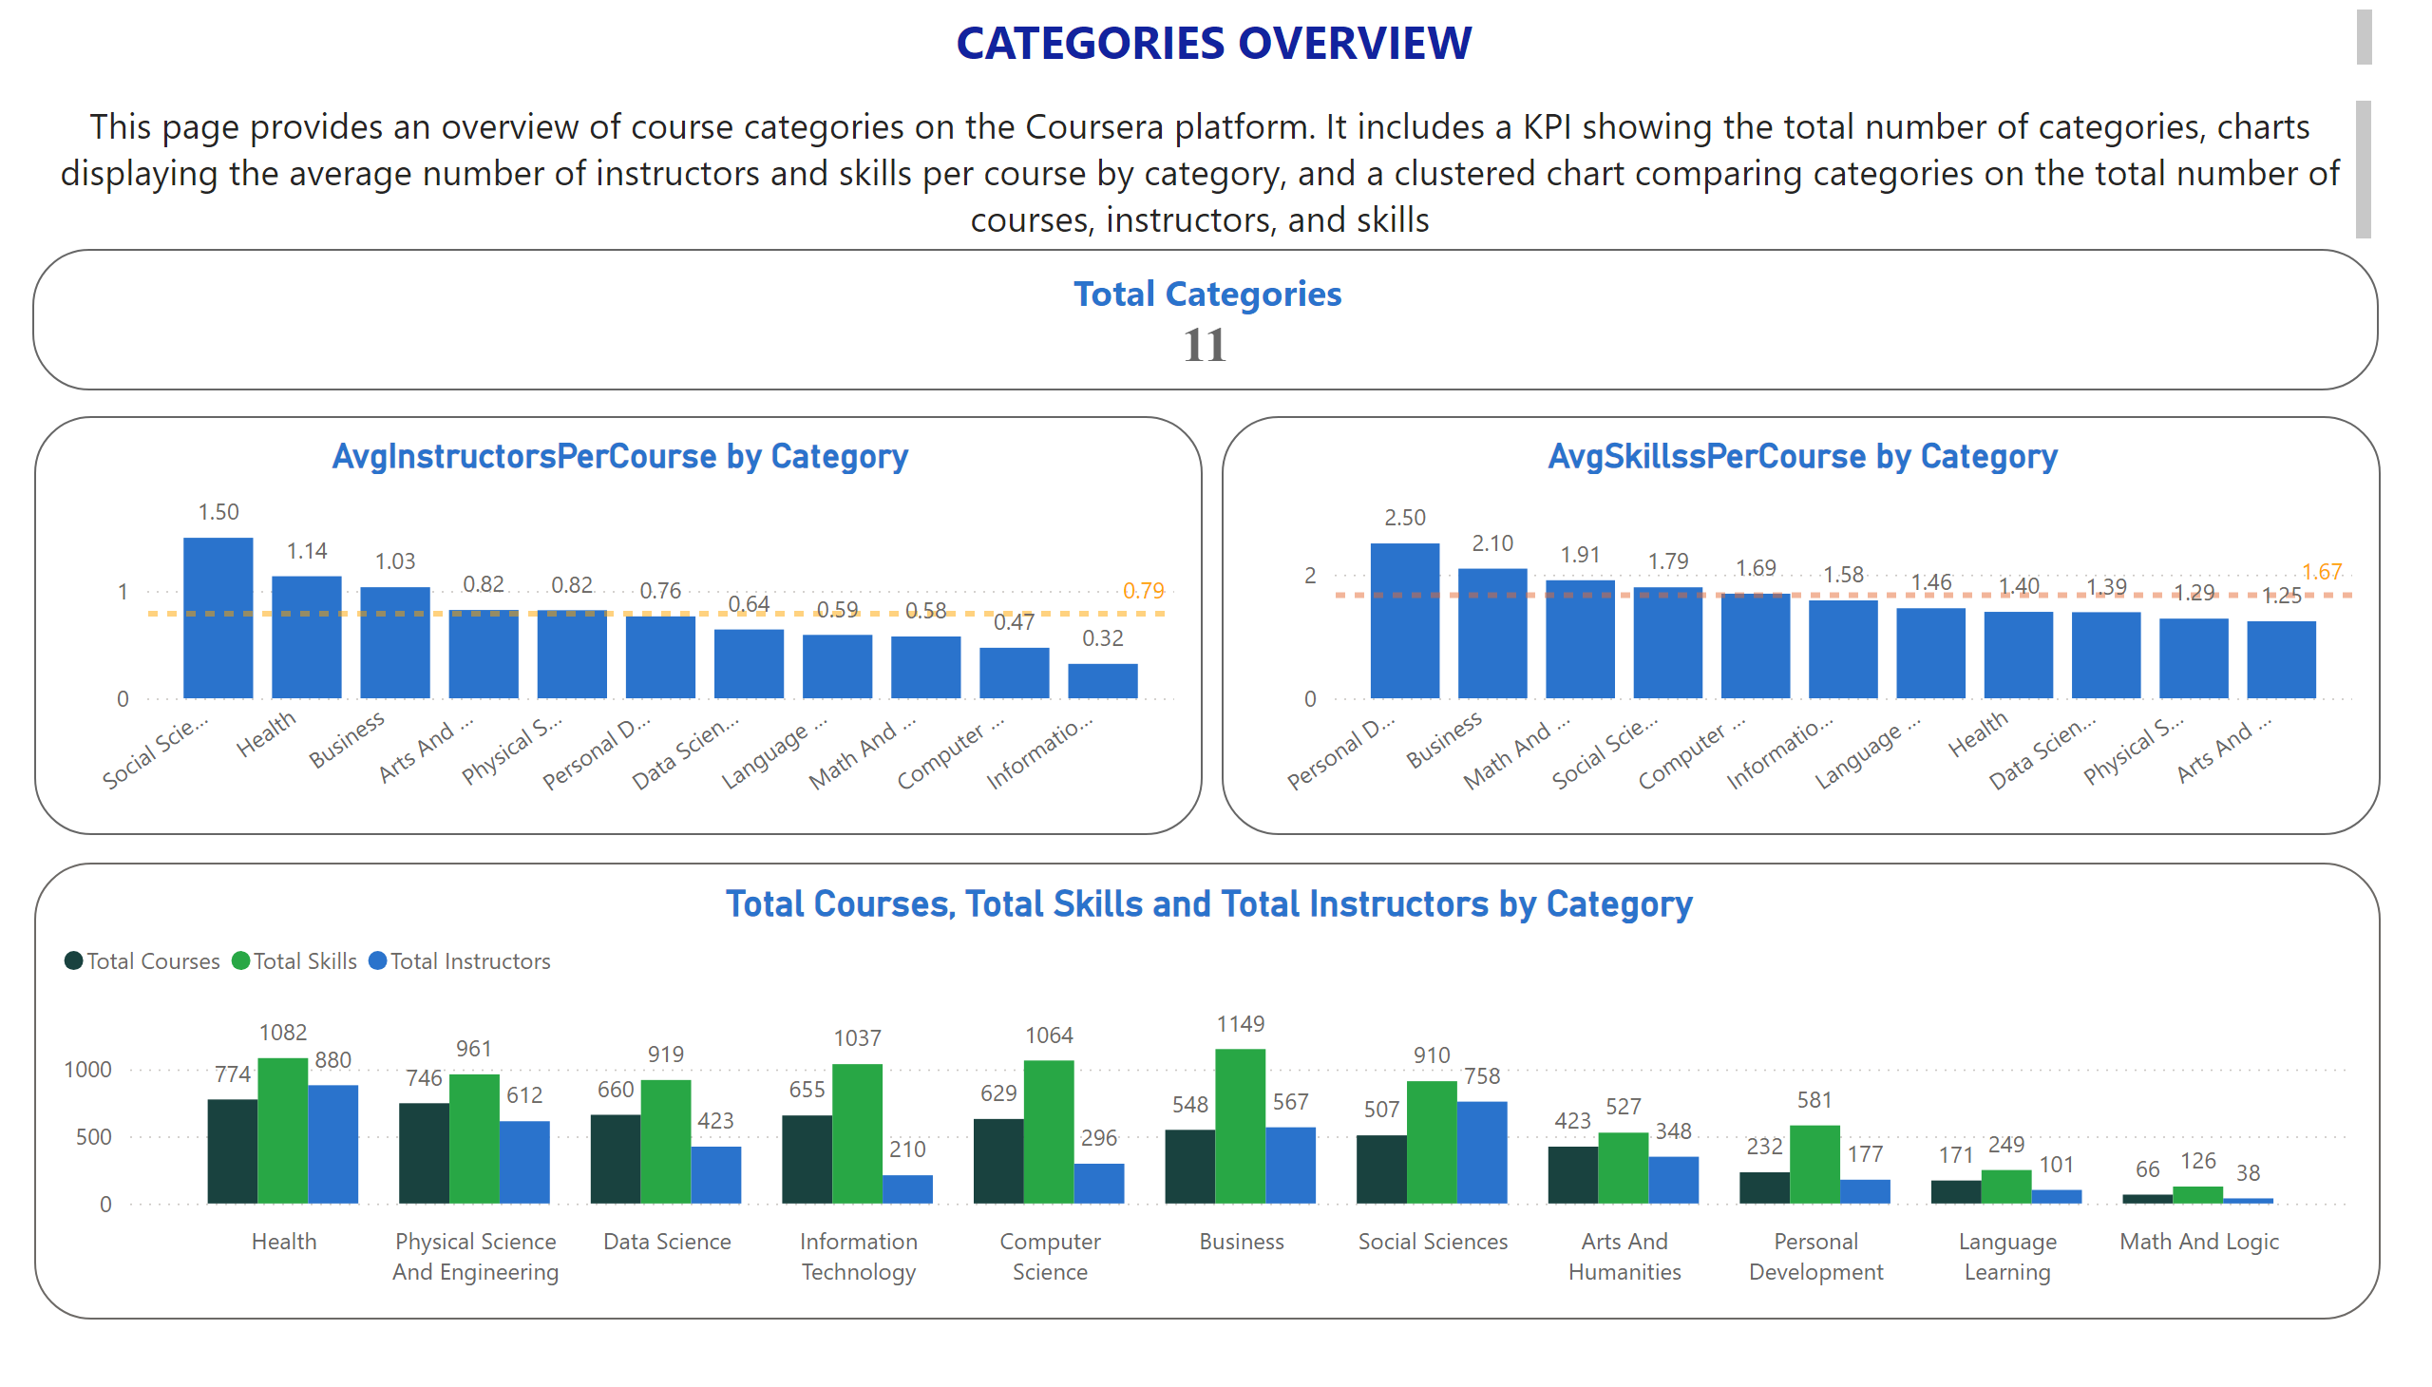
Category
Notes:
clusteredColumnChart
This clustered column chart shows the distribution of courses, instructors, and skills for each category
listSlicer
No alt text provided
textSlicer
No alt text provided
textSlicer
No alt text provided
textSlicer
No alt text provided
Total Categories
This KPI shows the total number of category in the Coursera platform.
clusteredColumnChart
This column chart shows the average number of instructors per course for each category, with a reference line indicating the overall average across all categories.
clusteredColumnChart
This column chart shows the average number of skills per course for each category, with a reference line indicating the overall average across all categories.
textbox
Categories Overview
textbox
This page provides an overview of course categories on the Coursera platform. It includes a KPI showing the total number of categories, charts displaying the average number of instructors and skills per course by category, and a clustered chart comparing categories on the total number of courses, instructors, and skills
textSlicer
No alt text provided
textSlicer
No alt text provided
textSlicer
No alt text provided

Slide 11
Categories Dashboard – Key Insights
Main KPI
Total categories: 11
Average number of instructors per course (by category)
Social Sciences → 1.50
Health → 1.14
Business → 1.03
Average number of skills per course (by category)
Personal Development → 2.50
Business → 2.10
Math & Logical → 1.90
Combined overview
Grouped column chart showing Total Courses, Total Skills, and Total Instructors per category.

Slide 12
Conclusion
This analysis highlights several key insights from the Coursera dataset:
Data Analysis is the skill with the highest number of courses.
Health is the top category for both course count and instructor count.
The instructor with ID 158 315 127 has the most courses.
Business has the highest number of skills.
Social Sciences shows the highest average instructors per course.
Personal Development has the highest average skills per course.
Although Data Analysis belongs to Data Science, the category shows a low average of instructors per course (0.64).

