Slide 1

DEVELOPMENT & IMPLEMENTATION OF INDUSTRIAL AUTOMATION SYSTEM
Presented by
D. Gopi Prasanna [22NN1A0463]
B. Sravanthi [23NN5A0402]
B. Sri Lakshmi [22NN1A0454]
M. Rajeswari [22NN1A0474]
Under the Esteemed Guidance of
Ms . K . Vinuthna, M. Tech
Associate Professor, Dept. of E.C.E
Department Of Electronics And Communication Engineering
Vignan’s Nirula Institute Of Technology & Science For Women

Slide 2
Contents
Abstract
Introduction
Block diagram
Components & Its Specifications
Software Used
Working process
1. Advantages & disadvantage
Output & Result
Conclusion
Future Add - On’s
References

Slide 3
Abstract
Industrial automation system integrates IoT to connect and monitor devices.
Enables real-time data collection and analysis for improved process control.
Optimizes operations through predictive maintenance and efficiency enhancement.
Uses sensors, actuators, and communication networks to automate tasks.
Reduces human intervention by enabling intelligent automation.
Improves productivity and reduces costs through data-driven decision-making.

Slide 4
Introduction
Industrial automation is evolving rapidly with IoT integration.
IoT enhances efficiency, reduces costs, and improves productivity.
Traditional systems relied on isolated controls, limiting connectivity.
IoT enables real-time data exchange between machines, sensors, and analytics platforms.
This transformation enhances process monitoring, decision-making, and automation.
An IoT-based system consists of sensors, cloud infrastructure.
Key benefits include operational visibility, predictive maintenance, and resource optimization.
This paper explores methodologies, challenges, and benefits of IoT in industrial automation.

Slide 5
1.Problem Statement
Traditional industrial automation relies on isolated controls with limited real-time monitoring, leading to inefficiencies.
Lack of real-time data exchange results in delayed decision-making, increased downtime, and higher operational costs.
Absence of predictive maintenance causes unexpected equipment failures and unplanned disruptions.
Cybersecurity risks, data management challenges, and system compatibility issues hinder seamless IoT integration.
Effective IoT implementation is crucial to overcoming these challenges and enhancing industrial automation efficiency.

Slide 6
2.Problem Solution
Real-Time Connectivity – Enables continuous monitoring and instant data exchange, reducing decision-making delays.
Predictive Maintenance – Sensors and analytics detect potential failures in advance, minimizing downtime and costs.
Optimized Resource Utilization – Enhances energy efficiency, reduces waste, and improves productivity.
Cloud-Based Data Management – Centralized storage and AI-driven analytics streamline operations and decision-making.
Cybersecurity Measures – Encryption, authentication, and secure IoT frameworks protect data integrity.
Seamless System Integration – IoT-compatible protocols ensure smooth adaptation with existing industrial infrastructure.

Slide 7
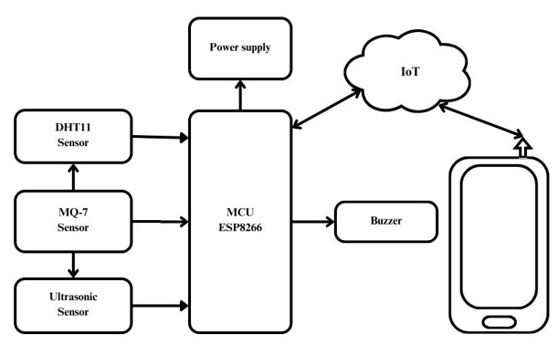
Block Diagram
Fig: Block diagram of automation system

Slide 8
Sensors: DHT11 (temperature/humidity), MQ-7 (gas), and ultrasonic sensors collect environmental and potentially health-related data.
MCU (ESP8266): Processes sensor data and communicates with the IoT cloud.
Buzzer: Provides alerts.
IoT: Enables remote monitoring and data access.
Mobile Phone: Used for interface and notifications.
Power Supply: Powers the system.

Slide 9
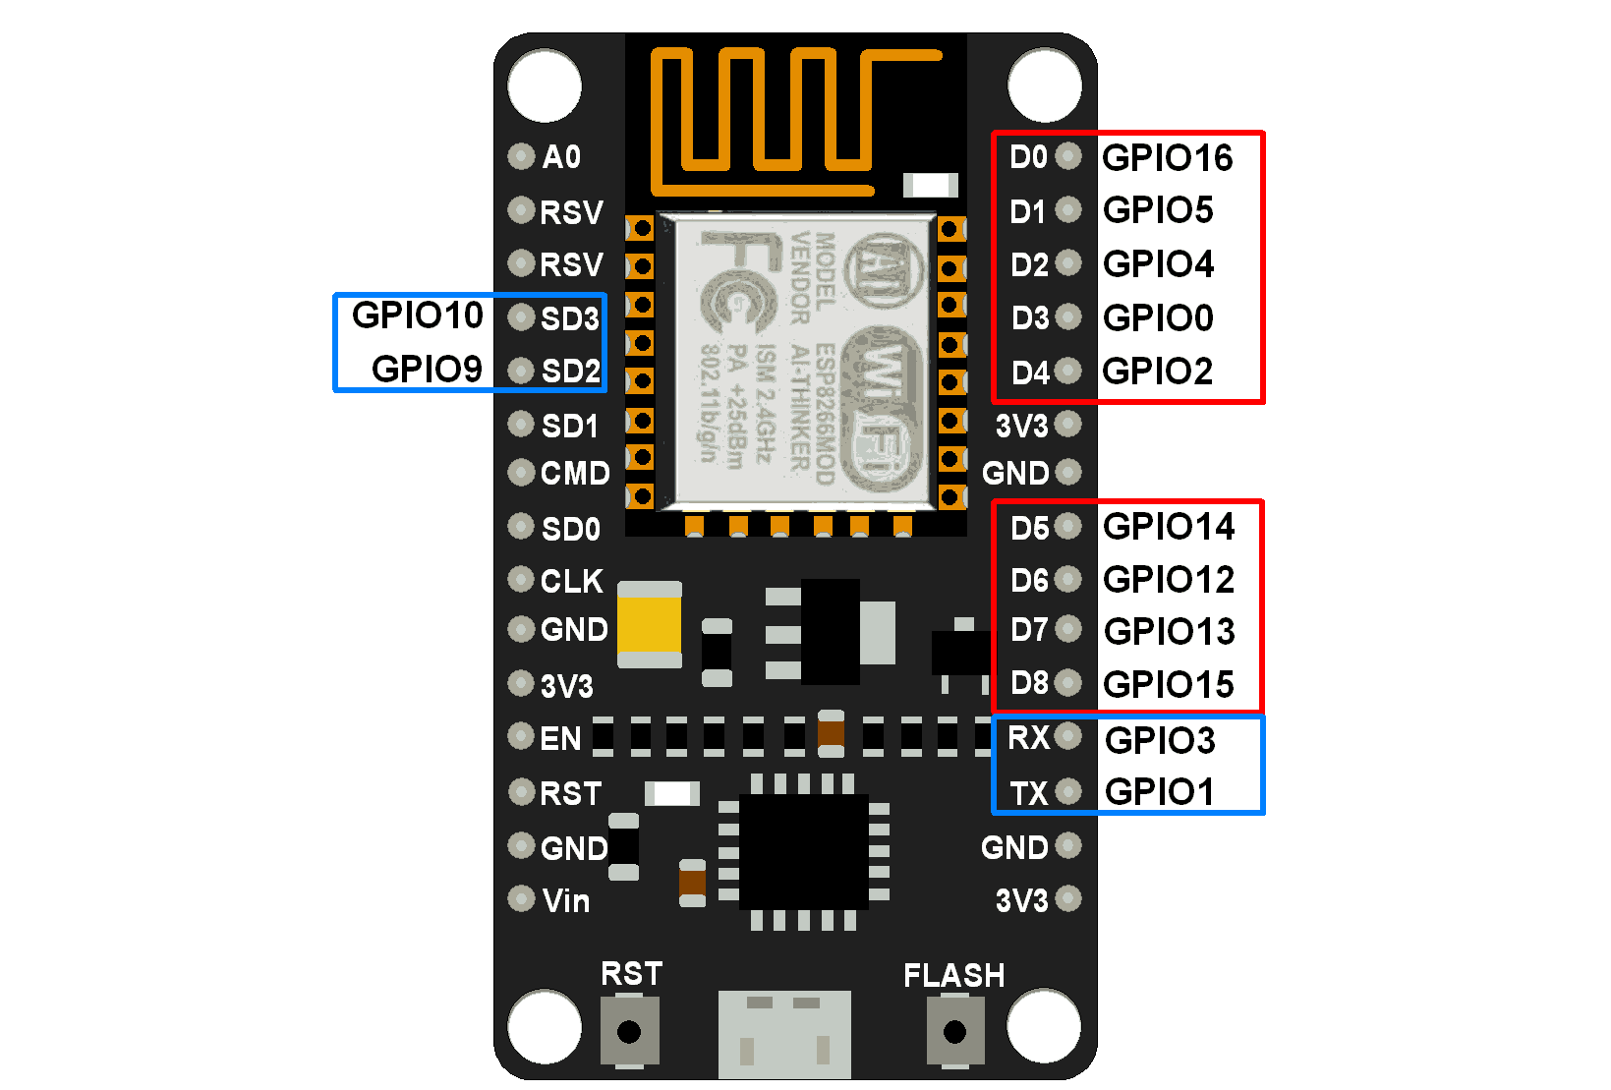
Components & Its Specifications
ESP8266 32bit-Microcontroller
Handles IoT communication with sensors and Blynk platform.
Supports Wi-Fi & Bluetooth (BLE & Classic in ESP32).
Operates at 3.3V with 7-12V input via Vin pin.
Dual-core (ESP32) / Single-core (NodeMCU), up to 240 MHz clock speed.
Multiple GPIO, PWM, and ADC channels for versatile applications.
Fig:ESP8266 32bit-Microcontroller

Slide 10
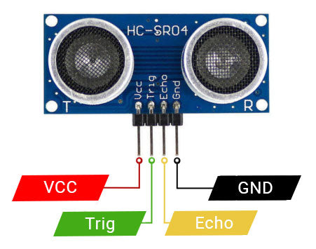
Ultrasonic Sensor (HC-SR04)
Fig: Ultrasonic Sensor (HC-SR04)
Measures object distance using sound wave reflections.
Operates at 5V DC with 15mA working current.
Detection range: 2cm to 400cm with ±3mm accuracy.
Uses 40 kHz frequency for distance measurement.
Trigger input: 10µs pulse, Echo output: Pulse width proportional to distance.

Slide 11
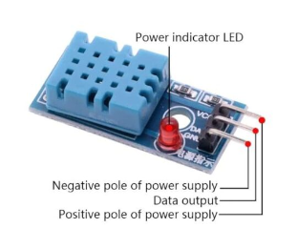
DHT Sensor Module with LED
Fig:DHT Sensor Module with LED
Measures temperature & humidity for environmental monitoring.
Operates at 3.3V to 5V DC with digital output.
Temperature range: 0°C to 50°C with ±2°C accuracy.
Humidity range: 20% to 90% RH with ±5% accuracy.
Fast response time: <5 seconds, sampling rate: 1 Hz.

Slide 12
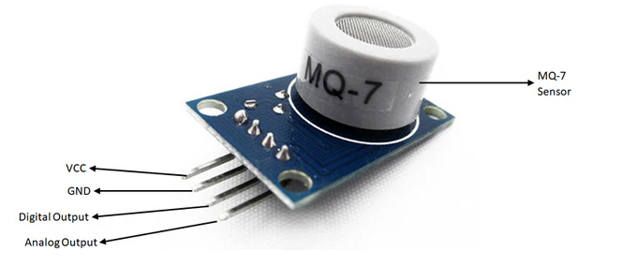
MQ -7 Gas sensor
Fig:MQ -7 Gas sensor
Detects carbon monoxide (CO) concentrations from 10 to 10,000 ppm.
Operates at 5V DC with <150mA power consumption.
Provides both analog (0-5V) & digital (0/5V) outputs.
Adjustable sensitivity via onboard potentiometer.
Fast response, stable performance, long lifespan, and low cost.
Heater consumption: ~350mW, operating temperature: -10°C to 50°C.

Slide 13
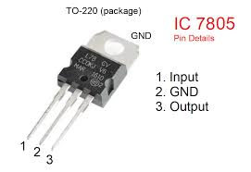
LM7805 Power Supply Module
Fig:LM7805 Power Supply Module
Provides stable 5V output from a 7V to 35V input.
Maximum output current: 1.5A, with ±2% voltage tolerance.
Low quiescent current: 5mA, dropout voltage: 2V.
Built-in thermal & short-circuit protection for safety.
Operating temperature: 0°C to 125°C, TO-220 package.
Pinout: Vin (input voltage), GND (ground), Vout (regulated 5V output).

Slide 14
Software Used
IoT Cloud & Servers
IoT Cloud: Scalable infrastructure for connecting, managing, and securing IoT devices.
Types of Servers:
IoT Data Server – Data collection & processing.
IoT Web Server – Remote device control.
Embedded Web Server – Local lightweight control.
Network Server – Manages large-scale IoT connections
Blynk IoT
No-code IoT platform for remote hardware control.
Features: Cloud-based, multi-device control, remote monitoring, scalability, open-source.
Applications: Used in prototyping & commercial IoT solutions.

Slide 15
Setting Up Blynk 2.0 & Arduino IDE:
Blynk 2.0 Web & Mobile App Setup:
Create Blynk account → Add Template & Datastreams.
Set up Web Dashboard → Configure Switch Widgets → Generate Auth Token.
Blynk Mobile App Setup:
Download Blynk app → Log in → Add Device from Template.
Configure UI & controls.
Arduino IDE & NodeMCU ESP8266 Setup:
Install ESP8266 Board & Blynk Library in Arduino IDE.
Connect NodeMCU ESP8266 via USB, select board & port.

Slide 16
Working process
1.Sensor Data Collection & Object Detection
Ultrasonic Sensor: Measures object distance using time-of-flight principles.
MQ7 Gas Sensor: Detects harmful gases in the environment.
DHT Sensor: Monitors temperature and humidity in real time.
2. IoT Connectivity & Data Transmission
Sensors are connected to ESP8266/NodeMCU, which gathers and processes data.
Data is transmitted via Wi-Fi to the Blynk IoT platform for remote monitoring.
3. Cloud-Based Data Processing & Analysis
The Blynk cloud platform stores and visualizes real-time data.
Integrated machine learning algorithms analyze historical data for predictive maintenance.

Slide 17
4. Automated Alerts & Notifications
If an object is detected within a set range, alerts are sent to the user’s mobile device.
Notifications for gas leakage, temperature rise, or humidity changes ensure quick response.
5. Remote Monitoring & Control
Users access real-time data via Blynk’s mobile app or web dashboard.
Actuators can be remotely controlled based on sensor readings.
6. Predictive Maintenance & Decision-Making
Machine learning predicts potential equipment failures and schedules maintenance.
Reduces downtime and prevents unexpected machine failures.
7. Security & Scalability
Data encryption & authentication protect system integrity.
Modular architecture allows easy integration of additional sensors for scalability.

Slide 18
Advantages & Disadvantage
Advantages:
Increased efficiency
Reduced operational costs
Improved safety
Real-time monitoring & control
Higher productivity
Data-driven decision making
Scalability & flexibility
Disadvantages:
High initial cost
Complex setup & integration
Cybersecurity risks
Job displacement
Maintenance & technical challenges
Dependence on technology
Customization challenges

Slide 19
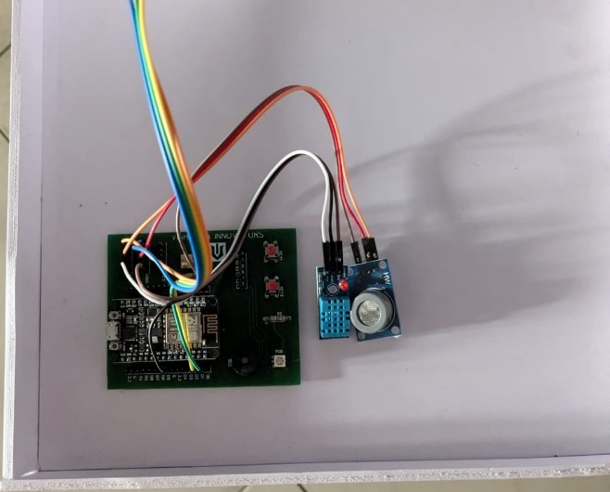
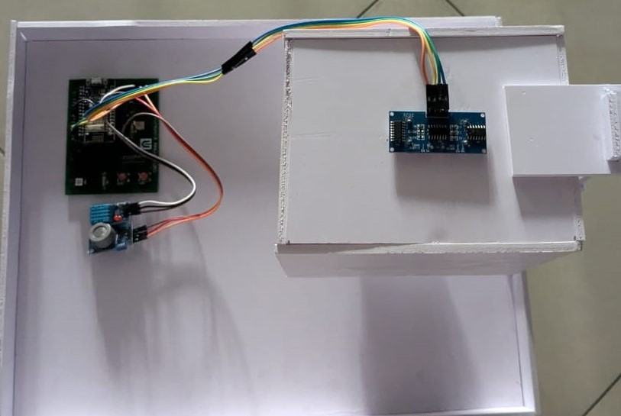
Output & Result

Slide 21
Conclusion
Improves operational efficiency and productivity.
Enables real-time monitoring and decision-making.
Reduces downtime through predictive maintenance.
Optimizes resource utilization (energy, materials, manpower).
Provides scalability for future industrial needs.
Enhances data-driven decision-making with analytics.
Requires strong cybersecurity measures for data protection.
Involves high initial costs but ensures long-term savings.
Supports advancements in smart manufacturing and Industry.

Slide 22
Future Add - On’s
AI Integration – Enhancing predictive maintenance and automation.
Edge Computing – Faster processing with minimal cloud dependency.
5G Connectivity – Low-latency communication for real-time operations.
Blockchain Security – Secure and tamper-proof data transactions.
Robotic Automation – AI-powered robots for precision tasks.
Augmented Reality (AR) – AR-based remote monitoring and diagnostics.
Energy Optimization – Smart power management for efficiency.
Self-Healing Systems – Automated detection and real-time issue resolution.

Slide 23
References

Slide 24


