Slide 1
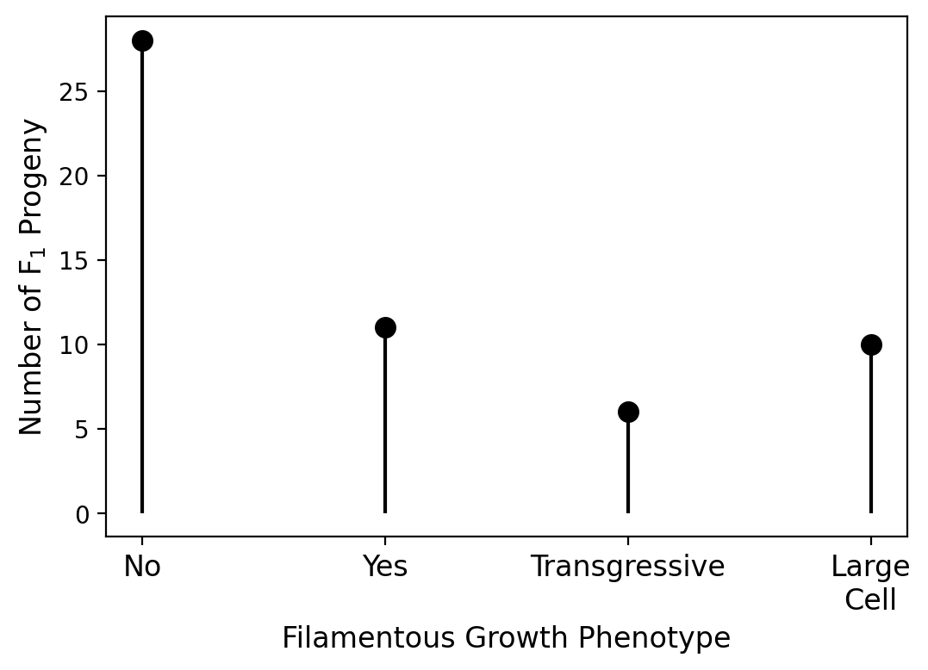
Summary Statistics
Total number of progeny: 57
Unique progeny: 55 (2 sets of clones)
Clones:
A27 & A24 (T & F)
A44 & A43 (T & F)
Number of progeny with aneuploidy: 1
(A03, chromosome 11, non-filamentous)
Total number of genetic variants: 1926
On chromosome 4: 1409 (MAT)
On chromosome 2: 475 (Markers in CF830)
Median number of
variants per
chromosome: 4
Number of unique haploblocks
(for QTL mapping): 59

Slide 2
Information Theoretic Approach
I (G₁; C)
I (G₁, G₂; F)
H (G₁)
H (F)
H (F)
H (G₁)
G₁
Phenotypic
space
Phenotypic
space
Genetic
Variant
Site
G₂
F
G₁
F
H (G₂)
Hu et al. 2013

Slide 3
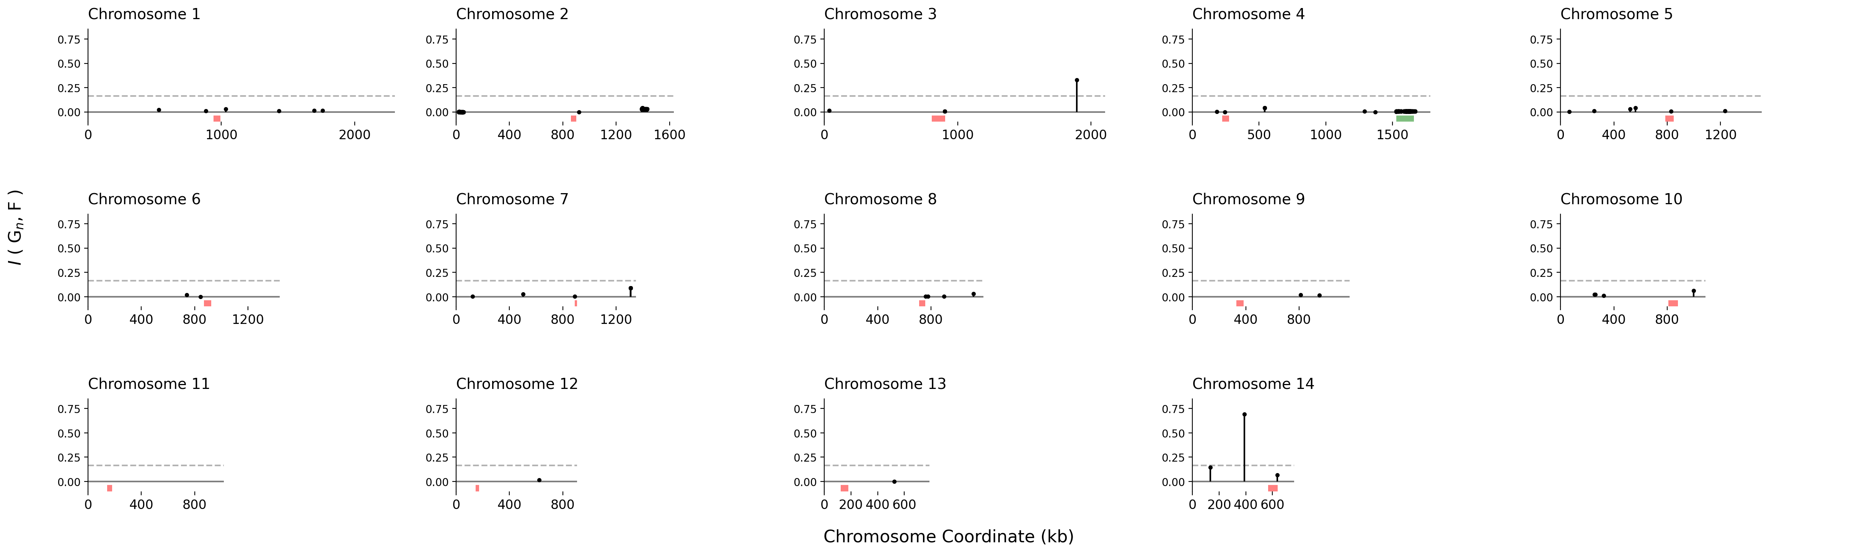
Filamentous Growth Manhattan Plot

Slide 4
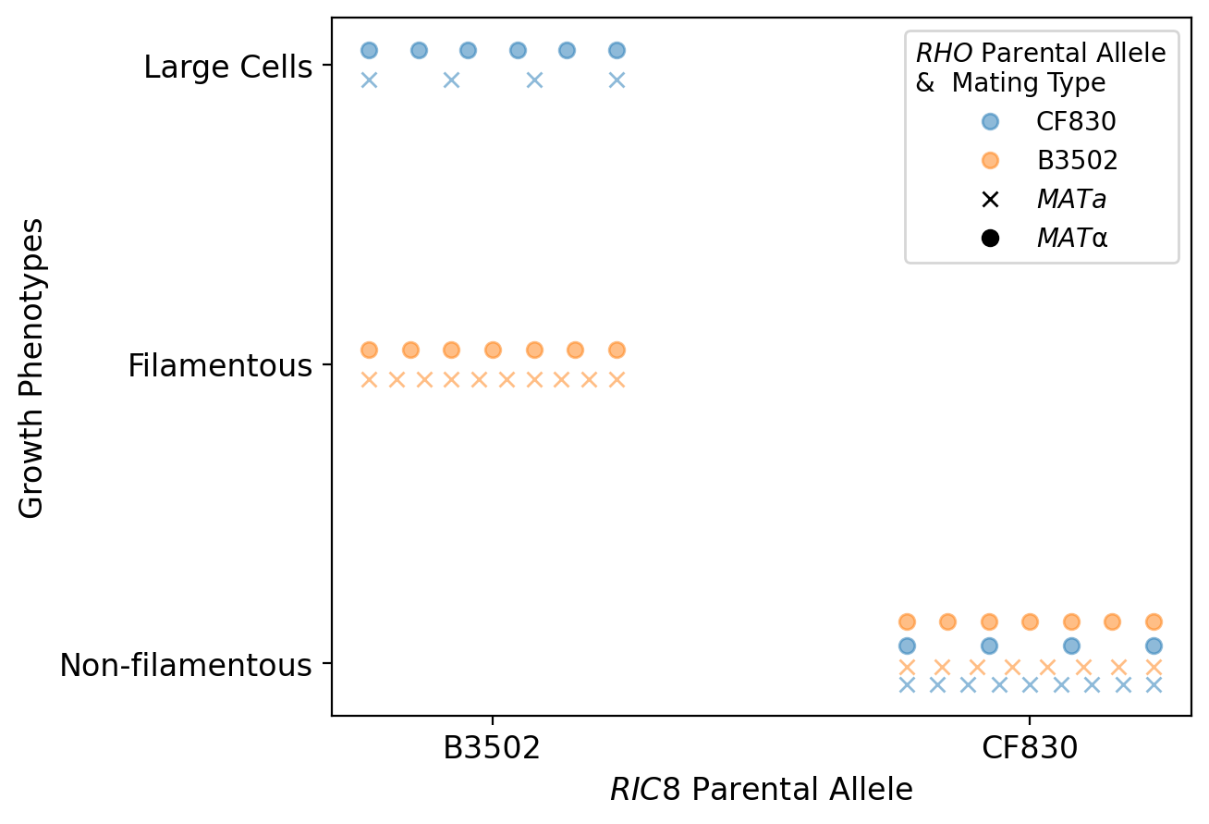
Filamentous Phenotype by Genotype
Main effects:
I ( RIC8, F ) = 0.69 (p-value = 0.0)
I ( RHO, F ) = 0.33 (p-value = 0.0)
Epistatic effect:
I ( RIC8, RHO, F ) = - 0.0045
(p-value = 0.0)

Slide 5
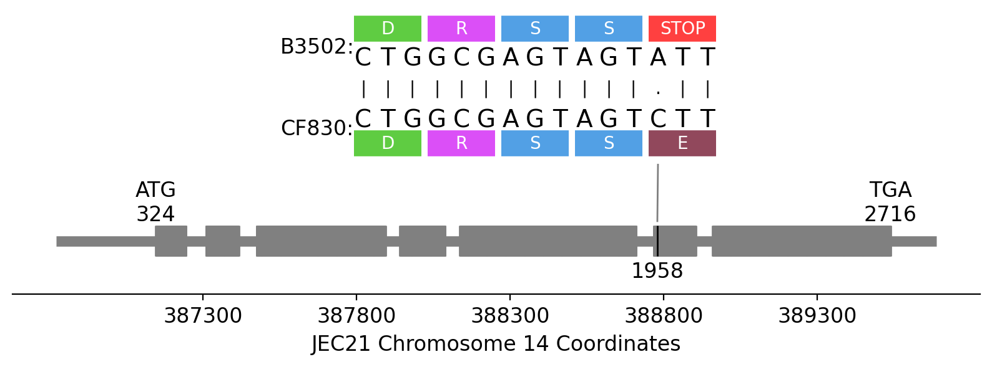
RIC8 Gene Model (Chromosome 14 QTL)

Slide 6
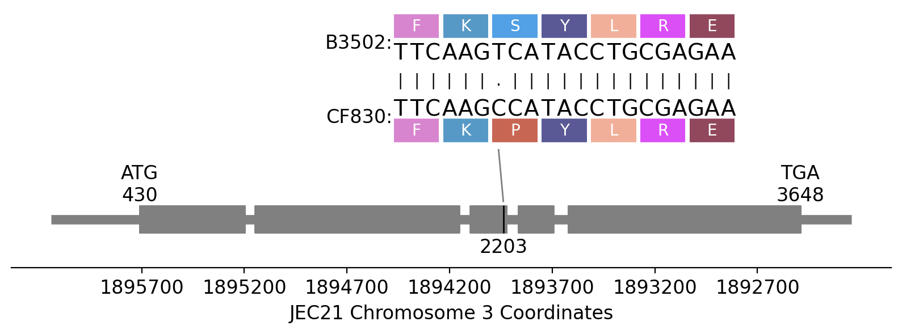
RHO Gene Model (Chromosome 3 QTL)

