Slide 1
Store Sales Prediction

Slide 2
Outline
01
Introduction & Project workflow
Goal and workflow of project
02
Data Description
Describe the data
03
Data preprocessing
Analysis and visualization
04
Machine learning Model
Models

Slide 3
Introduction
The goal of this project, I will use machine learning to Store Sales Prediction to provide the stores with essential insights into the upcoming inventory and cash flow for the following months.

Slide 4
Project workflow
1
Import libraries
2
Data Preprocessing
Data visualization
3
Read Data
Data splitting
Build Models
4
Evaluating Model Performance

Slide 5
Data Description
This dataset can be found at Kaggle. This dataset contains over 18000 rows with 8 features and after engineering features 16. The dataset that they provided contains the information of sales with:
ID: Unique identifier for a row
Store id: Unique id for each store
Store type: Type of the store
Location type: Type of the location where the store is located
Region Code: Code of the region where the store is located
Date: Information about the date
Holiday: If there is a holiday on the given date
Discount: If the store offers a discount on the given date

Slide 6
Data preprocessing
Analysis and visualization

Slide 7
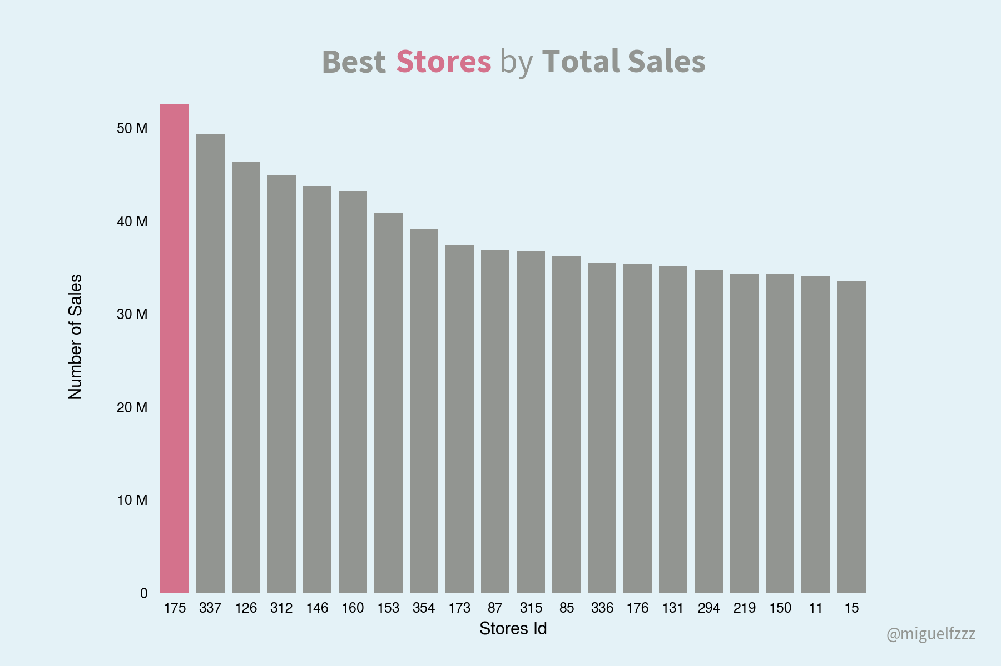
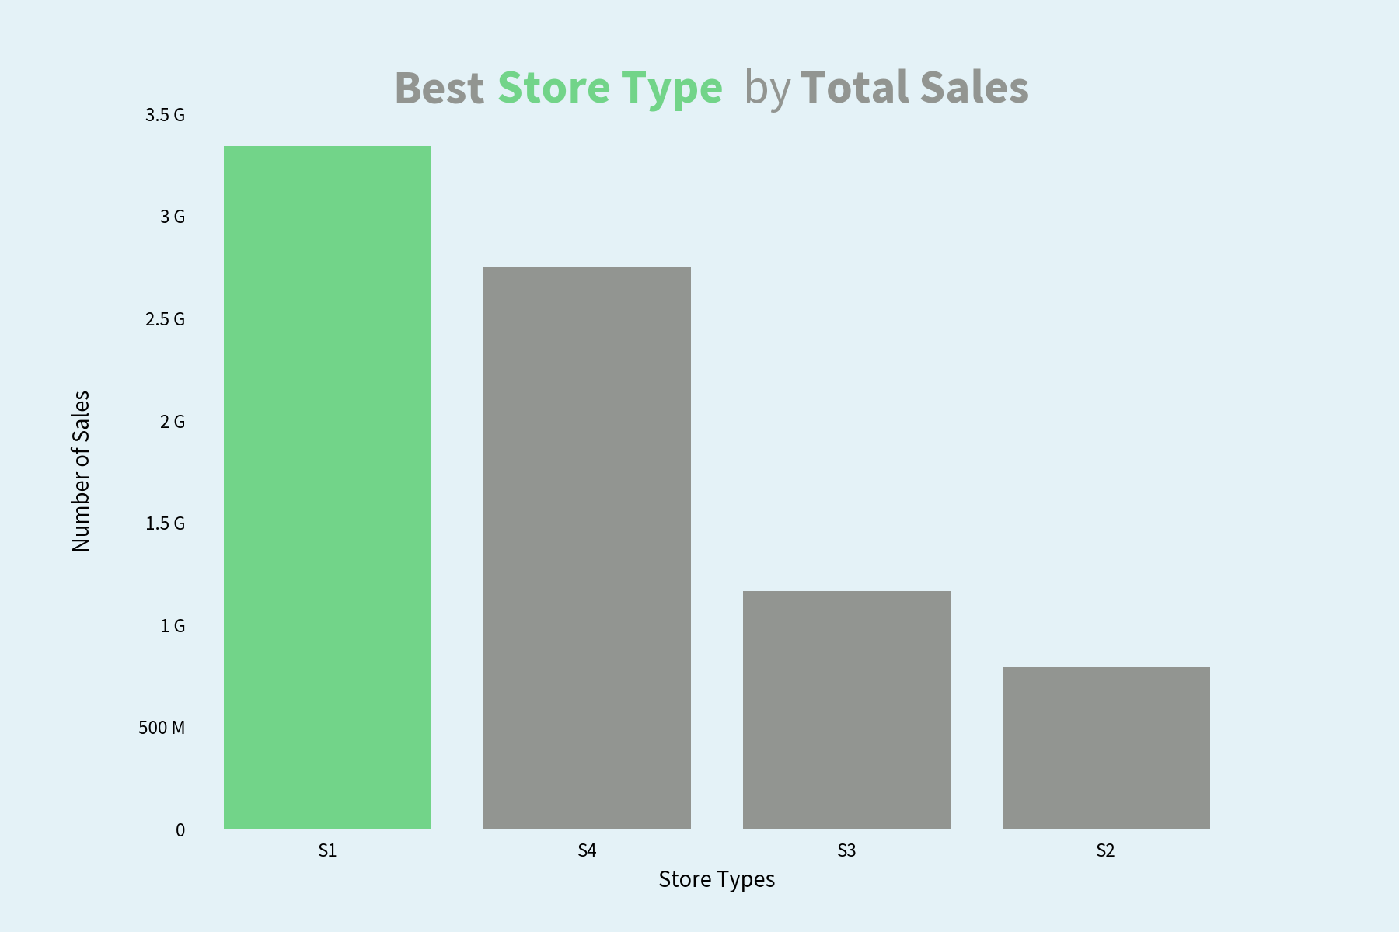
Analysis and visualization
The best stores (by number of sells)
The best store types (by number of sales)

Slide 8
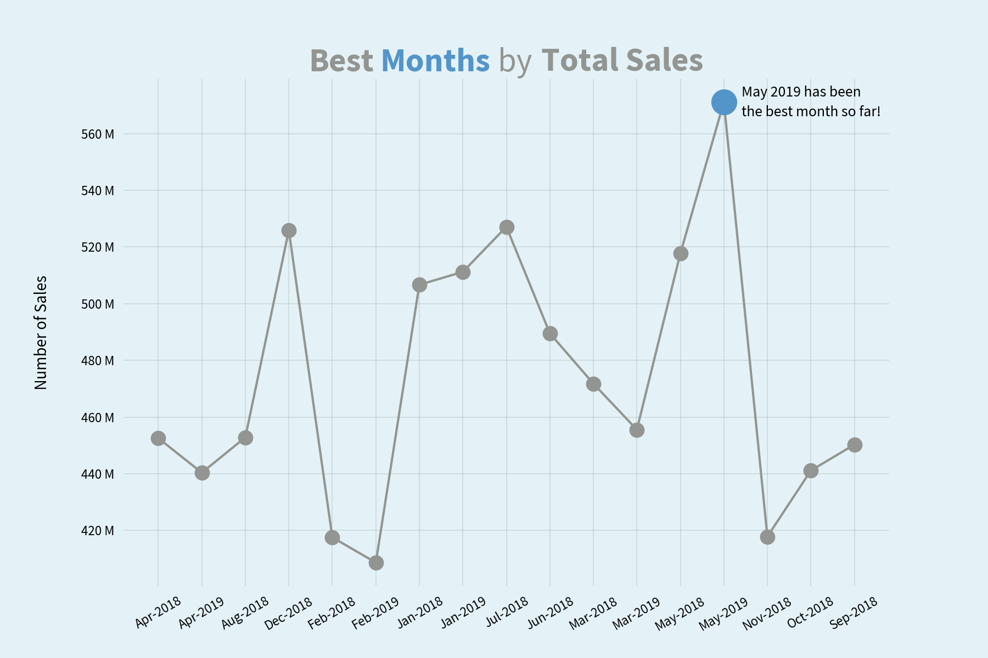
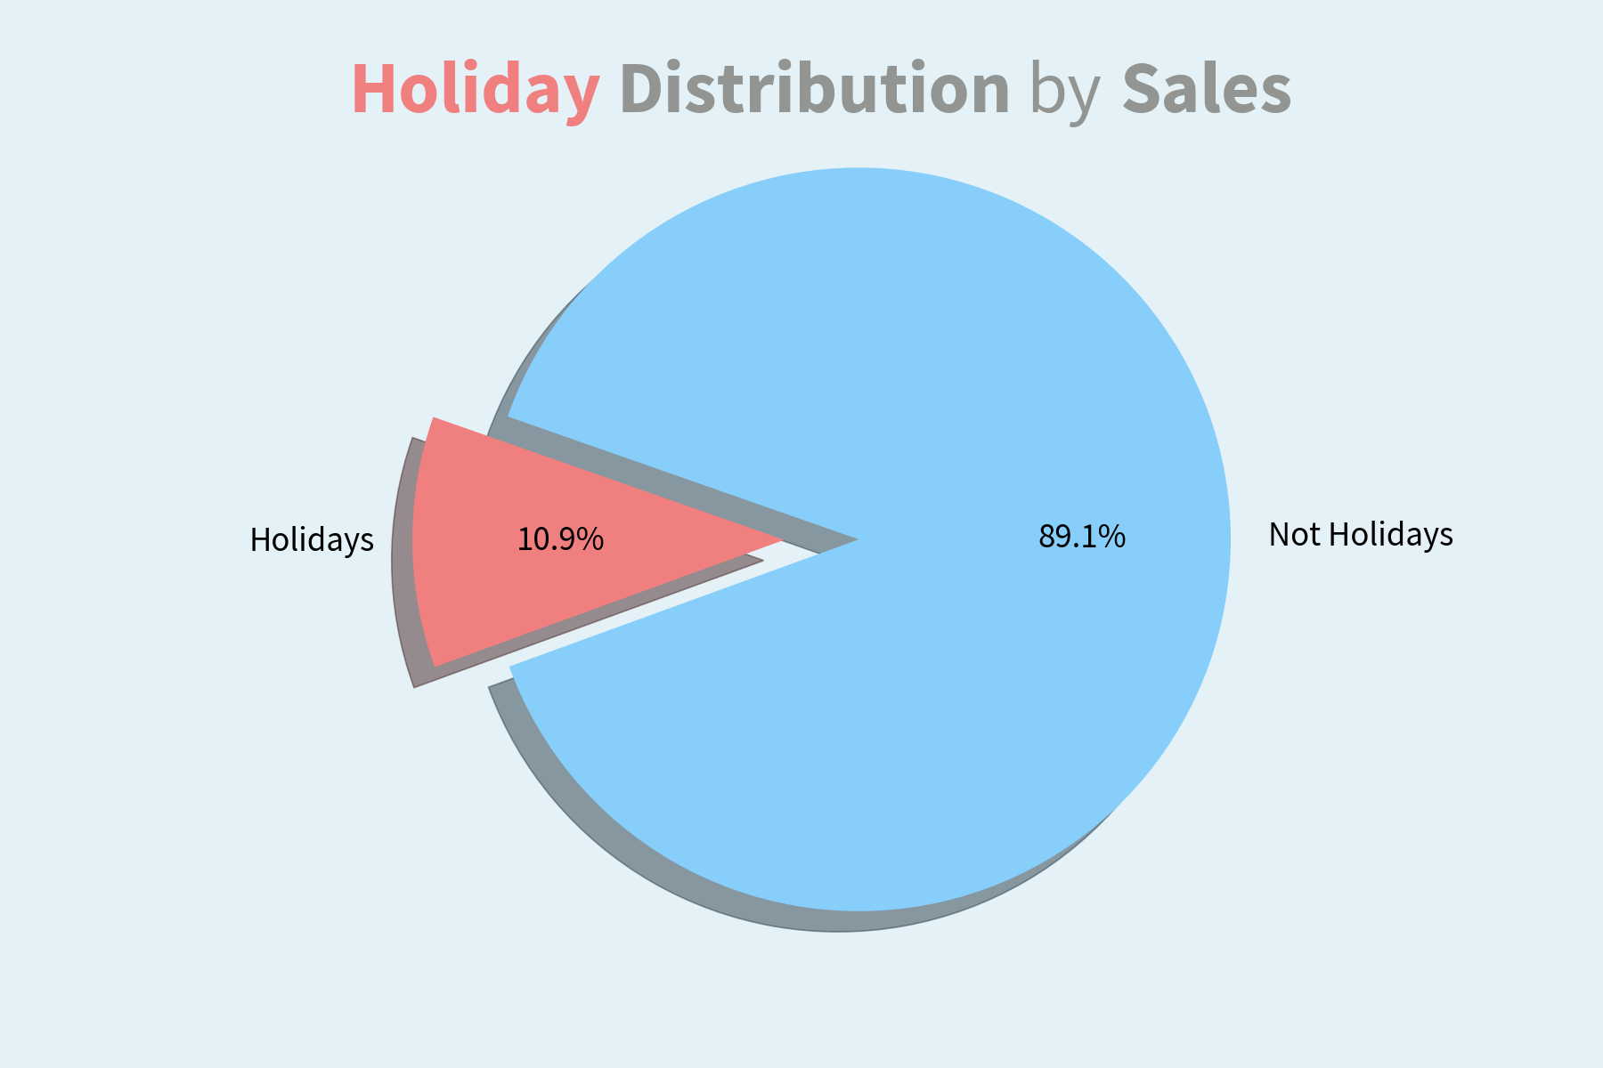
Analysis and visualization
Best months by Total sells
Holidays Distribution by Sales

Slide 9
Machine learning Model

Slide 10
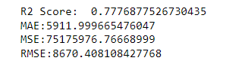


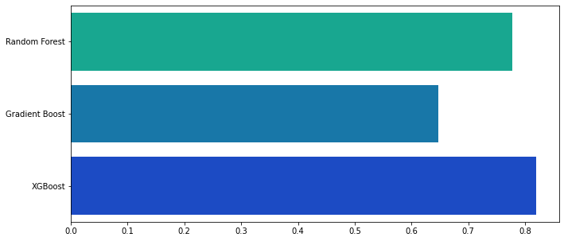
Models
Random Forest
Gradient Boosting RegressorDecisionTreeClassifier
XGBRegressor
Scores

Slide 11
Thanks!

