Slide 1
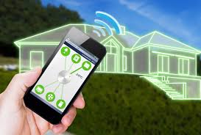
HOME AUTOMATION SYSTEM
Nithya Shree M
Sabarish K C
Mahalakshmi T M

Slide 2
ABSTRACT
The main objective of this project is to operate the electrical devices(lights, fans , etc) using Internet. This project works on the concept of “INTERNET OF THINGS”. The software used here is Arduino .

Slide 3
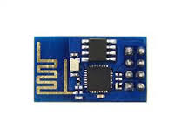
REQUIREMENTS
Software Requirements:
Arduino
Android Studio
Visual Studio 15
Hardware Requirements:
ESP8266 Board

Slide 4
WORKING
The ESP8266 Board is connected to the mobile device using WIFI module.
During compilation process, an IP address is generated.
This IP is given as input to the mobile application that has been developed.
Once the input is given, the control of the devices page will be displayed.

Slide 5
CONCLUSION
Thus, this project helps in the efficient use of electrical devices using Internet in order to ease human work.

Slide 6
THANK YOU

