Slide 1
BANK LOAN CASE STUDY
Final Project – 2
Submitted by: Mahalakshmi Sreenivasan

Slide 2
PROJECT DESCRIPTION
I have been given 3 datasets relating to Bank Loan Case Study. They are:
application_data: contains information of the client at the time of loan application
previous_application: contains information about the client’s previous loan data
columns_description: describes meaning of the variables
It is expected to use the concepts of EDA to determine the driving factors behind loan default
Concepts of Statistics, MS Excel and Jupyter Notebook are used to analyze the dataset and obtain the required results.

Slide 3
PROJECT APPROACH
Firstly, I went through the datasets given. Since they were large enough, I opened several Excel Worksheets for the same, to reduce chances of error and understand each record better. Then , I executed each of them in Jupyter Notebook.
The column variables are read and understood from the columns_description excel sheet.
I have also done a decent research on the terms new to me.

Slide 4

Tech Stack Used
Jupyter Notebookis the backbone for this project
It is a free Python environment that supports many popular machine learning libraries .

Slide 5
Insights
On analyzing the Bank Loan Case Study Dataset, I've got a deeper understanding of the importance of Outliers and its effects.
The usage of Python Machine Learning commands have become clearer.
I can implement the Advanced Statistical Functions and Visualization tools for datasets in a much better way.

Slide 6
RESULTS

Slide 7
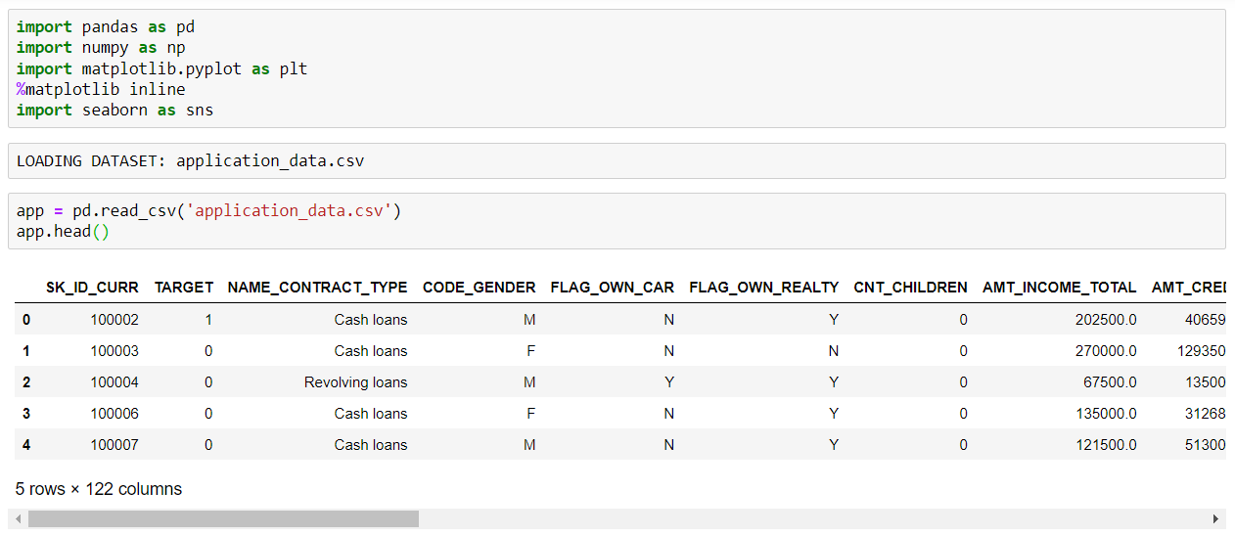

Loading the Dataset
Missing Data must be analyzed to avoid a large skew and difference in the required result.
We must determine the columns whose missing values have an impact on the dataset. Then, an appropriate imputation method must be used.
For Example, Median and Mode can be used for Categorical Data.
(First, load the dataset application_data.csv)

Slide 8
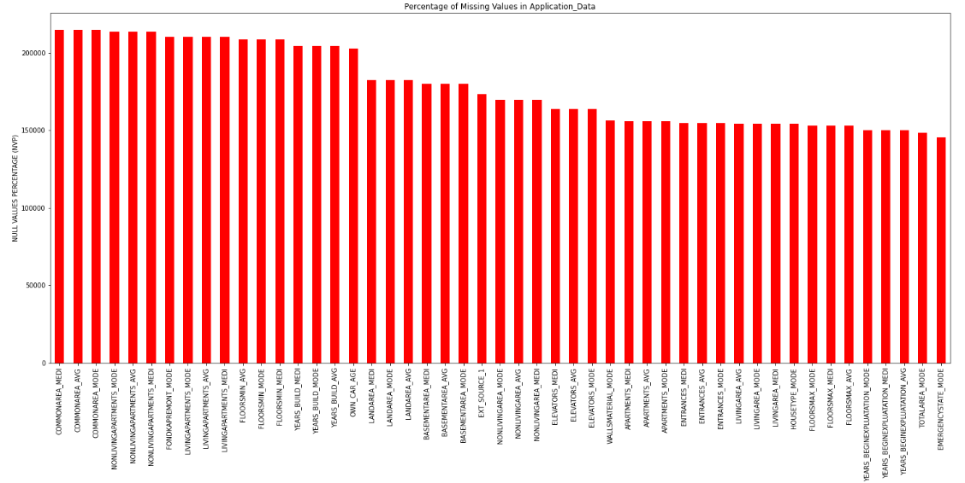
Data Cleaning
Perform Data Inspection through info() and describe(), calculate Null Value Percentage (NVP) and visualize columns having NVP>35%.

Slide 9
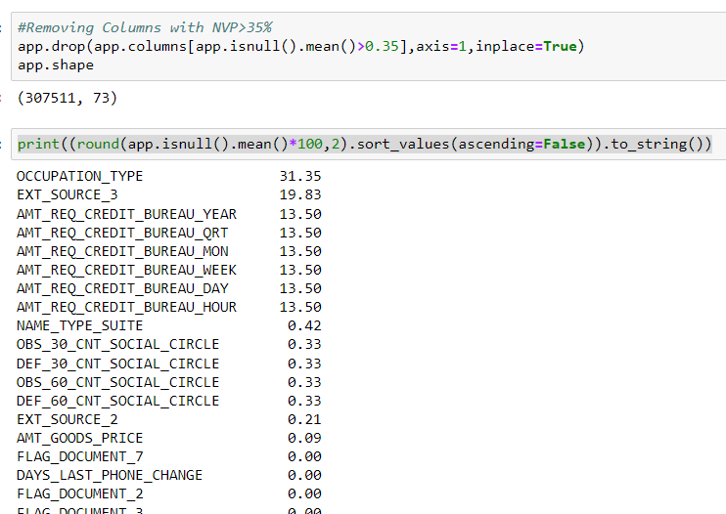
Here, the columns with NVP>35% are dropped.
So, the size of dataset reduces

Slide 10
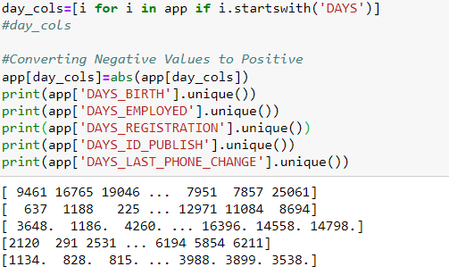
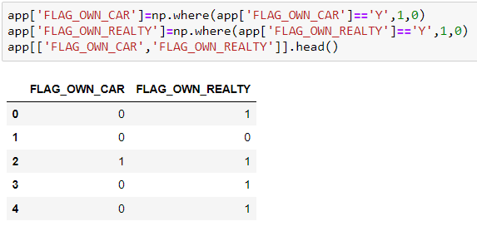
Error Handling
Negative Values columns are made Positive
The ‘Y’ and ‘N’ are converted to ‘1’ and ‘0’ respectively

Slide 11
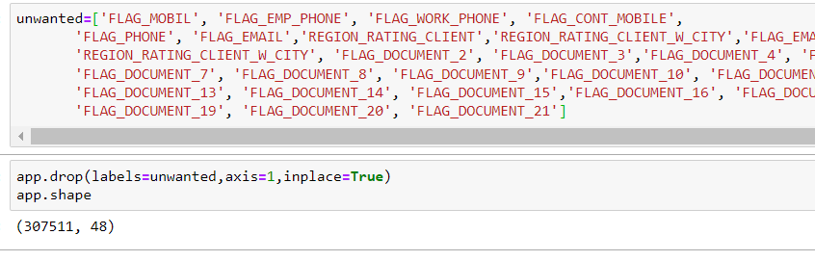
Here, the unnecessary columns are identified and dropped.
This helps for a better Data Analysis

Slide 12
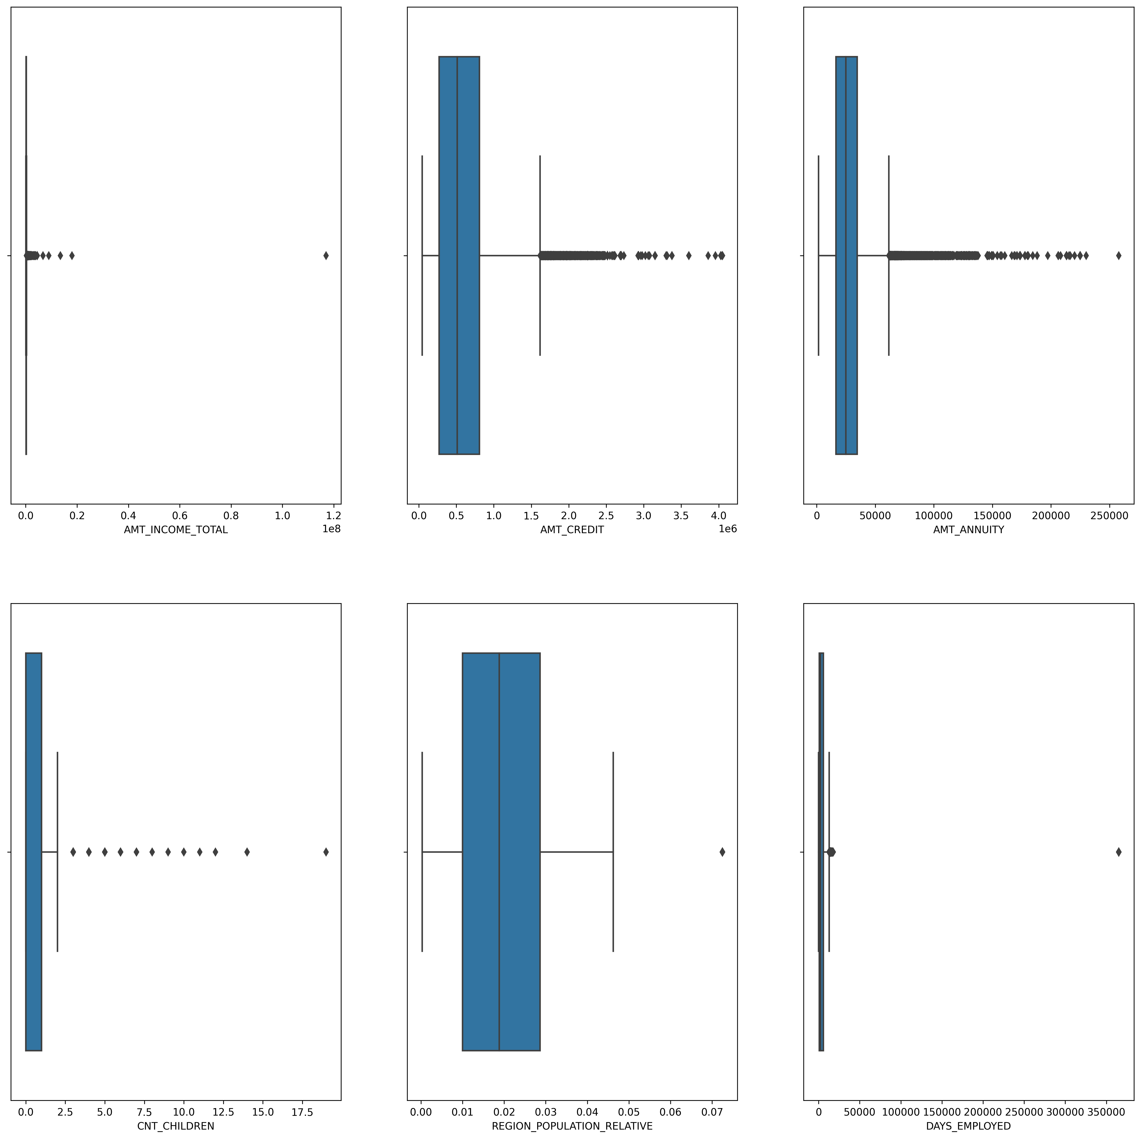
Outlier Analysis
The IQR for AMT_INCOME_TOTAL is very slim and there are a lot of outliers
The Q3 of AMT_CREDIT is larger than Q1 and there exists many outliers
The Q3 of AMT_ANNUITY is larger than Q1 and there exists many outliers
In CNT_CHILDREN, there exists outliers for children >2.5
In REGION_POPULATION_RELATIVE, Q3 is greater than Q1 and there exists only 1 outlier; after 0.07
The IQR in DAYS_EMPLOYED is very slim and many outliers exist after 10000 and 350000

Slide 13
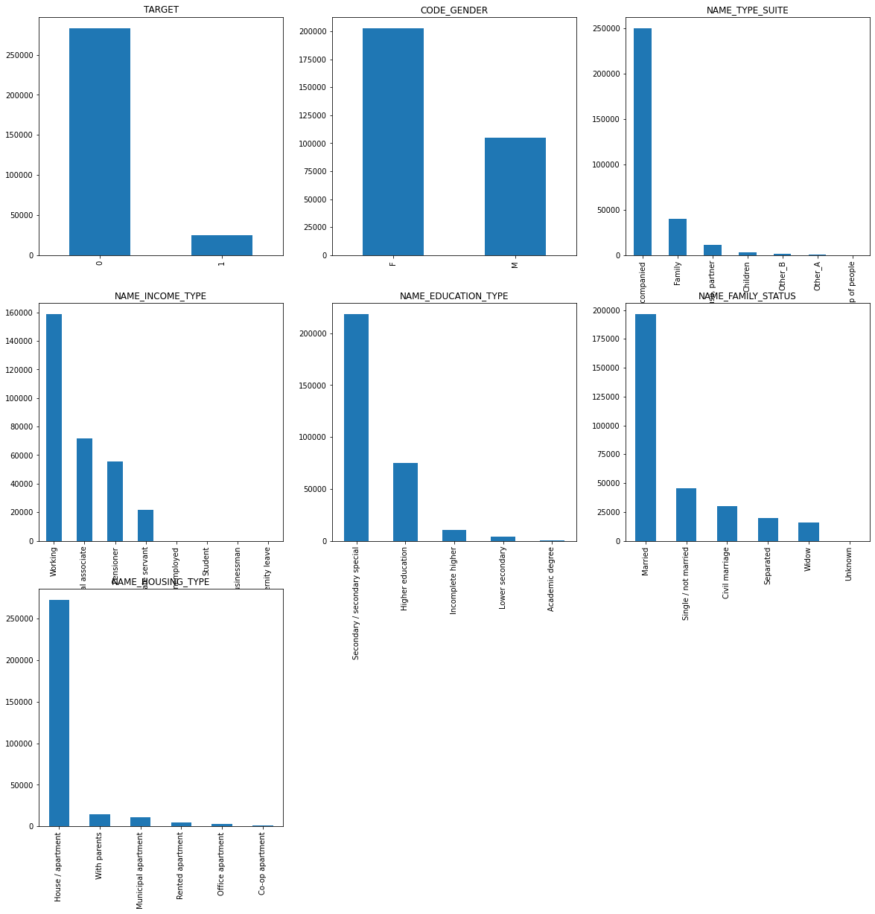
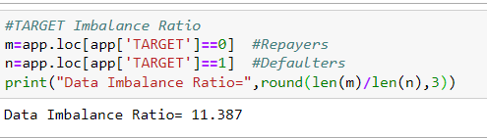
Data Imbalance
Data Imbalance is checked for various columns: TARGET,CODE_GENDER,NAME_TYPE_SUITE,NAME_INCOME_TYPE,NAME_EDUCATION_TYPE,NAME_FAMILY_STATUS,NAME_HOUSING_TYPE
TARGET has the maximum imbalance
Data Imbalance Ratio = 11.387

Slide 14
Univariate Analysis
It is a statistical analysis technique used to study a single variable.
Analysis is done for both Categorical and Continuous data using Bar Graphs and Density Plot, respectively

Slide 15
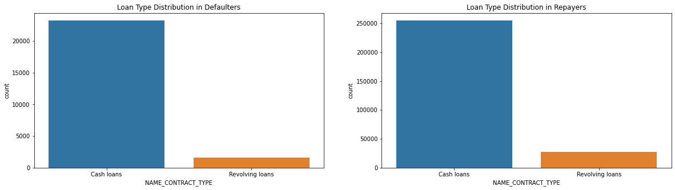
CATEGORICAL DATA
1) Loan Type
For both the cases, Revolving Loans are less compared to Cash Loans

Slide 16
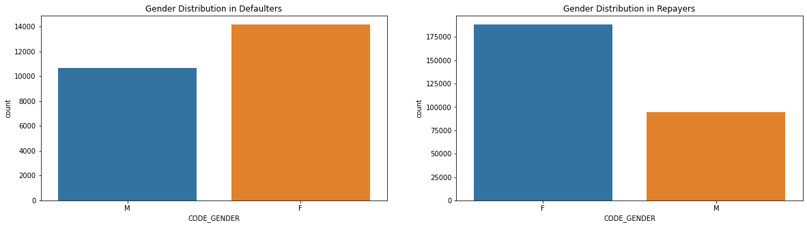
2) Gender
There are more Female Defaulters and Repayers

Slide 17
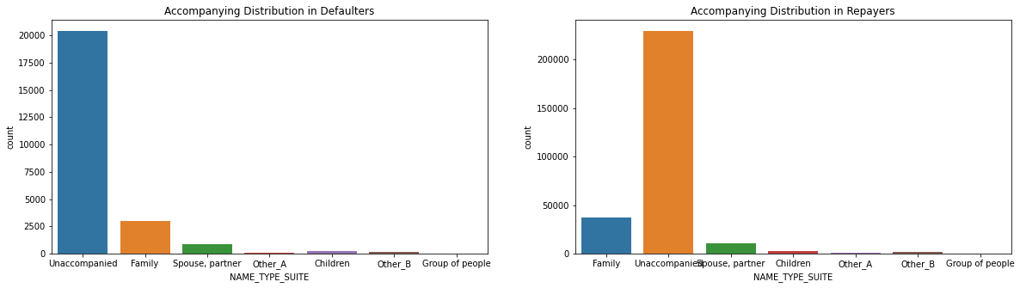
3) Client Accompaniment
Most of the Defaulters and Repayers were unaccompanied

Slide 18
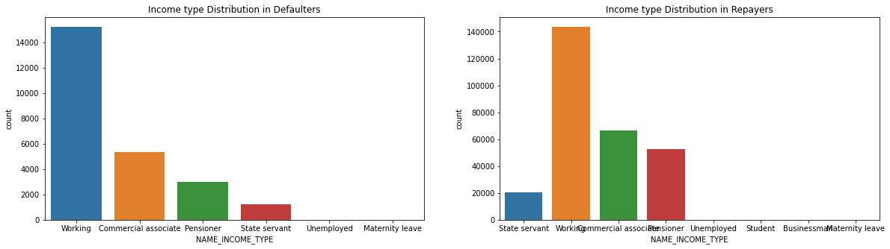
4) Income Type
There are more Working People who are Defaulters and Repayers

Slide 19
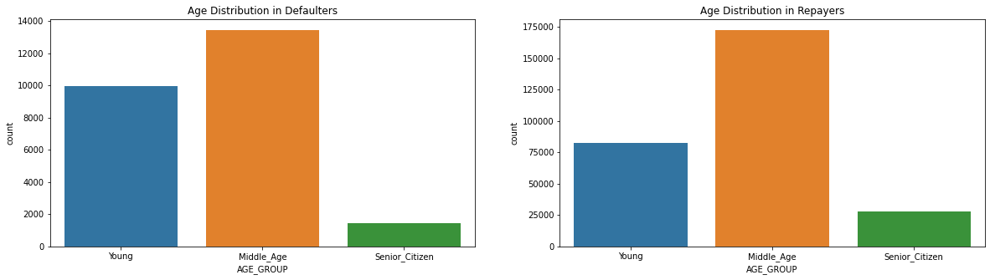
5) Age
There are more Middle- Aged people as Defaulters and Repayers

Slide 20
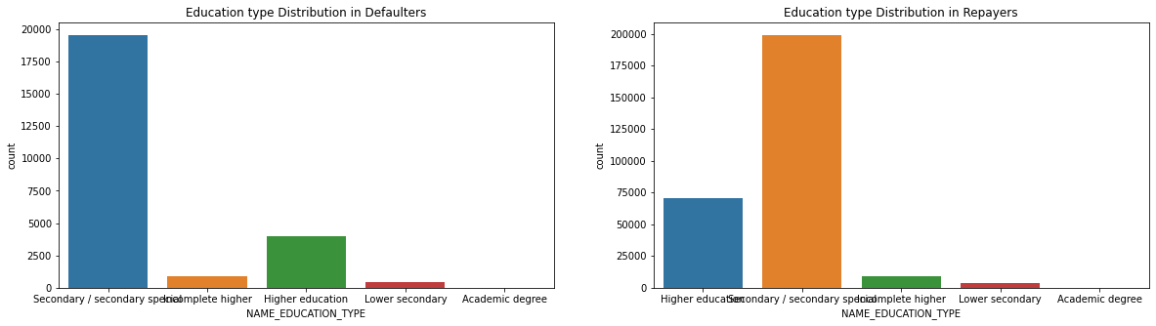
6) Education Type
People with Secondary Level Education are more as Defaulters and Repayers

Slide 21
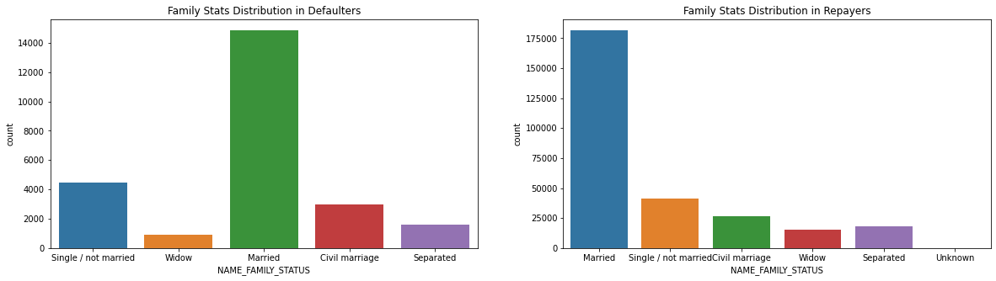
7) Family Status
There are more Married people as Defaulters and Repayers

Slide 22
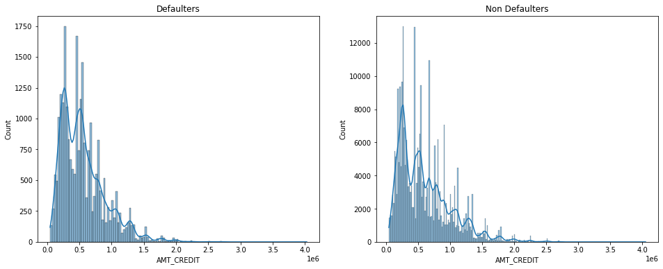
CONTINUOUS DATA
1) Credit Amount
Defaulters: As credit amount reduces, the number of defaulters increases
Non- Defaulters: As credit amount reduces, the number of non- defaulters increases

Slide 23
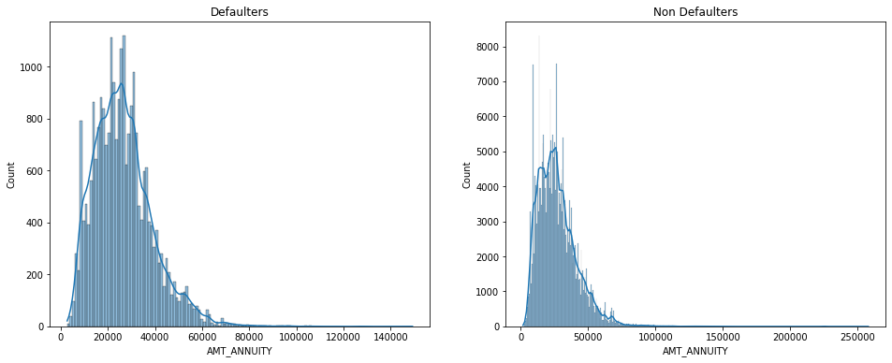
2) Annuity Amount

Slide 24
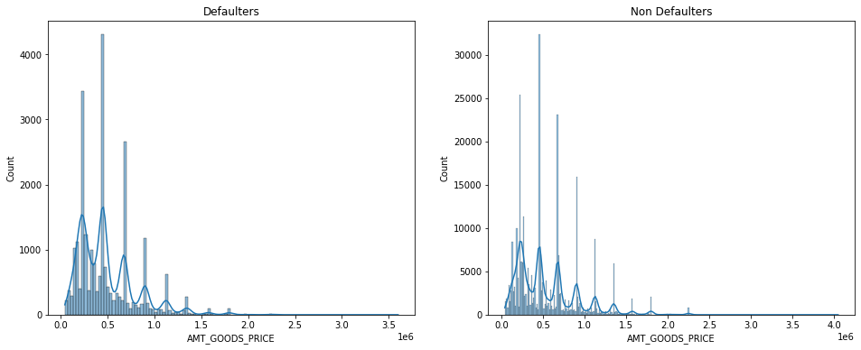
3) Goods Amount
Both Defaulters and Non- Defaulters show the same pattern

Slide 25
Bivariate Analysis
It is a statistical analysis technique used to study the relationship between two variables.
It can be used to study the relationship between two continuous variables, two categorical variables, or a combination of one continuous and one categorical variable.
Example: Relation between AMT_CREDIT and various other columns

Slide 26
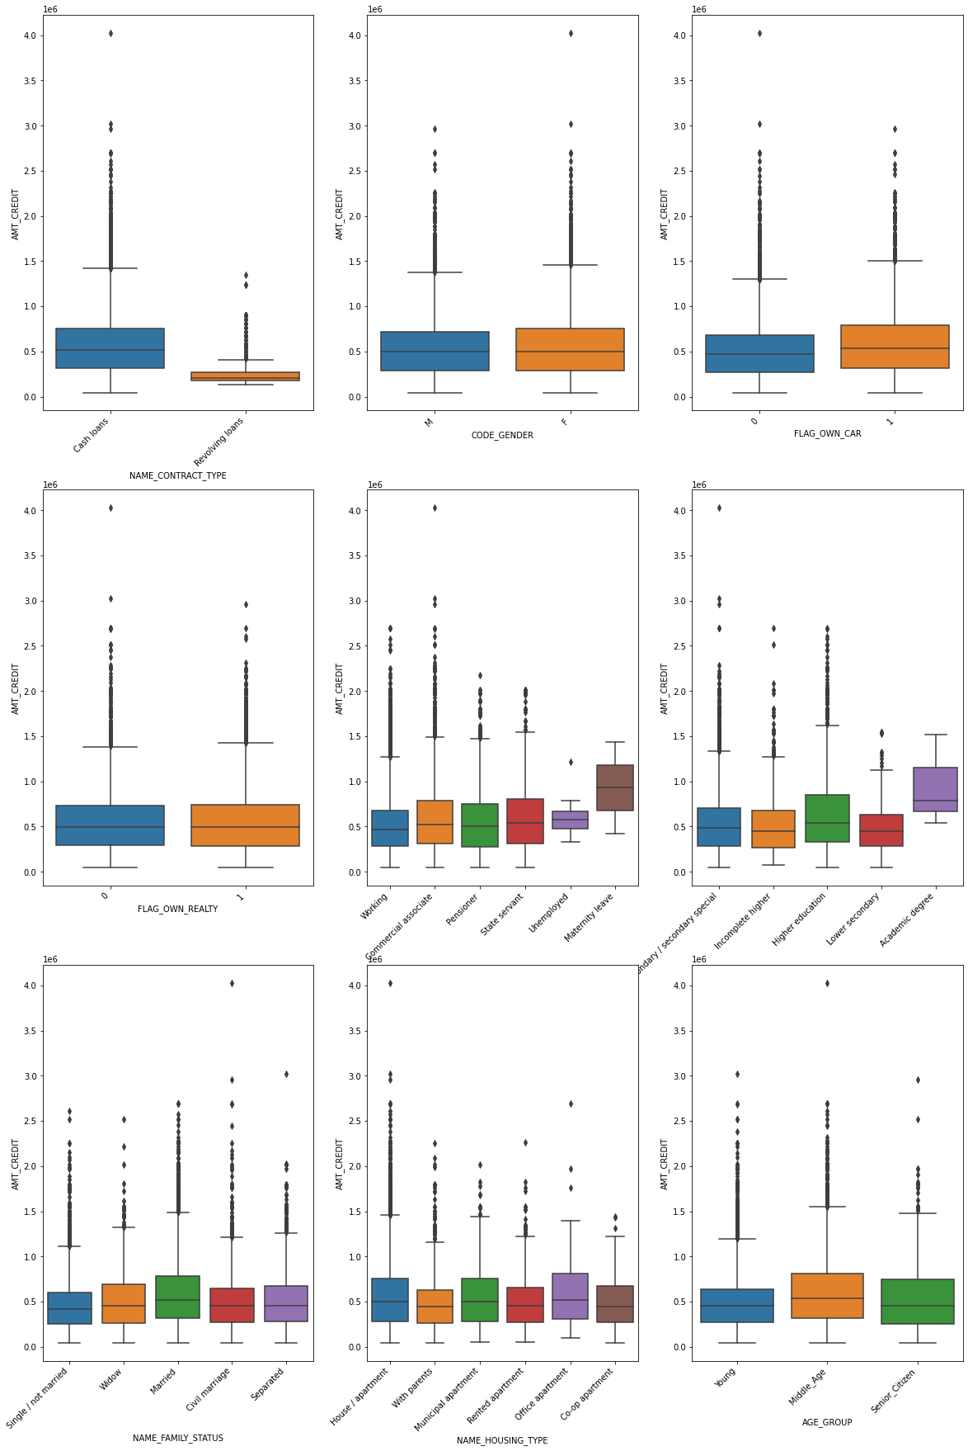
1) Defaulter
The Credit Amount for Revolving Loans are low
There is no credit difference between Genders, Car Owners, and those who own House or Flat
The Unemployed people have got a low amount of loan received
The people with Lower Secondary Education got lower amount of loan
Married people have more loan credited
The Young group of people have received lower amount of loans

Slide 27
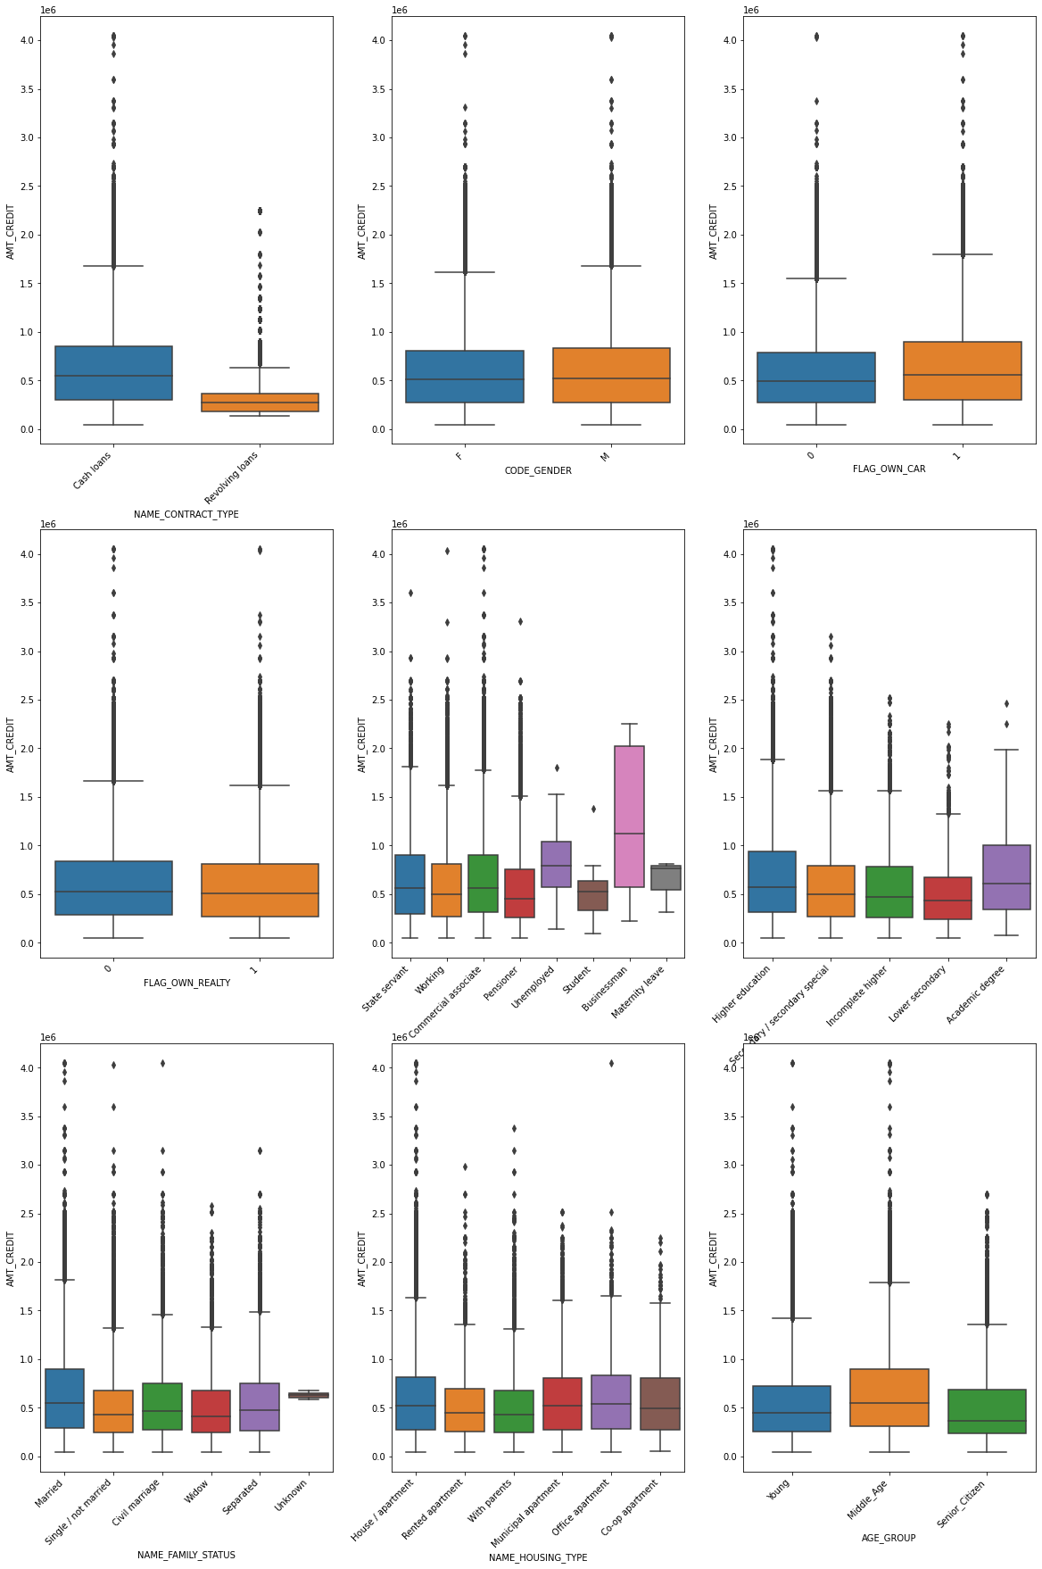
1) Non- Defaulter
The Credit Amount for Revolving Loans are low
There is no credit difference between Genders, Car Owners, and those who own House or Flat
The Unemployed people have got a spike in amount of loan received. Also, the Businessmen have got high loan credits.
The people with an Academic Degree got a greater amount of loan
Married people have more loan credited
The Middle- Age group of people have received lower amount of loans

Slide 28
CORRELATION ANALYSIS
It is a statistical technique used to determine the strength and direction of the relationship between two variables.
It helps to identify whether two variables are positively or negatively related to each other, and to what extent.
Correlation Analysis determines which variables are most strongly related to each other.

Slide 29
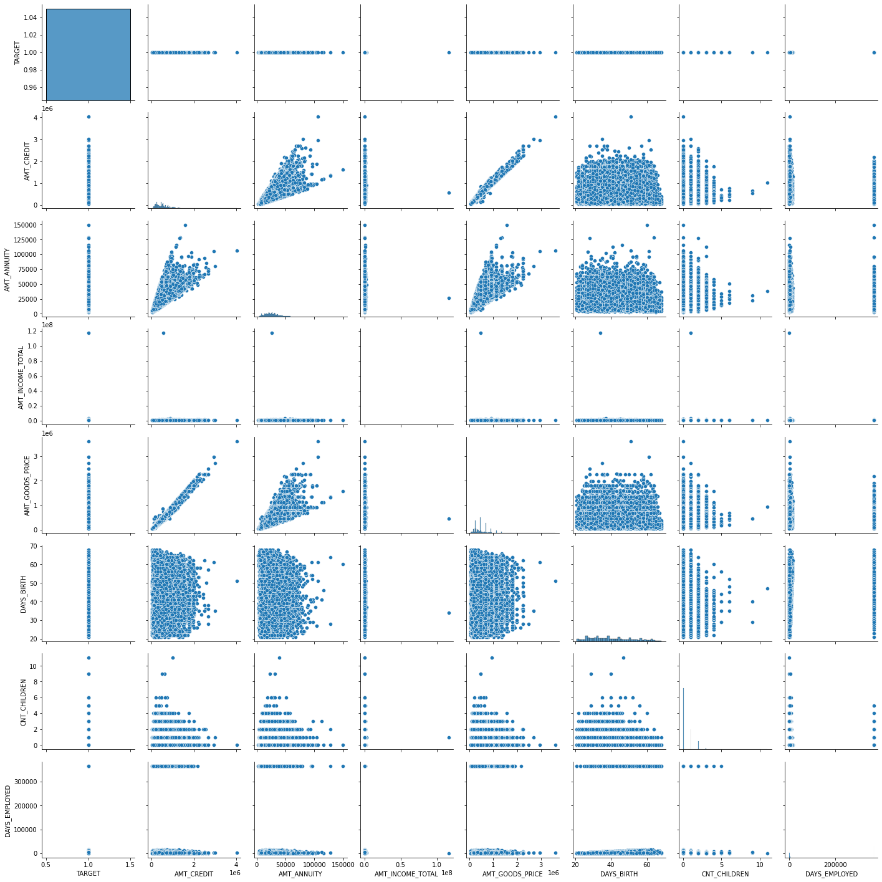
1) Pair Plot- Defaulters

Slide 30
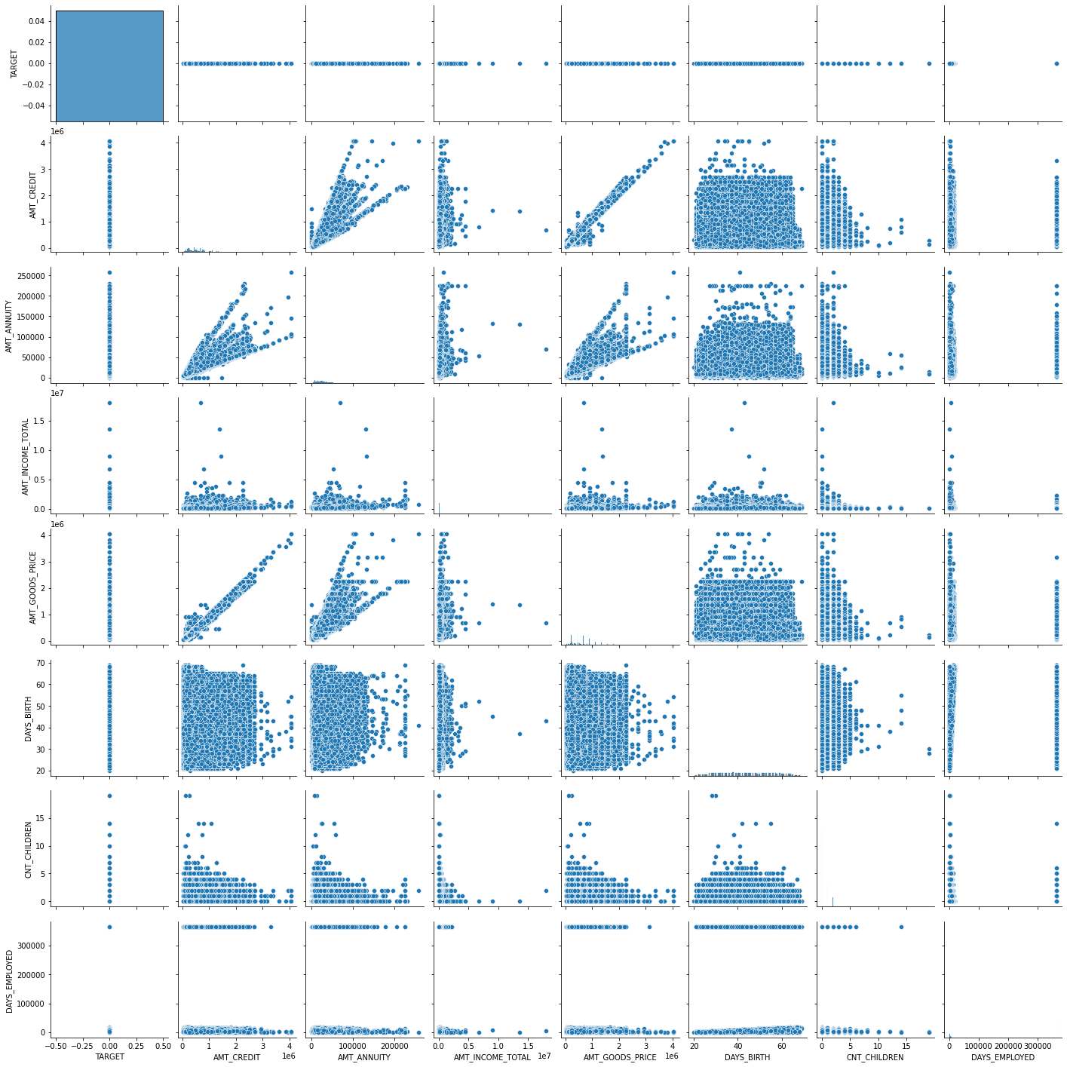
1) Pair Plot- Repayers

Slide 31
From the above Pair Plots, it can be observed that:
AMT_CREDIT, AMT_ANNUITY and AMT_GOODS_PRICE have quite a similar relation, that is, they can be correlated.
As the credit rises, the prices of consumer goods and EMI amount rise.
But they do not give a good indicator for defaulter detection.

Slide 32
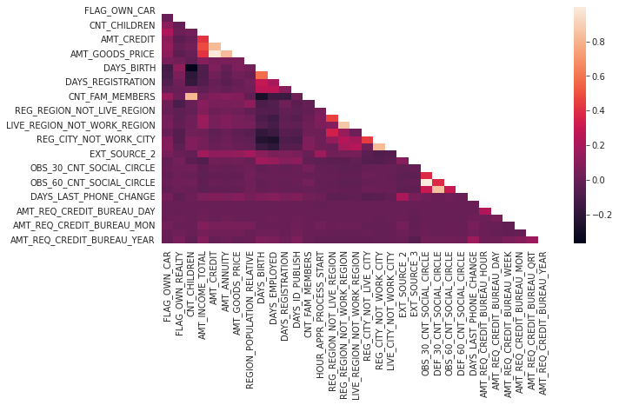
1) HeatMap - Defaulters

Slide 33
1) HeatMap - Repayers

Slide 34
From the above Heat Maps, it can be observed that:
AMT_CREDIT is inversely proportional to DAYS_BIRTH
AMT_CREDIT is inversely proportional to CNT_CHILDREN
AMT_CREDIT, AMT_GOODS_PRICE are high in densely populated regions

Slide 35
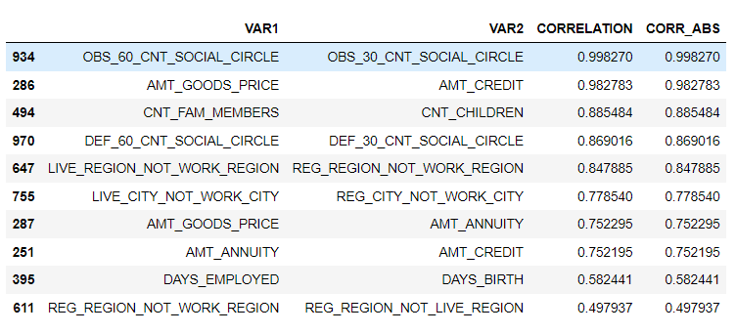
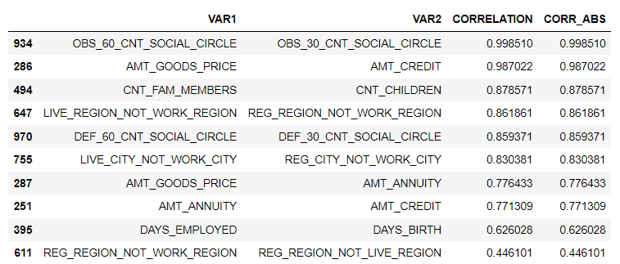
Correlation Top10- Defaulters
Correlation Top10- Repayers
There is not much difference seen between the correlations.
Therefore, Correlations are at the same level.

Slide 36
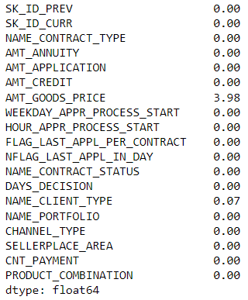
Loading the Dataset
Now, lets load the dataset previous_application.csv
Data Cleaning
The NULL values are replaced and unwanted columns are removed.
The updated structure of the dataset is given.

Slide 37
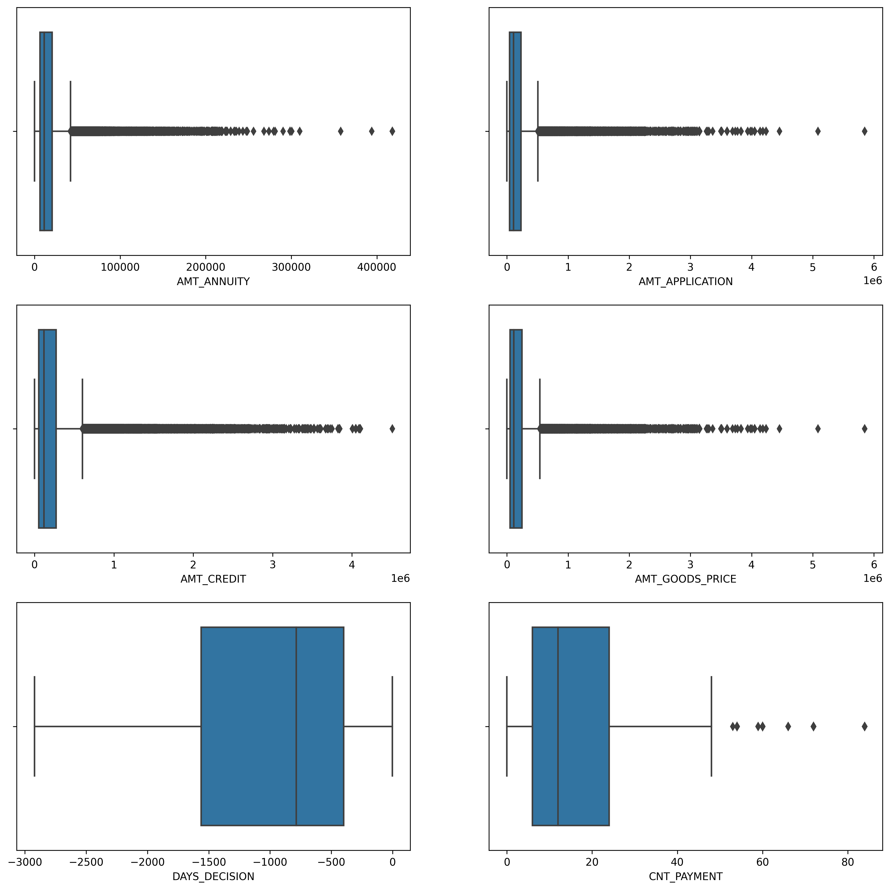
Outlier Analysis

Slide 38
RESULTS
It is demonstrated as to how and whom a company should distribute loans to.
Exploratory Data Analysis (EDA) is used to determine the Risk factors in the Banking and Financial Industries, respectively.

