Slide 1
Final Project Azure Search
Shrestha , Maha
Deep Azure@McKesson

Slide 2
Problem Statement
Whenever a company or any entity looking to develop their own search pages that returns results like the famous search service providers in Google, Bing, Amazon, Yahoo, then they are left with choices on its development, implementation and scalability.
Building the search page in traditional ways might not be as effective or compelling as in today’s age, where user wants the search to be multi-functional and multi-featured. For example, user might like to see suggestions based on few keywords, see results based on 5-mile radiuses, or get results based on his/her preference and relevance, and desires to get those results back fast. On top of that, user might want to be able to properly navigate between search results and be able to narrow down those results applying different filters. This is when Azure Search Service come to play to address all those factors to provide rich and great user search experience.
As my final project, I have chosen to use “Azure Search Service” to build a search engine that lets user search for the restaurants by their name, type or zip code.

Slide 3
Overview of Azure Search Service
Azure Search is a cloud base search-as-a-service solution with different search experience over the content in web, mobile and applications that is fast and scalable.
Azure search service helps build a search engine that lets user search using different categories pertaining to the search they are performing.
This Search service api provides ability to understand what user be looking for and come back different suggestions. It goes even further to able to return the search result based on geo location (like radius and coordinates)
Azure Search is highly scalable and easy to build using Azure Portal which saves a lot of time towards development and hosting of the software

Slide 4
Technology and Software Used
Azure Portal to create Azure Search service
Azure SQL as a Database System
CLI to create Azure SQL
NodeJs to run the Search Application
VSCode to edit the code and launch the application

Slide 5
Hardware Used
Intel 2-core i5-6300U CPU 2.40GHz, 8 GB RAM, 64-bit Windows 7 OS

Slide 6
High Level Steps
Create a Azure Search Service in the Azure Portal.
Create Azure SQL Database.
Load data into the Azure SQL table.
Import data and create index to Azure Search using the portal.
Install Node.js for windows.
Download sample code from GitHub.
Extract the code into VS Code editor and run npm commands.
Make changes to config file to point towards Azure Search Service and Azure Data Center (note the api key and connections strings).
Compile the code and run the search application.

Slide 7
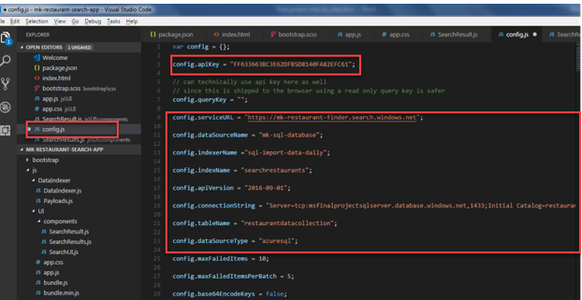
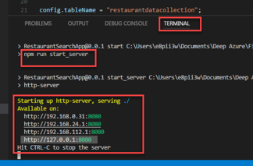
Code Overview

Slide 8
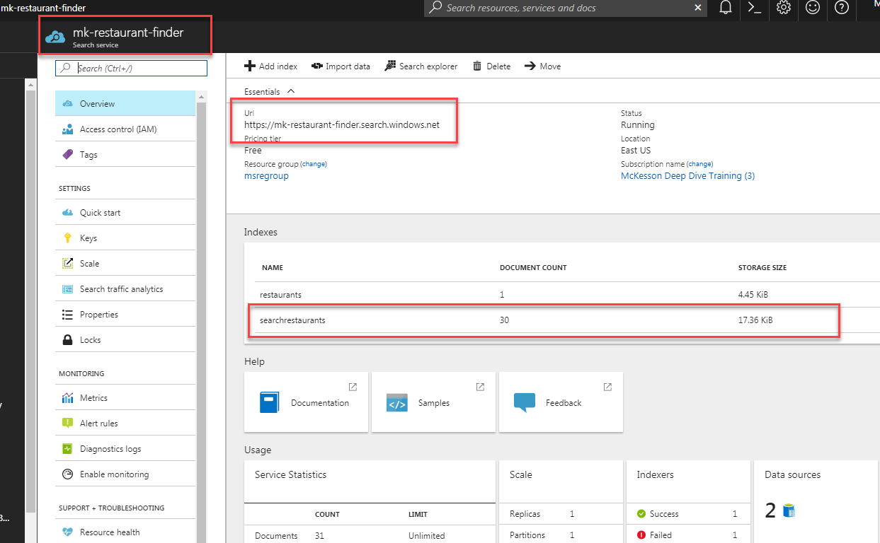
Azure Search Service

Slide 9
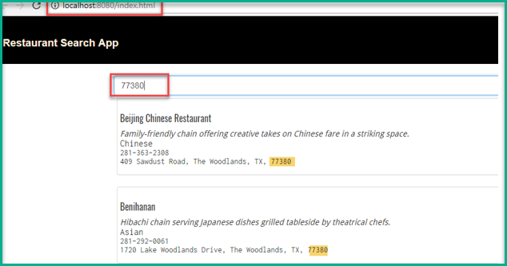
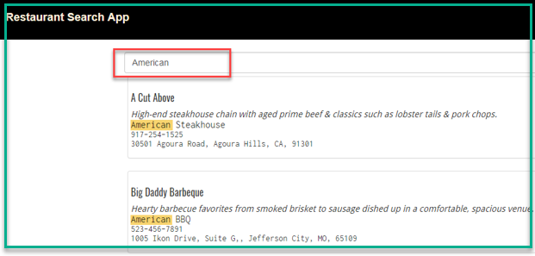
Final Result

Slide 10
What I learned, and liked
I learned quite a bit while setting the Azure Service in Azure Portal - how easy it was to create a azure service, import data, create indexes, and schedule data imports periodically.
Also, got impressed how straightforward it was to configure to my search app to be able to point towards the azure service (just needed to provide right authentication keys, url and indexes).
Another factor I got impressed with is how instant the search was and how fast it responded with in my app.

Slide 11
Future Work
Add all below available features to make this Restaurant Search App more user friendly and desirable.
Use Geo-search feature to explore data based on the proximity of a search result to a physical location.
Enable Search suggestions to get type-ahead queries in a search bar.
Use Faceted navigation for self-directed filtering, like to filter restaurant by types or by price or reviews.
Add button to sort the query results.
Add checkboxes and dropdowns to be able to filter the query results or narrow the results.

Slide 12
YouTube URLs, GitHub URL, Last Page
Two minute (short):https://youtu.be/BaaeLt4cOe0
15 minutes (long):https://youtu.be/Fwynr6qPYrg
GitHub Repository with all artifacts: https://github.com/maha-shrestha/FinalProjectAzureSearch

