Slide 1
HOUSING PRICE PREDICTION
A Regression Analysis of Median District House Values
P. Mahalaxmi Reddy

Slide 2
OVERVIEW
Project Objective
Purpose
20,640
Housing prices are shaped by income, location, and household density. A reliable predictive model enables buyers, lenders, and planners to estimate fair value from census-level indicators.
residential districts in the dataset
9
3
1
Predict median house value from eight numeric predictors
numeric features,
incl. target
regression models
compared
2
Compare Linear Regression, Decision Tree, and Random Forest
3
Identify the strongest price drivers
0.81
4
Optimize the best-performing model through tuning
best R² score achieved
(tuned Random Forest)
2

Slide 3
DATA
Dataset Overview
Feature | Description | Range
longitude / latitude | Geographic location of district | -124.35 to -114.31 / 32.54 to 41.95
housing_median_age | Median age of houses in district | 1 – 52 years
total_rooms / total_bedrooms | Total rooms / bedrooms in district | 2 – 39,320 rooms
population / households | People / households in district | 3 – 35,682 people
median_income | Median household income (10k USD) | 0.5 – 15.0
median_house_value | Target: median house value (USD) | 14,999 – 500,001
Data quality: 207 missing values in total_bedrooms (~1%), imputed with the column median. No duplicate rows found.
3

Slide 4
PREPARATION
Data Preprocessing Pipeline
1
2
3
4
Handle Missing Values
Remove Outliers
Scale Features
Split Data
Imputed 207 missing total_bedrooms entries with the column median.
Applied the IQR rule across all numeric columns — boxplots showed extreme values in total_rooms, population, and median_income.
Standardized all predictors with StandardScaler ahead of modeling.
80% train / 20% test split, random_state = 42, for consistent evaluation.
4

Slide 5
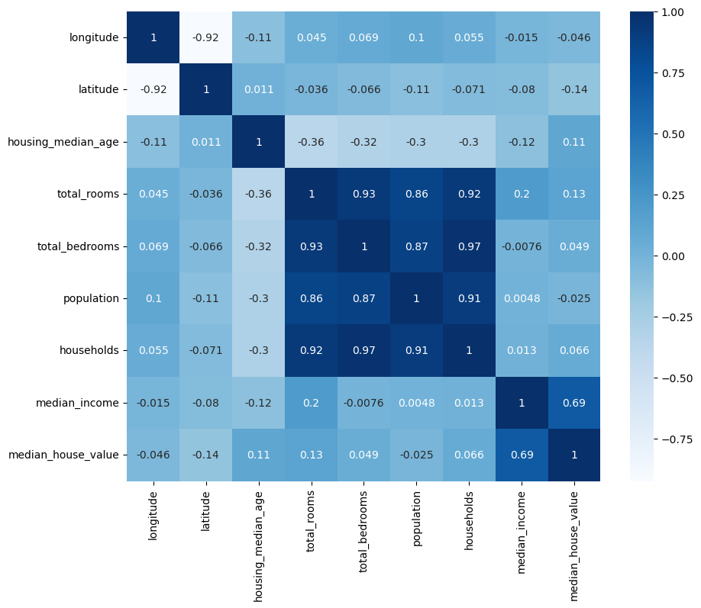
EXPLORATORY ANALYSIS
What the Data Reveals
Key Insights
Median income has the strongest positive correlation with house value.
Latitude & longitude show mild negative relationships — reflecting regional price gaps.
Most numeric features are right-skewed with long tails (total_rooms, population).
Boxplots confirm outliers concentrated in room counts, population, and income.
Figure 1. Correlation heatmap
5

Slide 6
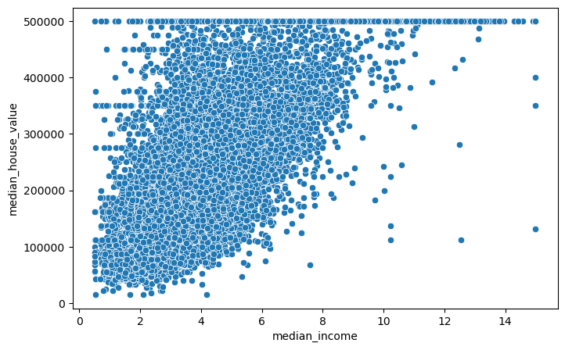
EXPLORATORY ANALYSIS
Median Income as the Leading Predictor
House value rises consistently with median income
The scatter plot shows a clear positive relationship between income and price. Most homes are valued under $500,000, and the relationship holds fairly consistently across the income range — explaining why income dominates every model's feature importance.
6

Slide 7
METHODOLOGY
Three Models, One Benchmark
Linear Regression
Decision Tree
Random Forest
Baseline linear model — fast, interpretable, assumes linear relationships.
Captures non-linear splits in the data; prone to overfitting on its own.
Ensemble of trees averaging predictions for stronger generalization.
All models trained on standardized features with an 80/20 train-test split, evaluated by MAE, MSE, RMSE, and R².
7

Slide 8
RESULTS
Random Forest Achieves the Strongest Performance
Model | MAE | RMSE | R²
Linear Regression | 51,810 | 71,133 | 0.614
Decision Tree | 44,299 | 69,870 | 0.627
Random Forest | 32,094 | 49,880 | 0.810
Random Forest (Tuned) | — | — | 0.812
Tuning (GridSearchCV, 5-fold): n_estimators=200, max_depth=20, min_samples_split=2
8

Slide 9
MODEL INSIGHT
Median Income Is the Dominant Predictor
52.2%
of the tuned Random Forest's predictive power is attributable to median income alone
Location (longitude and latitude) together account for a further ~30%, while structural features (rooms, bedrooms, households) each contribute under 3%.
9

Slide 10
CONCLUSION
Random Forest Delivers the Strongest Result
1
2
3
4
Best Model
Leading Predictor
Key Challenges
Recommended Next Steps
Tuned Random Forest Regressor — R² = 0.812, the lowest error among all models tested.
Median income, contributing more than half of total feature importance.
Missing values, skewed outliers, and a price cap near $500,000 in the source data.
Hyperparameter tuning, and evaluate gradient-boosted models.
Housing Price Prediction • P. Mahalaxmi Reddy

