Slide 1

Student Grade Analysis with AWK
Jamila Shirinli
Mahabbat Zakariyayev
Riad Dadashov

Slide 2
Plan
01
02
03
04
05
06
07
09
Abstract
Motivation
Datasets
Findings
Conclusions
08
10
Data Preparation and Cleaning
Research
Questions
Methods
Limitations
References

Slide 3
1
Abstract
We analyzed a student grade dataset. Our goal was to identify performance patterns, grade distributions, and inconsistencies. Using AWK, we cleaned the data, computed averages, and summarized results. Most students passed, but tests showed large disparities and some incorrect grades.

Slide 4


Problem Statement
2
Objective:
Compare students’ test performance with their final letter grades. In some cases, averages and grades don’t match. Detecting such inconsistencies is essential.

Slide 5
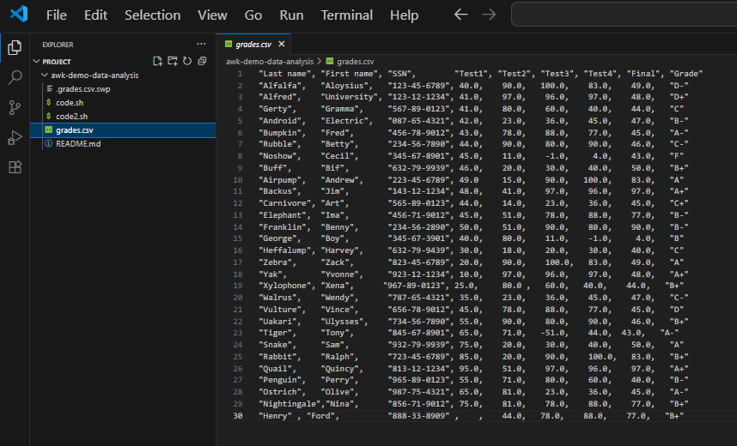
Dataset Description
3
The dataset grades.csv contains 30 students’ last names, first names, SSNs, four test scores, a final exam, and overall letter grades. The dataset was sourced from an open academic repository and supplemented from GitHub for reproducibility.

Slide 6
Data Preparation and Cleaning
4
We cleaned the dataset by removing null values and excluding invalid entries such as negative test scores. One issue encountered was inconsistent formatting (missing commas and blank fields) that caused parsing errors, which we corrected with AWK filters. Outliers (e.g., -51 in Test3) were removed to ensure fair averages. After cleaning, the dataset was suitable for statistical summaries and grade validation checks.

Slide 7
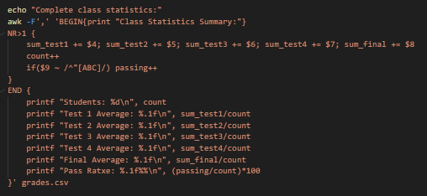
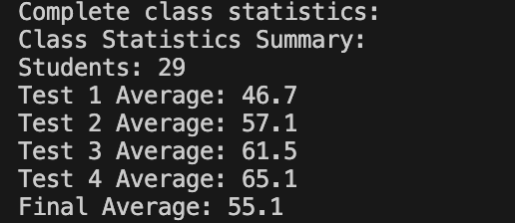
Research Questions
5
Our research question was: How do test scores and grade distributions reflect student performance patterns, and what proportion of students achieve passing grades? Additionally, can we detect incorrect or inconsistent grades in the dataset?

Slide 8
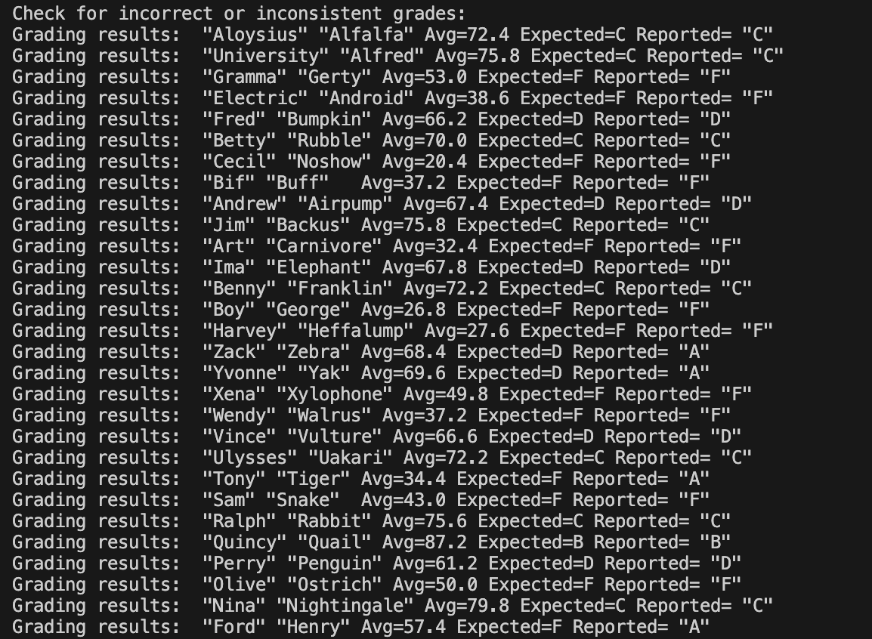
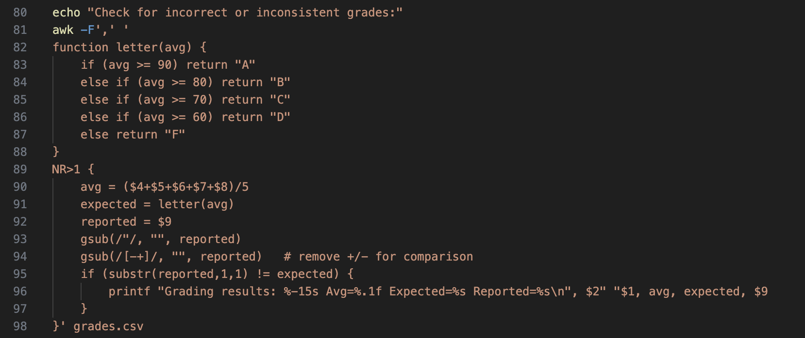
Incorrect Grade findings
Here are the results we got

Slide 9
Methods
6
We used Bash scripting and AWK for text-based data processing. AWK was appropriate because it efficiently handles CSV parsing, filtering, and field-based computations. We calculated descriptive statistics (averages, min/max, totals), grouped results by grades, and generated performance summaries. We also computed average test scores per student and compared them to their reported letter grades to identify inconsistencies.

Slide 10

Findings
7
The average Test1 score was around the mid-40s, with high variability.
Several students had missing or invalid scores, impacting fairness in grading.
Grade distribution showed that most students achieved passing grades (A–C range), but there were multiple D and F outcomes.
High performers (Test1 ≥ 80) accounted for only a small fraction of students.
Some final letter grades were inconsistent with test averages (e.g., students with low averages having high letter grades or vice versa), showing grading errors or mislabeling in the dataset.
variability

Slide 11
Limitations
8
Our analysis is limited by the small dataset size and formatting inconsistencies. Results may not generalize to larger student populations. Additionally, letter grades may have been assigned with unknown criteria (e.g., curved grading), so some mismatches might not be true errors.
awk 'END {print "Total records:", NR}' grades.csv

Slide 12
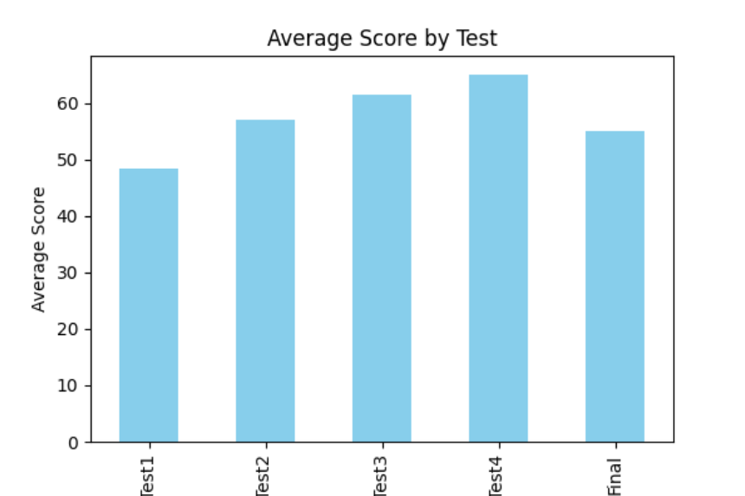
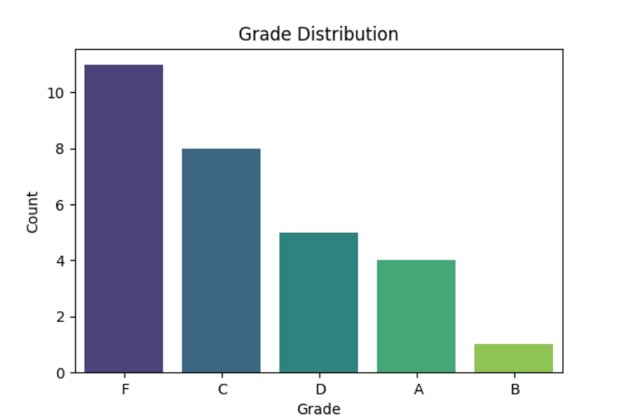
Data Visualization

Slide 13
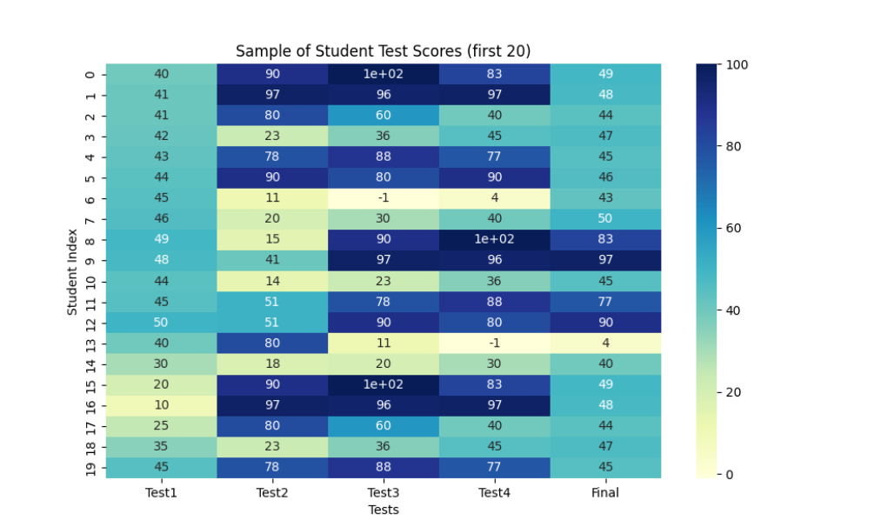
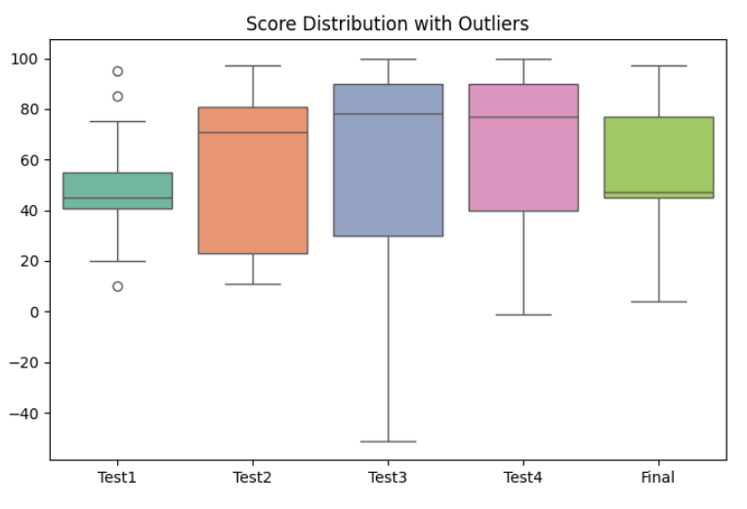

Slide 14
Conclusion
9
Student performance shows a wide spread, with only a small group excelling while many hover near passing thresholds. Data cleaning is essential for accurate insights, and grade distributions reveal important patterns in assessment fairness and student achievement. A major finding was the presence of *incorrect or inconsistent final grades*, which highlights the importance of verifying grading processes.

Slide 15


References
No external research papers were used. All work was conducted using the provided dataset and AWK scripting.
https://people.sc.fsu.edu/~jburkardt/data/csv/csv.html
https://github.com/mahabbatzakariyayev/awk-demo-data-analysis
10

