Slide 1
“A Machine Learning Model to Predict the Employability of
Fresh CSE Graduates in Bangladesh”
S U B M I T T E D B Y
S U P E R V I S E D B Y
Md. Mahabub Alam
Kazi Hassan Robin
WUB 03/23/64/3835
Associate Professor
Department of Computer Science and Engineering
World University of Bangladesh
Md. Al-Amin Miah
WUB 03/23/64/3829
Subir Sarker Saurav
WUB 03/23/64/3840
Notes:
Title slide. Project report submitted to the Department of CSE, World University of Bangladesh.

Slide 2
INTRODUCTION
What This Project Is About
This project applies supervised machine learning to model the employability of fresh Computer Science and Engineering graduates in Bangladesh — identifying which academic, technical, experiential and behavioural factors most strongly determine employment outcomes, and converting that model into interpretable, individual-level guidance.
BACKGROUND
PROBLEM STATEMENT
WHY IT MATTERS
Employability is a multidimensional propensity, not an outcome (Yorke, 2006; Tomlinson, 2017; Clarke, 2018). In computing, where the technical knowledge base turns over faster than a four-year degree, employers recruit on demonstrated capability rather than credentials.
Bangladesh's ICT sector reports sustained demand (Jony et al., 2022), yet university graduates record the country's highest unemployment rate at 13.5% (BBS, 2025). The binding constraint is alignment between graduate profiles and employer requirements — not a shortage of jobs.
The evidence a student can access is diagnostic, aggregate and retrospective. Tracer studies report one to two years after graduation, when the affected cohort can no longer act. No context-specific, individual-level predictive model exists for Bangladeshi CSE graduates.
MOTIVATION
MAIN OBJECTIVES
SCOPE & PURPOSE
Skills employers reward accumulate over semesters and cannot be acquired at the point of job search. The value of employability research therefore lies in an early, explainable signal a student can still respond to — not in describing who was hired after the fact.
(1) Identify and rank the determinants of employability. (2) develop, implement and evaluate a supervised classification model under an imbalance-sensitive protocol.
(3) interpret the model and translate it into evidence-based recommendations.
Supervised binary classification with an interpretability layer, on a secondary cross-sectional dataset of 50,000 student records. Outcome: employed in an ICT role within 12 months of graduation. Delivered behind a documented HTTP API.
Chapters 1–6 of the final thesis are represented across the slides that follow: problem and objectives (Ch. 1), literature and research gaps (Ch. 2), development methodology (Ch. 3), research and system design (Ch. 4), results and discussion (Ch. 5), and conclusions (Ch. 6).
Notes:
Introduction slide requested by the supervisor: project scope, background, problem, importance, motivation, objectives and purpose in one view.

Slide 3
CHAPTER 1 — THE PROBLEM
Bangladesh's Graduate Employability Paradox
Approximately 2.62 million people were unemployed at the end of 2024, of whom roughly 885,000 held tertiary qualifications. Unemployment rises monotonically with education rather than falling, and about one in three unemployed graduates remained without work for up to two years (BBS, 2025). Bangladesh does not exhibit a general shortage of jobs so much as a structural mismatch between what higher education produces and what the labour market absorbs.
UNEMPLOYMENT RATE BY EDUCATION LEVEL, 2024
University graduates
13.5%
Higher secondary
13.5%
Unemployment rate among university graduates the highest of any education group in Bangladesh
7.13%
Secondary school
1.96%
WHY IT MATTERS FOR CSE
No formal education
CSE and IT graduates already have an employment rate above the national graduate average (Jony et al., 2022) — advantaged, but not sufficient. A documented gap remains between the skills Bangladeshi universities deliver and what industry requires (Hasan et al., 2024), and national statistics are not disaggregated by discipline, so CSE-specific employability cannot be inferred from them.
1.25%
ICT-sector demand is strong and rising, yet graduate unemployment rises with education level — evidence of mismatch, not a general jobs shortage.
Notes:
Chapter 1, Sections 1.1-1.2. Source: Bangladesh Bureau of Statistics, Labour Force Survey 2024 (BBS, 2025).

Slide 4
CHAPTER 1 — RESEARCH DESIGN
Research Objectives & Scope
THREE RESEARCH OBJECTIVES
1
Identification of Employability Determinants
Identify, examine and analyse the major academic, technical, experiential, behavioural and career-related factors associated with the employability of fresh CSE graduates in Bangladesh.
2
Model Development and Evaluation
Develop, implement and comparatively evaluate supervised machine learning classification models for predicting the employability of fresh CSE graduates in Bangladesh.
3
Interpretation and Evidence-Based Recommendation
Interpret the best-performing model by identifying the relative importance of different employability factors, and translate that interpretation into actionable recommendations.
POPULATION
DATA SOURCE
OUTCOME
DESIGN
Fresh CSE graduates (≤ 24 months)
Kaggle — 50,000 records
ICT role within 12 months
Cross-sectional, supervised
Notes:
Chapter 1, Sections 1.3, 1.4 and 1.6. Excluded from scope: salary, job satisfaction, promotion trajectory, psychometric inventories, socio-economic status.

Slide 5
CHAPTER 2 — LITERATURE REVIEW
The Research Gap and Our Contribution
A systematic review documents that employability-prediction studies are fragmented across inconsistent datasets, features and evaluation protocols, and calls explicitly for context-specific models (Mezhoudi et al., 2023). Models exist for Nigeria, the Philippines, Malaysia, Egypt, Vietnam and India — but none for Bangladesh.
FIVE IDENTIFIED RESEARCH GAPS (TABLE 2.2)
OUR CONTRIBUTION — FOUR ELEMENTS COMBINED
G1
No context-specific evidence for Bangladeshi CSE graduates
Bangladesh + CSE focus
Bangladeshi work targets academic performance (Zulfiker et al., 2020) or career category (Biswas et al., 2021), not employability.
The first employability model built specifically for fresh CSE graduates entering the Bangladeshi ICT labour market.
G2
Fragmented, design-constrained feature coverage
Six-dimension feature set
Institutional-record studies report academic predictors only; those that include experiential variables find them dominant.
Theory-derived features spanning academic, technical, experiential, certification, soft-skill and career-preparation attributes.
G3
Weak and non-comparable evaluation practice
Imbalance-sensitive evaluation
Accuracy reported alone, on small samples, without class distribution or minority-class recall (Baffa et al., 2023).
A documented, seeded stratified hold-out protocol with per-class precision, recall and F1 on a 10,000-record test partition.
G4
Absence of interpretability
Scale and transparency
Most reviewed models are black boxes, so predictions cannot be translated into student guidance.
50,000 records — an order of magnitude above the reviewed studies — with every limitation stated rather than obscured.
G5
Neglect of fairness in developing-country settings
Framed honestly: the model is Bangladesh-focused in its research question, but at this stage is trained on a secondary, non-Bangladesh-specific dataset — a limitation this thesis states explicitly (Sections 1.6 & 6.2).
Employment prediction models can encode bias (Guo et al., 2020), yet fairness analysis is effectively absent from South Asian research.
Notes:
Chapter 2, Sections 2.6 and 2.7. Table 2.1 groups the reviewed studies into single-classifier institutional studies (Group A), advanced ensemble studies (Group B) and Bangladeshi educational data-mining studies (Group C).

Slide 6
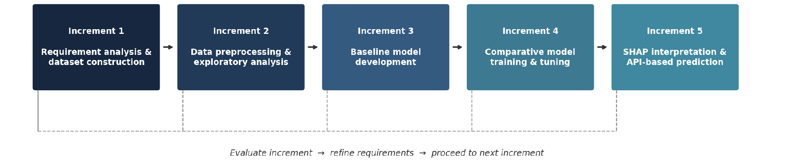
CHAPTER 3 — METHODOLOGY
Built in Five Evaluated Increments
The system was developed using an Incremental Model of the SDLC rather than Waterfall, because the achievable accuracy, the most informative features and the most suitable algorithm could only be determined once real data had been explored. Each increment delivered a working, testable artefact whose evaluation fed directly into the requirements of the increment that followed.
Figure 3.2 — Incremental development of the employability prediction system
1
2
5
1
Requirement analysis & dataset construction
2
Data preprocessing & exploratory analysis
3
Baseline model development
4
Comparative model training & tuning
5
Interpretation & API-based prediction
Research objectives translated into a concrete attribute list; the Student Career Success Prediction Dataset (50,000 records, Kaggle) identified and prepared.
Missing values, inconsistent categories and outliers treated; numeric features scaled, categorical features encoded; class balance of the outcome examined.
A Logistic Regression baseline was specified. In the executed implementation the pipeline was validated end-to-end directly with XGBoost; the baseline comparison remains outstanding.
Decision Tree, Random Forest, SVM and XGBoost were planned under a common protocol. Only XGBoost was trained within the project timeframe, on a single stratified 80:20 hold-out.
The selected model was interpreted through native feature-importance analysis and served through a documented HTTP API. SHAP attribution was specified but is not implemented.
Why not Waterfall: a data-driven model whose achievable accuracy and most informative features are unknown until the data has been explored cannot have its specification frozen at the outset. The Spiral Model's repeated formal risk analysis carries overhead heavier than this project's scale warrants (Section 3.2).
Notes:
Chapter 3, Sections 3.1-3.3. Increments 3, 4 and 5 are reported with their actual execution status, consistent with Sections 5.8, 5.9 and 5.15 of the thesis.

Slide 7
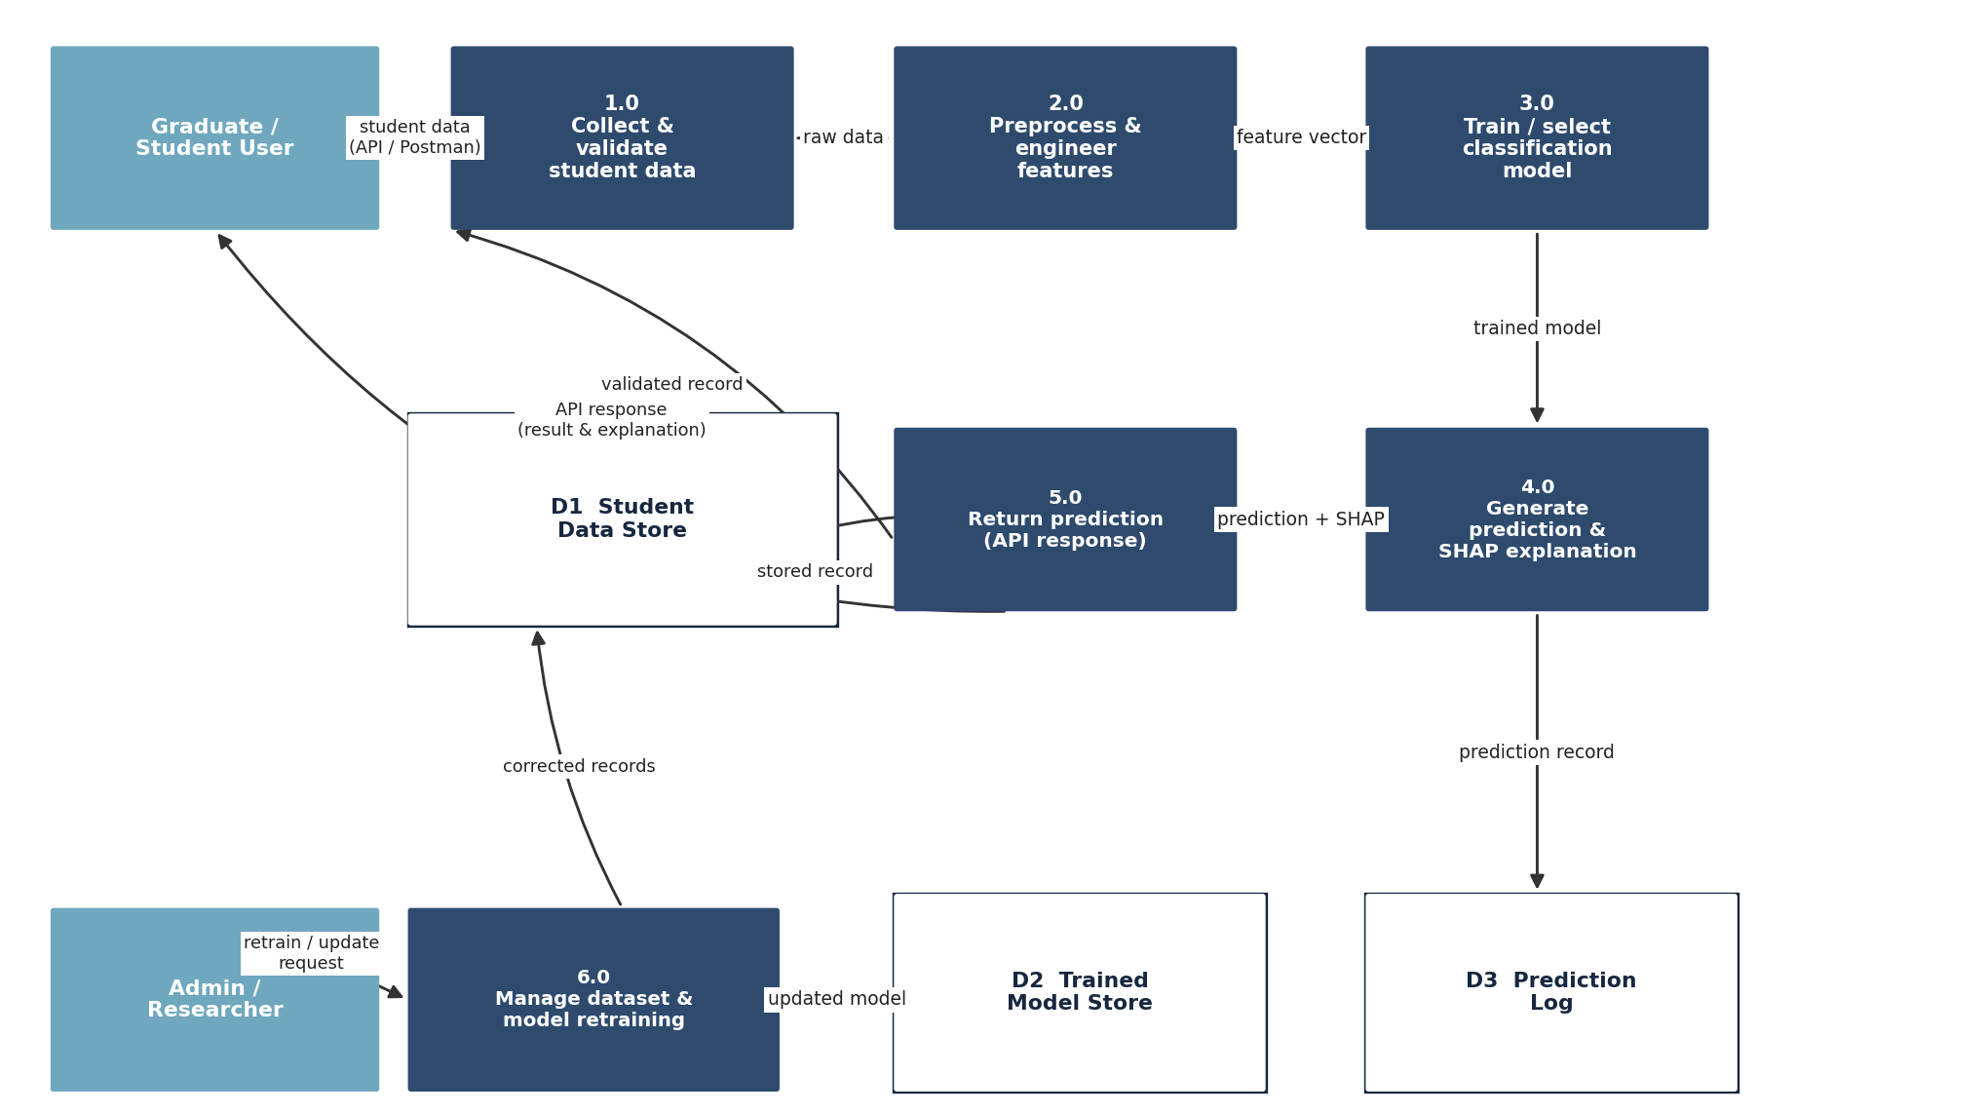
CHAPTER 4 — RESEARCH DESIGN
ML Pipeline & System Architecture
The pipeline comprises nine stages, from data collection through to the prediction returned for a new graduate. Splitting the data before any transformation is fitted is what guarantees that performance is judged only on records the model has never seen.
Data Collection
(Kaggle dataset, 50,000 records)
Data Preprocessing
Feature Engineering
Exploratory Data Analysis (EDA)
Training / Testing Dataset Split
Machine Learning Model Training
Figure 4.3 — Data Flow Diagram (DFD Level 1)
Model Evaluation
Model Selection
Employability Prediction
(returned via API / Postman)
SYSTEM REQUIREMENTS (TABLES 4.1 & 4.2)
FR1–FR2
Submit and validate a graduate profile across all six attribute dimensions.
delivered
FR3–FR4
Return a binary prediction with probability; SHAP explanation specified.
partial
Based on Figure 4.1 — machine learning model workflow (Section 4.2)
FR5
Present prediction and explanation through an interactive dashboard.
planned
At prediction time a new graduate's profile passes through the same fitted preprocessing and feature transformation used in training before being scored.
FR6–FR7
Compare model performance; manage the dataset and trigger retraining.
at script level
Notes:
Chapter 4, Sections 4.2-4.5. NFR6: the system is accessible through a documented HTTP API at this stage; a browser-based dashboard is future work (Section 6.3). Figure 4.4 presents the corresponding use-case design.

Slide 8
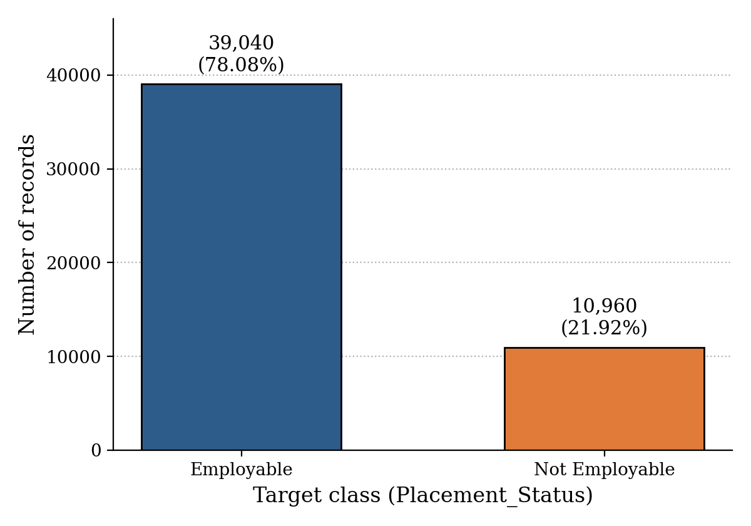
CHAPTER 5 — DATA FOUNDATION
The Dataset and Its Class Imbalance
DATASET
Student Career Success Prediction Dataset
SOURCE
Kaggle — Fatimah, M. (2026); file student_career_success_dataset_cleaned.csv
RECORDS
50,000 instances × 23 columns (22 predictors + 1 target)
TARGET
Placement_Status — Employable / Not Employable
PARTITIONS
40,000 training (80%) | 10,000 testing (20%), stratified
CLEANING
drop_duplicates(); median imputation (numeric), modal imputation (categorical)
Figure 5.3 — Absolute class distribution of the target variable
TYPE
Secondary, cross-sectional, publicly available
39,040 Employable (78.08%) · 10,960 Not Employable (21.92%) · ratio 3.56 : 1
The dataset is an order of magnitude larger than the single-institution samples typical of the reviewed literature. A test partition of 10,000 records makes reported metrics stable to within a fraction of a percentage point.
WHY THE IMBALANCE MATTERS
A degenerate classifier predicting Employable for every student would score 78.08% accuracy while learning nothing. Any reported accuracy must be judged against that floor, not against 50%. The minority class is precisely the population the system exists to identify.
Three corrections were applied: SMOTE within the training folds, scale_pos_weight ≈ 3.56, and a decision threshold lowered from 0.50 to 0.35.
This is a secondary dataset, not primary data collected from Bangladeshi CSE graduates — findings are illustrative of the Bangladeshi context and should be validated on a Bangladesh-specific sample before generalisation (Sections 1.6 & 6.2).
Notes:
Chapter 5, Sections 5.1 and 5.4, Tables 5.1 and 5.3. Full-dataset class counts derive from the stratified test-partition support (7,808 / 2,192) x 5.

Slide 9
CHAPTER 5 — FEATURE ANALYSIS
The 18 Modelling Features Across Six Dimensions
The 22 candidate predictors were reduced to a modelling set of 18 features: six demographic and contextual attributes were deliberately excluded, and two composite features were engineered from attributes already present — giving 14 numeric and 4 categorical features (Table 5.2).
1 ACADEMIC ATTAINMENT & EFFORT
2 TECHNICAL PROFICIENCY
CGPA · Academic_Performance · Study_Hours_Per_Week
Programming_Skill
3 PRACTICAL EXPERIENCE
4 CERTIFICATION & PORTFOLIO
Internships · Projects_Completed · Hackathons
Certifications · GitHub_Profile
5 SOFT SKILLS
6 CAREER PREPARATION & BEHAVIOUR
Communication_Skills · Problem_Solving · Teamwork · English_Proficiency
Resume_Score · Interview_Score · Leadership_Experience
EXCLUDED — 6 ATTRIBUTES
ENGINEERED — 2 FEATURES
Age, Gender, University_Year and Major are demographic or contextual descriptors a student cannot change at the point of intervention; retaining them would let the model encode group membership rather than modifiable preparation behaviour, and would risk exactly the subgroup bias identified as gap G5. Attendance_Percentage and LinkedIn_Profile were excluded as optional attributes not consistently interpretable across institutions.
Overall_Preparedness_Index = (Interview_Score × 0.7) + (Internships × 0.3), a weighted readiness measure. Skills_per_Project = Programming_Skill ÷ (Projects_Completed + 1), distinguishing concentrated skill from high project volume. Both derive entirely from existing attributes and introduce no external information.
Notes:
Chapter 5, Section 5.2. The exclusion is a deliberate design decision consistent with the system's purpose: to produce actionable guidance about what a student can change, not a demographic profile of who is likely to be hired.

Slide 10
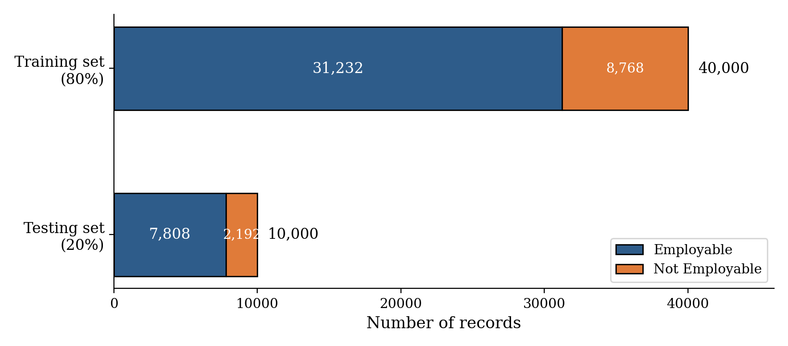
CHAPTER 5 — IMPLEMENTATION
Split, Preprocessing & the Implemented Pipeline
THE EXECUTED PIPELINE, STAGE BY STAGE
1
Load cleaned CSV, deduplicate, strip whitespace from string columns
2
Construct the two composite features
3
Drop target and the six optional attributes → 18-feature matrix; label-encode target
Figure 5.5 — Stratified 80:20 partition with class composition
4
Stratified 80:20 split (test_size = 0.2, stratify = y, random_state = 42)
5
ColumnTransformer preprocessing → SMOTE → XGBoost classifier, as one pipeline object
PREPROCESSING — FITTED INSIDE THE PIPELINE
6
Predict via predict_proba, then apply the custom decision threshold of 0.35
Preprocessing is implemented using a scikit-learn ColumnTransformer embedded directly within the modelling pipeline to prevent data leakage. The 14 numeric features are processed using training-set median imputation followed by StandardScaler, while the 4 categorical features use modal imputation and OneHotEncoder with handle_unknown='ignore'. The target variable is encoded using LabelEncoder, mapping Employable to 0 and Not Employable to 1 alphabetically. SMOTE is also included as a pipeline step, ensuring that synthetic minority samples are generated exclusively from the training data.
MODEL CONFIGURATION
n_estimators
learning_rate
max_depth
200
0.05
6
scale_pos_weight
random_state
training time
≈ 3.56
42
4.41 s
The threshold is a deliberate asymmetry: failing to flag a graduate who needs support is a more serious error than flagging one who does not, because the first withholds help while the second merely offers unnecessary guidance.
Notes:
Chapter 5, Sections 5.3, 5.5 and 5.6. The single stratified hold-out is defensible at n = 50,000; k-fold cross-validation is recommended as an extension in Section 6.3.

Slide 11
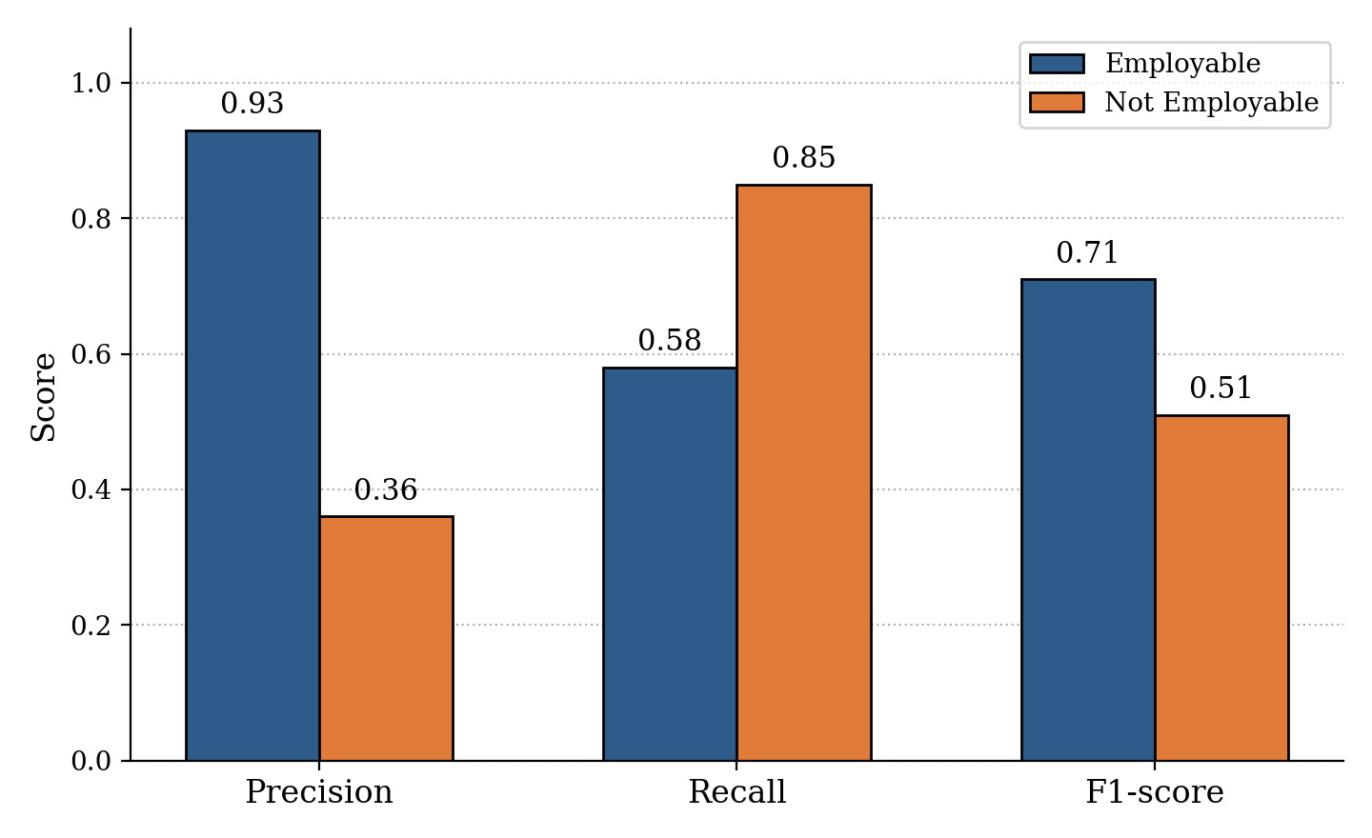
CHAPTER 5 — RESULTS
Model Performance: Classification Results
The trained pipeline was evaluated on the 10,000 held-out records using accuracy, per-class precision, recall and F1-score. Reporting all of them per class directly addresses the evaluation weakness identified across the reviewed literature, in which studies reported headline accuracy without minority-class recall.
0.6384
0.8082
0.6384
0.6690
Accuracy
Weighted precision
Weighted recall
Weighted F1
TABLE 5.5 — CLASSIFICATION REPORT (THRESHOLD = 0.35)
Class / Average
Precision
Recall
F1
Support
Employable
0.93
0.58
0.71
7,808
Not Employable
0.36
0.85
0.51
2,192
Accuracy
—
—
0.64
10,000
Macro average
0.65
0.72
0.61
10,000
Weighted average
0.81
0.64
0.67
10,000
Training over 40,000 records completed in 4.41 seconds — a figure that makes the periodic retraining pathway designed in Chapter 4 entirely practical.
Figure 5.10 — Per-class precision, recall and F1-score comparison
Notes:
Chapter 5, Section 5.7, Table 5.5 and Figure 5.10. All values reconcile exactly with the console output reproduced as Figure 5.7 in the thesis.

Slide 12
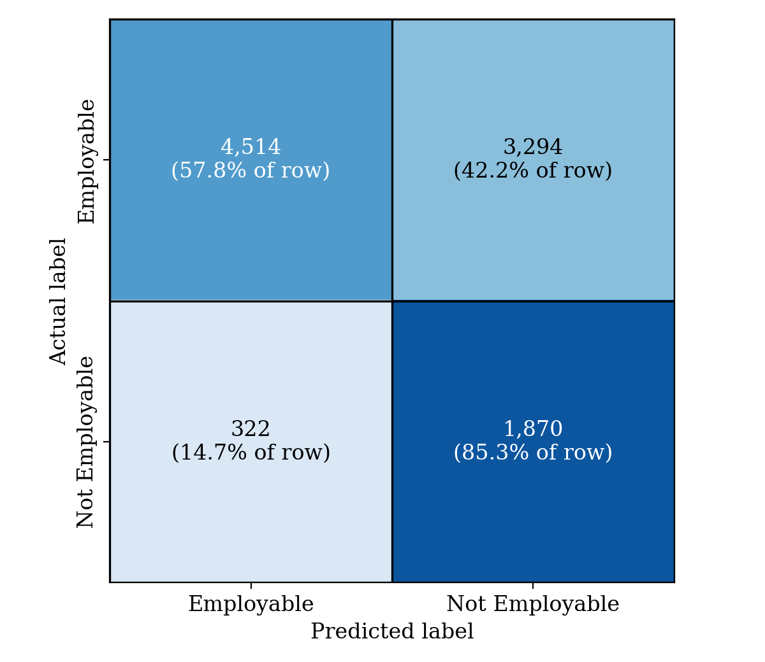
CHAPTER 5 — RESULTS
Confusion Matrix & the Recall–Precision Trade-off
1,870
of 2,192 at-risk graduates correctly identified
85.3%
minority-class recall — the operationally decisive figure
322
at-risk graduates missed by the model
WHAT THE MODEL ACHIEVES
The three imbalance corrections were applied specifically to maximise recovery of at-risk graduates, and on that criterion the model performs strongly. For an early-warning system whose purpose is to route students toward support before they reach the job market, minority-class recall is the decisive number.
Figure 5.8 — Confusion matrix on the held-out test set
THE COST, STATED PLAINLY
The matrix reconciles exactly: (4,514 + 1,870) / 10,000 = 0.6384; minority recall 1,870 / 2,192 = 0.853; minority precision 1,870 / 5,164 = 0.362.
Minority precision of 0.36 means roughly two of every three flagged graduates are in fact employable, and overall accuracy of 63.84% sits about 14 points below the 78.08% majority-class baseline. The configuration is over-corrected toward the minority class and requires recalibration before deployment.
Notes:
Chapter 5, Sections 5.7 and 5.14. The likely mechanism of over-correction is that SMOTE, scale_pos_weight and the lowered threshold compound; evaluating the three levers separately is a priority extension (Section 6.3).

Slide 13
CHAPTER 5 — MODEL SELECTION
Why XGBoost: Justification & Comparison Status
The executed pipeline trains and evaluates XGBoost only. Logistic Regression, Decision Tree, Random Forest and SVM were identified as candidate comparators in the research design, but comparative results have not yet been produced — so the algorithm choice is justified on established properties, not on a claim of measured superiority.
Tabular performance
Non-linear relationships
Feature interactions
Gradient-boosted tree ensembles are the consistent leading family on structured tabular classification of this size and shape (Chen & Guestrin, 2016).
The marginal value of a first internship plainly exceeds that of a fourth; tree splits represent such saturating effects without specifying them in advance.
With max_depth = 6, each tree can encode interactions of up to six attributes automatically — something a linear model captures only through manual terms.
The boosting mechanism
Regularisation
Efficiency & interpretability
Each successive tree fits the residual errors of the current ensemble, concentrating capacity on cases the model is currently getting wrong.
L1 and L2 penalties on leaf weights, plus the depth limit and 0.05 shrinkage, give several independent controls on model complexity.
4.41 s over 40,000 records makes periodic retraining practical, and native feature importance supplies the interpretability layer.
TABLE 5.6 — CANDIDATE ALGORITHMS AND THEIR STATUS
Model
Status on this data
Principal limitation for this problem
Logistic Regression
Not yet measured
Assumes additive, linear log-odds; cannot represent skill–experience interactions unaided
Decision Tree
Not yet measured
High variance; a single unpruned tree overfits and is unstable across resamples
Random Forest
Not yet measured
Trees grown independently, so errors are averaged rather than corrected
Support Vector Machine
Not yet measured
Kernel training scales poorly beyond ~10,000 rows; no native feature importance
XGBoost (selected)
Accuracy 0.6384 · weighted F1 0.6690
Combining its class weighting with SMOTE risks the over-correction observed in Section 5.7
Notes:
Chapter 5, Section 5.8. Completing the comparison under the identical stratified split and imbalance-sensitive protocol is the single highest-priority item of remaining work (RQ3, Section 6.3.1).

Slide 14
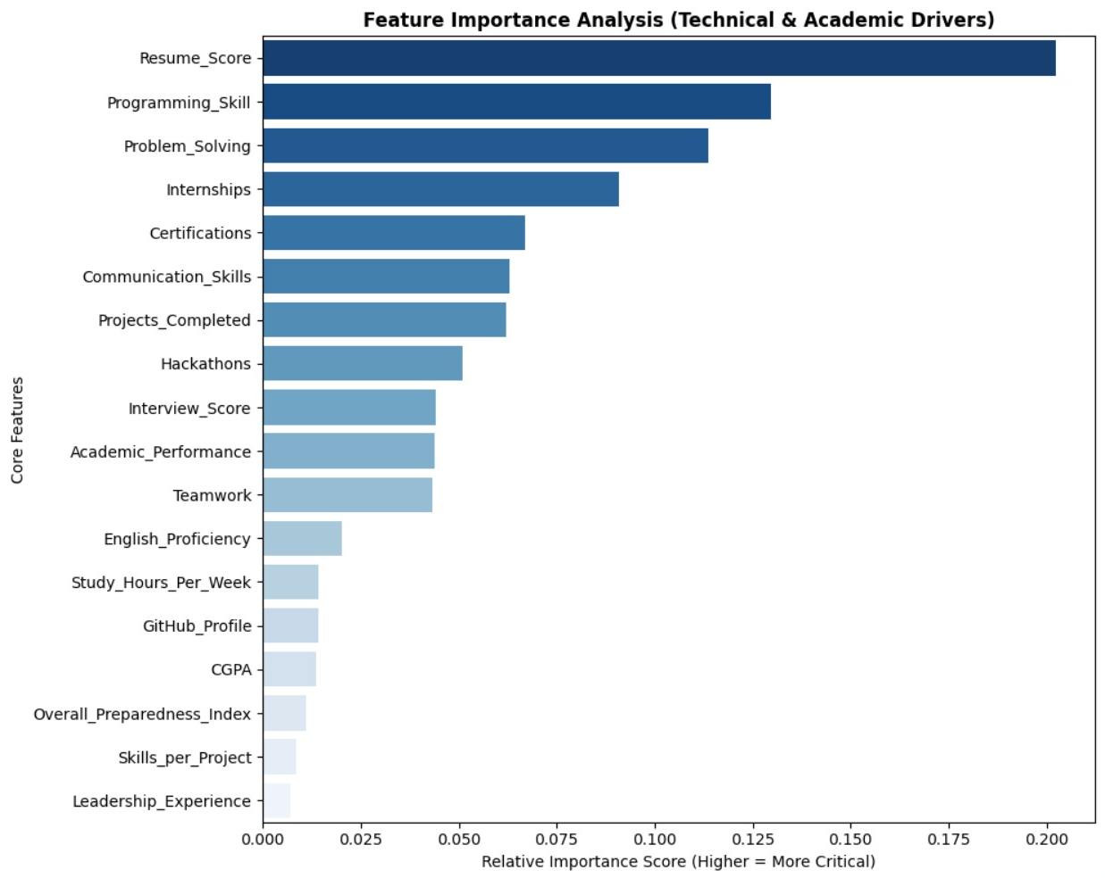
CHAPTER 5 — MODEL INTERPRETATION
Key Finding: What Actually Drives Employability
THE SIX HIGHEST-PRIORITY FEATURES
1
Resume_Score
Career preparation
2
Programming_Skill
Technical proficiency
3
Problem_Solving
Soft skills
4
Internships
Practical experience
5
Certifications
Self-directed learning
6
Communication_Skills
Soft skills
15th
of 18 — the rank of CGPA, with an importance of 0.013581, below Study_Hours_Per_Week and GitHub_Profile
Figure 5.12 — Native XGBoost feature importance across the 18 retained features
Every one of the six leading features is a demonstrated capability or a piece of portfolio evidence — what a graduate can show they can do, and how well they can present it. Academic attainment is not irrelevant, but it is decisively secondary to evidenced skill and experience.
Notes:
Chapter 5, Section 5.10, Table 5.7. Both engineered features rank near the bottom (16th and 17th), because they are fixed combinations of attributes the ensemble already has and can construct for itself. Numeric scores for the fourteen highest-ranked features remain to be transcribed from core_features_xgb_importance.csv.

Slide 15
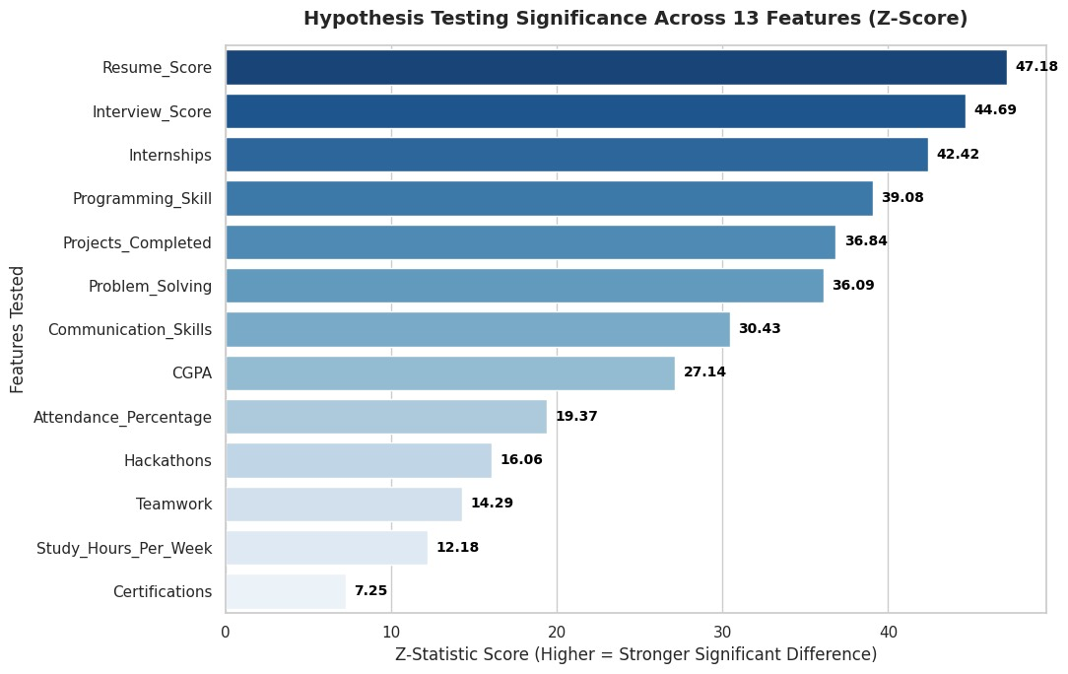
CHAPTER 5 — STATISTICAL VALIDATION
Hypothesis Testing: The Two-Proportion Z-Test
Feature importance establishes which attributes the model relies upon, but not whether observed differences between employable and non-employable graduates are statistically significant. The Z-test was executed on the dataset's 13 original numeric attributes, comparing group means between Employable (n = 7,808) and Not Employable (n = 2,192).
WHY THE Z-TEST, NOT THE T-TEST
Both group sizes exceed by three orders of magnitude the threshold at which the t-distribution converges on the normal, so the tests agree to many decimal places. The two-proportion Z-test also directly addresses the question the binary target poses (Table 5.8).
RESULT
All 13 attributes show a statistically significant difference in mean, with p < 0.0001 in every case; the null hypothesis of equal means is rejected throughout. Strongest: Resume_Score (z = 47.18), Interview_Score (44.69), Internships (42.42).
READING IT CORRECTLY
At n = 50,000 the standard error is very small, so differences of no practical consequence register as highly significant. Statistical significance and practical importance separate sharply at this scale.
Figure 5.14 — Z-statistic magnitude by attribute, ranked in descending order
Cohen's d has not yet been computed alongside these Z-statistics, so the practical — as opposed to statistical — magnitude of each difference remains to be assessed. This is recorded as outstanding in Section 5.15 and recommended in Section 6.3.1.
Notes:
Chapter 5, Section 5.11. The test ran on the original numeric columns prior to feature exclusion, so it includes Attendance_Percentage and excludes the two engineered composites.

Slide 16
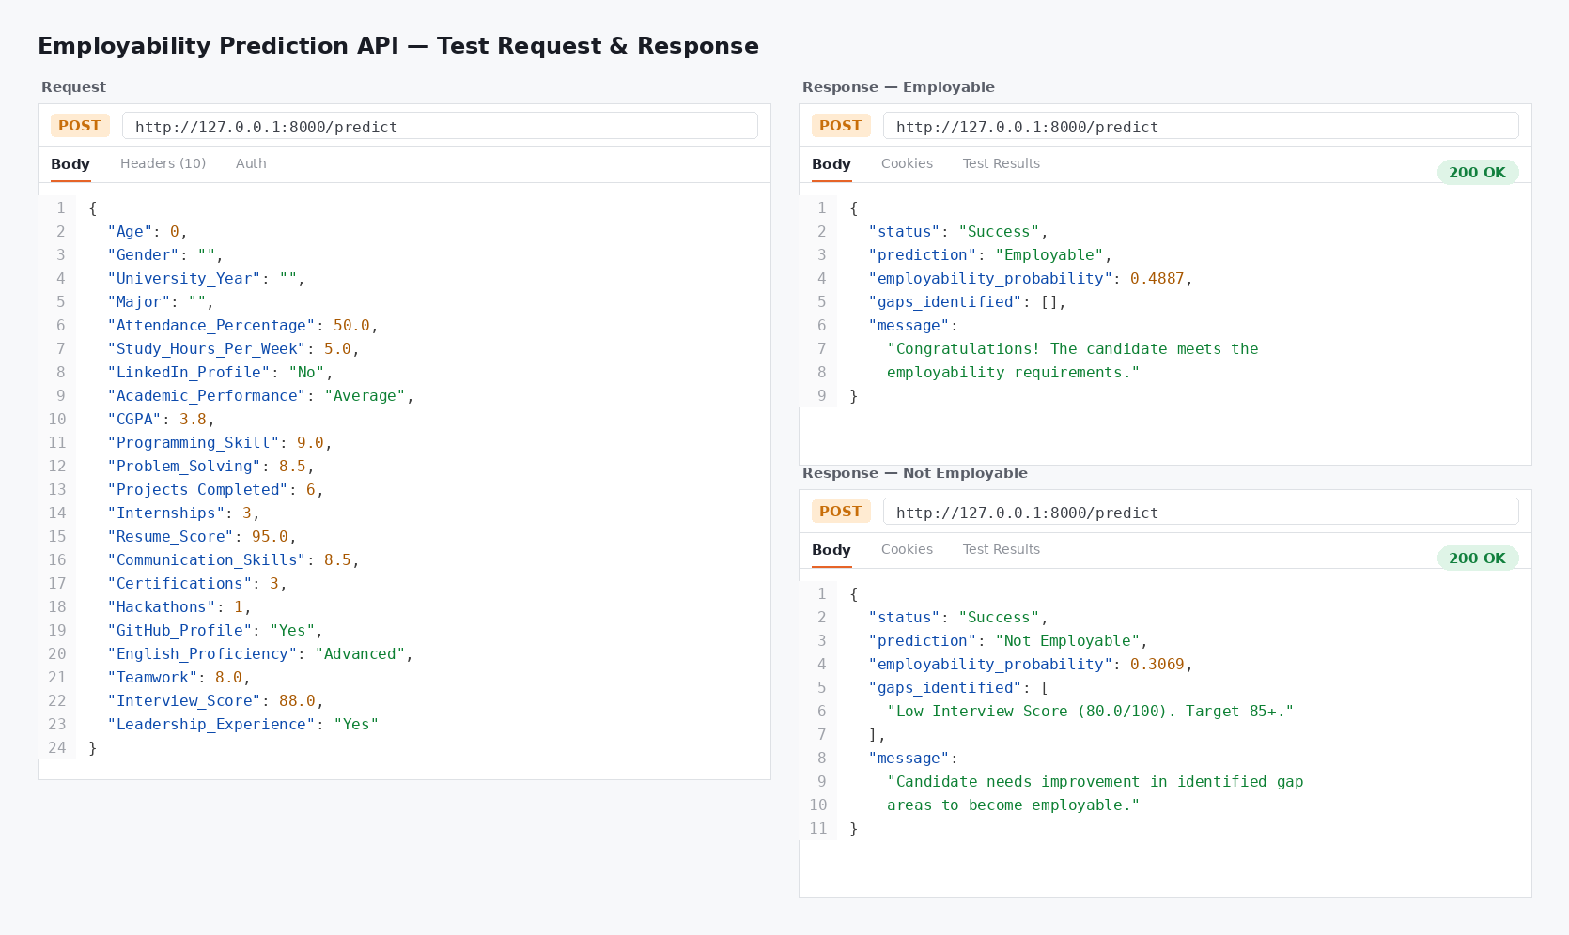
CHAPTER 5 — SYSTEM OUTPUT
From Model to Prediction: The HTTP API
No dashboard has been built yet. A student's data is submitted directly to the trained model through a documented HTTP API — exercised here using Postman — without any account, registration or login.
WHAT IS PERSISTED AND SERVED
The trained pipeline and fitted label encoder are persisted with joblib as best_employability_pipeline.pkl and label_encoder.pkl, so the exact artefacts evaluated in Section 5.7 are those served at prediction time. Per-record predictions are exported as improved_placement_predictions.csv and headline metrics as improved_final_metrics.json.
REQUIREMENTS SATISFIED
FR1 and FR2 (submission and validation) and FR3 (binary prediction with probability) are satisfied through the API. FR5 — the interactive dashboard — remains future work.
STATED HONESTLY
Figure 5.11 — Illustrative Postman request and response for an employability prediction
Figure 5.11 documents the intended request–response contract, not a capture of the deployed endpoint. Its eight fields do not correspond to the 18 features the model consumes, and the base_rate of 0.52 shown does not match the 21.92% minority-class base rate. SHAP attribution is not computed by the executed pipeline. Aligning the contract with the real schema is recorded as outstanding (Sections 5.15 & 6.3.4).
Notes:
Chapter 5, Section 5.9. FR6 and FR7 are exercised at the level of the underlying training and evaluation script, not through a user-facing interface.

Slide 17
CHAPTER 5 — DISCUSSION
Research Questions Revisited
Each research question is assessed explicitly against what the results establish — including where the answer is partial and why. Setting these boundaries is itself a contribution: it identifies precisely what a subsequent study must do to close them.
RQ1
The feature-importance analysis identifies and ranks all 18 retained attributes, establishing Resume_Score, Programming_Skill, Problem_Solving, Internships, Certifications and Communication_Skills as the strongest determinants and placing CGPA fifteenth. This fulfils Objective 1.
ADDRESSED
RQ2
A supervised classifier recovers 85.3% of graduates who will not be placed, from attributes available at or shortly after graduation. It is partial because accuracy of 63.84% falls below the 78.08% baseline and no threshold-independent measure (ROC-AUC) has been computed.
PARTIALLY ADDRESSED
RQ3
This question required a comparison across candidate algorithms under a common protocol. Only XGBoost was trained, so no comparative claim can be made. Stated plainly rather than presented as settled, because a comparative claim unsupported by comparative evidence would not withstand examination.
OPEN
RQ4
The global ranking converts model behaviour into concrete cohort-level guidance for students, universities and policymakers. It is partial because per-student SHAP attribution is not implemented, so the system indicates which attributes matter in general rather than for a given graduate.
PARTIALLY ADDRESSED
Also not addressed: subgroup fairness (gap G5) — the demographic attributes that would permit an audit were deliberately excluded from training — and national representativeness, which requires validation on a primary Bangladeshi sample.
Notes:
Chapter 5, Sections 5.12 and 5.13. Discussion: the dominance of experiential, technical and career-preparation features over academic performance corroborates Finch et al. (2013), Jackson (2013) and Baffa et al. (2023), on a sample an order of magnitude larger.

Slide 18
CHAPTER 6 — LIMITATIONS
Limitations & Recommendations
LIMITATIONS BOUNDING THE CONCLUSIONS
FOUR RECOMMENDATIONS
Secondary, non-Bangladesh-specific dataset
1
Students
Records are not guaranteed to reflect the Bangladeshi ICT labour market, curricular structure or student population; the six dimensions are operationalised as proxies.
Treat resume quality, programming and problem-solving ability, internship experience and recognised certifications as substantially more consequential than marginal CGPA improvement when allocating preparation effort during the degree.
Dataset provenance outside our control
The sample was assembled by the dataset's original publisher, so sampling technique and quality control lie outside the researcher's knowledge.
2
Universities
Use the ranked determinants to inform curriculum revision toward greater work-integrated learning, and to target career counselling where it changes outcomes most.
Incomplete algorithmic comparison
Only XGBoost was trained and evaluated, so no claim of comparative superiority over the four candidate comparators is made.
3
Institutional deployment
Confine any deployment of the current model to low-stakes routing — offering optional guidance to flagged students — until minority-class precision improves. At 0.36 precision it is unsuitable for any decision that allocates scarce resources or carries a cost to the student.
Uncalibrated precision–recall trade-off
Three imbalance corrections applied simultaneously appear to over-correct, yielding 0.36 precision; no threshold-independent measure separates model from threshold.
4
Future data collection
Cross-sectional design
Move from the secondary dataset used at this stage toward a primary, Bangladesh-specific dataset collected via a probability-based or institutionally coordinated sampling frame.
Predictors and outcomes are observed at a single point in time, so the model establishes predictive association rather than causation.
Notes:
Chapter 6, Section 6.2.

Slide 19
CHAPTER 6 — CONCLUSIONS
Conclusions & Future Work
KEY TAKEAWAY
What a graduate can evidence outweighs CGPA. Across all 18 retained features, the model's decisions were driven overwhelmingly by evidenced capability and career preparation — Resume_Score, Programming_Skill, Problem_Solving, Internships, Certifications and Communication_Skills occupied the six highest positions, while CGPA ranked fifteenth with an importance of 0.013581. This reinforces the argument that employability in computing disciplines cannot be reduced to grade point average, on a sample an order of magnitude larger than the reviewed studies.
What was built
What it demonstrates
What it does not settle
A 50,000-record dataset reduced to 18 modelling features, partitioned by a stratified 80:20 split, with an XGBoost classifier trained inside a pipeline of imputation, standardisation, one-hot encoding and SMOTE — served behind a documented HTTP API.
At-risk graduates can be recovered at high rates from attributes available at or shortly after graduation: 1,870 of 2,192 correctly identified, a recall of 85.3%. This is the operationally relevant capability for an early-warning system.
It does so at 0.36 minority precision and 63.84% overall accuracy — below the 78.08% baseline — indicating a configuration over-corrected toward the minority class that requires recalibration before deployment.
FUTURE WORK (SECTION 6.3)
Complete the present analysis
Collect the data now missing
Validate, extend and audit
Deploy the system
Execute the RQ3 comparison across Logistic Regression, Decision Tree, Random Forest and SVM on the identical split; compute ROC-AUC and precision–recall curves; evaluate the three imbalance levers separately; replace the hold-out with k-fold cross-validation; compute Cohen's d.
Internship duration, sector and conversion; certification issuer and recency; specific languages and frameworks; portfolio substance beyond a binary flag; socio-economic, institutional, geographic and longitudinal data (Table 6.1).
External validation by training on one dataset and testing on an independently collected one; LightGBM, CatBoost and stacking ensembles; NLP of CVs; subgroup fairness audit using the excluded demographic attributes as audit variables rather than predictors.
Implement SHAP against the actual 18-feature pipeline; build the interactive dashboard on the API (FR5, NFR6); expose administrator retraining (FR6, FR7); pilot within a university career service as a live early-warning tool.
Notes:
Chapter 6, Sections 6.1 and 6.3. Completing the comparative evaluation required by RQ3 is the highest-priority item, and is computationally trivial given the 4.41-second XGBoost training time.

Slide 20
THANK YOU!
Notes:
Closing slide. Open for questions.

