Slide 1
Introduction
Inflammation
Drug half-lives and Efficacy
Coordination Chemistry
Disease and oxidative stress

Slide 2
Objective
The objective of the current research work is to synthesize a drug that selectively and efficiently reduces inflammation and related maladies while minimizing toxicity.

Slide 3
methodology
Oxicam
NaOH
Metal Salt
Condensed on water bath
at 60ºC until precipitation
Stirred at 400 rpm
Stirred overnight
at 400 rpm
Filter the product,
washed & dried at ambient
Temperature

Slide 4
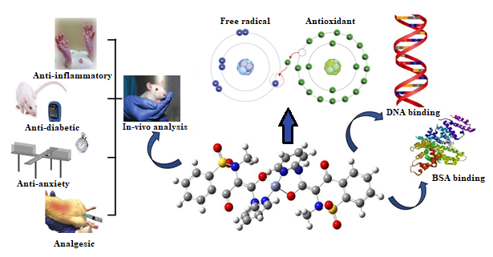

Slide 5
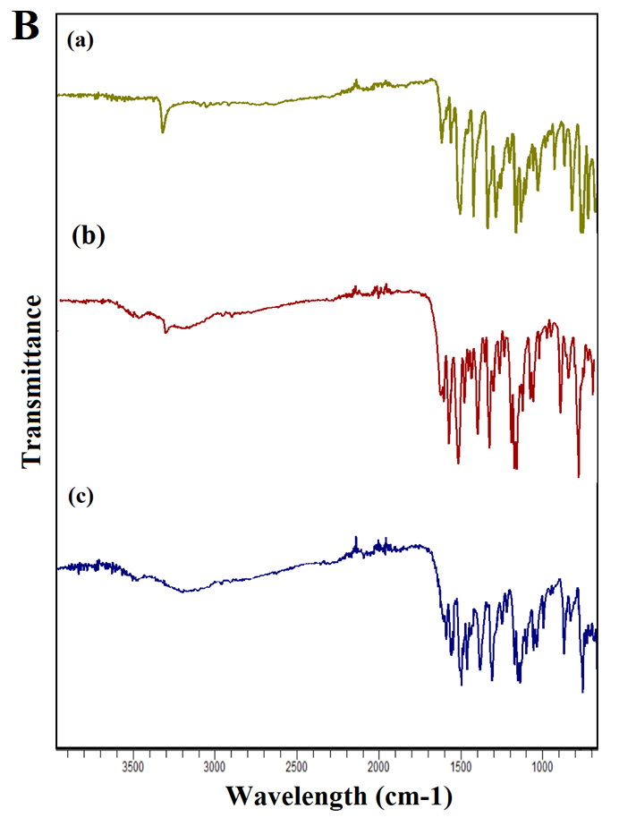
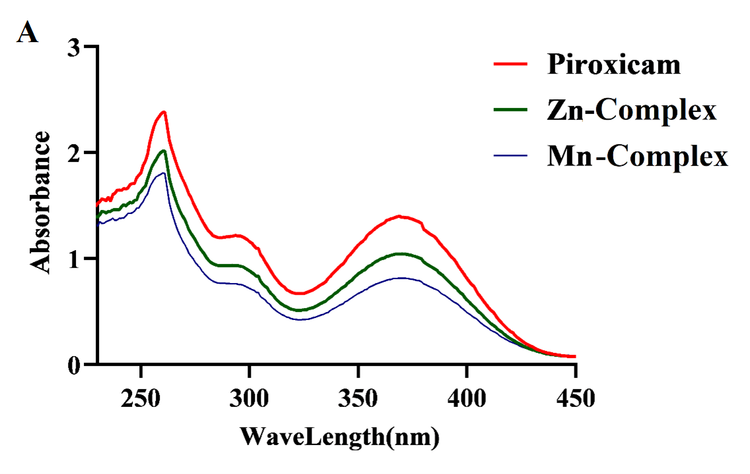
RESULTS
A) UV-Visible spectra of free Piroxicam, Zn and Mn-Complex of piroxicam. B) FTIR spectrum. (a) Piroxicam, (b) Zn-Complex and (c) Mn-Complex obtained by Agilent Technologies Carry 630 FTIR

Slide 6
Antioxidant activities
Table 1. IC₅₀ (μM) for radical scavenging activity.
Activities | Compounds | IC50 values (μM) w.r.t Time (Minutes)
 |  | 5 | 15 | 30 | 45 | 60 | 120
DPPH | Zn-Complex | - | >2000 | >2000 | >2000 | >2000 | >2000
 | Mn-Complex | - | >2000 | >2000 | >2000 | >2000 | >2000
 | Piroxicam | - | >2000 | >2000 | >2000 | >2000 | >2000
ABTS | Zn-Complex | 51.18 | 55.15 | 56.72 | 54.91 | 56.23 | 52.25
 | Mn-Complex | 39.37 | 39.17 | 42.10 | 31.26 | 39.40 | 35.34
 | Piroxicam | 65.61 | 58.57 | 67.65 | 79.29 | 87.54 | 120.78
Iron chelating | Zn-Complex | - | 470.86 | 472.31 | 477.31 | 454.41 | 1128.21
 | Mn-Complex | - | 182.45 | 194.22 | 152.35 | 624.46 | >2000
 | Piroxicam | - | >2000 | >2000 | >2000 | >2000 | >2000
FeCl3 reducing power | Zn-Complex | - | 84.43 | 51.38 | 50.51 | 50.51 | 52.12
 | Mn-Complex | - | 21.49 | 18.55 | 18.92 | 19.23 | 19.44
 | Piroxicam | - | 136.54 | 122.41 | 123.15 | 124.27 | 123.28
Phospho- molybdenum | Zn-Complex | - | 141.21 | 206.63 | 167.99 | 188.33 | -
 | Mn-Complex | - | 201.22 | 168.20 | 162.99 | 150.67 | -
 | Piroxicam | - | 862.09 | 1904.54 | 1849.99 | 1932.37 | -

Slide 7
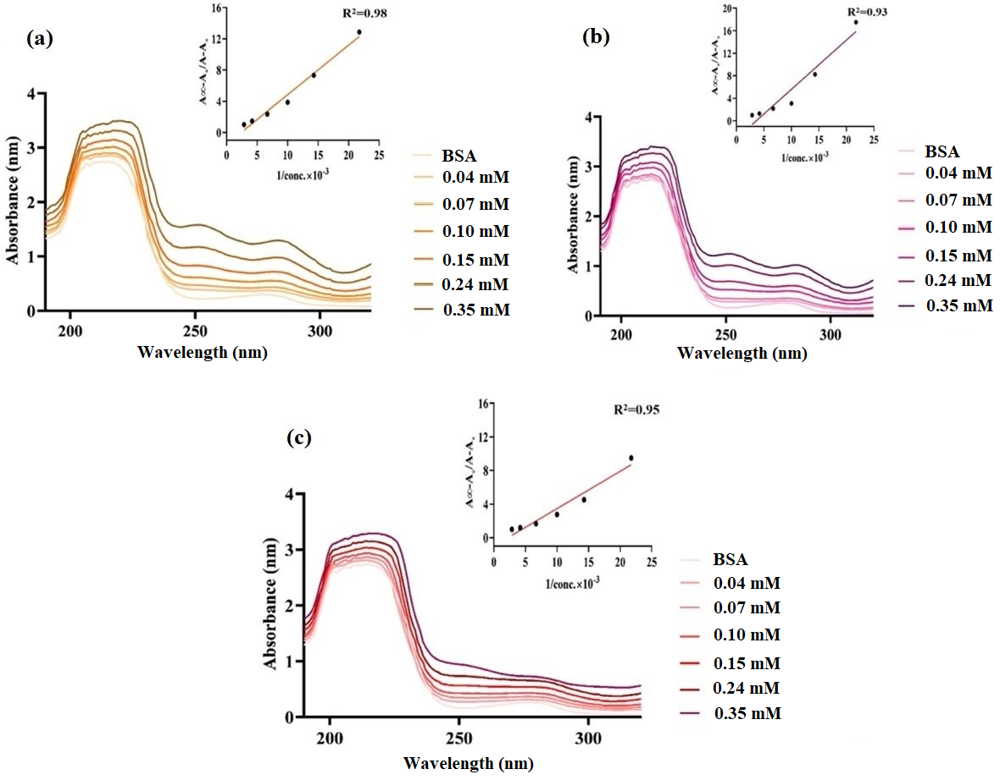
Protein Binding study
Table 3. Absorption spectral parameters of metal complexes with BSA
Complexes | λmax. |  | Δλ (nm) | Hyperchromism (%H) | Binding constant (K_{b}) | ΔG (KJ mol⁻¹)
 | Free | Bound
Zn-Complex | 277 | 283 | 06 | 75.9 | 0.24 ×10⁴ M⁻¹ | -19.6
Mn-Complex | 277 | 284 | 07 | 73.0 | 0.36 ×10⁴ M⁻¹ | -20.64
Piroxicam | 277 | 277 | 0 | 63.7 | 0.22 ×10⁴ M⁻¹ | -19.4
Figure 3. Absorption spectra of BSA in Tris-HCl/NaCl buffer upon successive addition complexes at different of various concentrations. (a) Zn-Complex, (b) Mn-Complex, and (c) Piroxicam

Slide 8
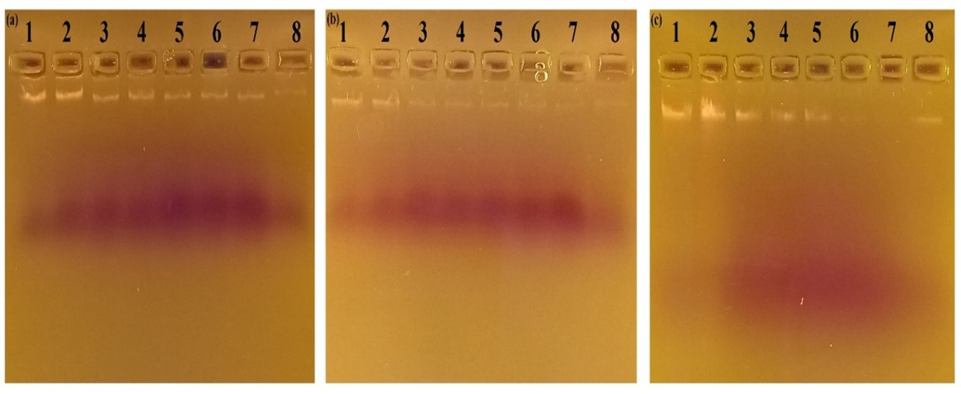
DNA Binding Study
Table 2. Percent cleavage of DNA induced by piroxicam and its metal complexes.
Complexes | % Inhibition
 | Ratio (DNA:Complex)
 | 1:4 | 1:6 | 1:8 | 1:10 | 1:15 | 1:20
Piroxicam | 1.69 | 46.95 | 48.98 | 65.49 | 67.74 | 69.49
Zn-Complex | 51.08 | 79.53 | 83.95 | 86.13 | 90.52 | 95.25
Mn-Complex | 1.44 | 53.31 | 68.46 | 78.21 | 95.47 | 98.47
Figure 2. Agarose gel electrophoresis band pattern of genomic DNA subjected to (a) piroxicam, (b) Zn-Complex, (c) Mn-Complex. Lane1: DNA as a control, Lane 2-7: different concentrations of complexes at a sequence of molar ratio 1:4, 1:6, 1:8, 1:10, 1:15, 1:20. Lane 8: H2O2 as a negative control.

Slide 9
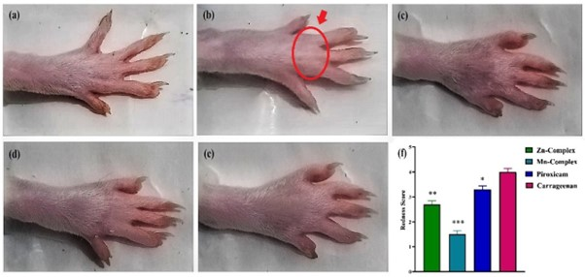
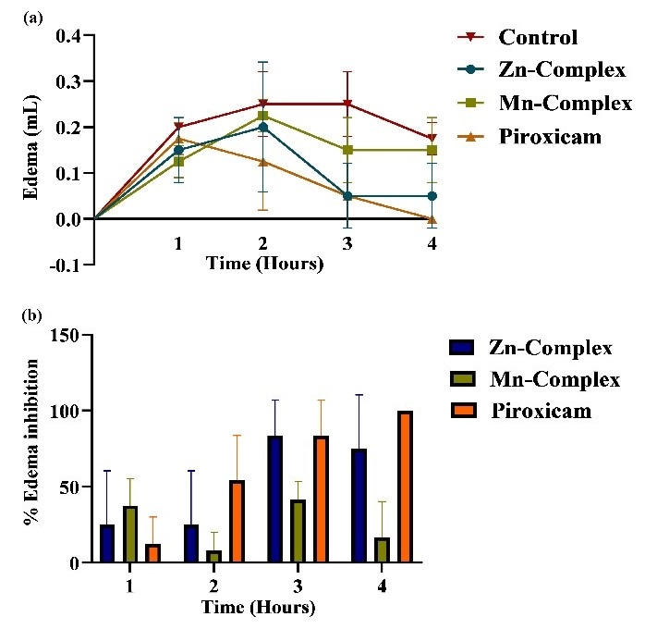
Carrageenan Induced Anti-inflammatory Activity
Carrageenan-induced paw edema status after 2 hours of activity. (a) Normal paw, (b) Carrageenan group, (c) Piroxicam treated paw, (d) Zn­-Complex treated paw, (e) Mn-Complex treated paw and (f) redness score. *P< 0.05 , **P< 0.01, ***P< 0.001 shows statistical difference when compared with control group. The R.H.S displays (a) the paw edema by water displacement method in mL. (b) % Edema inhibition displays graphically in ± SEM

Slide 10
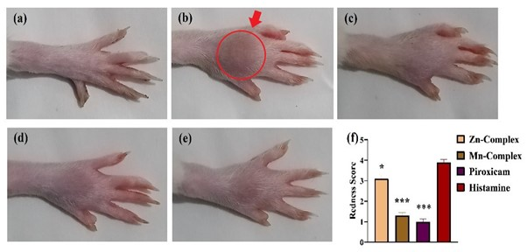
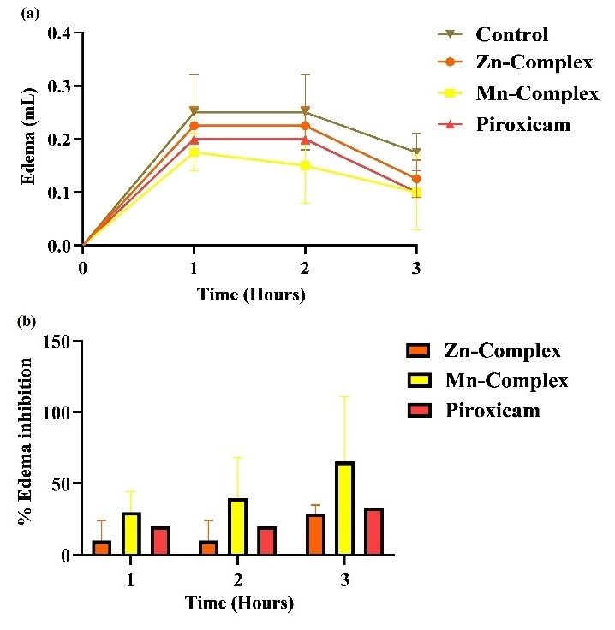
Histamine Induced Anti-inflammatory Activity
Histamine-induced paw edema after 2 hours of activity. (a) normal paw, (b) histamine-induced inflammation, (c) piroxicam treated paw, (d) Zn-Complex treated paw, (e) Mn-Complex treated paw. (f) redness score. *P< 0.05 , **P< 0.01, ***P< 0.001 shows statistical difference when compared with control group. The R.H.S displays (a) the paw edema by water displacement method in mL (b) % Edema inhibition displays graphically in ± SEM

Slide 11
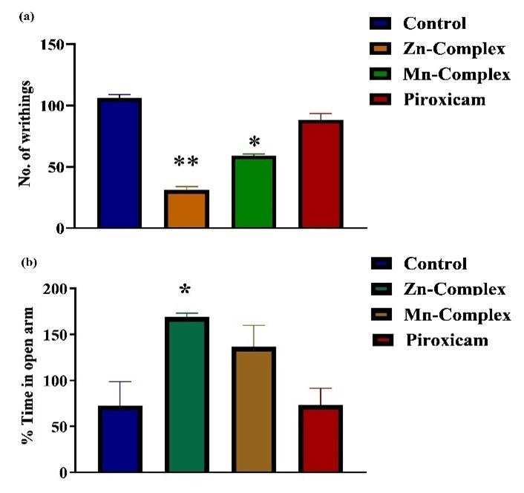
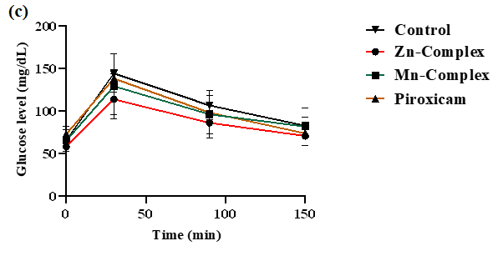
Analgesic, Anxiolytic, Antidiabetics
Figure 4. Acetic acid-induced analgesic (a) and anxiolytic (b) potential among rats treated with Piroxicam, Zn, and Mn-Complexes. The number of writhing and % Time in the open arm has been displayed in the form of mean ± SEM. *P< 0.05 and **P< 0.01 shows the statistical difference when compared with the control group. Oral glucose tolerance test in SD rats (c) for evaluating the anti-hyperglycemic effect.

Slide 12
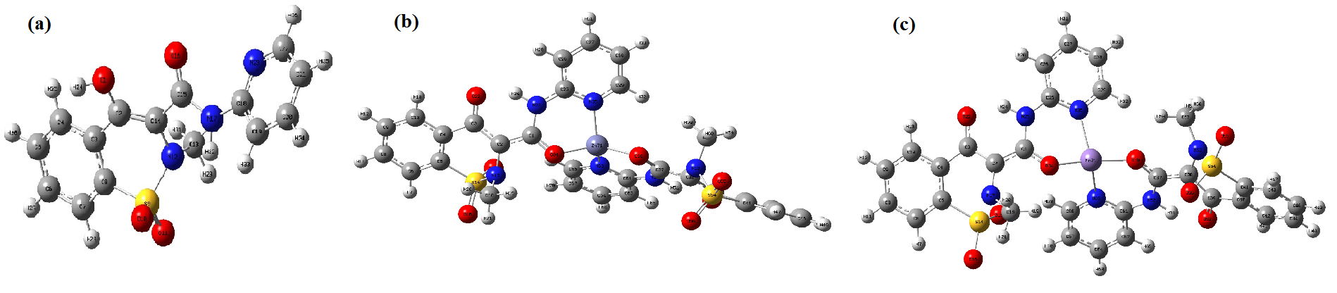
DFT Analysis
Geometry Optimization
Figure 14. Optimized geometry of (a) Piroxicam, (b) Zn-Complex, and (c) Mn-Complex optimized under B3LYP/6-31G(d), and B3LYP/LanL2DZ basis set, respectively, using Gaussian package09, viewed under GausseView software.

Slide 13
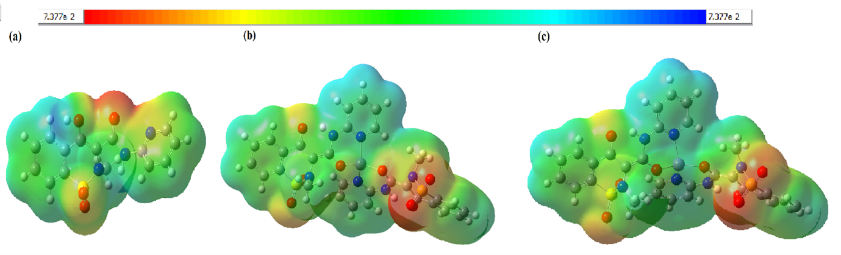
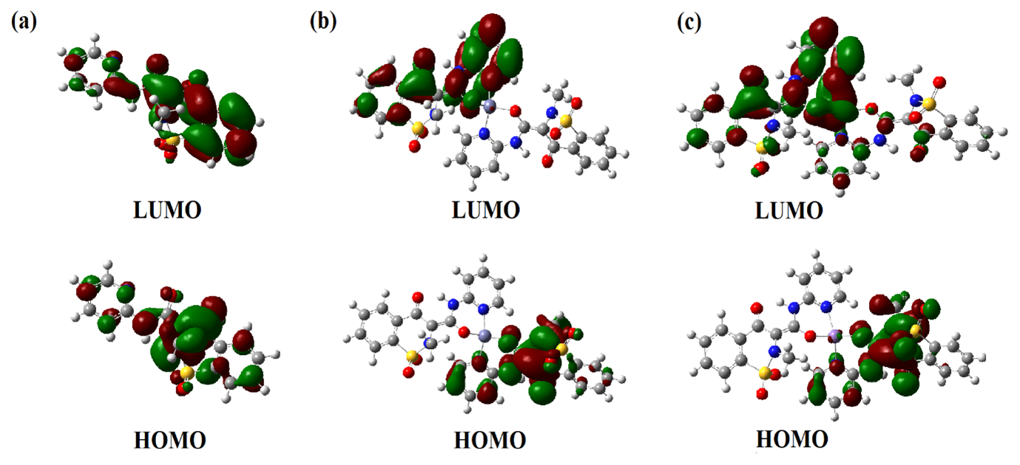
Table 9. Charge distribution analysis of studied compounds
Piroxicam
N23 -0.448 | O16 -0.542 | - | - | -
Zn-Piroxicam
Zn 1.303 | N63 -0.641 | N35 -0.628 | O36 -0.760 | O34 -0.752
Mn-Piroxicam
Mn 1.325 | N63 -0.676 | N35 -0.658 | O36 -0.810 | O34 -0.795
Figure 15. Electrostatic potential map of (a) Piroxicam (b) Zn-Complex (c) Mn-Complex showing total electron density based on color code from red to blue.
Table 10. Energy values of piroxicam, and Zn & Mn-Complexes
Parameters | Piroxicam | Zn-Complex | Mn-Complex
ELUMO | -0.089 | -0.078 | -0.100
EHOMO | -0.238 | -0.204 | -0.205
ΔE / eV | 0.149 | 0.126 | 0.105
Global hardness=η | 0.0745 | 0.063 | 0.052
Global softness=s | 6.711 | 7.936 | 9.524
Electronegativity=χ | 0.1635 | 0.141 | 0.152
Chemical potential=µ | -0.1635 | -0.141 | -0.152
Electrophilicity index=ωi | 0.179 | 0.158 | 0.221
Figure 16. LUMO and HUMO frontiers orbitals of (a) Piroxicam, (b) Zn-Complex, and (c) Mn-Complex.

Slide 14
Future Perspective
pH- responsive hydrogels
Kinetically controlled drug release

Slide 15
Other skills and Publications
Maha, N., Tajammal, A., Samra, M. M., Irfan, A., Laraib, N., & Basra, M. A. R. (2023). Comprehensive Biological, Photodegradation, Density Functional Theory, and Docking Exploration of Zn (II) and Mn (II) complexes of Piroxicam. ChemistrySelect, 8(29), e202301269.
Maha, N., Samra, M. M., Laraib, N., Irfan, A., Azam, M., & Basra, M. A. R. (2023). Insights into the geometrical parameters, charge distribution, and reactivity of Ca, Mg, Sr, and Bi complexes of piroxicam and meloxicam: A quantum chemical study. Computational and Theoretical Chemistry, 1230, 114346.
Khan, M. S., Maha, N., Riaz, M., Yasmin, T., Irfan, A., & Basra, M. A. R. (2024). Computational investigation of pyrazinamide drugs and its transition metal complexes using a DFT approach. Journal of Computational Chemistry, 45(10), 622-632.

Slide 16
INTRODUCTION
Inflammation is a multifactorial representation of organism’s immune response against maladies. Acute phase is a quick response towards a foreign stimulus, while the persistent retention of such an agent in the body arouse chronic phase. Coordination chemistry establishes a link between chemistry and biology by having numerous biologically improved potentials due to the unique chemistry they pose after chelation. For instance, metal complexes of NSAIDs are frequently synthesized and tested for their biological activity and selectivity due to COX-1 and COX-2 structure similarity. Several drugs possess short half-lives of approximately 6 to 8 hours and accord immediate relief from acute pain, but not suitable for chronic pain as it requires frequent dosing. The major cause of any disease is the elevation in oxidative stress which subsequently generates free radicals that ultimately trigger chronic inflammatory pathways of cancer, diabetes etc.

Slide 17
The research work that I am currently presenting initiates from the in-vivo analysis on acute phase of inflammation and directed towards in-vitro analysis on chronic phase of inflammation. For the first phase, carrageenan and histamine was injected at the SD rats’ paw and for the later phase DNA- cleavage and anti-diabetic activity were performed as chronic inflammation leads to subsequent representation of maladies like cancer and diabetes. Pharmacodynamic study was conducted through serum albumin protein. Moreover, anti-anxiety and analgesic activities were performed to speculate anxiety and pain level after drug administration.

