Slide 1

Unit 1

Slide 2
Welcome
Our class materials can be found at github.com/mahackers
If you have not created a GitHub account, you can do so at github.com/join
  Let me know what your username is and I will add you to our organization
We have a Facebook group
  Join at tinyurl.com/hackerfb
  We will announce class news here

Slide 3
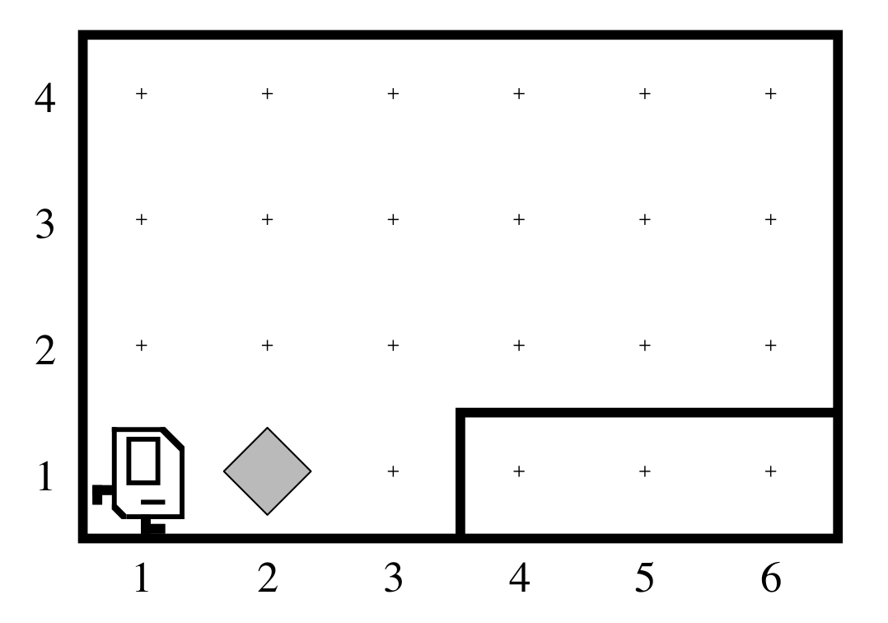
Karel The Robot
This is Karel’s world
  Streets are horizontal
  Avenues are vertical
  The diamonds are called “beepers”
    Karel can hold beepers
Karel can only process a few commands
  What commands?

Slide 4
Karel The Robot
Karel can:
  move
  turnLeft
  pickBeeper
  putBeeper

Slide 5
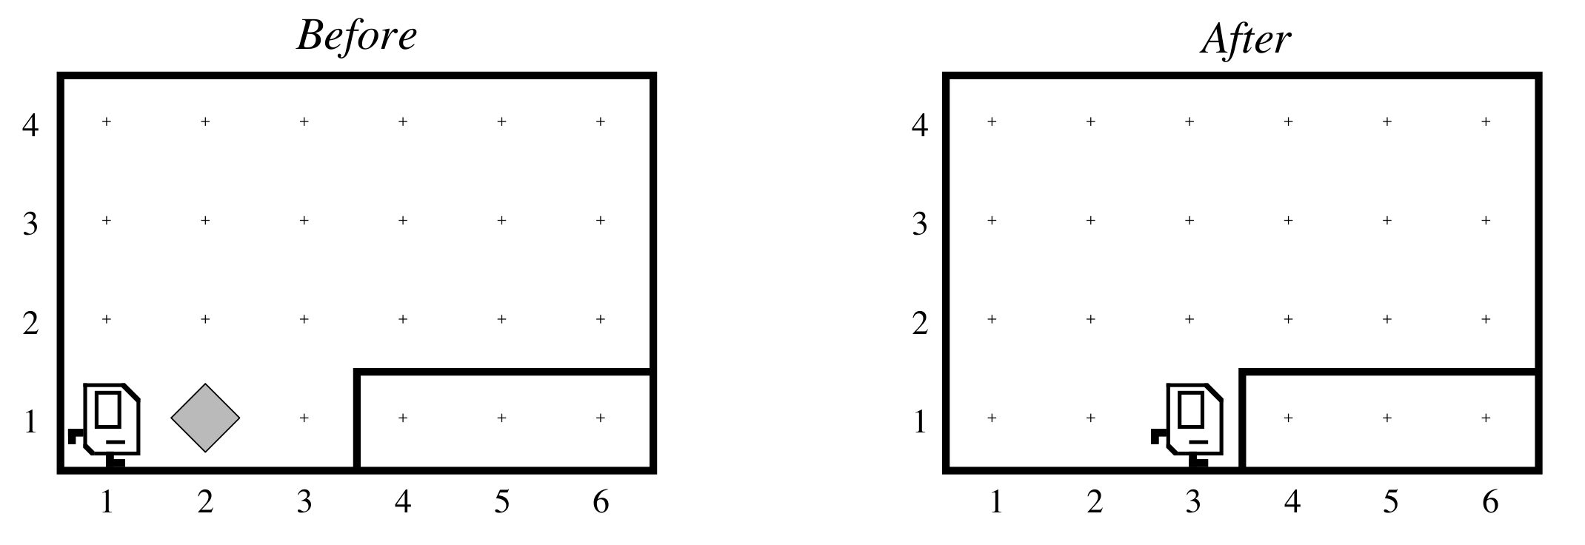
Karel Example #1
How can we tell Karel to do this?

Slide 6
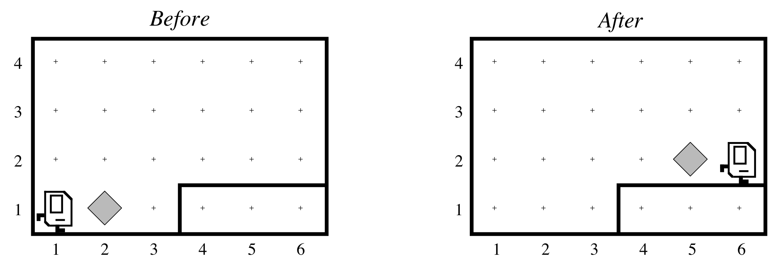
Karel Example #2
How can we tell Karel to do this?

