Slide 1
Online Voting System App
By - Mahadeo Khamgal

Slide 2
Problem Statement
Requirements.
As a user I should be able to login and logout of the website.
If I don’t have an account already, I should be able to create an account.
System should provide me new voter Id on successful registration.
As a user and a voter, I should be able to poll my vote into the system.
As a voter I should be able to check to voting results.

Slide 3
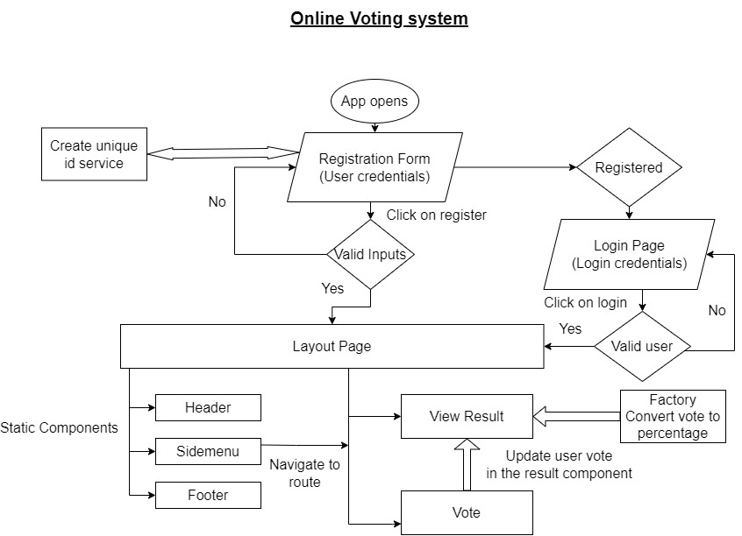
Flowchart of the App

Slide 4
Workflow of the App
App opens.
User is navigated to Registration Page.
user can register himself or click on go to login button if already registered.
on entering valid data, the user will get navigated to Layout page with his id on header.
also, on successful login user gets navigated to Layout page with his id on header.
Layout page contains Header, footer and side-menu as static directives(directives as views header has a controller to show username)
user can switch between Vote and View-result view using side-menu links.
Once user votes the vote button will be disabled and user will be navigated to View-result view in Layout only.
On click of logout button user will be logged out of system.

Slide 5
Register Page
Contains registration form with following fields.
Full Name
Email address
Birth Date
Password
Confirm Password
On click of register button form data gets validated, if the correct data is entered getVoterId service is called, till id is getting generated processing screen is shown and once user’s id is ready user gets navigated to Layout page.
Register controller sends the voter-id to Header controller and voter controller.

Slide 6
Login Page
Contains login form with following fields.
Voter id.
password
On click of login button form data gets validated, on successful validation user is navigated to Layout page.
login controller sends the voter-id to Header controller and voter controller.

Slide 7
Layout page
Contains static fields.
Header
Side-menu
Footer
Ui-view field is dynamic and changes as per the Ui-child route changes
Ui-view switches between polling and result view.

Slide 8
Vote view and controller
Shows candidates names and buttons for vote to the voter.
User can click and vote on any button among them.
All the vote buttons get’s disabled on clicking on any one vote button.
Vote data is sent to view result controller.
On voting user automatically navigates to Result view.

Slide 9
Result view
Shows candidates names and vote percentage.
Candidate having highest percentage will have green background color.
Vote percentage is calculated using calculatePercentage Factory.
User can click on any candidate row to see the vote count.
On clicking on logout button user is logged out and navigated to login page.

Slide 10
Thank you

