Slide 1
DATA ANALYSIS TASK
DATA Initiative Research position
Mahadharsan Ravichandran
NUID 002612021

Slide 2
AGENDA
GOAL
PROBLEM STATEMENTS / TASKS
WORKFLOW
CONCLUSION

Slide 3
Goal
Find out
Which country’s attributes most contribute to its economic growth.
Explain
GDP purchase power parity (GDP_PPP) by the factors.
GDP_PPP by a factor and group countries by that factor.

Slide 4
Tasks
Explain yearly GDP_PPP with the country factor scores from the same year and before
Group countries by which factor explains GDP_PPP change best.
Questions
Which factor is most important across all countries for improving GDP_PPP.
How much does improving each factor improve GDP (i.e. regression coefficients or similar).
Which factors are most important for which countries (heterogeneity), and group countries into segments, based on that.

Slide 5
Workflow
Import libraries and data
Data Preprocessing
Exploratory Data analysis
Simple Multiple Linear Regression
Multi variate Regression for each country
Multi variate Regression for each country and year
Countries segmentation by single factor

Slide 6
Import Lib, Data and Processing
Necessary libraries were imported.
Data from excel sheets were loaded as dataframe.
Data frames were reshaped and merged.

Slide 7
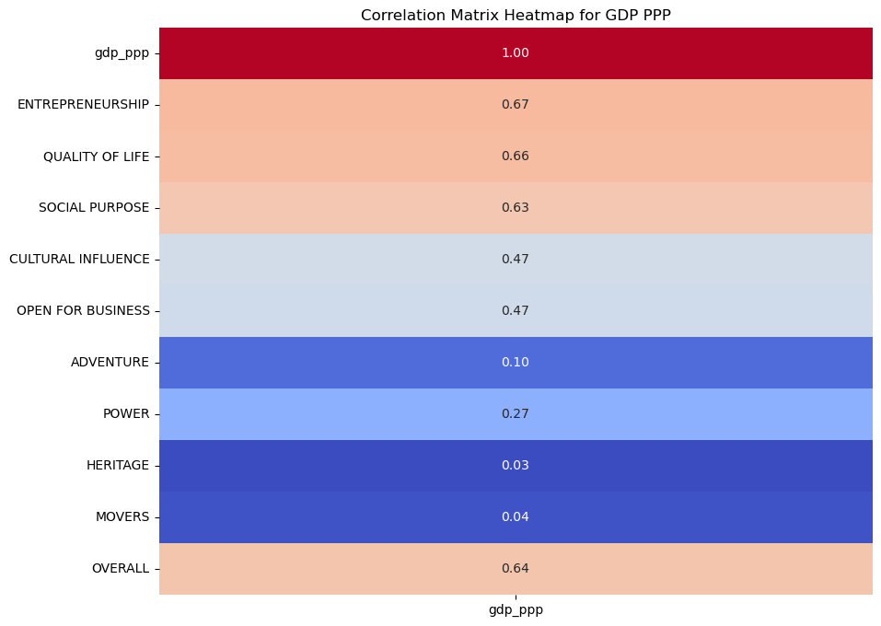
EDA
Correlation of all factors with GDP was analyzed.
It is found out that, overall countries, with higher levels of entrepreneurship tend to have higher GDP per capita.
Answer (a): which factor is most important across all countries for improving GDP_PPP.

Slide 8
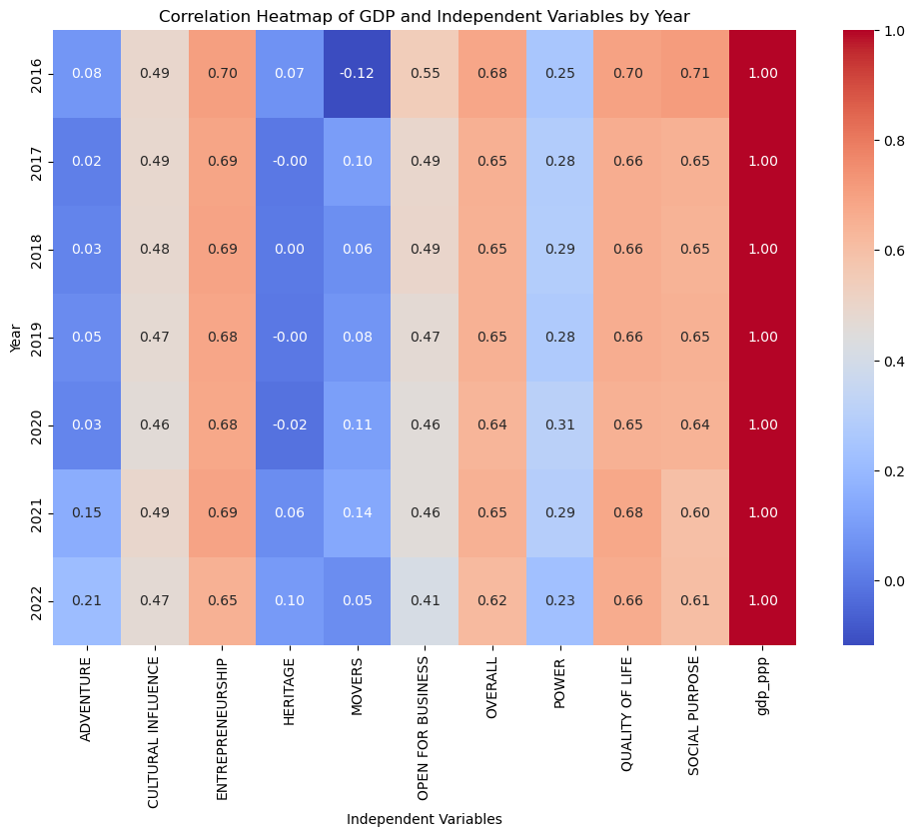
EDA
Correlation of all factors with GDP was analyzed by each year.

Slide 9
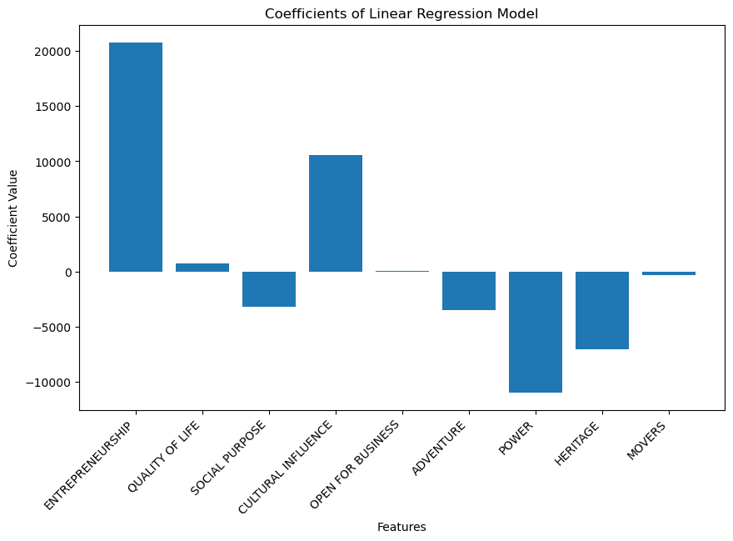
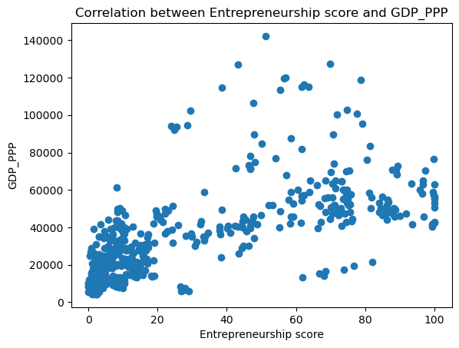
Multiple Linear Regression
After Simple Multiple Linear Regression, we can find out the factors’ relationship with GDP.

Slide 10
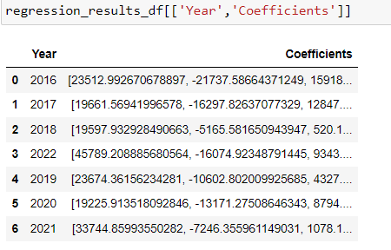
Multiple LR for each year
Through Multiple Linear Regression for each year, we can find out the factors’ relationship with GDP each year.

Slide 11
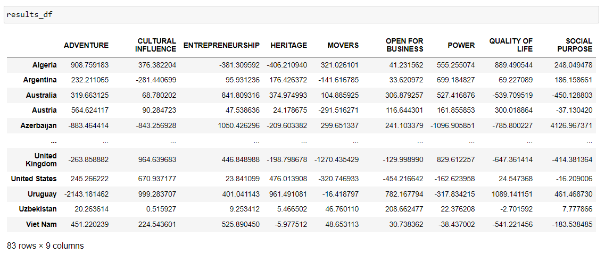
Multivariate Regression by each country
Through Multivariate Regression for each country, we can answer the question
Answer (b) how much does improving each factor improve GDP (i.e. regression coefficients or similar)

Slide 12
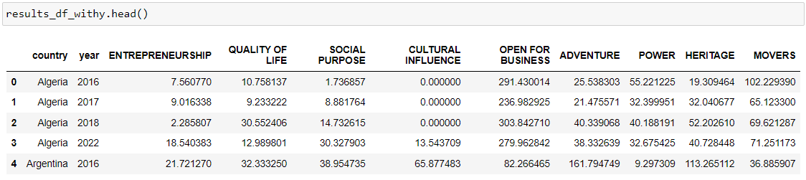
Multivariate Regression by each country and Year
Through Multivariate Regression for each country and year is done to assist segmenting each country into each factors.

Slide 13
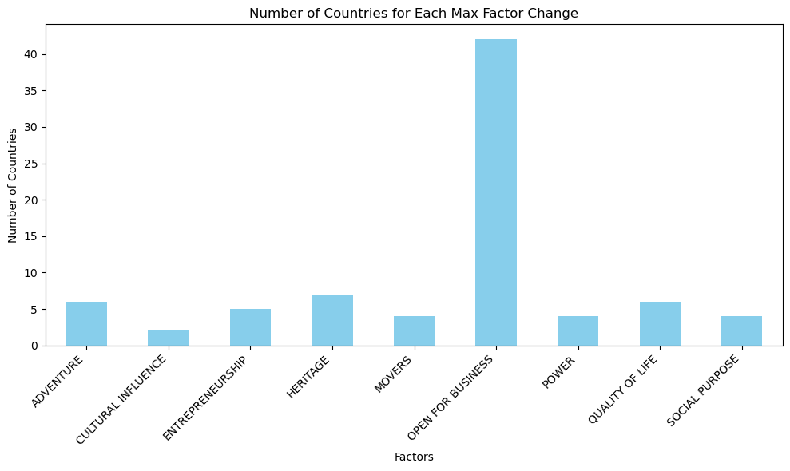
Segmentation of countries
I followed two approaches for segmentation of countries based on single factor
Brute Force method.
K means Algorithm.
Brute Force Method
Multivariate Reg. coeffs. for each country & year
Join GDP_PPP & GDP difference from year before
Find Highest GDP change year for particular country
Calculate the factor for max change
Assign that factor for that country and segment

Slide 14
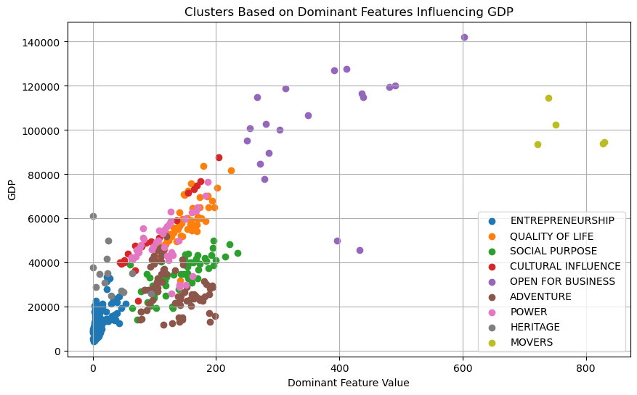
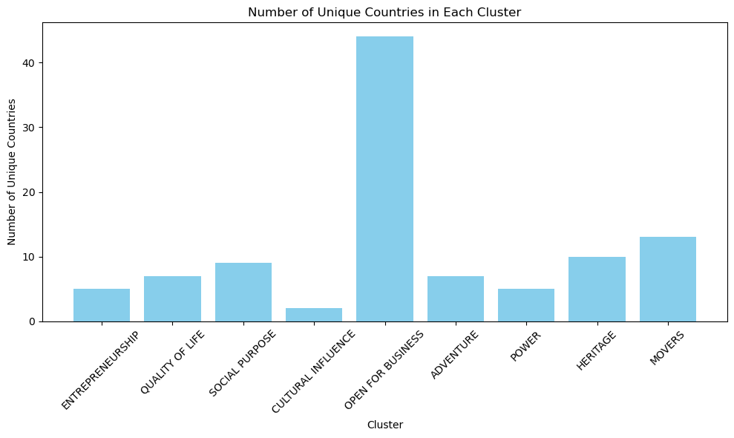
Segmentation of countries
K means clustering algorithm
Number of clusters is set to number of factors.
Clustered based on one similar single factor that explains the GDP Change for countries.
Answer (c)

Slide 15
Conclusion
Q (a) factor important across all countries for improving GDP
Goal1 and Q(b) Explained GDP by factor relationship
Import Lib and Data
EDA
Multiple linear Regression
Multiple linear Regression by year
Multivariate Regression by each country
Multivariate Regression by each country and time
Task 1
Explained yearly GDP_PPP with the country factor scores
Segmentation by brute force
Thus, all research questions, tasks and goals has been addressed as depicted here.
Goal 2, Q (c), T2 Grouped countries by one factor
Segmentation by K means algo.

