Slide 1
CSS Framework
Prepared by
Mahadi Hassan

Slide 2
Bootstrap Introduction
Bootstrap is a popular open-source front-end framework.
used to create responsive, mobile-first websites
provides ready-made CSS styles, components
With built-in JavaScript plugins

Slide 3
How to connect
There are two way to connect bootstrap to our file .
Offline ( Using download zip folder )
Online (Using CDN link )

Slide 4
Famous Framework
There are so many css framework .But Nowadays ,
1.Tailwind
2. Bootstrap is most famous
Here we will learn little a bit of this two framework .

Slide 5
Offline CSS framework
Downloading link
Bootstrap

Slide 6
Online using CDN link
1.For Tailwind: link
2.For Boootstrap
1. Inside <head>: link
2. Before closing </body> tag: link 2
Note : Cntl (keyboard )+ left click and get link

Slide 7
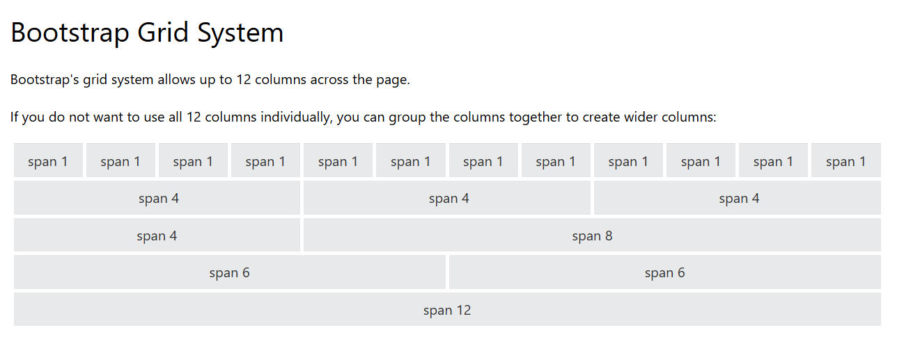
Bootstrap Grid System

