Slide 1

Introduction To HTML
Prepared by: Mahadi Hassan

Slide 2
Introduction to HTML
💡 What is HTML?
HTML stands for Hypertext Markup Language.
It is the standard language used to create and design webpages.
HTML provides the basic structure of a webpage, using a system of tags and elements.
It allows you to add text, images, videos, links, forms, and other content to your web pages.
HTML is not a programming language—it's a markup language.

Slide 3
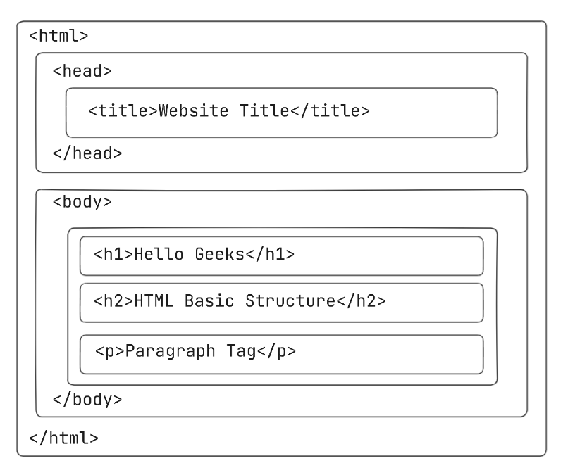
Basic Structure of HTML

Slide 4
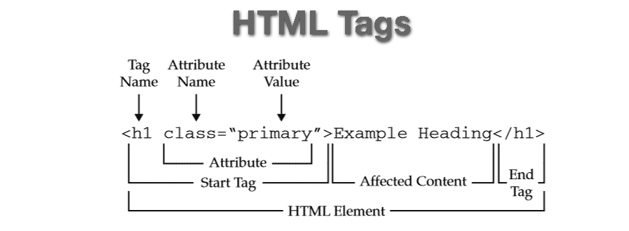
HTML Tags

Slide 5

Different Types of HTML Tag

Slide 6
1. Structural Tags
Tag | Purpose
<html> | Root element of an HTML document
<head> | Contains metadata and links
<body> | Contains the visible page content
<header> | Top section, often contains logo/nav
<footer> | Bottom section, often contains info/links
<main> | Main content area
<section> | Groups of related content
<article> | Self-contained content like blog posts
<nav> | Navigation links
<aside> | Sidebar or secondary content
<div> | Generic container (no semantic meaning)

Slide 7
2. Text Formatting Tags
Tag | Purpose
<h1> to <h6> | Headings (h1 is largest)
<p> | Paragraph
<br> | Line break
<hr> | Horizontal rule
<b> | Bold (non-semantic)
<strong> | Bold (semantic – strong importance)
<i> | Italic (non-semantic)
<em> | Emphasized (semantic)
<mark> | Highlighted text
<small> | Smaller text
<sub> | Subscript
<sup> | Superscript

Slide 8
3. Link & Media Tags
Tag | Purpose
<a> | Anchor (hyperlink)
<img> | Image
<audio> | Audio files
<video> | Video files
<source> | Specifies media sources
<iframe> | Embeds another webpage

Slide 9
3. List Tags
Tag | Purpose
<ul> | Unordered list (bullets)
<ol> | Ordered list (numbered)
<li> | List item
<dl> | Description list
<dt> | Term in a description list
<dd> | Description of the term

Slide 10
5. Table Tags
Tag | Purpose
<table> | Table container
<tr> | Table row
<td> | Table data cell
<th> | Table header cell
<thead> | Group of header rows
<tbody> | Group of body rows
<tfoot> | Group of footer rows
<caption> | Table title

Slide 11
6. Form Tags Used to
Tag | Purpose
<form> | Form container
<input> | Input field (text, checkbox, etc.)
<textarea> | Multi-line text field
<select> | Drop-down list
<option> | Option in a drop-down
<label> | Label for input elements
<button> | Clickable button
<fieldset> | Group related form elements
<legend> | Title for a fieldset

Slide 12
7. Meta & Head Tags Used in the <head> for metadata and resources.
Tag | Purpose
<title> | Page title (shown in browser tab)
<meta> | Metadata (charset, description, etc.)
<link> | Link to external resources (e.g., CSS)
<style> | Embedded CSS styles
<script> | Embedded JavaScript
<base> | Base URL for relative links

Slide 13
8. Media Tags
Tag | Purpose
<img> | Embeds an image
<audio> | Embeds audio content
<video> | Embeds video content
<source> | Specifies multiple media sources
<track> | Adds subtitles or captions to media
<iframe> | Embeds another HTML page (like a video or map)

Slide 14
9. Empty (Void)
Tag | Purpose
<br> | Line break
<hr> | Horizontal rule
<img> | Image
<input> | Input field
<meta> | Metadata
<link> | Link to external resource
<source> | Media source
<area> | Image map region
<col> | Column properties in tables

Slide 15

Any Question???

