Slide 1
CSS – Cascading Stylesheet
Prepared By
Mahadi Hassan

Slide 2
CSS
CSS = Cascading Style Sheets
- It defines how HTML elements are displayed.
- Controls colors, layouts, fonts, spacing, and animations.
- Works with HTML and JavaScript.
Note: HTML = structure, CSS = design, JS = interaction.

Slide 3
Why Use CSS?
Separate content from design
Reuse styles across multiple pages
Create responsive, modern layouts
Improve website speed and consistency

Slide 4
CSS Syntax
Basic CSS Syntax: selector { property: value; }
Explanation: Selector – which element we will style; Property – which aspect of the element we want to change; Value – how we style that property.
Example: p { color: blue; font-size: 18px; }

Slide 5
CSS – Using Method
CSS can be applied in three main ways:
Inline CSS – directly in the HTML element
Internal CSS – inside a <style> tag in the HTML <head>
External CSS – in a separate .css file linked to HTML

Slide 6
Inline CSS
  <p style="color: red; font-size: 18px;">Hello World!</p>

Slide 7
Internal CSS
<html>
<head>
<style>
h1 {
color: red;
}
</style>
</head>
<body>
<h1>This is CSS Page</h1>
</body>
</html>

Slide 8
External CSS
Html.html
<html>
<head>
<link rel=“stylesheet.css” href=“Style.css”>
</head>
<body>
<h1 >This is CSS Page</h1>
</body>
</html>
Style.css
h1{
color: red;
}

Slide 9
Confusion in CSS ?
What will be happen if we will use three method in one element for same attribute ?

Slide 10
Confusion Solve Method
CSS Priority Order (Cascade Rule):“Cascade” means the order of importance when multiple styles affect the same element.

Slide 11
Confusion Solve Method
Priority | Method | Example | Notes
1️⃣ | Inline CSS | <h1 style="color:red;"> | Highest
2️⃣ | Internal CSS | <style>h1{color:blue;}</style> | Medium
3️⃣ | External CSS | h1{color:green;} | Lowest
⚡ | !important | color:purple !important; | Overrides all

Slide 12
Selectors
Selector | Example | Description
Element | p {} | Targets all <p> tags
Class | .box {} | Targets elements with class="box"
ID | #main {} | Targets element with id="main"
Grouping | h1, h2 {} | Styles multiple elements
Universal | * {} | Targets all elements
Descendant | div p {} | Targets <p> inside <div>

Slide 13
Color Formats Supported in CSS
Format | Example | Description
Color name | red, blue | Predefined color names
HEX | #FF0000 | Hexadecimal color code
RGB | rgb(255, 0, 0) | Red, Green, Blue values
RGBA | rgba(255, 0, 0, 0.5) | RGB + transparency (opacity)
HSL | hsl(0, 100%, 50%) | Hue, Saturation, Lightness

Slide 14
Border & Outline Properties
Property | Values | Description | Usage Example
border-radius | length, percentage | Rounded corners | border-radius: 8px;
border-width | length | Border width | border-width: 2px;
border-style | solid, dashed, dotted, double | Border style | border-style: solid;
border-color | color | Border color | border-color: #ccc;
outline | width style color | Outline shorthand | outline: 2px solid red;
box-shadow | offset-x offset-y blur color | Box shadow | box-shadow: 0 2px 4px rgba(0,0,0,0.1);

Slide 15
Backgrounds
Property | Values | Description | Usage Example
background-color | color | Background color | background-color: #fff;
background-image | url(), linear-gradient(), radial-gradient() | Background image | background-image: url('image.jpg');
background-size | cover, contain, length | Background size | background-size: cover;
background-position | top, bottom, left, right, center | Background position | background-position: center;
background-repeat | repeat, no-repeat, repeat-x, repeat-y | Background repetition | background-repeat: no-repeat;

Slide 16
Box Model
Margin
Border
Padding
Content

Slide 17
Box Model Properties
Property | Values | Description | Usage Example
width | length, percentage, auto | Element width | width: 100%;
height | length, percentage, auto | Element height | height: 200px;
margin | length, percentage, auto | Outer spacing | margin: 10px;
padding | length, percentage | Inner spacing | padding: 1rem;
border | width style color | Border shorthand | border: 1px solid #000;
box-sizing | content-box, border-box | Box model calculation | box-sizing: border-box;

Slide 18
Fonts & Text
Property | Values | Description | Usage Example
font-family | font names | Font family | font-family: Arial, sans-serif;
font-size | length, percentage, keywords | Font size | font-size: 16px;
font-weight | normal, bold, lighter, bolder, 100-900 | Font weight | font-weight: 700;
color | color | Text color | color: #333;
text-align | left, right, center, justify | Text alignment | text-align: center;
line-height | number, length, percentage | Line height | line-height: 1.5;
text-decoration | none, underline, line-through | Text decoration | text-decoration: none;

Slide 19
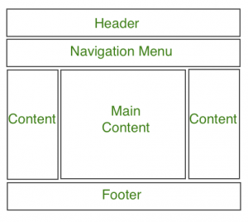
Layout

Slide 20
Layout Properties
Property | Values | Description | Usage Example
display | block, inline, inline-block,flex, grid, none | Defines how an element is displayed | display: flex;
position | static, relative, absolute, fixed, sticky | Positioning method | position: absolute;
float | left, right, none | Element floating | float: left;
clear | left, right, both, none | Clearing floats | clear: both;
z-index | auto, number | Stack order | z-index: 10;

Slide 21
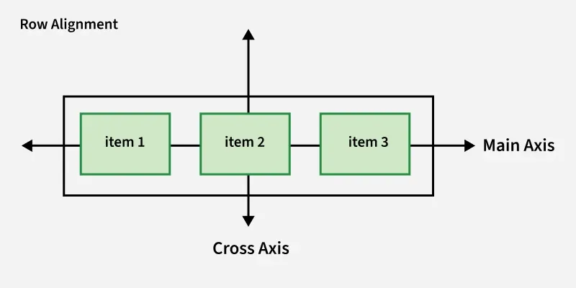
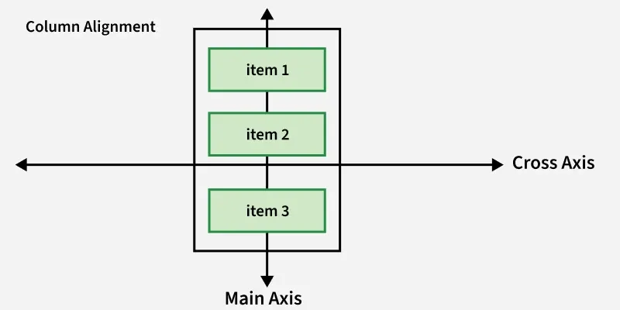
Flexbox Layout
FlexBox is a one-dimensional layout method for arranging items in rows or columns.

Slide 22
Flexbox Layout Properties
Property | Values | Description | Usage Example
flex-direction | row, column, row-reverse, column-reverse | Flex container direction | flex-direction: row;
justify-content | flex-start, flex-end, center, space-between, space-around | Horizontal alignment | justify-content: center;
align-items | stretch, flex-start, flex-end, center, baseline | Vertical alignment | align-items: center;
flex-wrap | nowrap, wrap, wrap-reverse | Wrapping behavior | flex-wrap: wrap;
flex | flex-grow flex-shrink flex-basis | Shorthand for flex items | flex: 1 0 auto;
gap | length | Space between flex items | gap: 1rem;

Slide 23
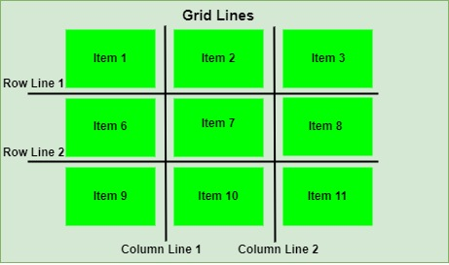
CSS Grid Layout
Grid Layout is a two-dimensional layout system for developing responsive webpages.

Slide 24
CSS Grid Layout
Property | Values | Description | Usage Example
grid-template-columns | track sizes | Defines grid columns | grid-template-columns: 1fr 1fr;
grid-template-rows | track sizes | Defines grid rows | grid-template-rows: 100px auto;
grid-template-areas | area names | Defines grid areas | grid-template-areas: "header header" "sidebar main";
grid-column | line numbers | Column placement | grid-column: 1 / 3;
grid-row | line numbers | Row placement | grid-row: 2 / 4;
grid-gap | length | Space between grid items | grid-gap: 20px;

Slide 25
Transitions & Animations
Property | Values | Description | Usage Example
transition | property duration timing-function delay | Transition shorthand | transition: all 0.3s ease;
animation | name duration timing-function delay iteration-count | Animation shorthand | animation: slide 1s ease-in-out;
transform | translate(), rotate(), scale(), skew() | 2D/3D transformations | transform: translateX(50px);
opacity | 0-1 | Element transparency | opacity: 0.8;
visibility | visible, hidden, collapse | Element visibility | visibility: hidden;

Slide 26
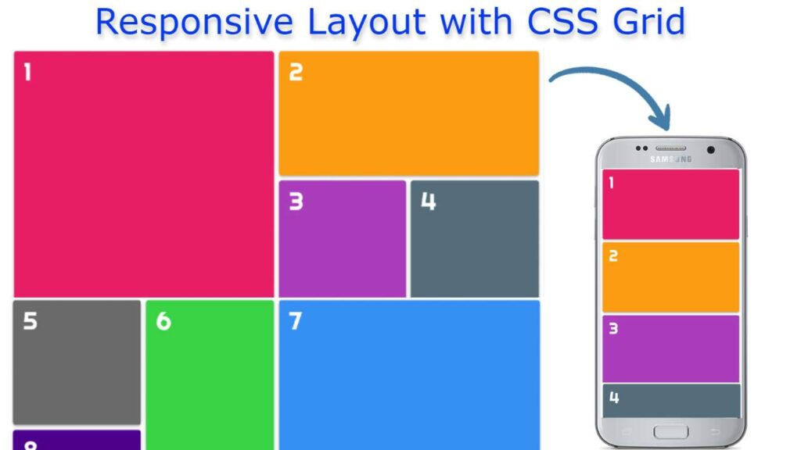
Responsive Design

Slide 27
Media Queries
Property | Values | Description | Usage Example
@media | screen, print, speech | Media type | @media screen { ... }
min-width | length | Minimum width | @media (min-width: 768px) { ... }
max-width | length | Maximum width | @media (max-width: 767px) { ... }
min-height | length | Minimum height | @media (min-height: 600px) { ... }
max-height | length | Maximum height | @media (max-height: 599px) { ... }
orientation | portrait, landscape | Screen orientation | @media (orientation: landscape) { ... }

Slide 28
Pseudo-classes & Pseudo-elements
Selector | Description | Usage Example
:hover | Mouse over element | a:hover { color: blue; }
:focus | Element has focus | input:focus { border-color: blue; }
:active | Element being activated | button:active { transform: scale(0.98); }
:first-child | First child element | li:first-child { font-weight: bold; }
:last-child | Last child element | li:last-child { margin-bottom: 0; }
:nth-child() | Specific child element | tr:nth-child(even) { background: #f5f5f5; }
::before | Before element content | .element::before { content: "→ "; }
::after | After element content | .element::after { content: ""; }

Slide 29
CSS Variables
Scope | Syntax | Description | Example
Global | :root { --var: value; } | Available throughout document | :root { --primary: blue; }
Local | .class { --var: value; } | Available within element & children | .card { --padding: 1rem; }
Element | element { --var: value; } | Scoped to specific element | header { --bg: black; }

Slide 30
CSS Variables Example
:root {
--primary-color: #3b82f6;
--font-size: 16px;
--spacing: 1rem;
}
.header {
color: var(--primary-color);
}
.main {
font-size: var(--font-size);
}
.footer {
padding: var(--spacing);
}

Slide 31
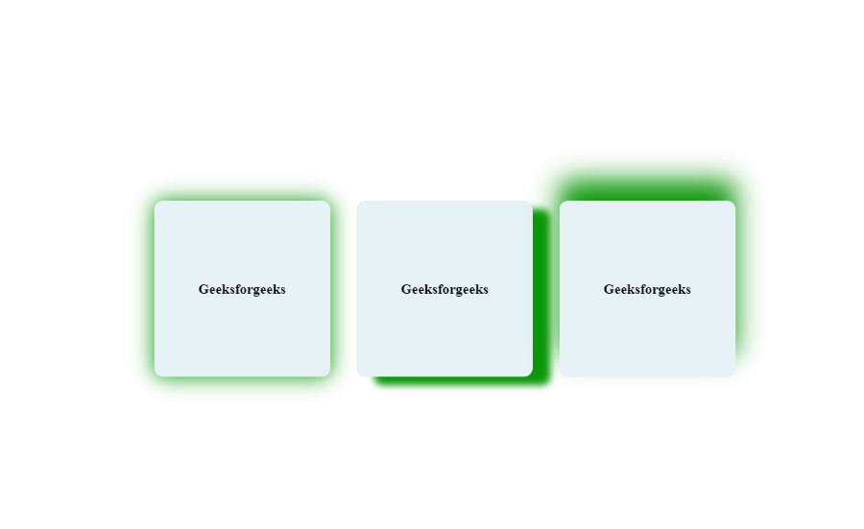
Shadows & Filters

Slide 32
Shadows & Filters
Category | Property | Common Values | Usage Example
Shadows | box-shadow | 2px 2px 10px #000 | box-shadow: 0 4px 8px rgba(0,0,0,0.1);
Shadows | text-shadow | 1px 1px 2px #000 | text-shadow: 2px 2px 4px rgba(0,0,0,0.5);
Filters | filter | blur(), brightness() | filter: blur(5px) brightness(150%);
Filters | backdrop-filter | blur(), grayscale() | backdrop-filter: blur(10px);

Slide 33
Best Practices
✅ Use External CSS
✅ Keep naming consistent
✅ Comment your code
✅ Avoid too much !important
✅ Test in multiple browsers

