Slide 1
CSE315:Introduction to Data Science Fall 2024
Descriptive Statistics (cont): Shape Relative standing and outlier
Week 3
Lesson 2

Slide 2
Descriptive Statistics(cont): Shape and outlier
Shape of the distribution of the dataset: Skewness and Kurtosis
Relative standing: Percentiles, quartiles.
Box plot
Detection of outlier: Box plot and z-scores.
Use of Python to calculate different descriptive Statistics, and, Construction of Box Plot.

Slide 3
Shape of the distribution of dataset
Coefficient of skewness and kurtosis measures the Shape characteristics of dataset.
The shape of the distribution is said to be
Symmetric if the observations are balanced, or evenly distributed, about the mean. In a symmetric distribution the mean, median, and mode are equal.
Skewed if the observations are not symmetrically distributed above and below the mean.
A Positively skewed (or skewed to the right) distribution has a tail that extends to the right in the direction of positive values.
A Negatively skewed (or skewed to the left) distribution has a tail that extends to the left in the direction of negative values.

Slide 4
Skewness Example
Positive Skewness (Long Tail to the Right):
Household Income: This is a classic example of positive skewness. Most people earn a modest income, while a few individuals have significantly higher incomes (millionaires and billionaires). This creates a long tail on the right side of the distribution.
Waiting Times at a Coffee Shop: The time it takes to get your coffee at a busy shop can also be positively skewed. While most customers wait a few minutes, some might encounter longer wait times due to complex orders, unexpected delays, etc.

Slide 5
Skewness Example (cont)
Negative Skewness (Long Tail to the Left):
Test Scores: In a well-designed test, most students score around the average, with fewer scoring very high or very low. This creates a negative skew, with a tail extending towards lower scores.
Number of Customers Entering a Store: On a typical day, a store might see a larger number of customers during peak hours and fewer throughout the rest of the day. This can result in a negatively skewed distribution of customer arrivals.
No Skew (Symmetrical Distribution):
Dice Rolls: When you roll a fair die, each number (1 to 6) has an equal probability of landing. This results in a perfectly symmetrical distribution with no skew.
Heights of Adults: While individual heights can vary, the overall distribution of adult heights in a population often approximates a normal curve with no significant skew.

Slide 6
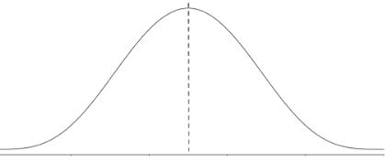
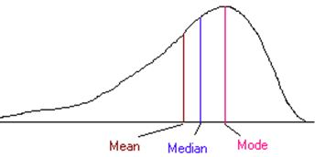
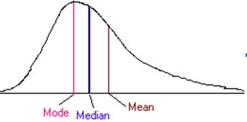
Skewness
Mean = Median = Mode
Negatively skewed
Positively skewed
Symmetric
In the case of skewed distribution, median always lies between the mean and mode. The median is not sensitive to extreme values. Thus, in case of skewed distribution or the presence of an outlier, the median is the best measure of central tendency.

Slide 7
Skewness
Coefficient of skewness(CSK) measures degree of asymmetry of a distribution around its mean.
Absolute measure of skewness: Sk = Mean – Median
Relative measure of skewness (Karl Pearson’s Coefficient of Skewness),
Alternatively,
CSK = 0, The distribution is symmetric
CSK<0, the distribution is negatively skewed
CSK>, the distribution is positively skewed
Example: Determine the CSK of the dataset (2,6,8,10,15) and comment on the shape.

Slide 8
Kurtosis
Kurtosis is a measure of the degree to which a distribution is “peaked” or flat in comparison to a normal distribution whose graph is characterized by a bell-shaped appearance. Kurtosis can be expressed as:
The degree of kurtosis of a distribution is measured relative to that of a normal curve.
The curves with greater peakedness than the normal curve are called “Leptokurtic”.
The curves which are more flat than the normal curve are called “Platykurtic”.
The normal curve is called “Mesokurtic.” The Fig.4 describes the three different curves mentioned above:

Slide 9
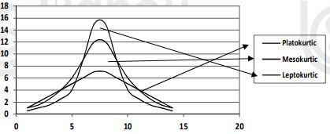
Description of coefficient of Kurtosis
If kurtosis = 0, then curve is said to be mesokurtic (normal);
If kurtosis < 0, then curve is said to be platykurtic;
If kurtosis > 0, then curve is said to be leptokurtic.

Slide 10
Relative Standing
The three main measures of relative standing are:
z-scores, ii) Quartiles, iii) percentiles.
Z-scores indicate how many standard deviations a value is from the mean.
Quartiles divide data into four equal parts. A percentile indicates the percentage of values falling below a particular point.

Slide 11
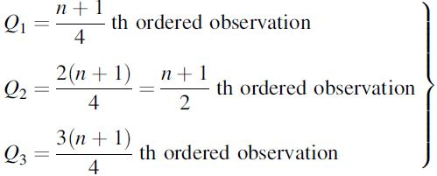
Relative Standing (cont)
Percentile divides the series into 100 equal parts.
Decile divides the series into 100 equal parts.
Quartile divides a data set into four equal parts. A data set has three quartiles:
The following formulas are used to find the quartiles (1st, 2nd, 3rd) for a set of data:
First quartile, Q1= 25th percentile, divides the bottom 25% of the data from the top 75%,
Mid- quartile, Q2= 50th percentile, divides the bottom 50% of the data from the top 50%,
Third quartile, Q3= 75th percentile, divides the bottom 75% of the data from the top 25%.

Slide 12
Quartile Example
Q. Find the quartiles, inter quartile range, 5 summary measures. Construct Box Plot.
Data: 14.6,24.3,24.9,27,27.2,27.4,28.2,28.8,29.9,30.7,31.5,31.6,32.3,32.8,33.3,33.6,34.3,36.9,38.3,44
Ans,
Ordered data: 14.6,24.3,24.9,27,27.2,27.4,28.2,28.8,29.9,30.7,31.5,31.6,32.3,32.8,33.3,33.6,34.3,36.9,38.3,44
The smallest and largest measurements are 14.6 and 44, respectively.
The first quartile is the Q1=(20+1)/4 = 5.25th measurement, which is 27.2 + (.25)(7.4 -27.2)=27.25.
The median is the Q2=(20+1)/2=10.5th measurement which is 30.7+(.5)(31.5-30.7)=31.1; and
The third quartile is the Q3=(3/4)(20+1)=15.75th measurement, which is equal to 33.3+(.75)(33.6 -33.3)= 33.525.
The interquartile range is IQR=33.525 - 27.25 = 6.275.
The range is 29.4, and the IQR is 100(6.275/29.4)=21 percent of the range.

Slide 13
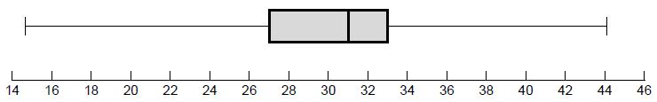
Quartiles
The resulting box-and-whisker plot is shown in following Figure:
Detection of outlier:
An outlier is an observation whose value, x, either exceeds the value of the third quartile by a magnitude greater than 1.5(IQR) or is less than the value of the first quartile by a magnitude greater than 1.5(IQR).
That is, an observation of x > Q3+1:5(IQR) or an observation of x < Q1-1:5(IQR) is called an outlier.
For the dataset in the previous slide, an observed value smaller than 17.84 or larger than 42.94 would be considered an outlier.
Therefore, two observed values 14.6 and 44 are outliers.
Third quartile
Q3+1:5(IQR)
=33.525+1.5(6.275)=42.94
Q1-1:5(IQR)
=27.25-1.5(6.275)=17.84
Second Quartile or Median
First Quartile

Slide 14
Z-scores
Detection by z-score:
z-scores of the dataset:
-2.65,-1.04,-0.94,-0.59,-0.56,-0.53,-0.39,-0.3,-0.11,0.02,0.15,0.17,0.29,0.37,0.45,0.5,0.62,1.05,1.28,2.23
Z-score values indicate that the dataset has no outlier.
Interpretation:
The z-score value for the observed value 36.9 is 1.05 shows that the observed value, 36.9 is 1.05 standard deviations from the mean.

Slide 15
Python codes
#Calculates different descriptive statistics for the dataset:
x=[14.6,24.3,24.9,27,27.2,27.4,28.2,28.8,29.9,30.7,31.5,31.6,32.3,32.8,33.3,33.6,34.3,36.9,38.3,44]
import statistics
import pandas
import numpy
# Using statistics module
statistics.quantiles(x,n=4) # Returns 3 quartiles
statistics.mean(x)
statistics.stdev(x)
(x[1]-statistics.mean(x))/statistics.stdev(x) #zscore for the 2nd obs, x[1]=24.3
statistics.median(x)
statistics.mode(x)
statistics.harmonic_mean(x)
statistics.geometric_mean(x)

Slide 16
Python codes (cont)
#using pandas
df=pandas.DataFrame(x)
df.describe() # mean, std, min, max, quartiles
df.mean()
df.std()
df.skew()
df.kurtosis()
#using numpy
numpy.mean(x)
numpy.median(x)
numpy.std(x)
numpy.
#using scipy
import scipy

Slide 17
Python codes(cont)
from scipy.stats import kurtosis
from scipy.stats import skew
skew(x)
kurtosis(x)
#similar codes
scipy.stats.skew(x)
scipy.stats.kurtosis(x)
scipy.stats.kurtosis(df)
#BOXPLOT
import matplotlib.pyplot as plt
plt.boxplot(x)
plt.title('Basic Boxplot')
plt.show()
plt.xlabel('Customized X Label')

Slide 18
Spss output
Mean 30.5800
Std. Deviation 6.02841
Skewness -.374
Std. Error of Skewness .512
Kurtosis 2.269
Std. Error of Kurtosis .992
Percentiles 25 27.2500 (Q1)
50 31.1000 (Q2)
75 33.5250 (Q3)

