Slide 1
Data Science Housing Project
by Maximilian Häusler

Slide 2
Client: Jacob Phillips
Buyer
Specifications:
Historic (<1965)
4+ Bathrooms or small house closeby with 4+ bathrooms
Big lot for tennis,pool and golf (>150000sqft)
No waterfront

Slide 3
Hipotheses
House prices are dependent on the month of the year
The price/sqft is higher in populated areas
House condition correlates with the grade of the house

Slide 4
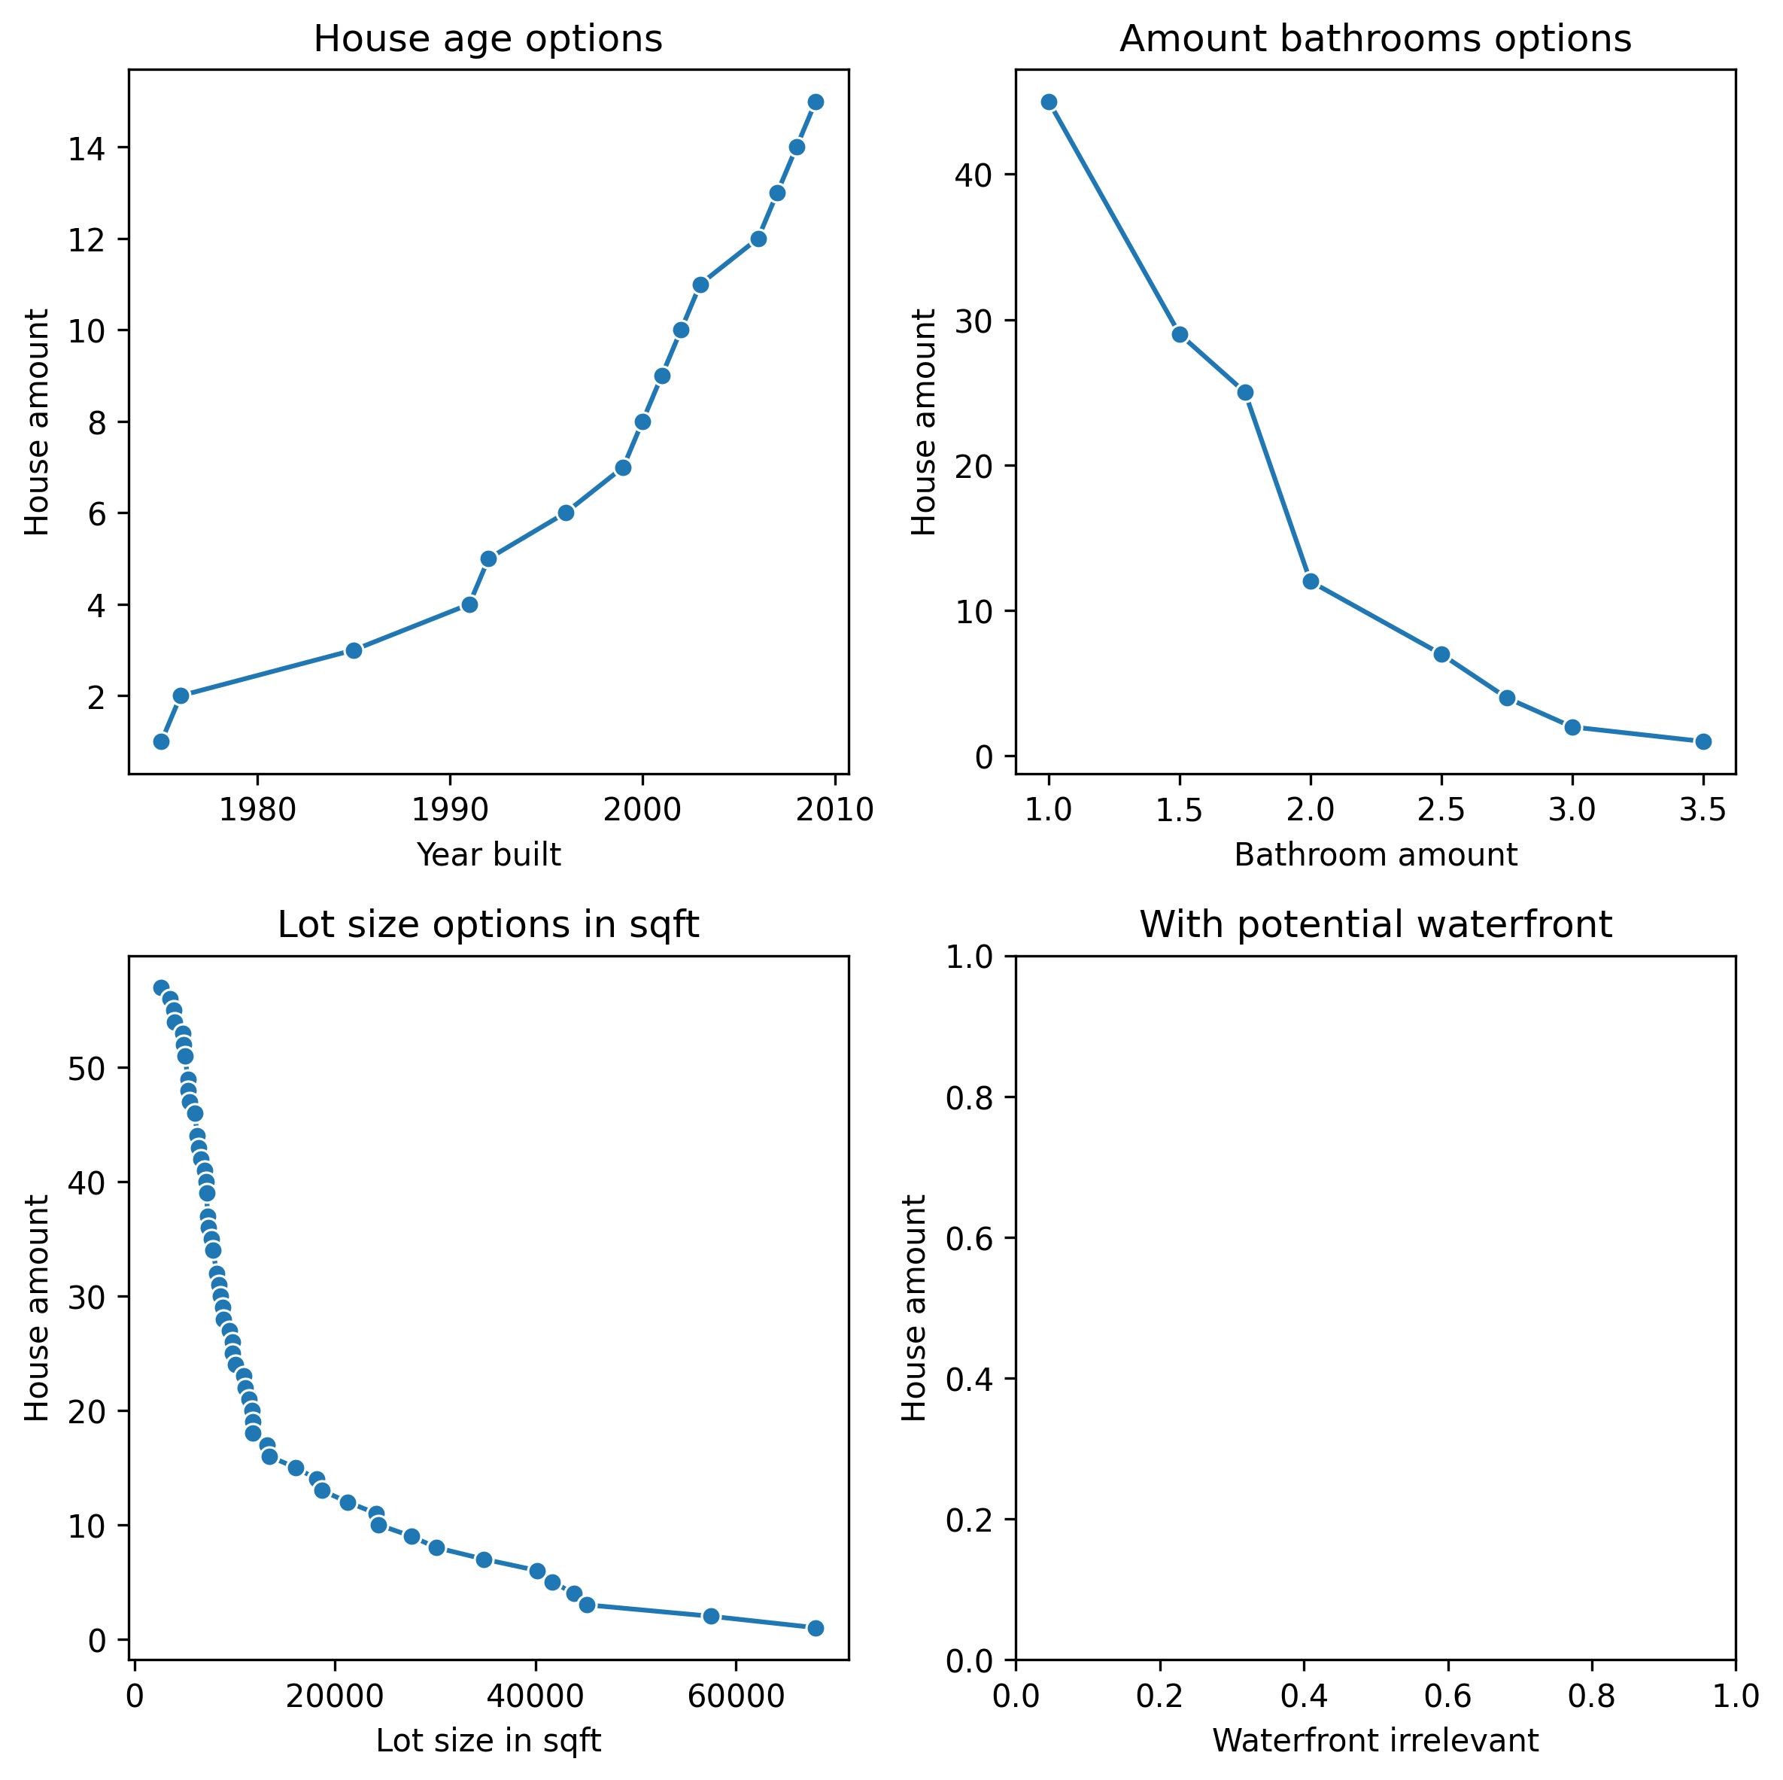
Options without small house
Varying the specifications, we get the following options:
The age has to be at least 10 years newer
One of the bathrooms not full size
Lot would not fit a golf court
No more options with waterfront
Recommendation:
1 small size bathroom or built a small house directly on
the property

Slide 5
Options with small house closeby
Follow the link to see all options:
  /home/mahaeu/Exercises/Spiced_Projects/eda-housing-data/combined_map.html
  Choose freely and ask for more details

Slide 6
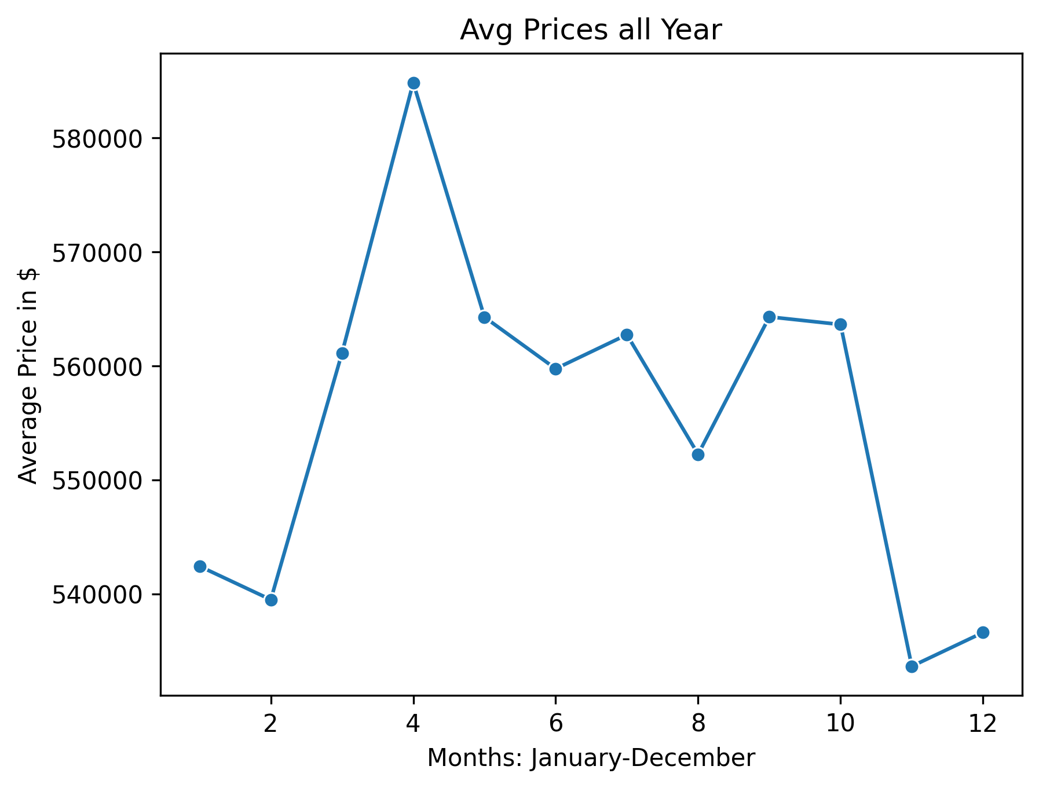
1. House prices are dependent on the month of the year
Avg house Prices over all houses:
Slight trend to high prices in spring
and summer

Slide 7
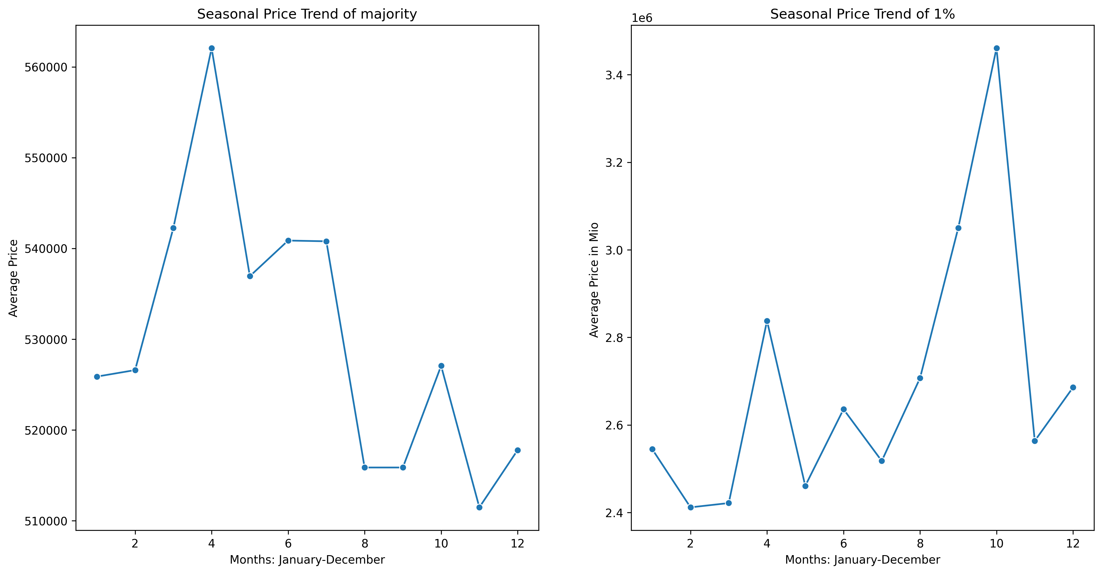
Luxury vs Avg house prices
High prices in May for avg houses
High prices in October for Luxury houses starting at ~2 Mio $

Slide 8
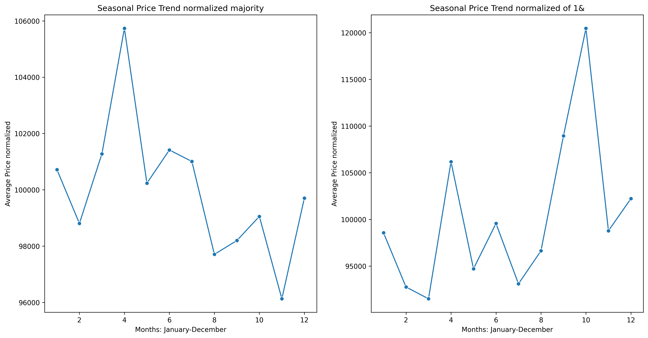
Luxury vs Avg house ratio
House prices normed to 100.000$
Price fluctuations higher for
luxury houses

Slide 9
2. The price/sqft is higher in populated areas
Comparison between the avg distance of houses in each zipcode
The average price refers to the price per sqft of the lot
and of the living area

Slide 10
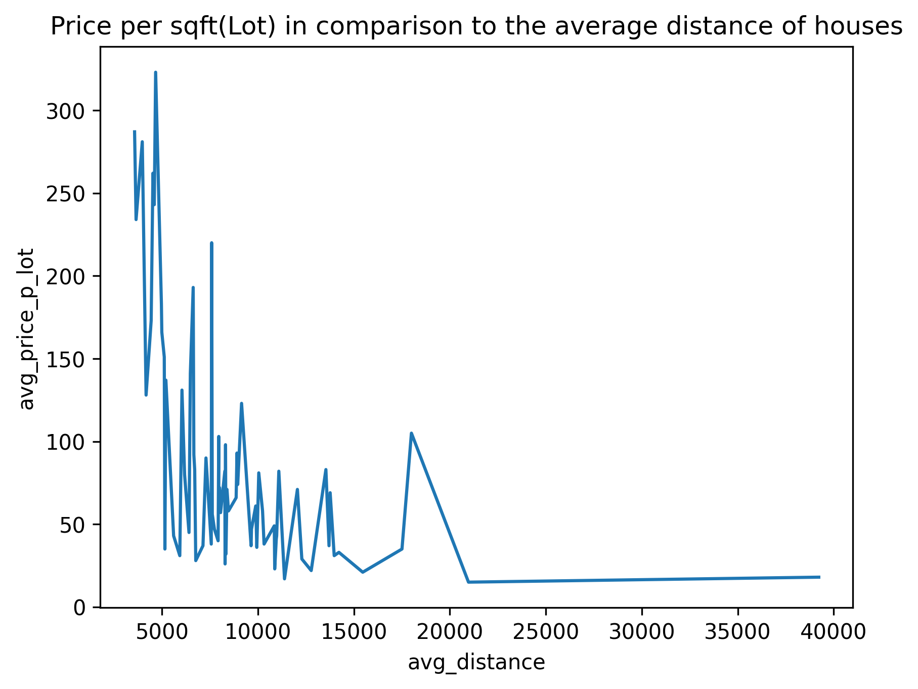
Price in comparison to lot size
Trend for more expensive prize per ft² of lot in relation to the average distance of houses

Slide 11
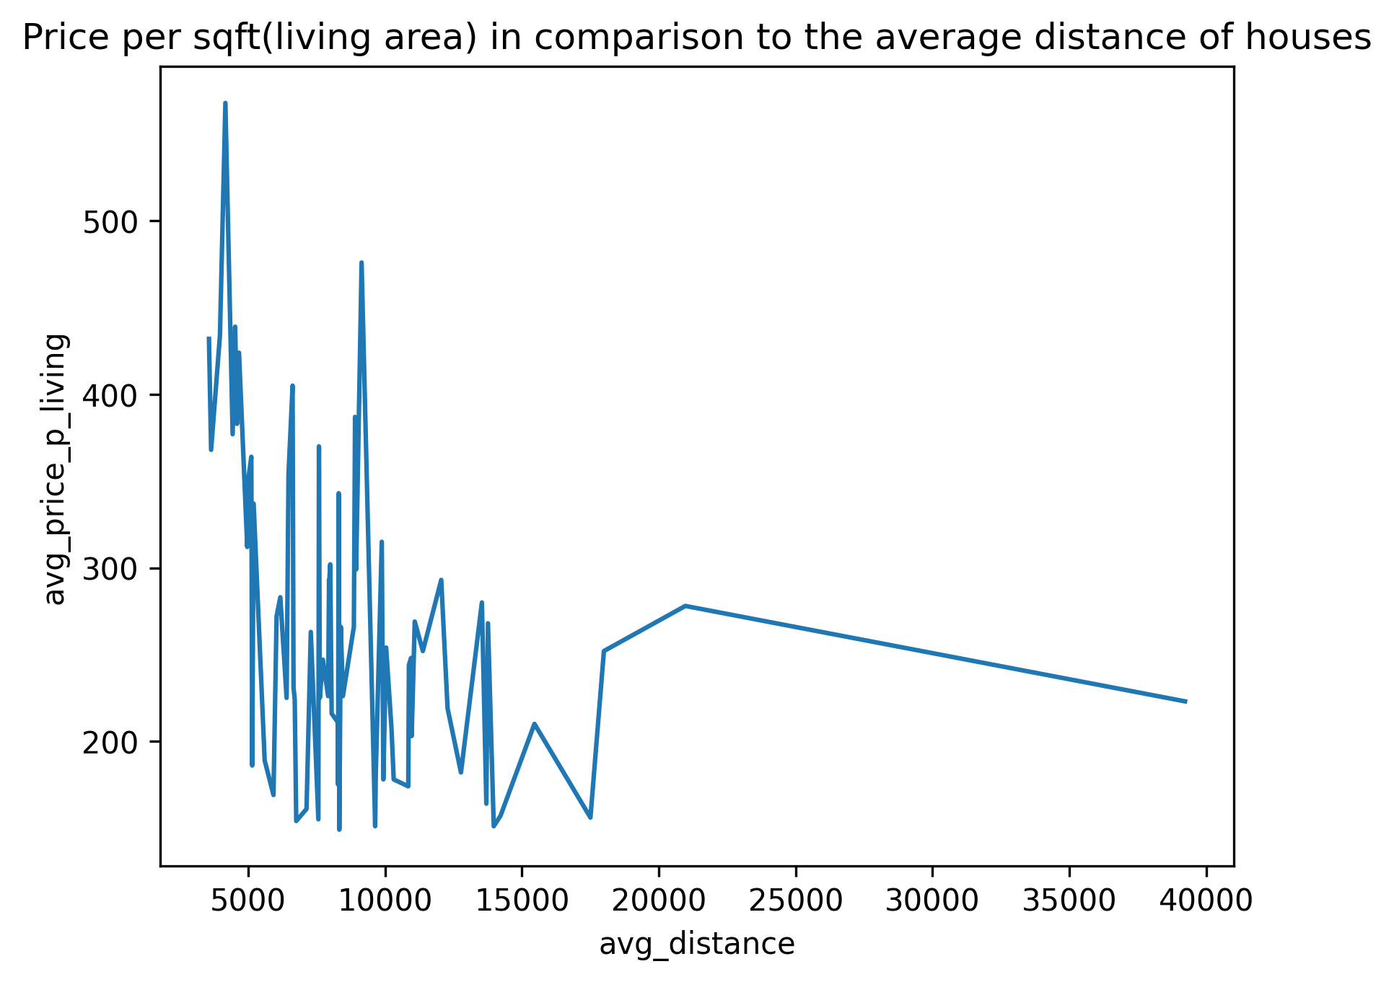
Price in comparison to living area
Similar trend for price per ft² living area

Slide 12
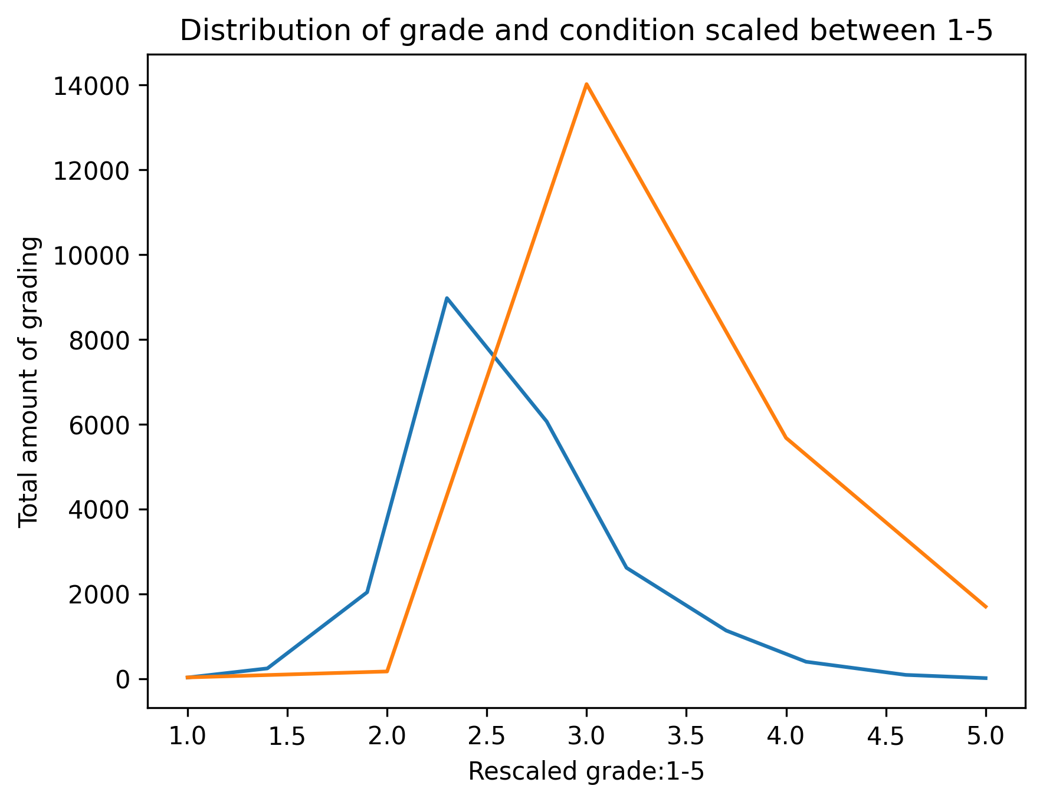
3. Hose condition correlates with the grade of the house
The grade and condition of houses are

Slide 13
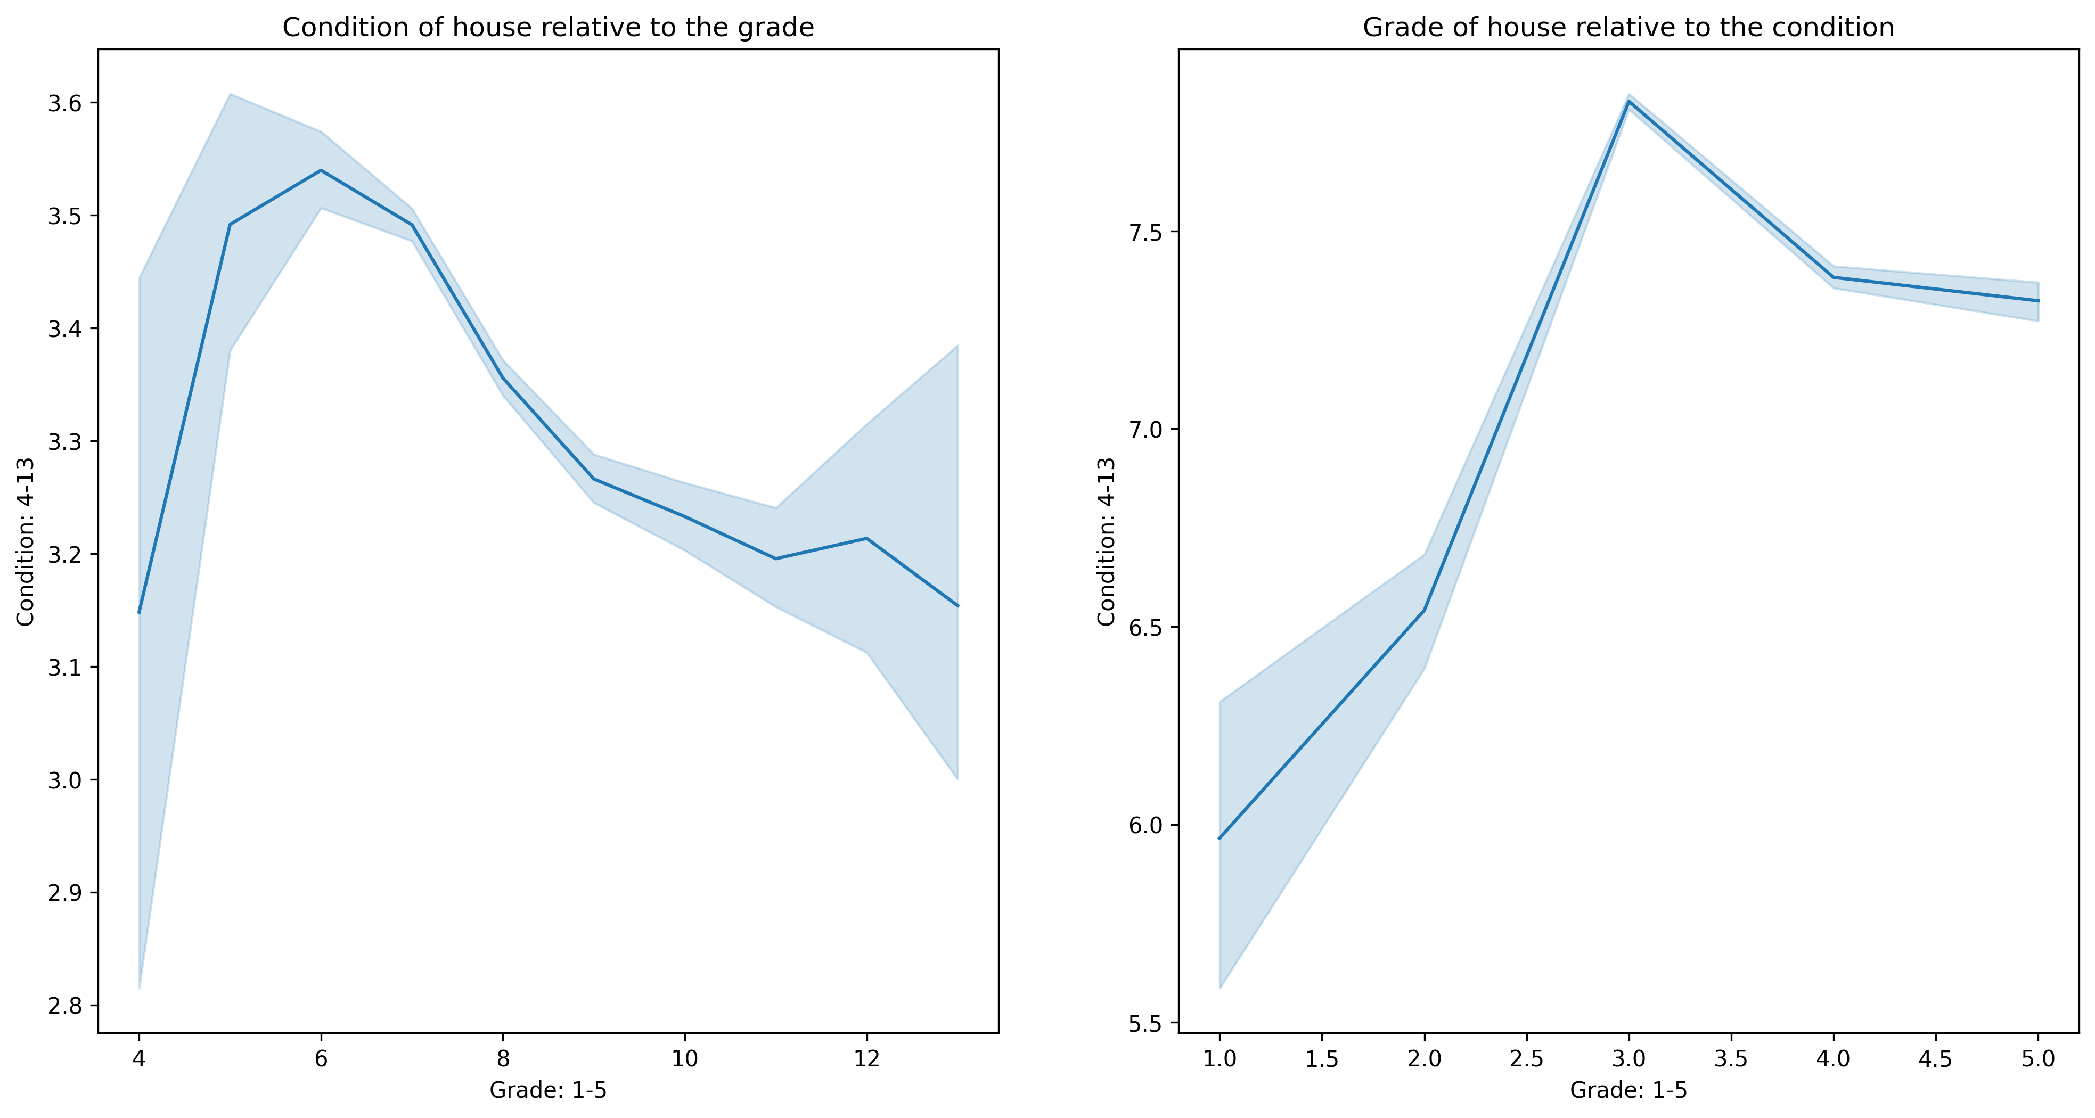

Slide 14
