Slide 1


Slide 2
Agenda
Introduction & Overview
Advantages
Creating and dropping database
Data types
Inserting
Querying
Updating
Deleting
Projection
Limiting Records
Indexing
Replication
Sharding

Slide 3
Introduction and Overview
{
x:3,
y:”Abc”,
z:[1,2],
a: { }
}
What MongoDB gives:-
Database that work on clusters.
Faster development speed.
Complex data (Document Oriented).
How document-oriented looks like?
JSON/BSON

Slide 4
Can you create a relational table
{
_id: “33”
x:3,
y:”Abc”,
z:[1,2]
}
{
_id: “34”
x: 4,
y: “Xyz”
z: [4,5,6]
}
id | X | Y
33 | 3 | Abc
34 | 4 | Xyz
T1
id | Z
33 | 1
33 | 2
34 | 4
34 | 5
34 | 6
T2
How do you retrieve all records with _id = 33?

Slide 5
Can you create a relational table
{
_id: “33”
x:3,
y:”Abc”,
z:[1,2]
}
{
_id: “34”
x: 4,
y: “Xyz”
z: [4,5,6]
}
id | X | Y
33 | 3 | Abc
34 | 4 | Xyz
T1
id | Z
33 | 1
33 | 2
34 | 4
34 | 5
34 | 6
T2
Select * from T1,T2 where T1.id=T2.id and id=33
db.collections.find({_id:”33”})

Slide 6
RDBMS - MongoDB
RDBMS | MongoDB
Database | Database
Table | Collection
Row | Document
Column | Key/Field
sqlplus | mongo
Maximum size of a document in MongoDB is 16 MB

Slide 7
Creating and Dropping Database
Command to create database:-
use <database-name>
Example:-
use vita
Dropping database
db.dropDatabase() //Will drop the current database

Slide 8
In which format data is stored in MongoDB?
BSON
Binary JSON
Data types
bool
int
double
string
document
objectid
array
date
And many more…

Slide 9
Inserting Data
Command to insert a document:-
db.collection.insert(
{ key : value, key : value, … },
{
writeConcern: <document>,
ordered: <boolean>
} )
Example:-
db.products.insert(
{ item: “Soap", qty : 100, type: “Bathing" },
{
writeConcern: { w: "majority", wtimeout: 5000 },
ordered : true
} )

Slide 10
ObjectId
ObjectId is a 12-byte BSON type.
It is constructed using:
a 4-byte value representing the seconds since the Unix epoch,
a 3-byte machine identifier,
a 2-byte process id, and
a 3-byte counter, starting with a random value.
ObjectIds are small
unique
Fast to generate
MongoDB uses ObjectIds as the default value for the _id field if the _id field is not specified.

Slide 11
Adding different types of data to document
Adding string type of data in document:-
db.person.insert( {name: ”Robinhood Pandey”} )
Adding int type of data in document :-
db.person.insert({age:28})
Adding sub-document in a document:-
db.person.insert( {name: “Rahul”, gender: ”M”,
address: {city:”Mumbai”,Pincode: 400069}
} )

Slide 12
Adding different types of data to document
Adding array in document:-
db.person.insert( {name: “Ramesh”,
skills: [“C”,”C++”,”Java”,”MongoDB”]
} )
Adding date type in a document:-
db.person.insert( { birth: new Date(“Oct 04, 1970”) } )
db.person.insert( { birth: new Date() } ) //for current date

Slide 13
Inserting Data
Using variable:
<variable-name> = <document>
db.<collections>.insert(<variable-name>)
Example:-
x = {name: ”Mr. India”, strength: {visibility : false} }
y = {name: “Thor”, Strength: { weapon : “Hammer” } }
db.superheroes.insert( x );
db.superheroes.insert( y );

Slide 14
Question
In Mongo what would you type to insert the value of x as 3 and y as 4 in a collection “temperature” for the “country” database? (Consider country database does not exist)

Slide 15
Challenging Question

Slide 16
Insert() Syntax - writeConcern
db.collection.insert(
{ key : value, key : value, … },
{
writeConcern: <document>,
ordered: <boolean>
} )

Slide 17
Write Concern
Write Concern Levels
Unacknowledged
Acknowledged (Default)
Journaled
Replica Acknowledged

Slide 18
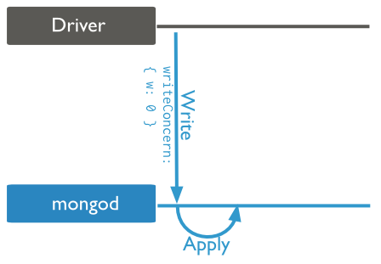
Unacknowledged

Slide 19
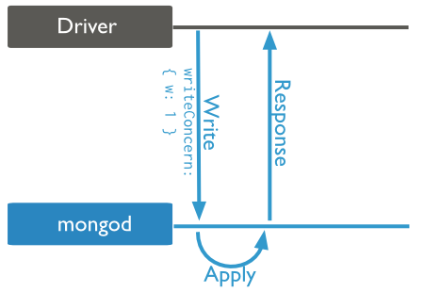
Acknowledged (Default)

Slide 20
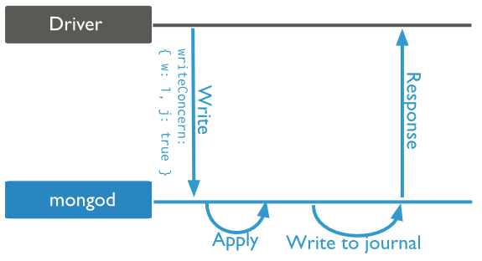
Journaled

Slide 21
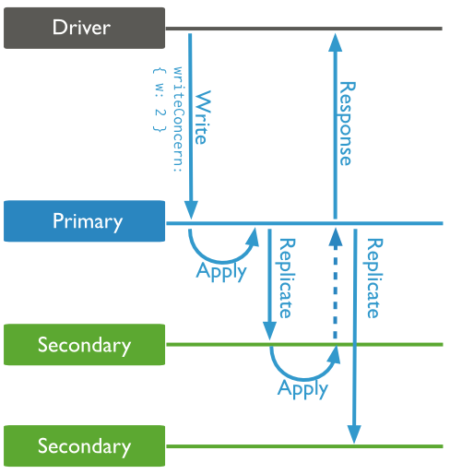
Replica Acknowledged

Slide 22
{ w: “majority” }
Confirms that write operations have propagated to the majority of voting nodes.
A majority of the replica set’s voting members must acknowledge the write operation before it succeeds.
This allows you to avoid hard coding assumptions about the size of your replica set into your application.

Slide 23
Examples of Write Concern
db.person.insert({ <document> },
{ writeConcern: { w: 0 } })
db.person.insert({ <document> },
{ writeConcern: { w: 1 } })
db.person.insert({ <document> },
{ writeConcern: { w: 1, j: true } })
db.person.insert({ <document> },
{ writeConcern: { w: 2 } })
db.person.insert({ <document> },
{ writeConcern: { w: “majority” } })

Slide 24
Bulk operation
Initialize a list of operations using either
db.collection.initializeUnorderedBulkOp()
or
db.collection.initializeOrderedBulkOp().
var bulk = db.items.initializeUnorderedBulkOp();
bulk.insert( { _id: 1, item: "abc123", status: "A", soldQty: 5000 } );
bulk.insert( { _id: 2, item: "abc456", status: "A", soldQty: 150 } );
bulk.insert( { _id: 3, item: "abc789", status: "P", soldQty: 0 } );
bulk.execute( { w: "majority", wtimeout: 5000 } );

Slide 25
Counting documents in a collections
Syntax:
db.<collections>.count()

Slide 26
Retrieving/querying documents
Syntax:-
db.collection.find(where-clause , projection )
Examples:-
db.person.find()
db.person.find( { _id: 101 } )
db.person.find( { }, { name: 1, age: 1 } )
db.person.find( { }, { name: 1, age: 1, _id: 0 } )
db.person.find( { }, { name: 1, age: 0, _id: 0 } )//Error
db.person.find( { }, { _id: 0, gender: 0 } )
db.person.find( { _id: 5 }, { skills: { $slice: 2 } } )

Slide 27
Retrieving/querying documents
Equality Condition
db.person.find( { gender: “M" } )
Specify Conditions Using Query Operators
db.person.find( { age: { $in: [ 18,19,20 ] } } )
Specify conditions for more than one field
db.person.find( { gender: ‘M', age: { $lt: 50 } } )
Specify OR Conditions
db.person.find( { $or: [
{ age: { $gt: 18 } },
{ friends: { $lt: 5 } }
]
} )

Slide 28
Retrieving/querying documents
Specify AND as well as OR Conditions
db.person.find( {
gender: “F”,
$or: [
{ age: { $gt: 18 } },
{ friends: { $lt: 5 } }
]
} )

Slide 29
Retrieving/querying documents
Exact Match on the Embedded Document
db.person.find( { address:
{
city: ‘Mumbai',
pincode: '123456’
}
} )

Slide 30
Retrieving/querying documents
Equality Match on Fields within an Embedded Document
db.person.find( {
‘address.pincode': 123456
} )

Slide 31
Retrieving/querying documents
Exact Match on an Array
db.person.find( { skills: [ “Java”, “MongoDB” ] } )
Match an array element that contains specific value
db.person.find( { skills: “MongoDB” } )
Match a Specific Element of an Array
db.person.find( { ‘skills.0': “Java” } )

Slide 32
Specify Multiple Criteria for Array Elements
{ _id: 5, type: "food", item: "aaa", ratings: [ 5, 8, 9 ] }
{ _id: 6, type: "food", item: "bbb", ratings: [ 5, 9 ] }
{ _id: 7, type: "food", item: "ccc", ratings: [ 9, 5, 8 ] }
db.person.find( { ratings:
{
$elemMatch:
{
$gt: 5,
$lt: 9
}
}
} )

Slide 33
Challenging Question
db.inventory.find( { 'memos.0.by': 'shipping' } )
{
_id: 100,
type: "food",
item: "xyz",
qty: 25,
price: 2.5,
ratings: [ 5, 8, 9 ],
memos: [
{ memo: "on time", by: "shipping" },
{ memo: "approved", by: "billing" }
]
}

Slide 34
1 more challenging question
db.inventory.find( { 'memos.by': 'shipping' } )
Write a query for documents where the ”memos” array has at least one embedded document that contains both the field “memo” equal to 'on time' and the field ”by” equal to 'shipping‘.
db.inventory.find( { memos: { $elemMatch: { memo: 'on time', by: 'shipping' } } } )

Slide 35
MongoDB Operators
Operators($)
|
|used for
|
------------------------------------
| Querying | Updating
| |
$gte $set set the value of a field/add new field
$lte $unset Remove/delete a field
$gt $inc increment
$lt $push Adding value to an array
$in $addToSet adding a unique value to the array
$type $pop remove from an array
$or
$not
$nin
$exists

Slide 36
JSON is stored on Disk in the form of BSON
Whenever we query mongo document, BSON gets converted into JSON, so that human eye can read it.
In case you are accessing mongo document using Java, then BSON gets converted to Java Object directly by driver.
All element names that start with “_”, “/” and “$” are reserved for internal use.

Slide 37
Updating Document

Slide 38
Updating Document
Syntax:-
db.collection.update(query, update, options)
db.collection.update( <selection-criteria>,
<modifications-to-apply>,
{
upsert: <boolean>,
multi: <boolean>,
writeConcern: <document>
}
)

Slide 39
Updating Document
Update Specific Fields
Change the person’s age from 20 to 21 with _id = 101
db.person.update( { _id: 101 }, { age: 21 } )
Use of MongoDB operators help in partial update
db.person.update( { _id: 1 }, { $inc: { age: 1 } } )

Slide 40
Update Specific Fields
{
_id: 2,
item: "XYZ123",
stock: 15,
info: { publisher: "5555", pages: 150 } ,
tags: [ ],
ratings: [ { by: "xyz", rating: 5, comment: "ratings and reorder will go away after update"} ],
reorder: false
}
db.books.update( { item: "XYZ123" }, {
item: "XYZ123",
stock: 10,
info: {
publisher: "2255", pages: 150
},
tags: [ "baking", "cooking" ]
} )

Slide 41
Updating Document
Update Specific Fields
db.books.update( { _id: “XYZ123” },
{ $inc: { stock: 5 },
$set: {
item: "ABC123", "info.publisher": "2222", tags: [ "software" ], "ratings.1": {
by: "xyz",
rating: 3
}
}
} )

Slide 42
Remove Fields
db.person.update( { _id: 1 },
{ $unset:
{ tags: 1 }
}
)
Given 1, -1 or 0 as a value to any field will not affect the query.
It just needed to complete the syntax of json

Slide 43
Replace all fields
db.books.update( { item: "XYZ123" },
{
item: "XYZ123",
stock: 10,
info: {
publisher: "2255", pages: 150 },
tags: [ "baking", "cooking" ]
}
)

Slide 44
Insert a New Document if No Match Exists
db.books.update( { item: "ZZZ135" },
{
item: "ZZZ135",
stock: 5,
tags: [ "database" ]
},
{
upsert: true
}
)

Slide 45
Update Multiple Documents
db.books.update( { stock: { $lte: 10 } },
{ $set: {
reorder: true
}
},
{
multi: true
}
)

Slide 46
Override Default Write Concern
db.books.update( { stock: { $lte: 10 } },
{ $set: {
reorder: true
}
},
{
multi: true, writeConcern: {
w: “majority”, wtimeout: 5000
}
} )

Slide 47
“Moves” In MongoDB

Slide 48
db.collections.save()
db.collection.save ( <document>, { writeConcern: <document> } )

Slide 49
About save() method
update() takes multiple arguments ({condition},{update to doc}, upsert, multi)
save() accepts only one argument(_id being the parameter for conditional argument).
update can accept any condition but save has the limitation of condition only on the _id field.
save() method is a mongodb shell helper method and not mongo server method.
It internally uses update() method to update document in the collections.
Helps developer avoid use of complex update() method.

Slide 50
Question
We have a collection Products with one document preexisting:
Which of the following would set available to 1?
db.products.update({_id:100},{$set:{available:1}})
db.products.update({_id:100},{$inc:{available:1}})
db.products.update({},{$set:{available:1}})
We can’t set as there is no column “available” in this document.
{
_id : 100,
name : “Lux”,
price : 20
}

Slide 51
Remove/Delete
Syntax:
db.collection.remove( <query>,
{
justOne: <boolean>, writeConcern: <document> }
)
We can remove one or more document or even remove whole collection.

Slide 52
Remove All Documents from a Collection
db.person.remove( { } )
db.person.drop()
drop the entire collection, including the indexes, and then recreate the collection and rebuild the indexes.

Slide 53
Remove All Documents that Match a Condition
db.person.remove( { age: { $gt: 45 } } )

Slide 54
Remove a Single Document that Matches a Condition
db.person.remove( { age: { $gt: 45 } }, true )
db.person.remove( { age: { $gt: 45 } }, 1 )

Slide 55
Override Default Write Concern
db.person.remove( { age: { $gt: 45 } }, { writeConcern: {
w: "majority",
wtimeout: 5000
}
} )

Slide 56
Isolate Remove Operations
db.person.remove( { age: { $gt: 45 }, $isolated: 1
} )

Slide 57
Questions
We have a collections called as users, how we delete a document where city is Mumbai and and registered = false?
{
_id : ObjectId("50897dbb9b96971d287202a9"),
name : "Jane",
likes : [ "tennis", "golf" ],
registered : false,
addr : {
city : “Mumbai",
country : "France"
}
}

Slide 58
Questions
Suppose we have a documents in a users collection of the form:-
{
_id : "Satyen",
likes : [ "tennis", "golf" ],
registered : false,
address : {
city : "Mumbai",
pincode : 400069
}
}
How would we, in the mongo shell, add that this users likes "football"? We want to record this even if the users does not yet have a document.

Slide 59
Some Operators
Syntax:-
db.<collections>.find( { name : { $<op> : <document> } } )
$in
db.persons.find({skills : { $in : [“Java”, ”MongoDB”] }})
$nin
db.persons.find({skills : { $nin : [“C#”, ”Sql Server”] }})
$and
db.persons.find( { skills: { $and:{ skills:”C” },{ skills:”R” } } } )
$all
db.persons.find( {skills : { $all : [ “C”, ”R”, “SAAS” ] } } )
$gte , $lte , $ne , etc…

Slide 60
Find and Modify

Slide 61
Syntax
db.collection.findAndModify(<document>)
db.collection.findAndModify({
query: <document>,
sort: <document>, remove: <boolean>, update: <document>, new: <boolean>,
fields: <document>, upsert: <boolean>
});
Specify either remove or update, both are not mandatory

Slide 62
Find and modify
db.persons.findAndModify({
query: { name: "Andy" }, sort: { friends: 1 },
update: { $inc: { score: 1 } },
})
Modifies and returns a single document.
By default, the returned document does not include the modifications made on the update.
To return the document with the modifications made on the update, use the new option.

Slide 63
Find and modify
db.person.findAndModify({
query: { name: "Andy" }, sort: { rating: 1 },
update: { $inc: { score: 1 } },
new: true
})

Slide 64
upsert
db.person.findAndModify({
query: { name: "Andy" }, sort: { rating: 1 },
update: { $inc: { score: 1 } }, upsert: true
})
When findAndModify() includes the upsert: true option and the query field(s) is not uniquely indexed, the method could insert a document multiple times in certain circumstances.

Slide 65
How to avoid multiple doc creation
To prevent the creation of multiple duplicate documents, create a unique index on the name field.
With the unique index in place, the multiple methods will exhibit one of the following behaviors:
Exactly one findAndModify() successfully inserts a new document.
Zero or more findAndModify() methods update the newly inserted document.
Zero or more findAndModify() methods fail when they attempt to insert a duplicate

Slide 66
In case of Sharded Collections
When using findAndModify in a sharded environment, the query must contain the shard key for all operations against the shard cluster for the sharded collections.

Slide 67
Comparisons with the update Method
By default, both operations modify a single document. However, the update() method with its multi option can modify more than one document.
If multiple documents match the update criteria, for findAndModify(), you can specify a sort to provide some measure of control on which document to update.
With the default behavior of the update() method, you cannot specify which single document to update when multiple documents match.

Slide 68
Comparisons with the update Method
By default, findAndModify() method returns the pre-modified version of the document. To obtain the updated document, use the new option.
The update() method returns a WriteResult object that contains the status of the operation. To return the updated document, use the find() method.
However, other updates may have modified the document between your update and the document retrieval. Also, if the update modified only a single document but multiple documents matched, you will need to use additional logic to identify the updated document.

Slide 69
Return Data
The findAndModify() method returns either: the pre-modification document or, if new: true is set, the modified document.
If the query finds no document for update or remove operations, findAndModify() returns null.
If the query finds no document for an update with an upsert operation, findAndModify()creates a new document. If new is false, and a sort option, the method returns an empty document {}.

Slide 70
Update and Return
db.people.findAndModify({
query: {
name: "Tom",
state: "active",
rating: { $gt: 10 }
},
sort: { rating: 1 },
update: { $inc: { score: 1 } }
})

Slide 71
Execution steps of previous query
This method performs the following actions:
The query finds a document in the people collection where the name field has the value Tom, the state field has the value active and the rating field has a value greater than 10.
The sort orders the results of the query in ascending order.
If multiple documents meet the query condition, the method will select for modification the first document as ordered by the sort.
The update increments the value of the score field by 1.
The method returns the original (i.e. pre-modification) document selected for this update.

Slide 72
Questions
To return the modified document, what changes do we need to make in the query?
What will be the result, If no document matched the query condition?

Slide 73
Upsert
db.people.findAndModify({
query: {
name: "Gus", state: "active", rating: 100 },
sort: { rating: 1 },
update: { $inc: { score: 1 } },
upsert: true
})

Slide 74
Return New Document
db.people.findAndModify({
query: {
name: "Pascal", state: "active", rating: 25
},
sort: { rating: 1 },
update: { $inc: { score: 1 } },
upsert: true,
new: true
})

Slide 75
Sort and Remove
db.people.findAndModify( {
query: {
state: "active"
},
sort: { rating: 1 },
remove: true
} )

Slide 76
Aggregation

Slide 77
Aggregation Introduction
Aggregations are operations that process data records and return computed results.
MongoDB provides a rich set of aggregation operations that examine and perform calculations on the data sets.
Running data aggregation on the mongod instance simplifies application code and limits resource requirements.

Slide 78
Aggregation Modal
Aggregation Pipelines
Map-Reduce
Single Purpose Aggregation Operations

Slide 79
Aggregation Pipelines
Documents enter a multi-stage pipeline that transforms the documents into an aggregated result.
The most basic pipeline stages provide filters that operate like queries and document transformations that modify the form of the output document.
Other pipeline operations provide tools for grouping and sorting documents by specific field or fields as well as tools for aggregating the contents of arrays, including arrays of documents. In addition, pipeline stages can use operators for tasks such as calculating the average or concatenating a string.
The pipeline provides efficient data aggregation using native operations within MongoDB, and is the preferred method for data aggregation in MongoDB.

Slide 80
Aggregation Pipelines
db.collection.aggregate(pipeline, options)
Pipeline → array
Options → document
explain → boolean
allowDiskUse → boolean
cursor → document

Slide 81
Examples – Group by and Calculate a Sum
db.orders.aggregate( [
{ $match: { status: "A" } },
{ $group: {
_id: "$cust_id",
total: { $sum: "$amount" }
}
},
{ $sort: { total: -1 } }
])
Notes:
The following aggregation operation selects documents with status equal to "A", groups the matching documents by the cust_id field and calculates the total for each cust_id field from the sum of the amount field, and sorts the results by the total field in descending order:

Slide 82
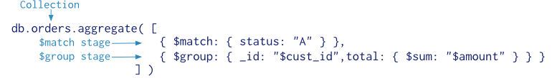
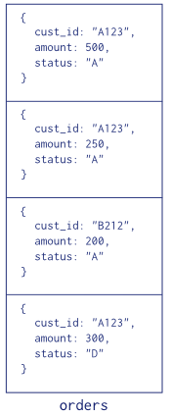
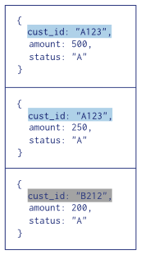
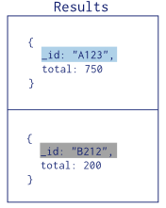


Aggregation Pipelines

Slide 83
Map Reduce
In general, map-reduce operations have two phases:
a map stage
that processes each document and emits one or more objects for each input document.
a reduce phase
that combines the output of the map operation.
Optionally, map-reduce can have a finalize stage to make final modifications to the result.
Like other aggregation operations, map-reduce can specify a query condition to select the input documents as well as sort and limit the results.
Map-reduce uses custom JavaScript functions to perform the map and reduce operations, as well as the optional finalize operation.
While the custom JavaScript provide great flexibility compared to the aggregation pipeline, in general, map-reduce is less efficient and more complex than the aggregation pipeline.

Slide 84
Map Reduce Syntax
db.collection.mapReduce(
<map>,
<reduce>,
{
out: <collection>,
query: <document>,
sort: <document>,
limit: <number>,
finalize: <function>,
scope: <document>,
jsMode: <boolean>,
verbose: <boolean>
}
)

Slide 85
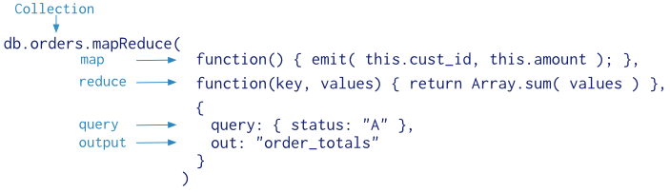
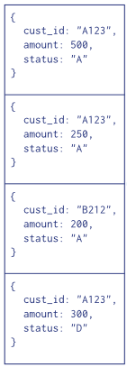
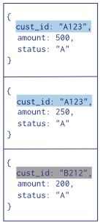
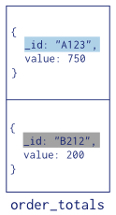
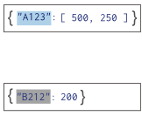


Example

Slide 86
Single Purpose Aggregation Operations
The common aggregation operations are:
Returning a count of matching documents
Returning the distinct values for a field
And grouping data based on the values of a field.
All of these operations aggregate documents from a single collection.
While these operations provide simple access to common aggregation processes, they lack the flexibility and capabilities of the aggregation pipeline and map-reduce.

Slide 87

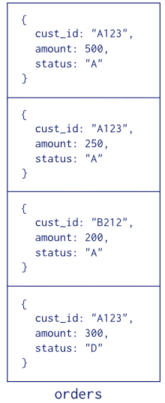


Example

Slide 88
Iterate a Cursor in the mongo Shell

Slide 89
Automatic Iteration of cursor
The db.collection.find() method returns a cursor. To access the documents, you need to iterate the cursor.
However, in the mongo shell, if the returned cursor is not assigned to a variable using the var keyword, then the cursor is automatically iterated up to 20 times to print up to the first 20 documents in the results.
Then next 20 documents can be retrieved using “it” command on mongo shell.

Slide 90
Manual Iteration of cursor
var myCursor = db.person.find( { gender: ‘M' } );
mycursor
OR
while (myCursor.hasNext()) {
print( tojson( myCursor.next() ) );
}
OR
while (myCursor.hasNext()) {
printjson( myCursor.next() );
}
OR
myCursor.forEach(printjson);

Slide 91
Replication

Slide 92
Replication
What is Replication?
Same piece of data on multiple machines.
Why we need replication?
High Availability (failover)
Data Safety (Durability)
Extra copies
DR (disaster recovery)

Slide 93
Some Terminology
Replication
Replication is the process of copying/synchronizing data across multiple servers.
Replica Set (Has upto 50 members/nodes in a Replica set)
A cluster of servers that implements master-slave replication, automated failover, automatic node recovery
Replication factor
No. of copies of data to be maintained
RF = No. of Members in Replica Set
Heartbeat
Replica set members send heartbeats (pings) to each other every two seconds. If a heartbeat does not return within 10 seconds, the other members mark the delinquent member as inaccessible.

Slide 94

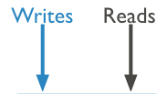





Replication in MongoDB

Slide 95
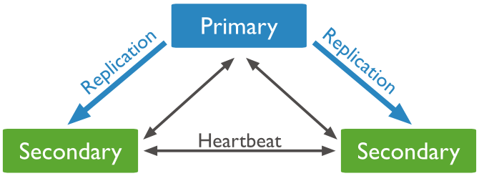
Comm. Between Replica Set

Slide 96
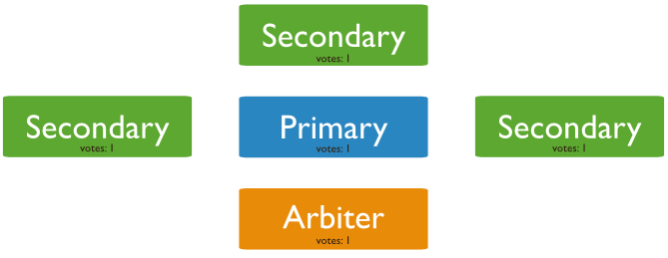
Replica Set Arbiter

Slide 97
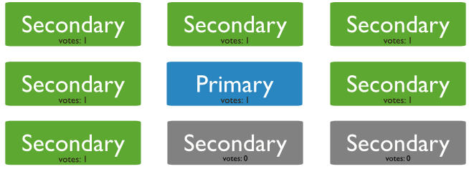
Non-Voting Members

Slide 98
Sharding

Slide 99
Sharding
Sharding is a method for storing data across multiple machines.
MongoDB uses sharding to support deployments with very large data sets and high throughput operations.
Database systems with large data sets and high throughput applications can challenge the capacity of a single server.
High query rates can exhaust the CPU capacity of the server.
Larger data sets exceed the storage capacity of a single machine.
Working set sizes larger than the system’s RAM stress the I/O capacity of disk drives.
To address these issues of scales, database systems have two basic approaches: vertical scaling and sharding.

Slide 100
Sharding
Sharding, or horizontal scaling, by contrast, divides the data set and distributes the data over multiple servers, or shards.
Each shard is an independent database, and collectively, the shards make up a single logical database.
No two shards will have same data.
Data is replicated within shards.

Slide 101
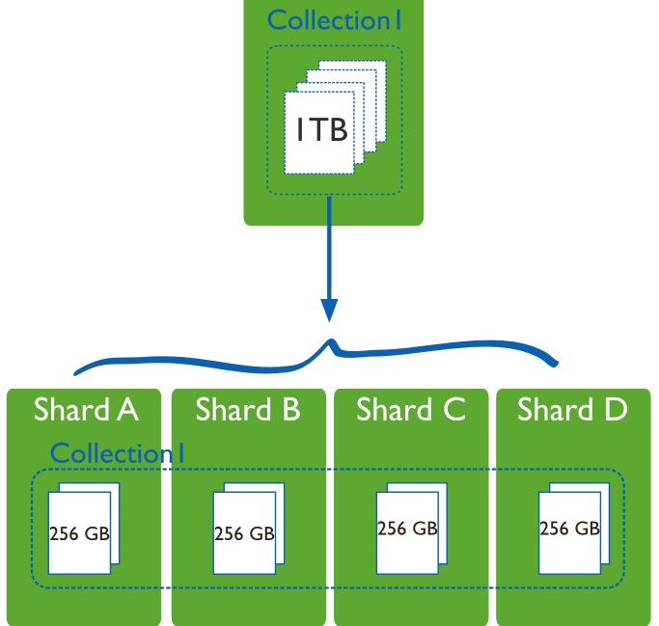
Sharding

Slide 102
Why Sharding?
Sharding addresses the challenge of scaling to support high throughput and large data sets:
Sharding reduces the number of operations each shard handles. Each shard processes fewer operations as the cluster grows. As a result, a cluster can increase capacity and throughput horizontally.
For example, to insert data, the application only needs to access the shard responsible for that record.
Sharding reduces the amount of data that each server needs to store. Each shard stores less data as the cluster grows.
For example, if a database has a 1 terabyte data set, and there are 4 shards, then each shard might hold only 256GB of data. If there are 40 shards, then each shard might hold only 25GB of data.

Slide 103




Sharding in MongoDB

Slide 104
Indexes

Slide 105
Index Introduction
Indexes support the efficient execution of queries in MongoDB.
Without indexes, MongoDB must perform a collection scan, i.e. scan every document in a collection, to select those documents that match the query statement.
If an appropriate index exists for a query, MongoDB can use the index to limit the number of documents it must inspect.
Indexes are special data structures that store a small portion of the collection’s data set in an easy to traverse form.
The index stores the value of a specific field or set of fields, ordered by the value of the field.
The ordering of the index entries supports efficient equality matches and range-based query operations.
In addition, MongoDB can return sorted results by using the ordering in the index.

Slide 106

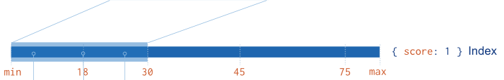
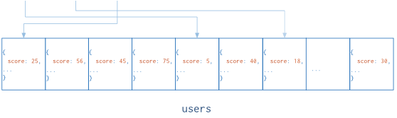
Indexes In MongoDB
The following diagram illustrates a query that selects and orders the matching documents using an index:

Slide 107
Indexes In MongoDB
The total size of an index entry, which can include structural overhead depending on the BSON type, must be less than 1024 bytes.
A single collection can have no more than 64 indexes.

Slide 108
Indexes in MongoDB
Syntax:- // 1 means ascending, -1 means descending
db.<collections>.ensureIndex({<key>:1},{<options>})
db.<collections>.createIndex({<key>:1},{<options>})
db.<collections>.getIndexes()
Examples:-
db.persons.ensureIndex( {name:1} );
db.persons.ensureIndex( {name:1},{unique:true} );
db.dropIndexes() → delete all indexes except “_id”
db.dropIndex({name:1}) → delete index on name asc.
db.dropIndex(“name”) → delete by Index name

Slide 109
Types of Indexes
Default (_id)
Single Field
Compound Index
Multikey Index
Geospatial Index
Text Index
Hashed Index

Slide 110
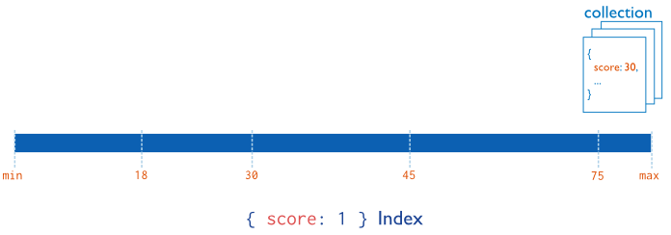
Single Field Index
Examples:-
db.collection.createIndex( { field: 1/-1 })
db.users.createIndex( { score: 1 } )

Slide 111
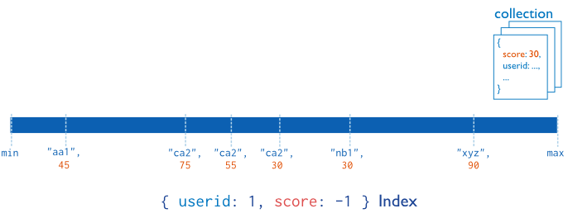
Compound Index
Syntax:-
db.users.ensureIndex({ “score”: -1 , “userid”: 1 })

Slide 112
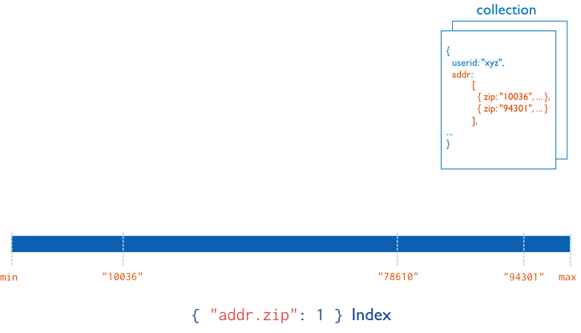
MultiKey Index
Syntax:-
db.users.ensureIndex({ “address.zip”: 1 } )

Slide 113
Geospatial Indexes
db.users.createIndex( { location : "2dsphere" } )

Slide 114
Text Indexes
db.reviews.createIndex( { comments: "text" } )

Slide 115
Hashed Indexes
Syntax:-
db.collection.createIndex( { _id: "hashed" } )

Slide 116
Questions
A MongoDB Index can have different types like integer, string, date?
True
False

Slide 117
Index Properties/Options
db.collection.createIndex(keys, options)

Slide 118
TTL -> Time To Live Option
db.eventlog.createIndex( { "lastModifiedDate": 1 },
{ expireAfterSeconds: 3600 } )

Slide 119
Unique Option
db.users.createIndex( { "user_id": 1 },
{ unique: true } )

Slide 120
Sparse Option
db.users.createIndex( { twitter_name: 1 },
{ sparse: true } )

Slide 121
Strategies in creating Index
The best indexes for your application are based on a number of factors, including the kinds of queries you expect, the ratio of reads to writes, and the amount of free memory on your system.
When developing your indexing strategy you should have a deep understanding of:
The application’s queries
The relative frequency of each query in the application
The current indexes created for your collections.
Which indexes the most common queries use.

Slide 122
Questions
typically, what’s the best index for this query, assuming we have lots of queries compared to writes?
db.users.find( { last:"smith", first:"john" } )
Fill in the blank:
db.users.ensureIndex( ___ )

Slide 123
$thankYou

