Slide 1
Database System Concepts and Architecture
Dr. Ali Obaidi

Slide 2
Data Models
A collection of concepts that can be used to describe the structure of a database (data types, relationships, and constraints)
basic operations (retrieval and updates)
specify the dynamic aspect or behavior of a database application( user-defined operations )
example: COMPUTE_GPA, which can be applied to a STUDENT object
Jan 29, 2002

Slide 3
Categories of Data Models
High-level or conceptual data models (common users)
low-level or physical data models (describe the details of how data is stored )
in between, representational (or implementation) data models can serve both categories above
Jan 29, 2002

Slide 4
Conceptual Data Model
Use concepts such as
  Entities:a real-world object or concept (DEPT) (COURSE)
  Attributes:property of interest that further describes an entity (dept no, name, telephone, etc)
  Relationships:interaction among the entities (DEPT) provides (COURSE)
Jan 29, 2002

Slide 5
Physical Data Model
Describes how data is stored in the computer.
It represents info such as
  record formats
  record orderings
  access path: make search more efficient
Jan 29, 2002

Slide 6
Representational Data Model
Used in traditional commercial DMBS
they include
  Relational Data model
  Network model
  Hierarchical model
Jan 29, 2002

Slide 7
Schemas
Is the description of the database (not database itself)
  Specified during database design
  Not expected to change frequently
  A displayed schema is called a schema diagram (Fig 2.1)
Each object in the schema-such as STUDENT or COURSE-is a schema construct.
Schema diagram represents only some aspects of a schema (name of record type, data element and some type of constraint)
Jan 29, 2002

Slide 8
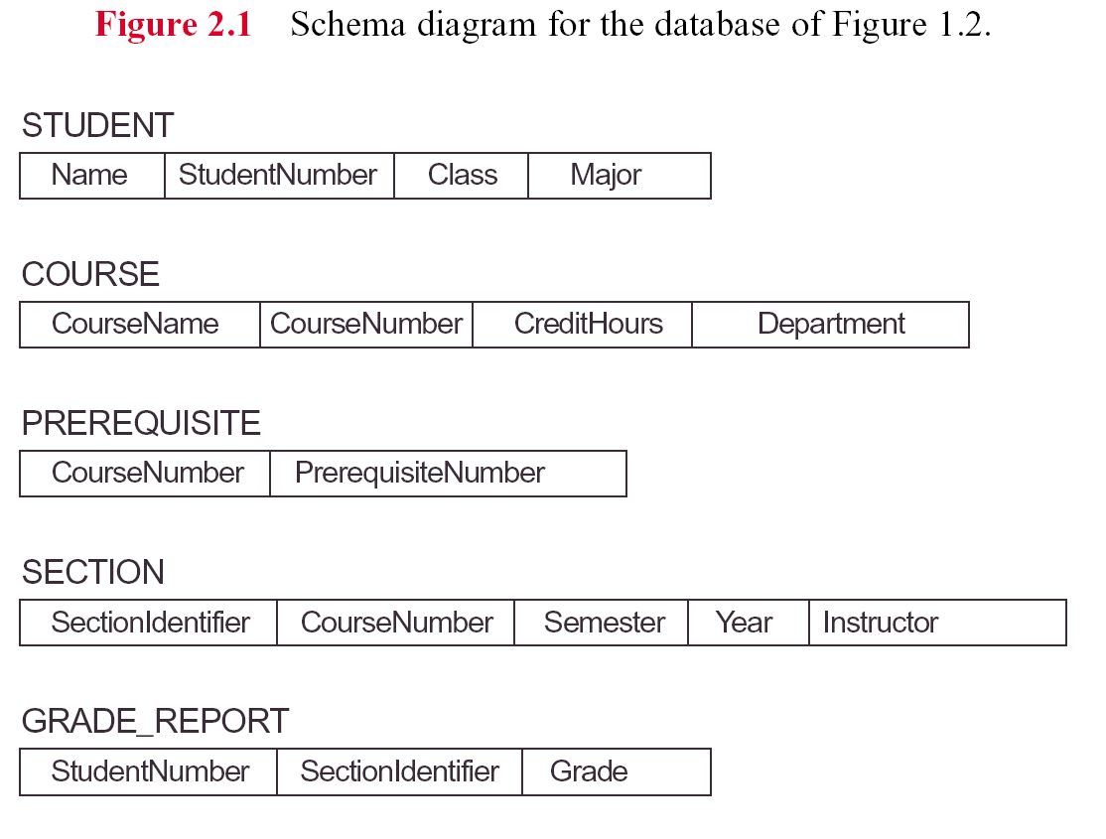
Jan 29, 2002

Slide 9
Instances and Database State
The data in the database at a particular moment in time is called a database state or snapshot or current set of occurrences or instances in the database
When we define a new database we have database state is empty state (schema specified only in DBMS)
The initial state when the database is first populated
Then At any point in time, the database has a current state
schema evolution: when we need to change the schema
Jan 29, 2002

Slide 10
The Three-Schema Architecture
Importance of using DB approach
  insulation of programs and data
  support of multiple user views
  use of a catalog to store the database description (schema).
The aim is to separate the user application and physical DB
schema can be defined into three levels:
  The internal level has an internal schema
  describes the physical storage structure of the database.
  uses a physical data model
Jan 29, 2002

Slide 11
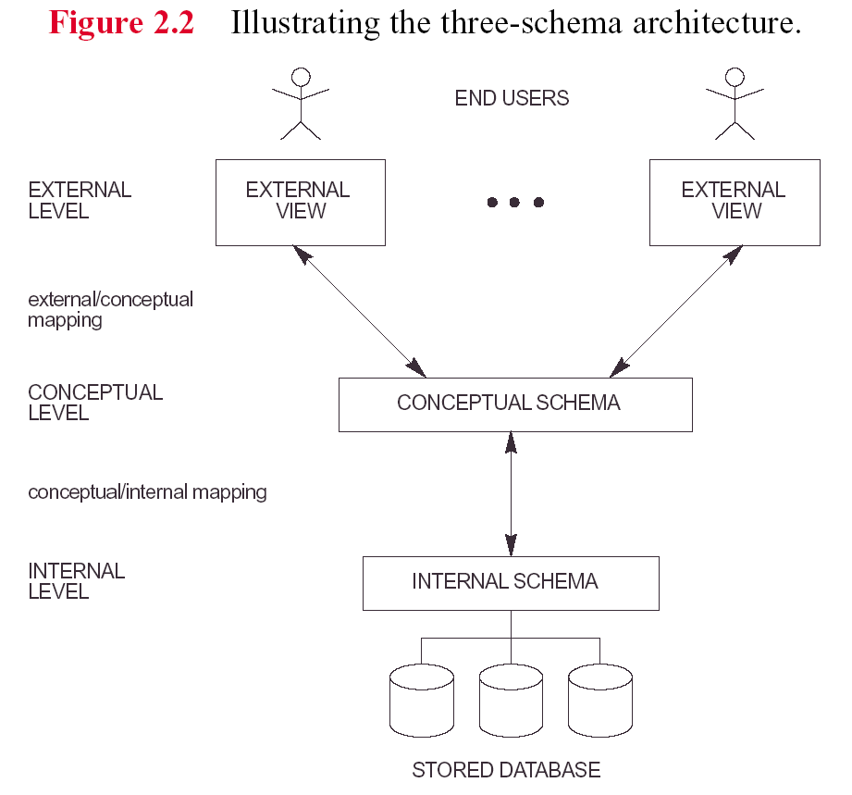
Jan 29, 2002

Slide 12
The Three-Schema Architecture
  The conceptual level has a conceptual schema describing the structure of the whole database for a community of users.
  It hides the details of physical storage structures and concentrates on describing entities, data types, relationships, user operations, and constraints.
  A high-level data model or an implementation data model can be used at this level.
  The external or view level includes a number of external schemas or user views describing the part of the db that a particular user group is interested in and hides the rest of the db from that user group.
  A high-level data model or an implementation data model can be used at this level.
Jan 29, 2002

Slide 13
Data Independence
Is the capacity to change the schema at one level of a database system without having to change the schema at the next higher level.
Logical data independence: capacity to change the conceptual schema without having to change external schemas or application programs.
Physical data independence: capacity to change the internal schema without having to change the conceptual (or external) schemas
Jan 29, 2002

Slide 14
DBMS Languages
Data Definition Language DDL: Language to specify conceptual and internal schemas for the database and any mappings between the two.
Storage definition language SDL: used when clear distinction between conceptual and internal schema.
view definition language VDL: specify user views and their mappings to the conceptual schema.
data manipulation language DML:retrieval, insertion, deletion, and modification of the data
Jan 29, 2002

Slide 15
DBMS Languages …..
SQL relational database language: represents a combination of DDL, VDL, and DML, as well as statements for constraint specification and schema evolution
There are two main types of DMLs:
  A high-level or nonprocedural DML : specify complex DB operations. Example SQL(set-at-a-time)
  A low-level or procedural DML: retrieve individual records or objects from DB and process each separately (record-at-a-time).
Jan 29, 2002

Slide 16
DBMS Interfaces
Menu-Based Interfaces for Browsing
  menus leads to formulation of a request
Forms-Based Interfaces
  display a form for each user (insert, select)
  designed for naïve users.
Graphical User Interfaces (GUI)
  display schema as diagram.
  Utilize both menu and forms.
Jan 29, 2002

Slide 17
DBMS Interfaces
Natural Language Interfaces
  Accept requests in native language and attempt to understand them.
  Refers to words in the schema and (standard words) to interpret the request.
Interfaces for Parametric Users (eg tellers)
  goal is to min the number of keystroks required. (use of function) keys
Interfaces for the DBA
  creating accounts, system privileges, changing schema, etc.
Jan 29, 2002

Slide 18
The Database System Environment
DBMS Component Modules (fig 2.3)
  db & DBMS stored in disk controlled by OS.
  Stored data manager control access to DBMS
  SDM puts data in buffers in main memory
  DDL compiler process schema definitions and store it in meta data.
  Run-time-data-proc handles DB accesses @runtime
  receive update or retrieve and solve them on the DB
  Query-Compiler: handles high level queries: parse, analyze and interpret uses DB access code.
  Precompiler extract DML commands from app program
Jan 29, 2002

Slide 19
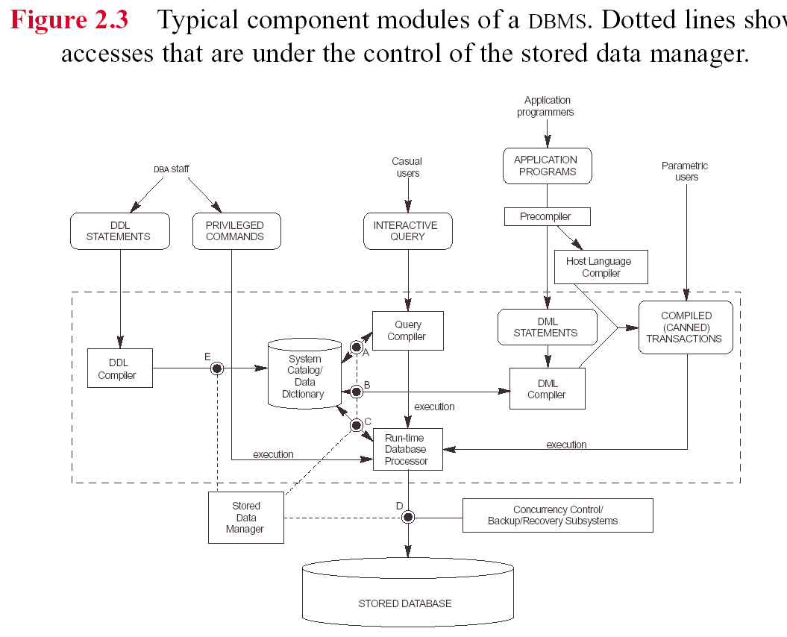
Jan 29, 2002

Slide 20
Database System Utilities
Loading: load existing files into the DB
Backup: creates backup copy of the DB
File reorganization: reorganize files for better performance
Performance monitoring: monitor DB usage and provide statistics to DBA
Jan 29, 2002

Slide 21
Tools, Application Environments & Communications Facilities
Case: design phase
data (information) repository: store catalog info, design decisions, usage, app program description, user information
Application Developer: e.g. power builder. Help in development of DB design, GUI, query, update etc.
Comm Software: allow users remotely to access the DB
Jan 29, 2002

Slide 22
Classification of DBManagement Systems
Data model:
  relational, object, object-relational, hierarchical, network, and other.
Number of users supported by the system.
  Single-user systems and Multiuser systems
Number of sites over which the database is distributed.
  centralized, distributed DBMS (DDBMS) ,Homogeneous DDBMSs ,federated DBMS (develop software to access several autonomous preexisting databases stored under heterogeneous DBMSs. )
Jan 29, 2002

Slide 23
Classification of DBManagement Systems …..
Cost of the DBMS: 10K-100K. Single 100-3K
General-purpose vs Special-purpose (When performance is a primary consideration.
  Example: on-line transaction processing (OLTP) systems, which must support a large number of concurrent transactions without imposing excessive delays. )
Jan 29, 2002

Slide 24
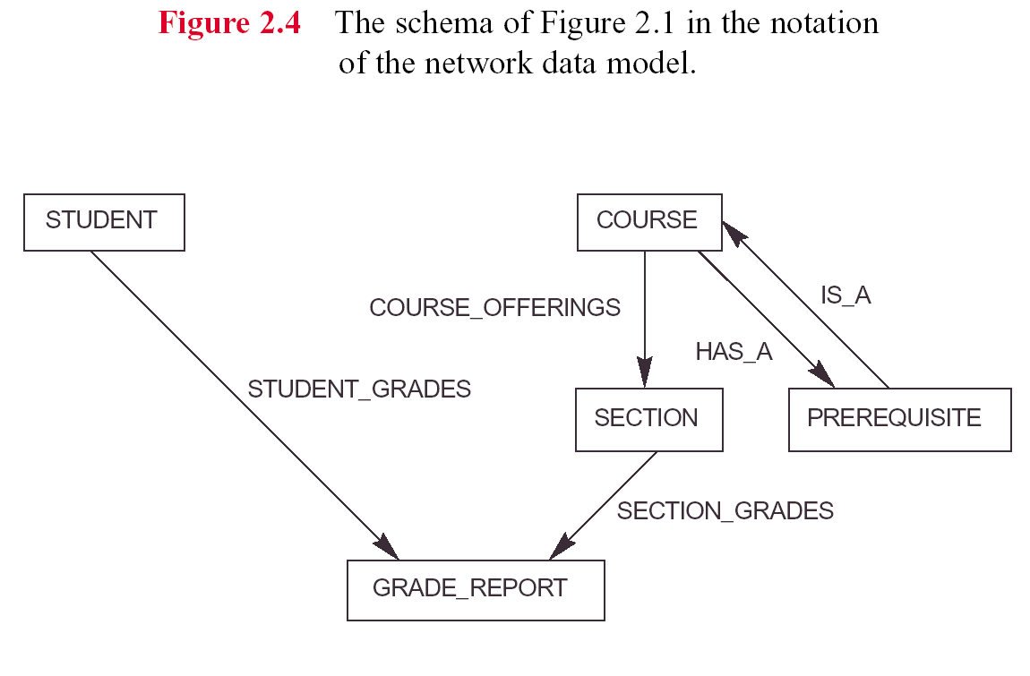
Jan 29, 2002

